Slide 1
Uncovering time-varying latent brain states with dynamic topic modeling

Slide 2
Introduction
Context-dependent, transient interactions between distributed brain regions are necessary for cognitive function
Traditional functional connectivity approaches assume temporal stationarity during the period of measurement
“Dynamic connectivity” approaches instead evaluate different aspects of brain connectivity over time (changes in correlation, spatial patterns, etc)

Slide 3
Unsupervised Generative Models
Given that a set of hidden variables can be inferred from a set of observations, what is the likelihood that one variable generated those observations?
What hidden states account for fluctuations in task-dependent interactions between brain regions?
How do they change over time?
Latent Dirichlet Allocation (Blei et al., 2003), or topic modeling, is a popular generative model used in natural language processing

Slide 4
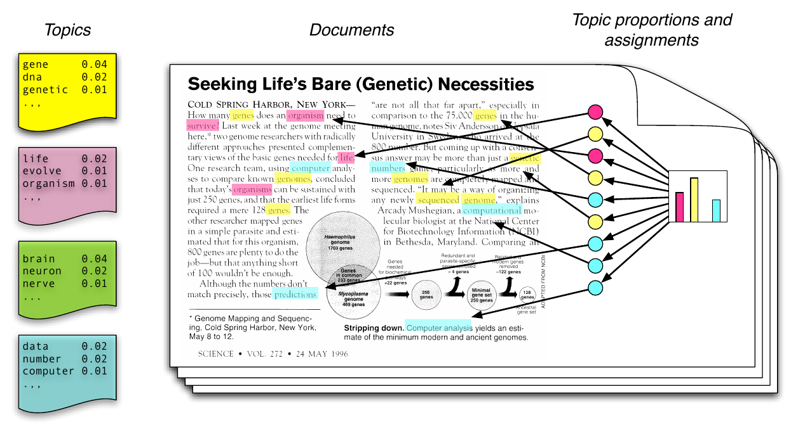
Topic Modeling
Blei (2011)

Slide 5
Latent Dirichlet Allocation
Word
Distributions per
Topic
(parameter)
Word
Topic Mixture
Distributions per
Document
(parameter)
Mixed Topic
Document
Topic
Words in Document
Documents in Corpus
Blei, Ng, Jordan (2003)

Slide 6
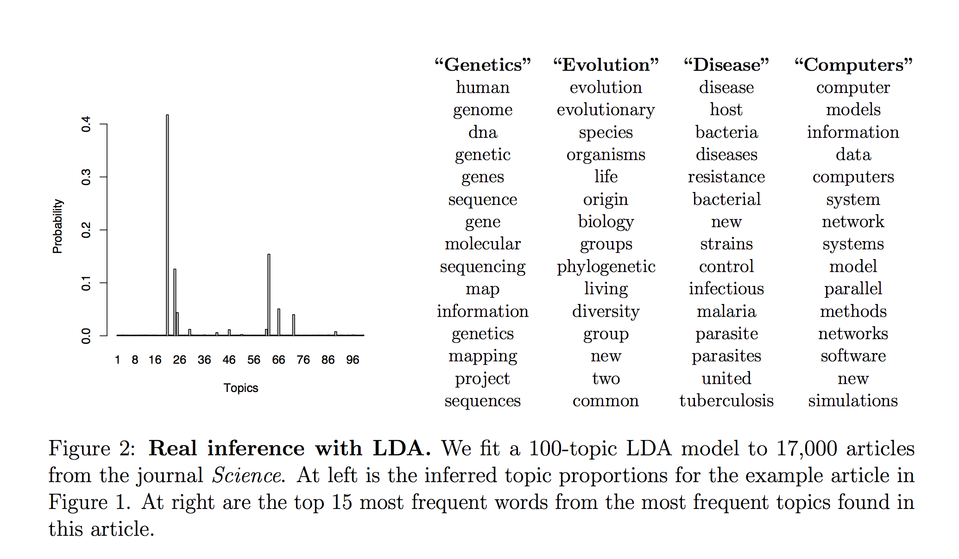
Blei (2011)

Slide 7
Great, but what about time?
In LDA, both the order the words appear in a document and the order the documents appear in the corpus are unknown to the model
We can group the documents by time and assume that the documents at each time point come from a set of topics that evolved from the previous time point
This is a dynamic topic model (Blei & Lafferty, 2006)

Slide 8
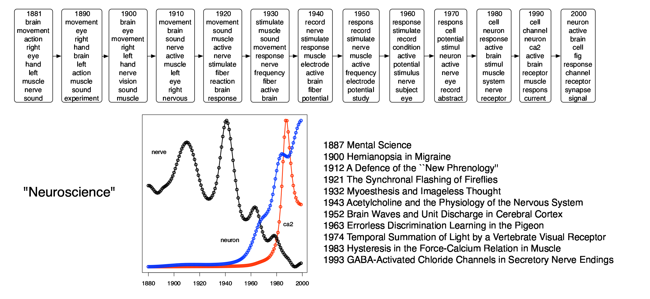
Dynamic Topic Model
Topic
Importantly, we also get out the proportion of
the corpus that this topic represents over time
Blei & Lafferty (2006)
Notes:
Analyzed the corpus of science from 1881 – 2000. This is the “neuroscience” topic. Importantly, you also get out the proportion of the corpus that this topic was responsible for over time

Slide 9
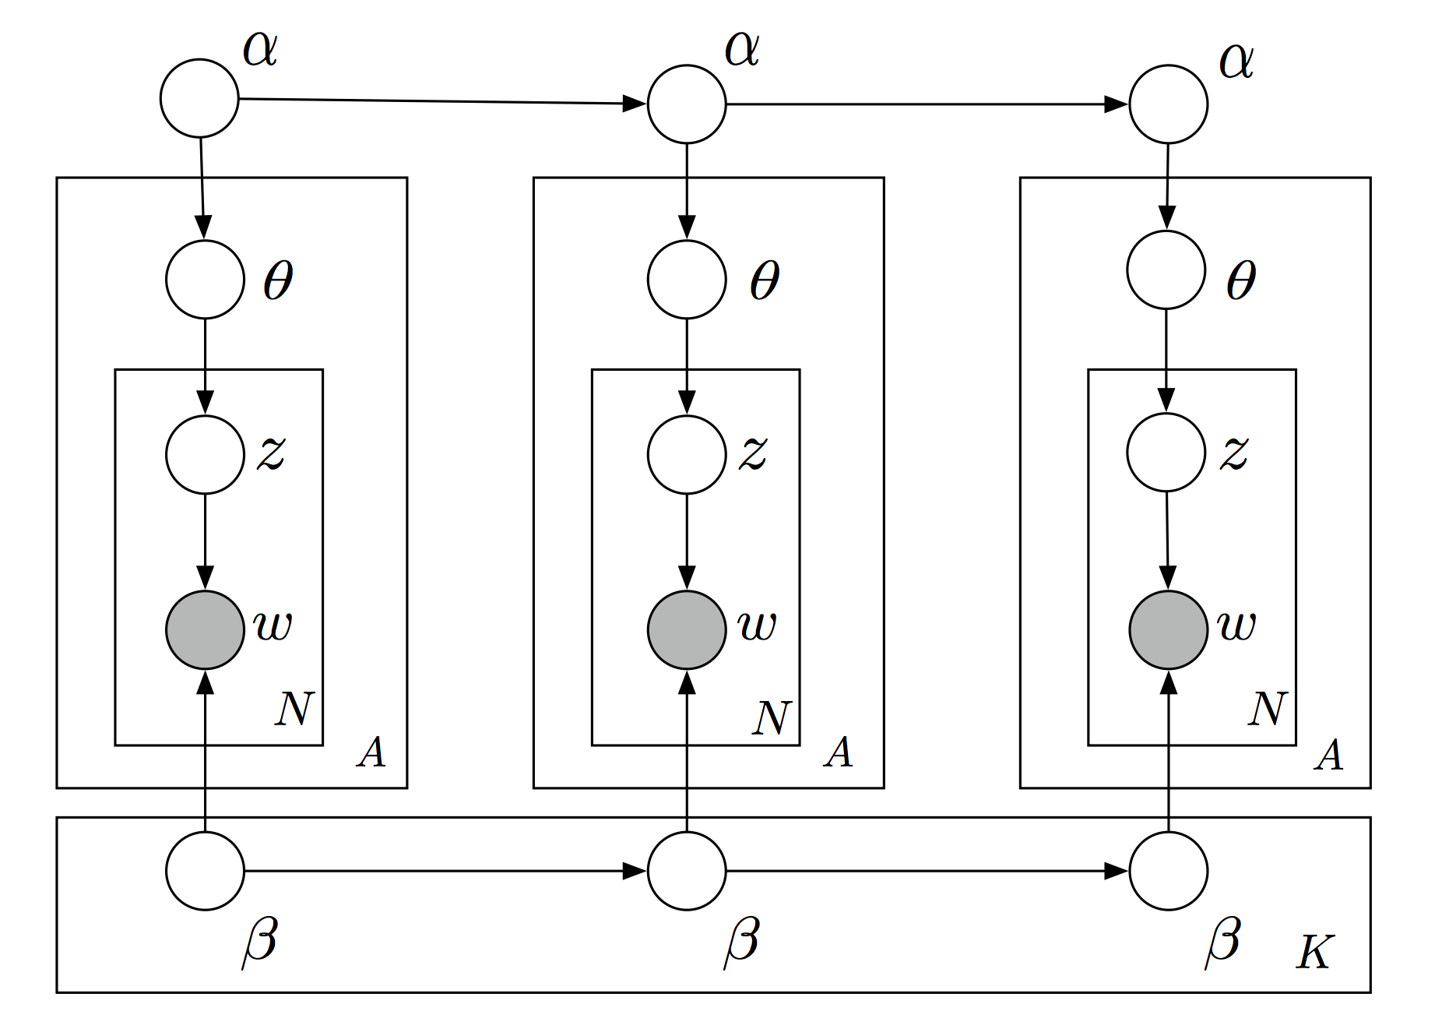
Dynamic Topic Model
Blei & Lafferty (2006)
Notes:
We fit an LDA at each time point and the priors have a markovian assumption

Slide 10
From NLP to fMRI
Topic modeling has been very successful in natural language processing/text mining
What would it take to apply this technique to fMRI data?
Problems:
1) We don’t have text/symbolic data
2) What is a word or document when it comes to fMRI?
Notes:
Sinister applications like determining people’s interests by finding topics from their tweets, etc

Slide 11
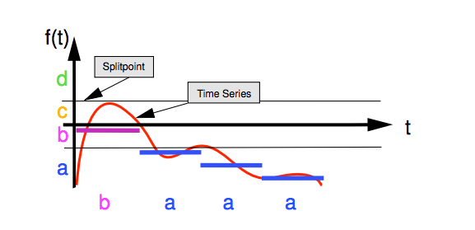

Symbolic Aggregate Approximation (SAX)
Lin et al. (2007)
Notes:
This handles problem number 1 and reduces our dimensionality – this is going to be necessary if we want to have enough similar data to glean useful info from the model

Slide 12
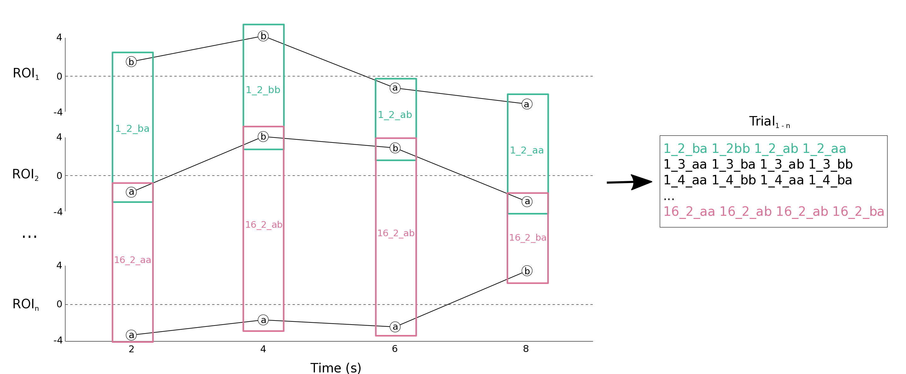
“Document” creation from functional connectivity For each subject:
Each “word” is the
activation levels
for 2 ROIs
Each “document” has
all “words” at each
timepoint
1_2_ba
1_3_aa
…
n_2_aa
1_2_bb
1_3_ba
…
n_2_ab
1_2_ab
1_3_ab
…
n_2_ab
1_2_aa
1_3_bb
…
n_2_ba
Notes:
Handles problem #2: Binarizing with two bins works the best, so that’s what this data is

Slide 13
Analysis Pipeline
Extract ROI timeseries
Symbolic Aggregate Approximation
Create Documents
Process Data
Dynamic Topic Model
Modeling
Group-wise state temporal probability matrix
Hierarchical Clustering
ROI x ROI probability matrices for each state
Analysis

Slide 14
Datasets
Validation datasets
Optofmri (3 rodents)
M1 stimulation → Thalamus
Insula control region
HCP n-back working memory (119 subjects)
Test-retest replication from two sessions
11 Load-dependent ROIs from 2-back v 0-back contrast
8 week math longitudinal (pre/post; 35 subjects)
16 ROIs from Supekar et al. 2015
Model fit on timeseries from response period (4 TR) of accurate trials during arithmetic verification task
Notes:
8 week is event related, not block, so we fit on only the trial level timeseries

Slide 15
OptofMRI

Slide 16
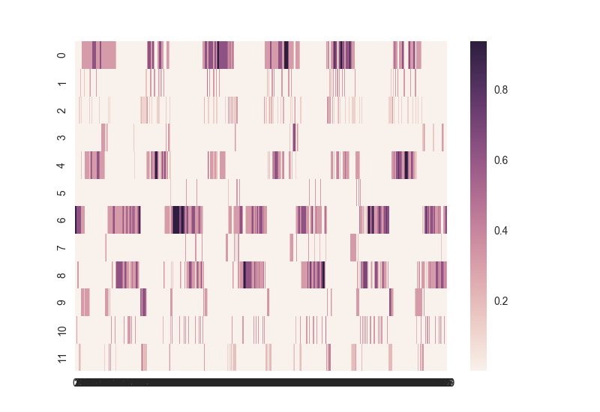
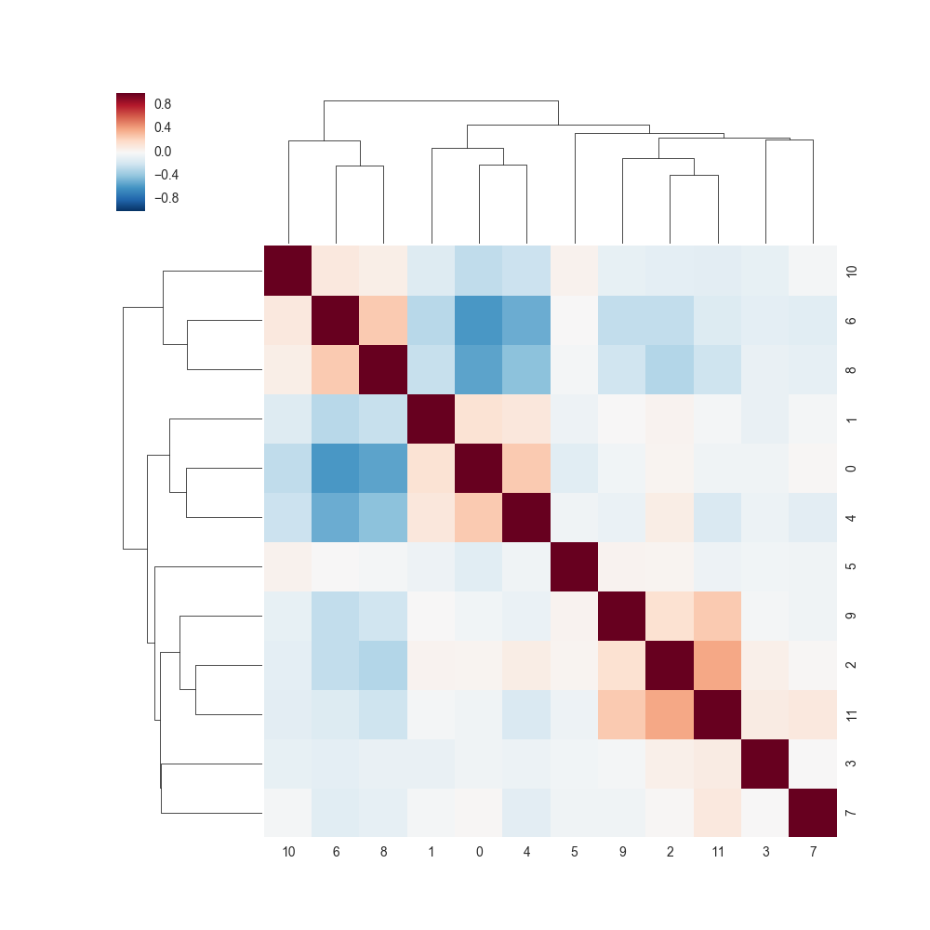
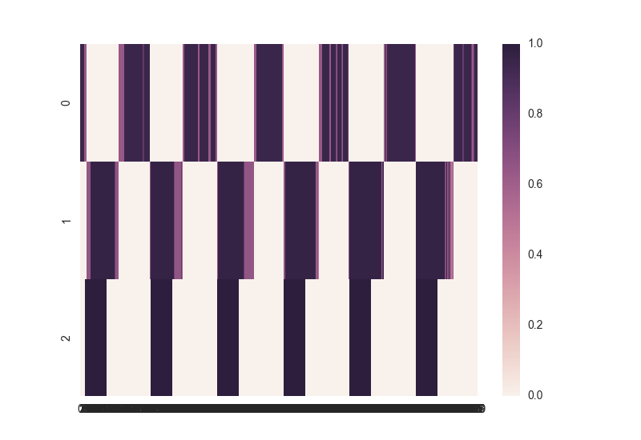
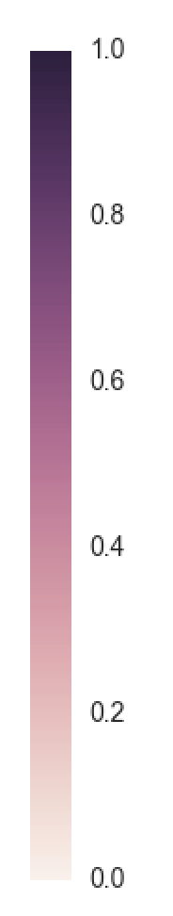
State Temporal Probability Matrix
A)
Hierarchical Clustering
B)
On
Cluster
Off
Cluster
0
TR
480
on
off
Stimulus
Design
C)
Off
State
On
State
0
OptofMRI (3 Rodents)
TR
480

Slide 17
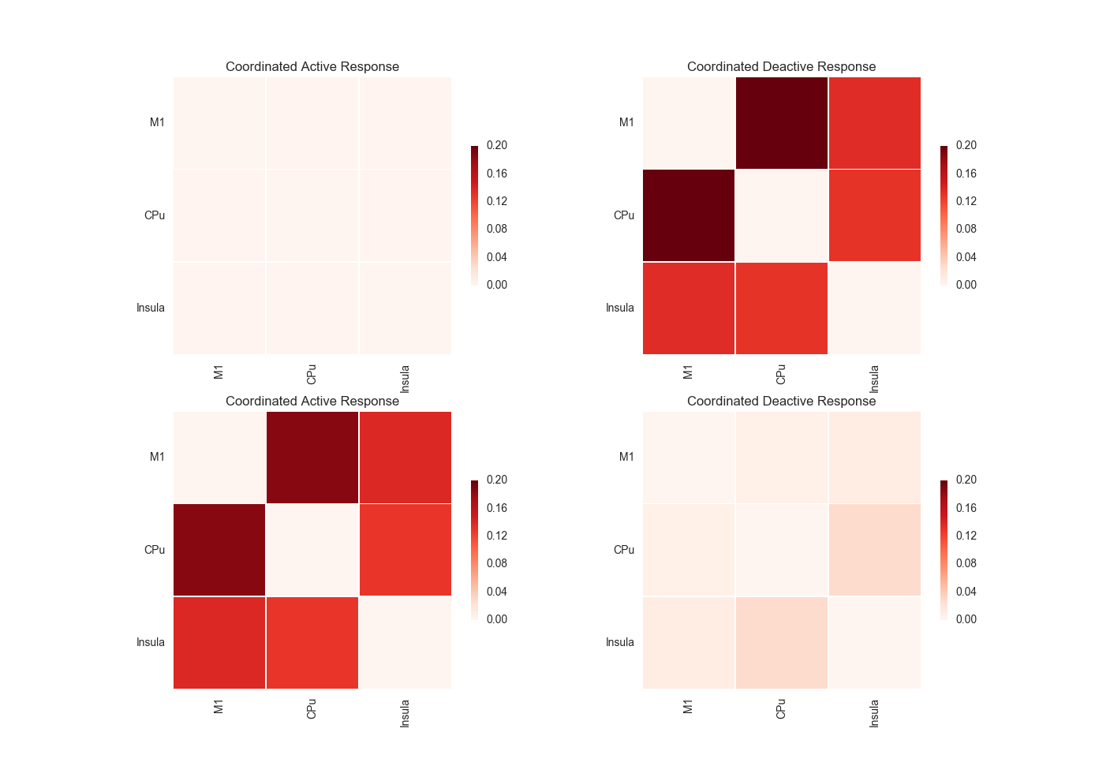
Static Response Matrices
Off
State
On
State
OptofMRI
Notes:
Sum probability across all time points for each “word” and then normalize for both active (bb) and deactive (aa) word matrices

Slide 18
HCP Working Memory

Slide 19
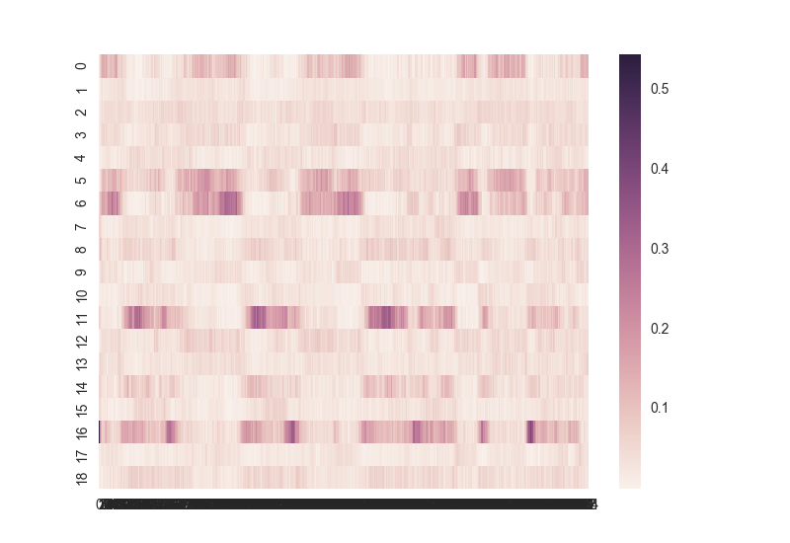
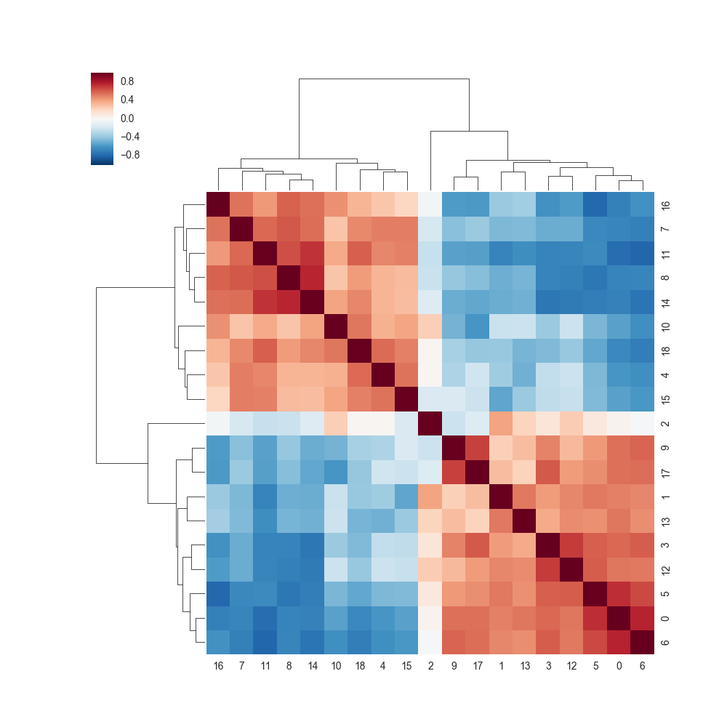
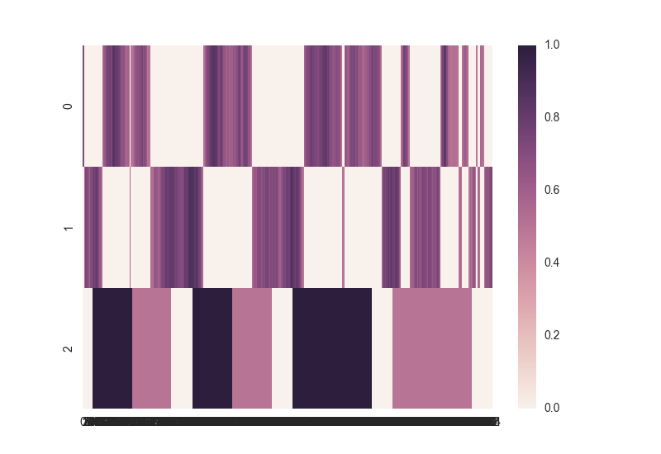

State Temporal Probability Matrix
A)
Hierarchical Clustering
B)
High Load
Cluster
Low Load
Cluster
0
TR
405
2bk
0bk
Task
Design
C)
Fix
High Load
State
Low Load
State
0
TR
405
HCP Working Memory Session 1

Slide 20
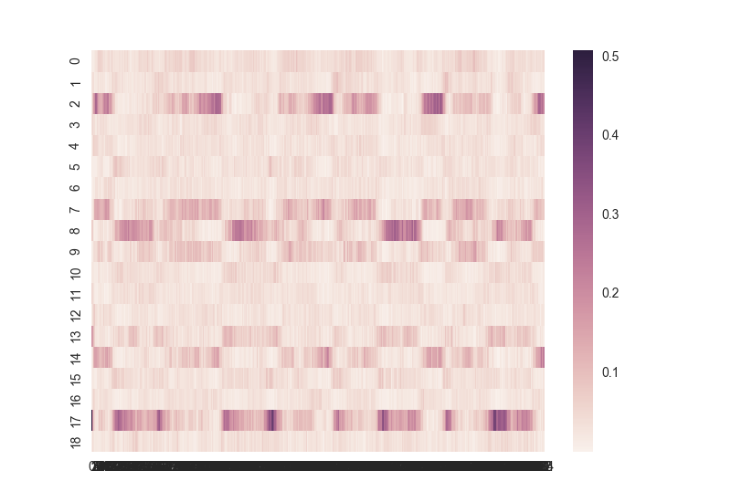
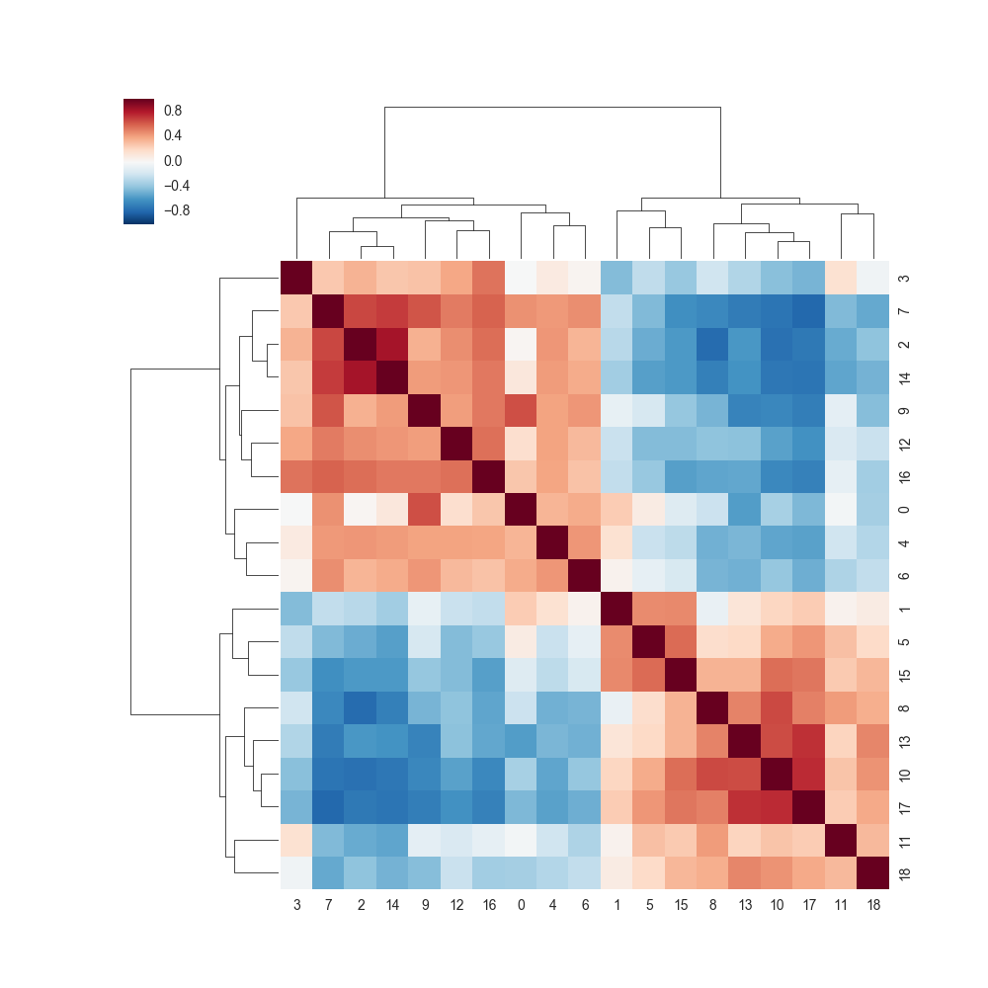
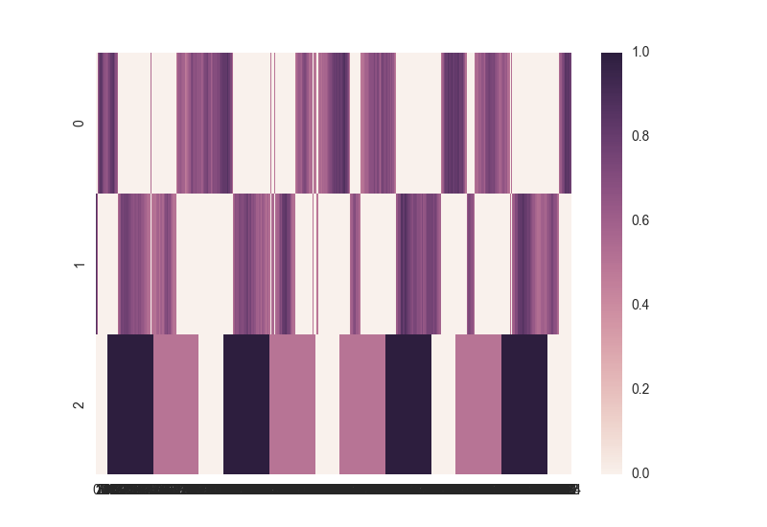

State Temporal Probability Matrix
A)
Hierarchical Clustering
B)
High Load
Cluster
Low Load
Cluster
0
TR
405
2bk
0bk
Task
Design
C)
Fix
High Load
State
Low Load
State
0
TR
405
HCP Working Memory Session 2

Slide 21
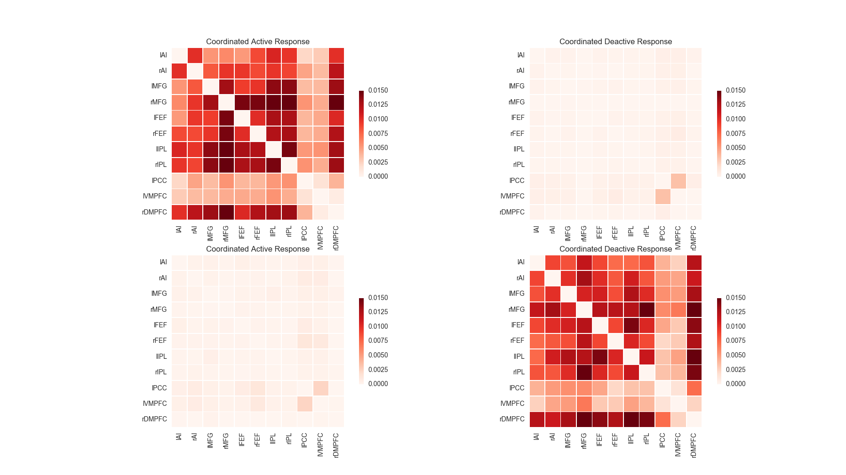
Static Response Matrices
High Load
State
Low Load
State
HCP Working Memory Session 1
Notes:
Sum probability across all time points for each “word” and then normalize for both active (bb) and deactive (aa) word matrices

Slide 22
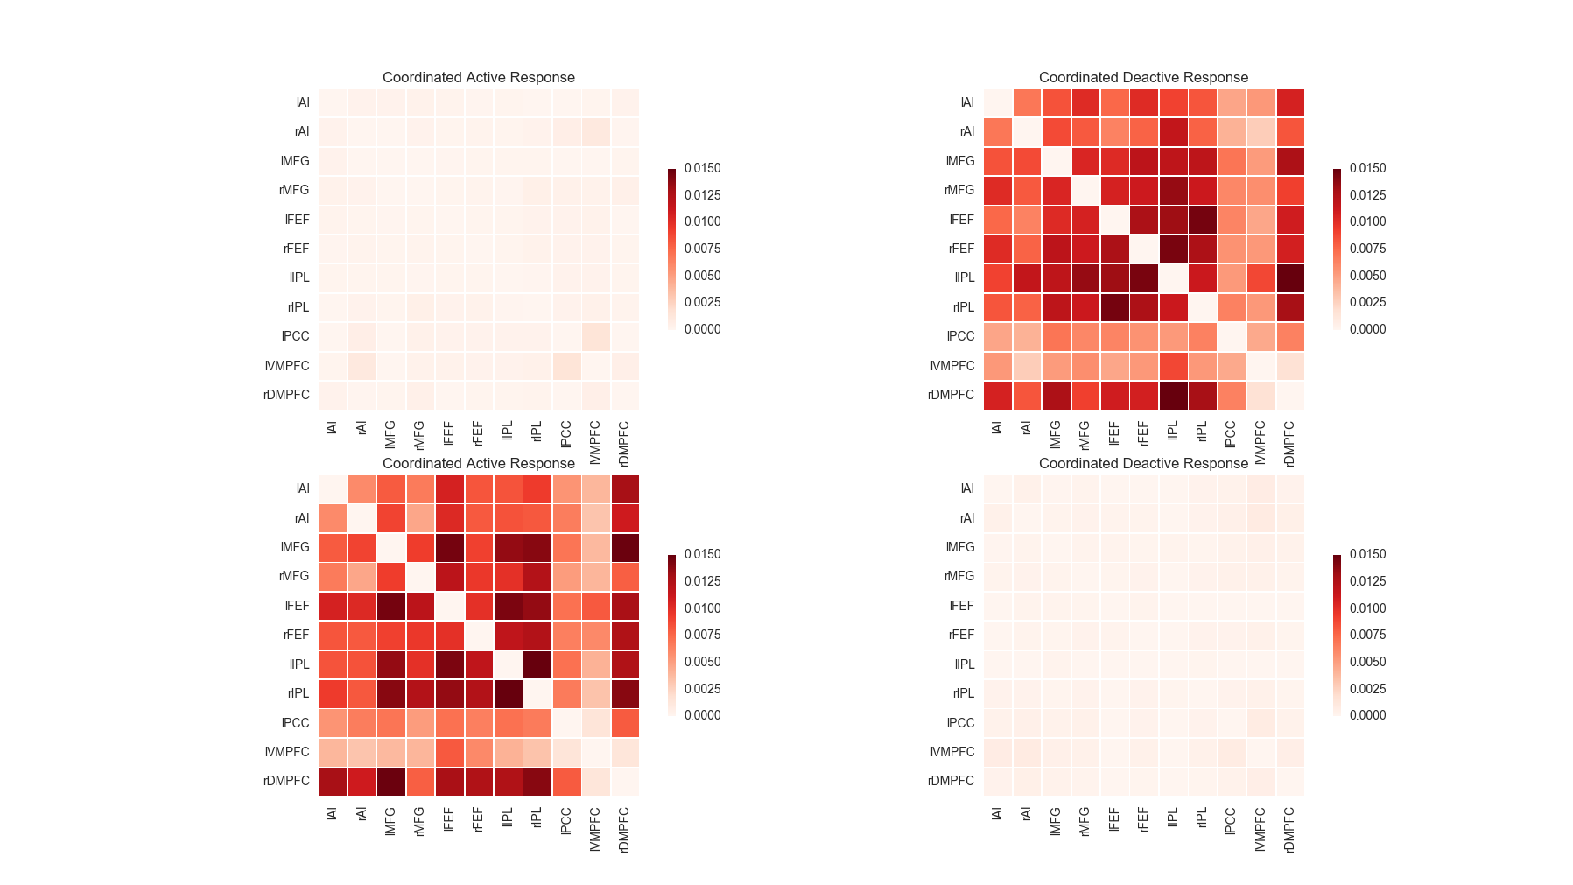
Static Response Matrices
Low Load
State
High Load
State
HCP Working Memory Session 2
Notes:
Sum probability across all time points for each “word” and then normalize for both active (bb) and deactive (aa) word matrices

Slide 23
8 Week Math Longitudinal

Slide 24
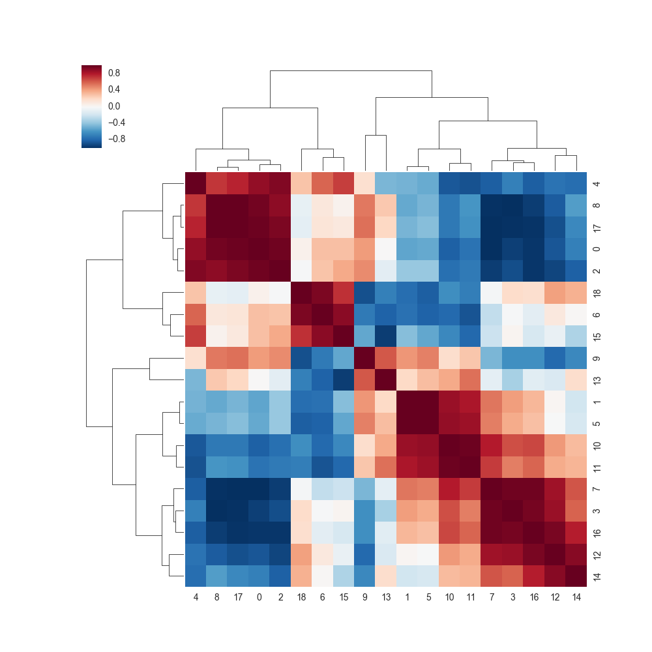
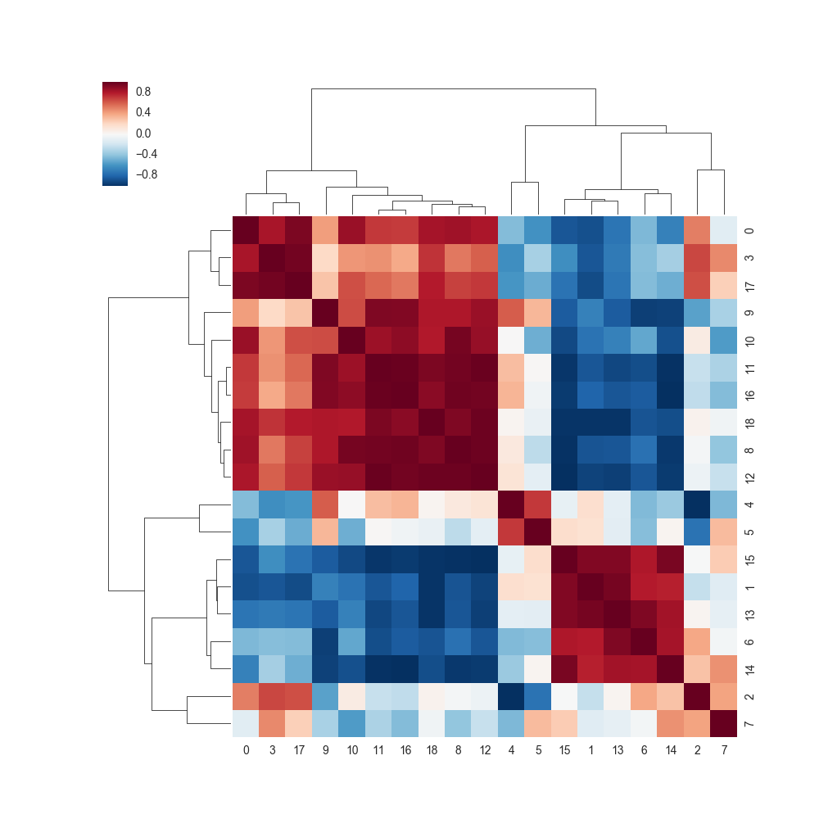
Pre Tutoring
Post Tutoring

Slide 25
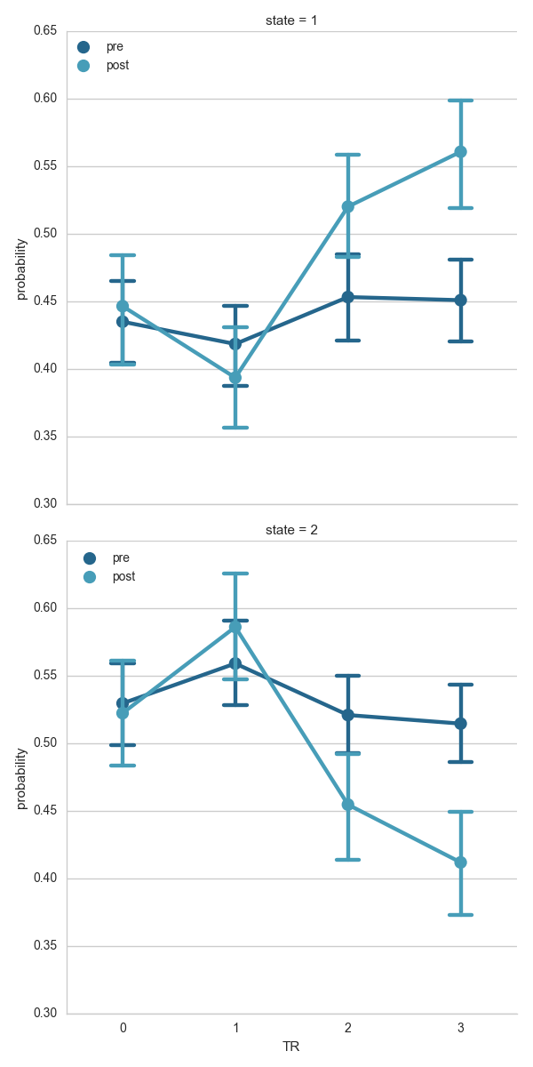
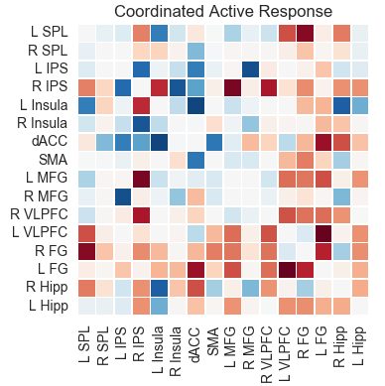
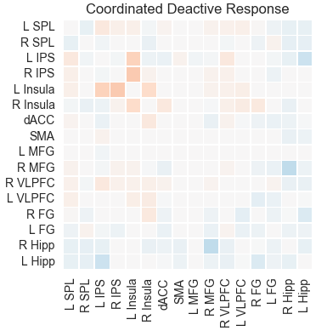

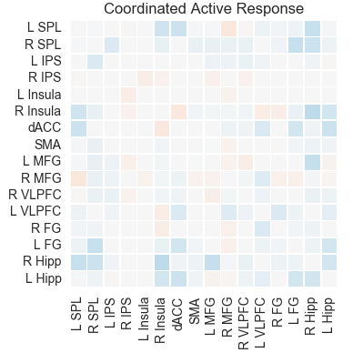
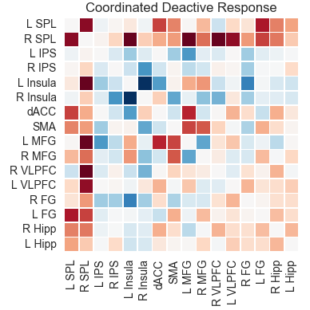
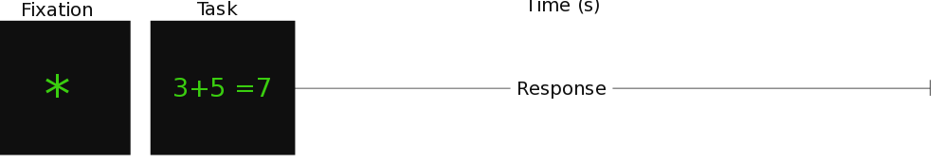
State 1
Post - Pre
State 2
Post - Pre
2
4
6
8
Time (s)
Notes:
Mean RT:
Pre: 3.9 s
Post: 3.3 s

Slide 26
Thanks!

