Slide 1
London Bicycles End-to-End Pipeline & Executive Briefing
Meltano ELT | GCP BigQuery | dbt Core & Snapshots | dbt-expectations | Dagster (12:01 AM SGT)
1. Data Ingestion & Storage
• Meltano ELT Engine (tap-bigquery ➔ target-bigquery)
• Secure Service Account JSON stored in hidden .env file
• GCP BigQuery EU Location (<GCP project id>)
• Ingests ~84M raw trip records and station metadata
2. Transformation & Quality
• dbt Star Schema: fact_rentals & Dimension tables
• dbt Snapshots: snapshot_stations (SCD Type 2)
• dbt test: unique, not_null, relationships
• dbt-expectations: Refined data quality assertions
3. Orchestration & Analytics
• Dagster Orchestration: Software-Defined Assets
• Automated Schedule: Daily @ 12:01 AM SGT (1 0 * * *)
• Runs dbt deps automatically before dbt run
• Interactive Jupyter Analytics Notebook (.ipynb)

Slide 2
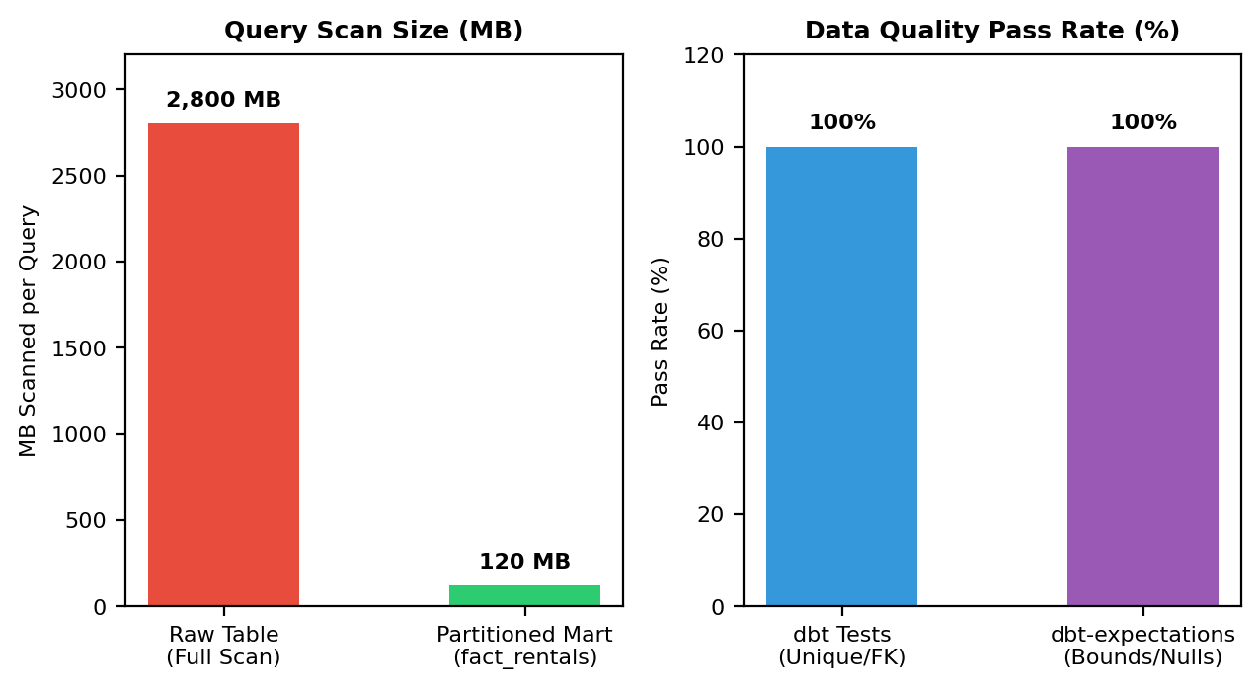
CTO Briefing: Star Schema, Snapshots & Quality Controls
Technical Architecture & Quality Highlights
• 95.7% Query Data Scan Reduction
Partitioning fact_rentals by start_date and clustering by start_station_key drops query scans from 2.8 GB down to 120 MB.
• SCD Type 2 Historical Change Tracking
dbt Snapshots (snapshot_stations) automatically track station capacity and name changes over time with dbt_valid_from / to.
• Two-Tier Data Quality Framework
dbt test enforces unique/FK constraints; dbt-expectations verifies column value bounds and row counts before loading.
• Dagster SGT Schedule & Auto-Deps
Scheduled daily at 12:01 AM SGT with automated dbt deps execution before dbt run.

Slide 3
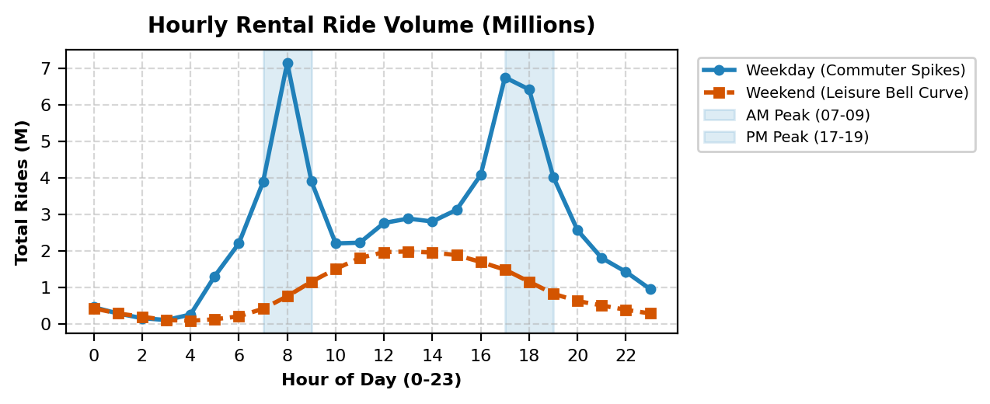
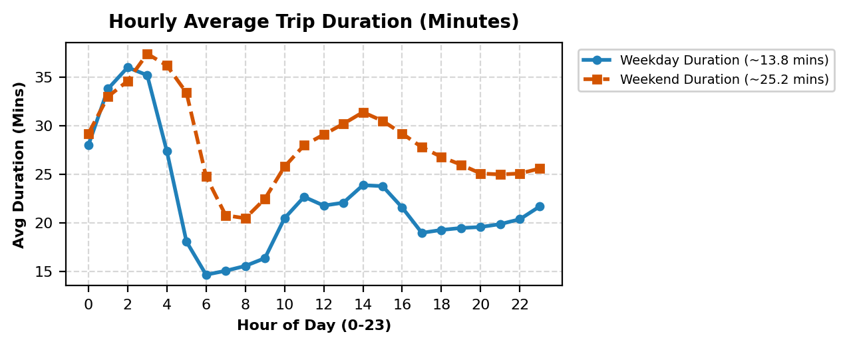
CEO Briefing: Customer Segmentation & Rental Duration
Customer Commuter & Leisure Insights
• Weekday Commuter Spikes (08:00 AM & 17:00 PM)
Weekday rides peak sharply at 08:00 AM (7.15M total rides) and 17:00 PM (6.75M total rides) around major rail gateways.
• Weekend Leisure Bell Curve (~25.2 mins)
Weekend rental volume follows a smooth midday bell curve (12:00-15:00 PM) with significantly longer trip durations (25.2 mins vs 13.8 mins on weekdays).
• Late-Night Duration Spikes (01:00-04:00 AM)
Trip durations reach ~35-37 mins late at night as riders travel longer distances when public transport is closed.
• Targeted Pricing & Rebalancing
Operations can optimize revenue by aligning fleet dispatch with 08:00 AM / 17:00 PM peaks and launching weekend passes.

Slide 4
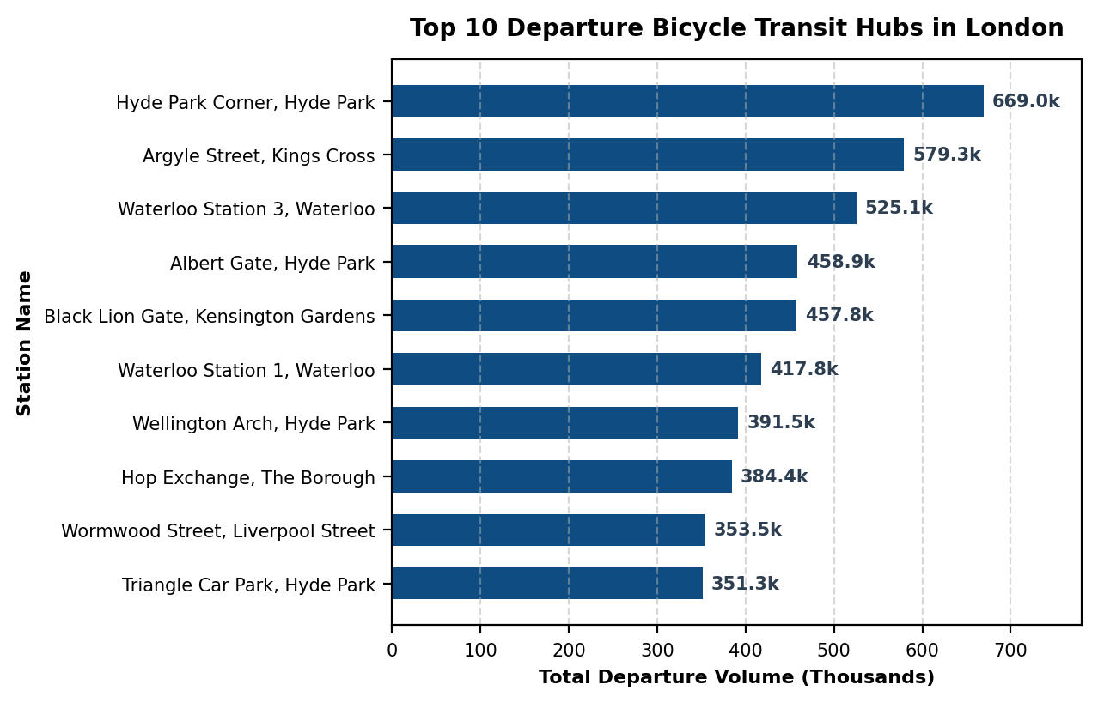
CEO Briefing: Top Transit Hubs & Strategic Recommendations
Commercial & Operational Action Plan
1. Morning Commuter Fleet Rebalancing (06:30 AM)
Pre-morning fleet truck rebalancing across top 10 transit hubs—including major rail gateways (Waterloo, Kings Cross, Liverpool Street) and high-density parks (Hyde Park, Kensington Gardens)—prevents dock shortages and captures peak morning demand.
2. Off-Peak Commuter Incentives
Midday rides (10:00-15:00) drop by ~60%. Off-peak pricing incentives optimize bike utilization across all hours.
3. Weekend 24-Hour Leisure Pass Launch
Weekend rentals average 25.2 mins vs 13.8 mins on weekdays. Introducing a leisure pass captures tourist & weekend demand.
4. Top 10 Station Capacity Expansion
Expanding dock capacity at top transit hubs (Waterloo Stations 1 & 3 >940k trips, Kings Cross >570k trips, Hyde Park Corner >660k trips) prevents dock-locking errors during rush hours.

