Slide 1

Problem Solving Techniques I– I Year / I Sem. – 22ES105
Manju S,
AP/CoE,
RTC,Coimbatore.

Slide 2
Topics
FUNCTIONS AND POINTERS
Modular programming, Function prototype, function definition, function call, Built-in functions (string functions, math functions) Recursion, Binary Search using recursive functions, Pointers ,Pointer operators, Pointer arithmetic – Arrays and pointers – Array of pointers – Parameter passing: Pass by value, Pass by reference.

Slide 3
Modular Programming and Why?
Modular programming is the process of subdividing a computer program into separate sub-programs.
Some programs might have thousands or millions of lines and to manage such programs it becomes quite difficult as there might be too many of syntax errors or logical errors present in the program, so to manage such type of programs concept of modular programming was approached.

Slide 4
Modular Programming
Each sub-module contains something necessary to execute only one aspect of the desired functionality.
Modular programming emphasis on breaking of large programs into small problems to increase the
maintainability,
readability of the code and
to make the program handy to make any changes in future or to correct the errors

Slide 5
Advantages: Modular Programming
Ease of Use : rather than focusing on the entire thousands and millions of lines code in one go we can access it in the form of modules. This allows ease in debugging the code and prone to less error.
Reusability :It allows the user to reuse the functionality with a different interface without typing the whole program again.
Ease of Maintenance : It helps in less collision at the time of working on modules, helping a team to work with proper collaboration while working on a large application.

Slide 6
Functions
Functions are just a block of code or set of statements defined to perform a particular task.
It is the basic building block of a C program that provides
Modularity : Easy to maintain
Reusability : Define the code once, and use it many times

Slide 7
2 types of functions :
Library/ Built in Functions: are the functions which are declared in the C header files such as scanf(), printf(), gets(), puts(), ceil(), floor(),getch(),strcpy(), etc.
User-defined functions: are the functions which are created by the C programmer, so that we can use it many times.

Slide 8
Lets’ dive into creating User defined functions

Slide 9
Functions and Syntax
The syntax of function can be divided into 3 aspects:
Function Declaration / prototype : A function must be declared globally in a c program to tell the compiler about the function name, function parameters, and return type
Function Definition : It contains the actual statements which are to be executed. It takes input, executes the code and returns output.
Function Calls: The statement that transfers the control of compiler to function definition

Slide 10
Syntax of function aspects
S.No | C function aspects | Syntax
1 | Function declaration | return_type function_name (parameter list);
2 | Function call | function_name (parameter_list)
3 | Function definition | return_type function_name (parameter list) { function body; }
While naming a function be aware of the naming conventions which we followed while naming an identifier

Slide 11
Simple function to print name
#include<stdio.h>
void printname(); // function declaration
void main()
{
printname(); //function call
printname();
}
// function definition
void printname()
{
printf(“\nhello");
printf(“\nhello");
}
The function is called twice and hence the output is
hello
hello
hello
hello
Remember a function can be called any number of times, with being defined only once.
If function concepts weren’t introduced, then we have to repeat the code that ’n’ number of times

Slide 12
With functions and without functions
#include<stdio.h>
void main()
{
printf("\nGoing to calculate the sum of two numbers:");
int a,b;
printf("\nEnter two numbers");
scanf("%d %d",&a,&b);
printf("The sum is %d",a+b);
int c,d;
printf("\nEnter two numbers");
scanf("%d %d",&c,&d);
printf("The sum is %d",c+d);
int e,f;
printf("\nEnter two numbers");
scanf("%d %d",&e,&f);
printf("The sum is %d",e+f);
}
#include<stdio.h>
void sum();
void main()
{
printf("\nGoing to calculate the sum of two numbers:");
sum();
sum();
sum();
}
void sum()
{
int a,b;
printf("\nEnter two numbers");
scanf("%d %d",&a,&b);
printf("The sum is %d",a+b);
}

Slide 13
With functions and without functions ?
Is reusability justified?
Code is written once and reused many number of times
Repetition of same code is reduced
When split as modules, maintenance would also be easy.

Slide 14
Function Declaration : Necessary / Optional
#include<stdio.h>
void main()
{
printname(); //function call
printname();
}
// function definition
void printname()
{
printf("hello");
printf("hello");
}
This program will though an error as the compiler encounters the function call statement, it is not aware of any function printname being defined at the end of the program.
Here function declaration is necessary because function definition is done below the function call statement.
So include function declaration statement at global declaration section.
But still VSCode doesn’t treat this as error as it is develop friendly

Slide 15
Function Declaration : Necessary /Optional
#include<stdio.h>
// function definition
void printname()
{
printf("hello");
printf("hello");
}
void main()
{
printname(); //function call
printname();
}
This program will run as the compiler encounters the function call statement, it is aware of the function ‘printname’ being defined before the function call statement..
Here function declaration is not necessary because function definition is done above the function call statement.

Slide 16
Parameters in functions
The data passed when the function is being invoked/called is known as the Actual Parameters/ Arguments.
Parameters written in Function Definition is Called Formal Parameters.
Formal parameters are always variables, while actual parameters do not have to be variables. They may be variables/ values

Slide 17
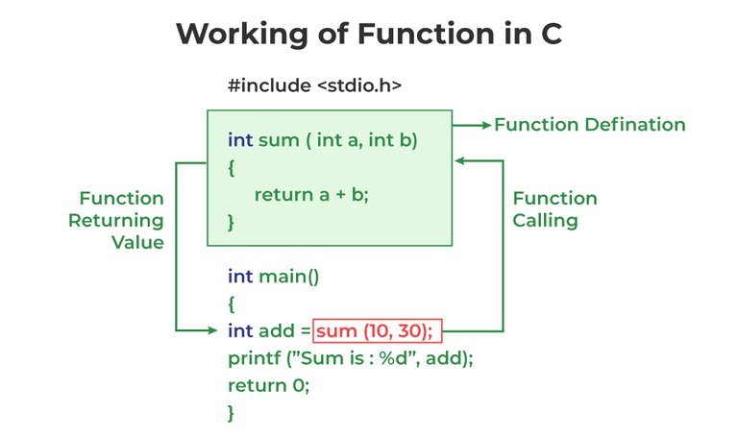
Control flow of functions
a, b are Formal parameters
10,30 are actual parameters/ arguments

Slide 18
4 Aspects of functions
A function may or may not accept any argument. It may or may not return any value. Based on these facts, There are four different aspects of function calls.
function without arguments and without return value
function without arguments and with return value
function with arguments and without return value
function with arguments and with return value

Slide 19
Function without arguments & without return value
#include<stdio.h>
void sum();
void main()
{
printf("\nGoing to calculate the sum of two numbers:");
sum();
}
void sum()
{
int a,b;
printf("\nEnter two numbers");
scanf("%d %d",&a,&b);
printf("The sum is %d",a+b);
}
As sum function don’t have arguments , we read input from user inside the function itself
As sum function cant return value the output is printed inside the function itself

Slide 20
Function without arguments & with return value
#include<stdio.h>
int sum();
void main()
{
int result;
printf("\nGoing to calculate the sum of two numbers:");
result = sum();
printf("%d",result);
}
int sum()
{
int a,b;
printf("\nEnter two numbers");
scanf("%d %d",&a,&b);
return a+b;
}
As sum function don’t have arguments, we read input from user inside the function itself
As sum function can return value the output is returned to main function and printed in main function

Slide 21
Function with arguments & with return value
#include<stdio.h>
int sum(int, int);
void main()
{
int a,b,result;
printf("\nGoing to calculate the sum of two numbers:");
printf("\nEnter two numbers:");
scanf("%d %d",&a,&b);
result = sum(a,b);
printf("\nThe sum is : %d",result);
}
int sum(int a, int b)
{
return a+b;
}
As sum function can have arguments , we read input from user inside the main function itself and passed in the function call statement.
As sum function can return value the output is returned to main function and printed in main function.

Slide 22
Function with arguments & without return value
#include<stdio.h>
void sum(int, int);
void main()
{
int a,b,result;
printf("\nGoing to calculate the sum of two numbers:");
printf("\nEnter two numbers:");
scanf("%d %d",&a,&b);
sum(a,b);
}
void sum(int a, int b)
{
printf("\nThe sum is %d",a+b);
}
As sum function can have arguments , we read input from user inside the main function itself and passed in function call statement.
As sum function cant return value the output is printed in sum function

Slide 23
To do
Write a C function to convert a decimal number to a binary number.
Write a C function to read ‘n’ values from user and to return the average of ‘n’ numbers.
Write a C function to read a number from user and to return the reverse of the number.
Write a C function to find whether a year is leap year or not.

Slide 24
Follow up
Types of function based on who defines it
User defined
Built-in
Types of function based on how it reads data and outputs data
function without arguments and without return value
function without arguments and with return value
function with arguments and without return value
function with arguments and with return value

Slide 25
Recursion
The process in which a function calls itself directly or indirectly is called recursion and the corresponding function is called a recursive function.
i.e. the function call statement is present inside the function definition itself.

Slide 26
Why recursion ?
Properties
Performing the same operations multiple times with different inputs.
In every step, we try smaller inputs to make the problem smaller.
Base condition is needed to stop the recursion otherwise infinite loop will occur.
Need of Recursion
Recursion can reduce the length of our code and make it easier to read, write and understand.

Slide 27
How memory is allotted for recursive functions?
Recursion uses more memory, because the recursive function adds to the stack with each recursive call, and keeps the values there until the call is finished

Slide 28
How to write a recursive function?
return_type func_name(parameters)
{
// Base case definition
// recursive call definition
}

Slide 29
When to use recursions?
Repeating same logic with different inputs
E.g. : Factorial(5) = 5* factorial(4)
Factorial(4) follows the same logic what factorial(5) did, but with different input and the input is taking us towards reducing the problem size.
Through each time the problem tries to reduce itself

Slide 30
Factorial / Fibonacci / Binary search
Factorial
fact(n)= n*fact(n-1)
Base case fact(1) is 1
Fibonacci
fibo(n)= fibo(n-1)+ fibo(n-2 )
Base case fib(0) is 0 and fib(1) is 1
Binary search
Binarysearch(low,high,n) if n> a[mid] → binarysearch(mid+1,high,n)
Binarysearch(low,high,n) if n< a[mid] → binarysearch(low,mid-1,n)
Base case : when element is present at mid provided low<high

Slide 31
Factorial using recursion
#include<stdio.h>
int factorial(int n)
{
if(n == 1)
return 1;
else
return n* factorial(n-1);
}
int main()
{
int a, fact;
printf("Enter a number to calculate factorial: ");
scanf("%d",&a);
fact = factorial(a);
printf("Factorial of %d = %d",a,fact);
return 0;
}
Base case
Recursive function call

Slide 32
Fibonacci series using recursion
#include <stdio.h>
int fibonacci(int num)
{
if (num == 0)
{ return 0;
}
else if (num == 1)
{
return 1; }
else
{
return fibonacci(num - 1) + fibonacci(num - 2); }
}
int main()
{
int num;
printf("Enter the number of elements to be in the series : ");
scanf("%d", &num);
int i;
for (i = 0; i < num; i++)
{
printf("%d, ", fibonacci(i));
}
return 0;
}

Slide 33
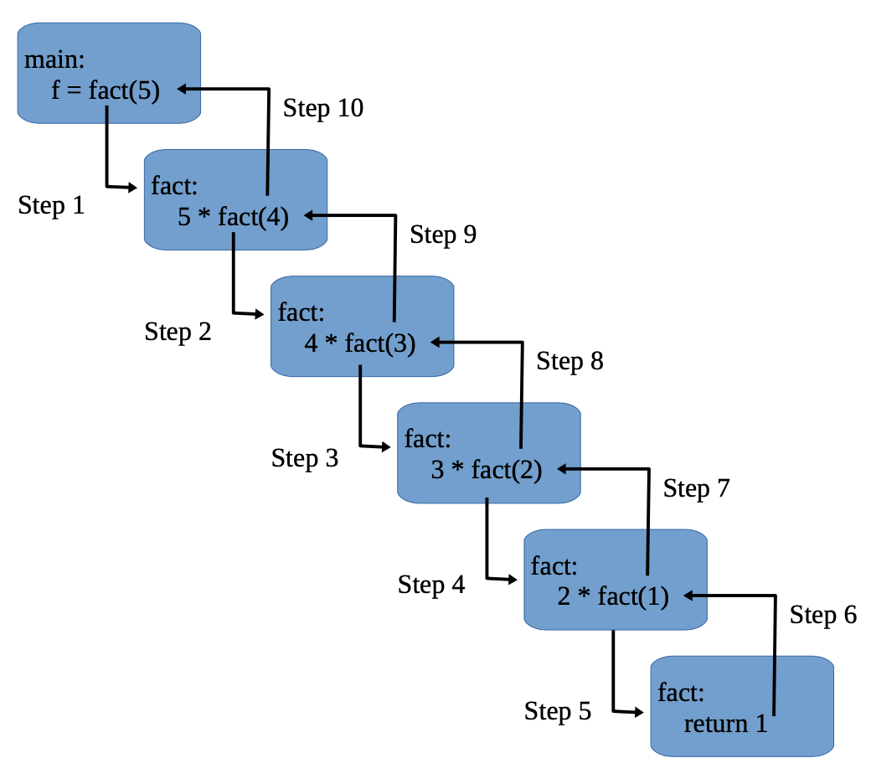
How recursion works?

Slide 34
Binary search using recursion
#include <stdio.h>
int binarySearch(int arr[], int low, int high, int x)
{
if (high >= low)
{
int mid = (low + high )/2;
if (arr[mid] == x)
return mid;
if (arr[mid] > x)
return binarySearch(arr, low, mid-1, x);
return binarySearch(arr, mid+1, high, x);
}
return -1;
}
int main(void)
{
int arr[] = {2, 3, 4, 10, 40};
int n = sizeof(arr)/ sizeof(arr[0]);
int x = 10; // search element
int result = binarySearch(arr, 0, n-1, x);
(result == -1)? printf("Element is not present in array") : printf("Element is present at index %d", result);
return 0;
}

Slide 35
2 types of recursion
Direct recursion
A function ‘fun’ is called direct recursive function, if it calls itself from within.
Indirect recursion
A function ‘fun’ is called indirect recursive if it calls another function say ‘fun_new’ and ‘fun_new’ calls ‘fun’ directly or indirectly

Slide 36
Looping vs. Recursion ?
Recursion | Iteration/looping
It is used with functions. | It is used generally with loops.
In each function call in recursion, extra Space is required in stack memory. | Here, in the case of each iteration, we do not require any space.
It terminates when the base condition is met. | It terminates when a condition becomes false.
Code size becomes smaller with recursion. | Code size is large in the case of iteration.
Recursion is slower than looping | Looping is faster than recursion

Slide 37
Pointers
A pointer is defined as a derived data type, that can store the address of other variables or a memory location.
We can access and manipulate the data stored in that memory location using pointers.
Syntax :
datatype * ptr;
where
ptr is the name of the pointer.
datatype is the type of data it is pointing to.

Slide 38
Visual Representation
int *ptr = &a;
int a= 10;
*ptr
a
10
1000
1000
1004
Address of ‘a’
(&a)
Address of ‘ptr’
(&ptr)

Slide 39
Pointer Declaration and initialization
Compiler understands that ptr is a integer pointer variable which can store an address of another integer variable
E.g. :
void main()
{
int var = 10; int * ptr; // declaration ptr = &var; // initialization
printf(“%d”, *ptr) // Dereferencing // 10
}

Slide 40
Referencing & Dereferencing
Referencing a pointer is the process of storing an address in a pointer variable. & is the referencing operator
int a=10; int *p=&a;
Dereferencing a pointer is the process of accessing the value stored in the memory address specified in the pointer. We use the same ( * ) dereferencing operator that we used in the pointer declaration.
printf(“%d”,*p);

Slide 41
Incompatible pointer type : Warning / Error
A floating type pointer variable cant reference a integer value
E.g. :
void main()
{
int var = 10; float * ptr; // declaration ptr = &var; // initialization is allowed
printf(“%d”, *ptr) // Dereferencing cant be done between different types
}

Slide 42
Pointer Example
k
r
#include<stdio.h>
int main()
{
int *r , k=10;
r= &k;
printf("%u\n", &r);
printf("%u\n", r);
printf("%u\n", &k);
printf("%u\n", k);
printf("%d\n", *r);
}
10
2686760
2686760
2686764
2686760
2686760
10
10
2686764

Slide 43
Guess the Output?
int main()
{
int *ptr ,y= 456;
ptr=&y;
printf("%d\n", *&*&*ptr);
return 0;
}
Output :
456

Slide 44
How many bytes does pointer variable take?
int main()
{
int *p;
float *p1;
double *y;
char*c;
printf("%d",sizeof(c));
printf("%d",sizeof(p));
printf("%d",sizeof(p1));
printf("%d",sizeof(y));
}
Irrespective of the datatype of the pointer variable, pointers are given a 4bytes for memory incase of 32 bit OS and 8 bytes incase of 64 bit OS

Slide 45
Double pointer
A double pointer is a pointer variable which stores the address of an pointer variable.
E.g. : int **a;
A is the double pointer that can store address of another pointer variable.

Slide 46
Example of Double Pointer
int main()
{
int a =10;
int *ptr=&a;
int **dptr=&ptr;
printf("%d\n",a);
printf("%d\n",&a);
printf("%d\n",ptr);
printf("%d\n",&ptr);
printf("%d\n",dptr);
printf("%d\n",*dptr);
printf("%d\n",&dptr);
printf("%d\n",*ptr);
printf("%d\n",**dptr);
}
10
2686764
2686764
2686760
2686760
2686764
2686756
10
10

Slide 47
Can a double pointer store address of another normal variable ?
Yes, a double pointer can store an address of another normal variable.
But dereferencing can’t work at second level.
Dereferencing will work only at one level.

Slide 48
Why pointers?
For dynamic memory allocation (malloc and calloc)
Data structure implementations
To return multiple values
For doing system level programming

Slide 49
Pointer arithmetic
Pointer Arithmetic is the set of valid arithmetic operations that can be performed on pointers.
Increment/Decrement of a pointer
Addition of integer to a pointer
Subtraction of integer to a pointer
Subtracting two pointers of the same type
Comparison of pointers of the same type

Slide 50
Pointer ++ and --
#include <stdio.h>
int main()
{
int a = 22;
int *p = &a;
printf("p = %u\n", p);
p++;
printf("p++ = %u\n", p);
p--;
printf("p-- = %u\n", p);
char c = 'a';
char *r = &c;
printf("r = %u\n", r);
r++;
printf("r++ = %u\n", r);
r--;
printf("r-- = %u\n", r);
}
p = 2686756
p++ = 2686760
p-- = 2686756
r = 2686755
r++ = 2686756
r-- = 2686755
int pointer increments by 4 bytes and char pointer increments by 1 byte

Slide 51
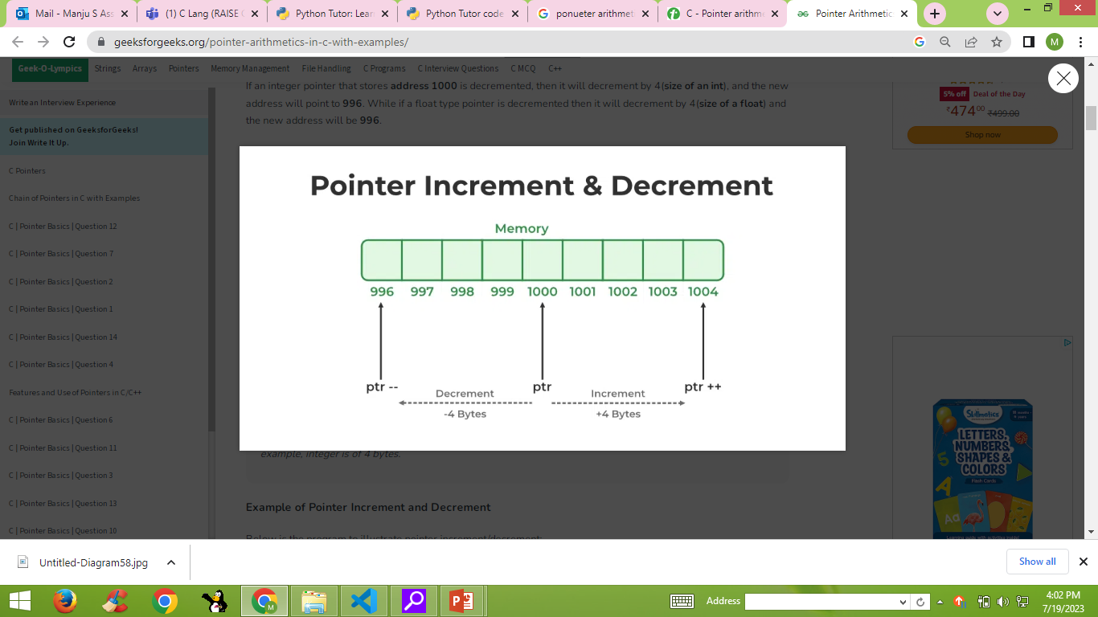
Pointer ++ and –

Slide 52
Addition/ subtraction of integer to a pointer
#include <stdio.h>
int main()
{
int a = 22;
int *p = &a;
printf("p = %u\n", p);
printf("p = %u\n", p+1);
printf("p = %u\n", p+5);
printf("p = %u\n", p-1);
}
p+1 moves 4 bytes ahead and p+5 moves 5*4 = 20 bytes ahead
p = 2686760
p = 2686764
p = 2686780
p = 2686756

Slide 53
Subtraction of 2 pointers
#include<stdio.h>
int main()
{
double a =10,b=20,c=30;
double *ptr1=&a;
double *ptr2=&b;
double *ptr3=&c;
printf("%u\n",ptr1);
printf("%u\n",ptr2);
printf("%u\n",ptr3);
printf("%u\n",ptr1-ptr2);
printf("%u\n",ptr1-ptr3);
}
Ptr1-ptr2 gives a 8byte difference i.e. 1
Ptr1-ptr3 gives 16 byte difference and hence 2
2686744
2686736
2686728
1
2

Slide 54
Comparison of pointers
#include<stdio.h>
int main()
{
double a =10,b=20,c=30;
double *ptr1=&a;
double *ptr2=&b;
double *ptr3;
if (*ptr1>*ptr2)
printf("\n a is greater");
else
printf("\n b is greater");
printf("%d",ptr3);
if(ptr3==NULL)
printf("\n Null Pointer");
}
Output :
b is greater
As ptr3 is not initialized it may have some garbage value

Slide 55
Null Pointer
A null pointer is a variable that has no valid address and is allocated to zero or NULL.
#include<stdio.h>
int main()
{
double *a=NULL; // NULL pointer
return 0;
}

Slide 56
Array and Pointers : Method 1 ( Dereferencing )
#include <stdio.h>
int main()
{
int N = 5;
int arr[] = { 11, 12, 13, 14, 15 };
int* ptr;
ptr = arr;
for (int i = 0; i < N; i++) {
printf("%d ", *ptr);
ptr++;
}
return 0;
}
Having known that array arr points to base address, the output would be
11 12 13 14 15
The ‘ptr’ keeps on incrementing through every iteration of ‘i’ until 4 traversing through the array.

Slide 57
Array and Pointers : Method 2 (Indexing )
#include <stdio.h>
void main()
{
int N = 5;
int arr[] = { 11, 12, 13, 14, 15 };
int* ptr;
ptr = arr;
for (int i = 0; i < N; i++)
{ printf("%d ", ptr[i]);
}
}
Having known that array arr points to base address, the output would be
11 12 13 14 15
The ‘ptr’ gets the index value ‘i’ that keeps on incrementing until 4 traversing through the array.

Slide 58
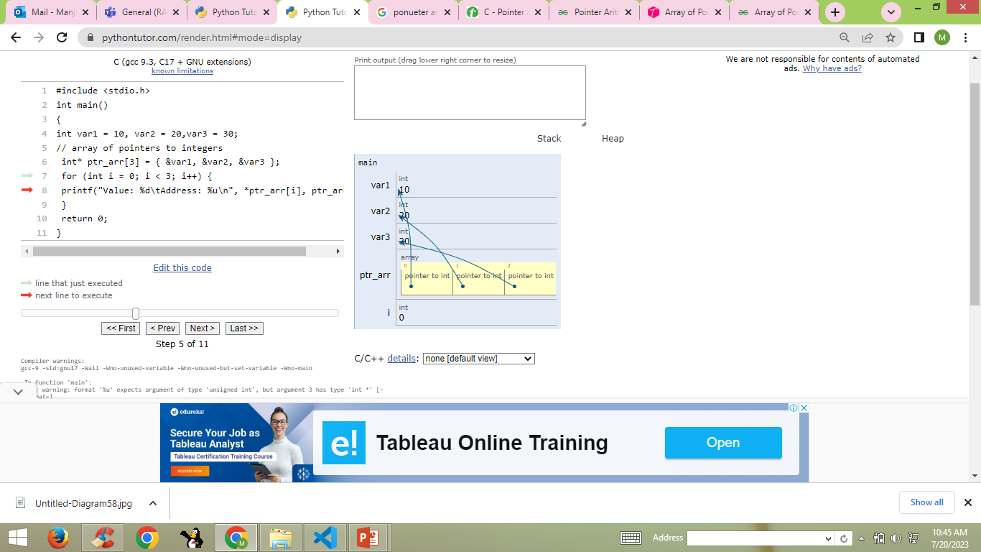
Array of pointers [pointing to variables]
Pointer variable ptr_arr is itself an array and hence can store more address of same typed variable.
#include <stdio.h>
int main()
{
int var1 = 10, var2 = 20,var3 = 30;
// array of pointers to integers
int* ptr_arr[3] = { &var1, &var2, &var3 };
for (int i = 0; i < 3; i++) {
printf("Value: %d\tAddress: %u\n", *ptr_arr[i], ptr_arr[i]);
}
return 0;
}
Value: 10 Address: 2686760
Value: 20 Address: 2686756
Value: 30 Address: 2686752

Slide 59
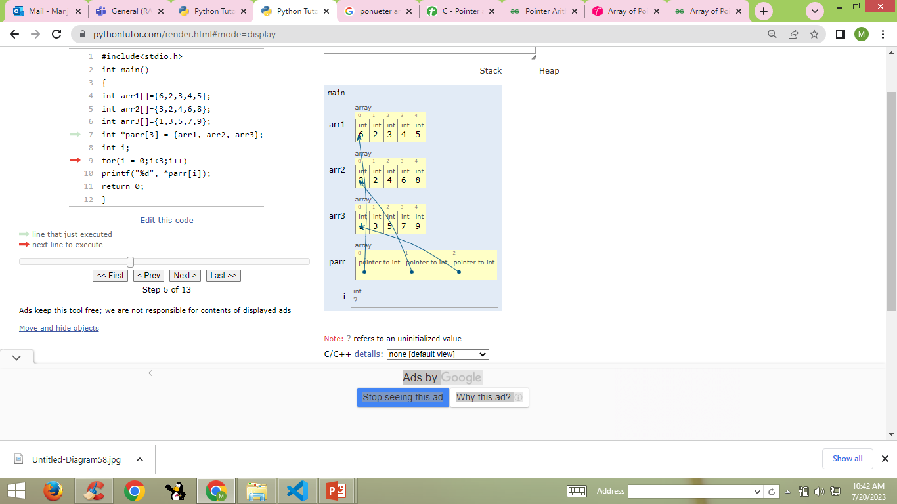
Array of pointers [pointing to array]
#include<stdio.h>
int main()
{
int arr1[]={6,2,3,4,5};
int arr2[]={3,2,4,6,8};
int arr3[]={1,3,5,7,9};
int *parr[3] = {arr1, arr2, arr3};
int i;
for(i = 0;i<3;i++)
printf("%d\t", *parr[i]);
return 0;
}
6 3 1

Slide 60
Function call [Parameter passing] types
A function can be called by 2 ways
Call by value
Call by reference
Note : The parameters passed to the function are called actual parameters whereas the parameters received by the function are called formal parameters

Slide 61
Call by value
In call by value method of parameter passing, the values of actual parameters are copied to the function’s formal parameters.
There are two copies of parameters stored in different memory locations.
One is the original copy and the other is the function copy.
Any changes made inside functions are not reflected in the actual parameters of the caller.

Slide 62
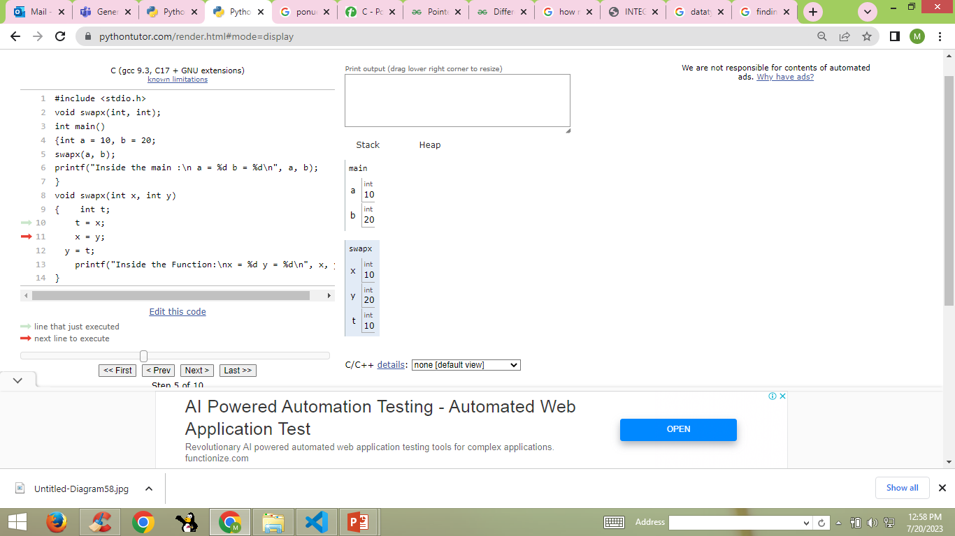
Call by value : Example
Separate block of memory for formal parameters and hence changes done to it will not be reflected back to actual parameters
#include <stdio.h>
void swapx(int x, int y);
int main()
{
int a = 10, b = 20;
swapx(a, b); // call by value
printf("Inside main :\na = %d b = %d\n", a, b);
return 0;
}
void swapx(int x, int y)
{ int t;
t = x;
x = y;
y = t;
printf("Inside Function:\nx = %d y = %d\n", x, y);
}
Inside Function:
x = 20 y = 10
Inside main :
a = 10 b = 20

Slide 63
Call by reference
In call by reference method of parameter passing, the address of the actual parameters is passed to the function as the formal parameters.
Both the actual and formal parameters refer to the same locations.
Any changes made inside the function are actually reflected in the actual parameters of the caller.
No separate block of memory for actual and formal parameters

Slide 64
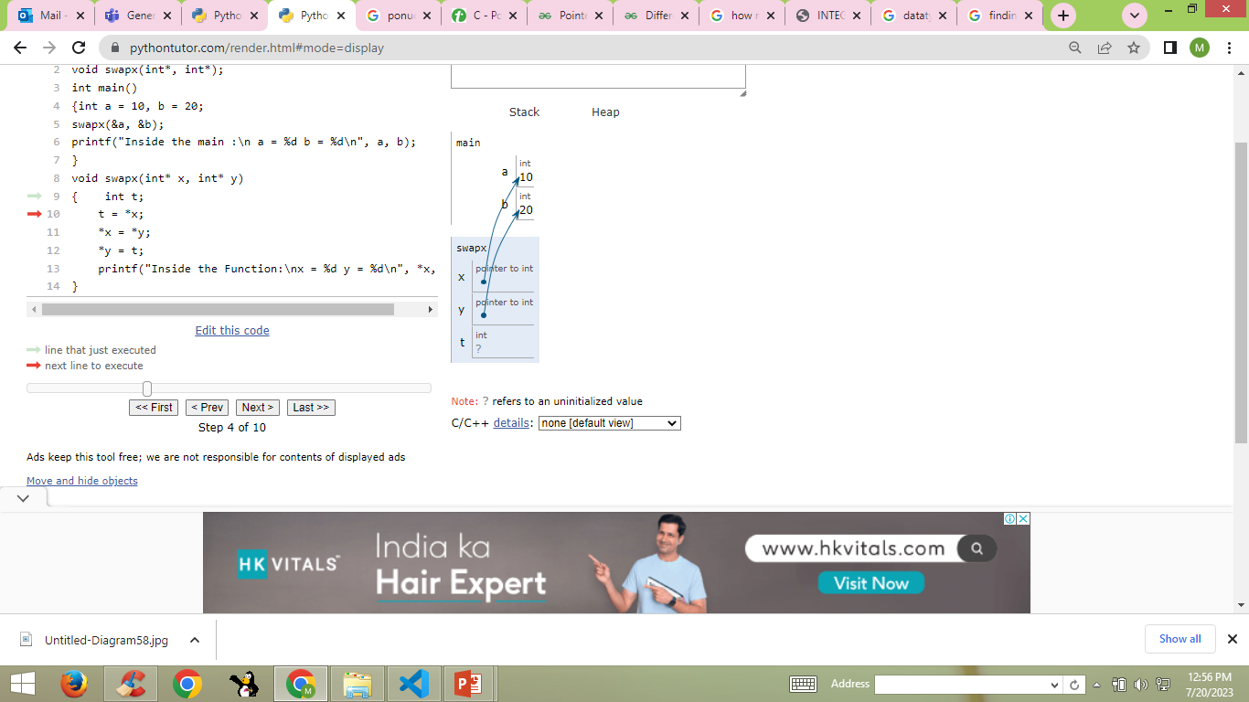
Call by reference : Example
No separate block of memory for formal parameters as address of actual parameters is passed and hence changes done to it will be reflected back to actual parameters
#include <stdio.h>
void swapx(int*, int*);
int main()
{int a = 10, b = 20;
swapx(&a, &b);
printf("Inside the main :\n a = %d b = %d\n", a, b);
}
void swapx(int* x, int* y)
{ int t;
t = *x;
*x = *y;
*y = t;
printf("Inside the Function:\nx = %d y = %d\n", *x, *y);
}
Inside Function:
x = 20 y = 10
Inside main :
a = 20 b = 10

Slide 65
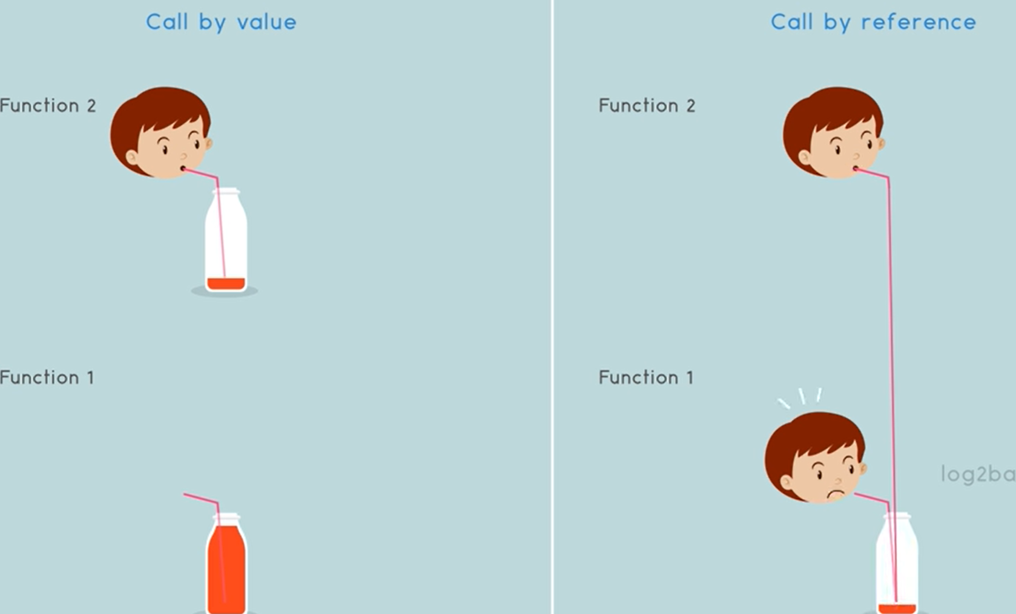
Call by value vs. reference

Slide 66
Math functions
The math.h header defines various C mathematical functions and one macro.
All the functions available in this library take double as an argument and return double as the result.
Header file : #include <math.h>

Slide 67
Math Functions : Sqrt () and pow ()
sqrt( x ) : returns the square root of the number ‘x’
pow(x,y) : returns the value of x to the power of y i.e. x ^{y}
#include <math.h>
#include <stdio.h>
void main()
{ printf("Square root : %lf\n",sqrt(225.0));
printf(“Power : %lf\n",pow(3,2));
}
Output :
Square root : 15.000000
Power : 9.000000

Slide 68
Math Functions : ceil and floor ()
ceil(x): returns the smallest integer value greater than or equal to x
floor(x): returns the largest integer value greater than or equal to x
#include <stdio.h>
#include <math.h>
int main() {
printf("%lf\n", ceil(1.4));
printf("%lf\n", floor(1.4));
return 0;
}
Output :
2.000000
1.000000

Slide 69
Other math functions
abs(x) | Returns the absolute value of x
cbrt(x) | Returns the cube root of x
cos(x) | Returns the cosine of x
exp(x) | Returns the value of E^{x}
sin(x) | Returns the sine of x (x is in radians)
tan(x) | Returns the tangent of an angle
log(x) | Returns the natural logarithm (base-e logarithm) of x

Slide 70
Note
Read values from user whenever required
Considering the slide size and format, programs are initialized with values for variables and arrays.
Not hardcoding the values, is a good programming practice.

Slide 71
Thank You

