Slide 3
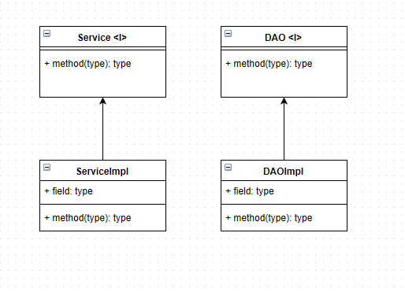
Service – DAO Patterns

Slide 4
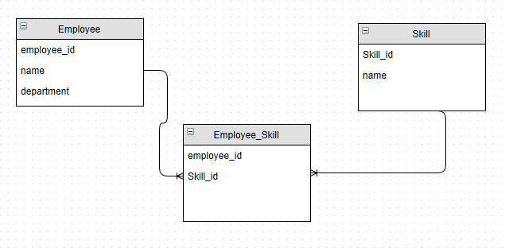
ER Diagram

