Slide 1
ESM UML Diagrams

Slide 2
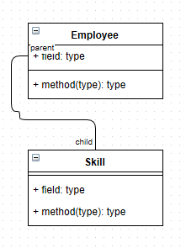
Class Diagram

Slide 3
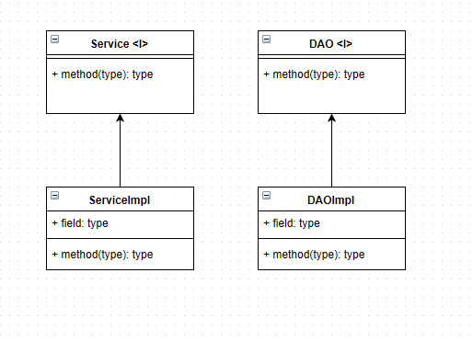
Service – DAO Patterns

Slide 4
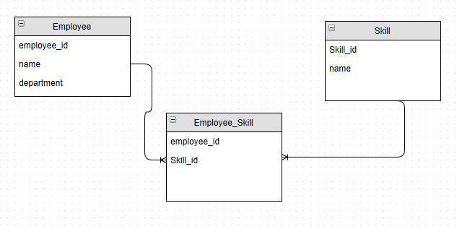
ER Diagram

