Slide 1
Convolutional AutoEncoder in Anomaly Detection
01
INTRODUCTION
Early and accurate detection of brain tumors using MRI is vital, but manual analysis is slow and prone to error, while supervised deep learning models like CNNs require large labeled datasets and are computationally expensive. To address this, we propose an unsupervised anomaly detection approach using a lightweight skip-connected convolutional autoencoder (CAE) trained only on healthy brain scans. The CAE reconstructs normal anatomy, and anomalies like tumors are identified by high reconstruction errors. We enhance detection accuracy by combining MSE, SSIM, and gradient-based losses, improving structural detail and tumor boundary clarity. This approach is efficient, accurate, and suitable for real-time deployment on standard hardware.
For Brain MRI scans
BURLA SURAJ – CB.SC.U4AIE24105 SAI KARTHIK - CB.SC.U4AIE24107
VISHNU TEJA - CB.SC.U4AIE24130
MOJAN INANI - CB.SC.U4AIE24105

Slide 2
Convolutional AutoEncoder in Anomaly Detection
01
INTRODUCTION
02
Early and accurate detection of brain tumors using MRI is vital, but manual analysis is slow and prone to error, while supervised deep learning models like CNNs require large labeled datasets and are computationally expensive. To address this, we propose an unsupervised anomaly detection approach using a lightweight skip-connected convolutional autoencoder (CAE) trained only on healthy brain scans. The CAE reconstructs normal anatomy, and anomalies like tumors are identified by high reconstruction errors. We enhance detection accuracy by combining MSE, SSIM, and gradient-based losses, improving structural detail and tumor boundary clarity. This approach is efficient, accurate, and suitable for real-time deployment on standard hardware.
OBJECTIVE
Train a CAE only on healthy MRI slices
Enhance reconstruction fidelity using a hybrid loss (MSE + SSIM + gradient)
Detect tumors by thresholding reconstruction error
BURLA SURAJ – CB.SC.U4AIE24105 SAI KARTHIK - CB.SC.U4AIE24107
VISHNU TEJA - CB.SC.U4AIE24130
MOJAN INANI - CB.SC.U4AIE24105
For Brain MRI scans

Slide 3
WHY NOT CLASSIFIERS
Aspect | Autoencoder (Anomaly) | Binary Classifier
Data needed | Only healthy scans | Healthy + tumor labels
Supervision | Unsupervised | Supervised
Inference cost | Low–Moderate | Low
Generalizes unseen anomalies | Good | Limited
Labeling effort | Minimal | High
01
02
INTRODUCTION
OBJECTIVE
Early and accurate detection of brain tumors using MRI is vital, but manual analysis is slow and prone to error, while supervised deep learning models like CNNs require large labeled datasets and are computationally expensive. To address this, we propose an unsupervised anomaly detection approach using a lightweight skip-connected convolutional autoencoder (CAE) trained only on healthy brain scans. The CAE reconstructs normal anatomy, and anomalies like tumors are identified by high reconstruction errors. We enhance detection accuracy by combining MSE, SSIM, and gradient-based losses, improving structural detail and tumor boundary clarity. This approach is efficient, accurate, and suitable for real-time deployment on standard hardware.
Train a CAE only on healthy MRI slices
Enhance reconstruction fidelity using a hybrid loss (MSE + SSIM + gradient)
Detect tumors by thresholding reconstruction error
For Brain MRI scans

Slide 4
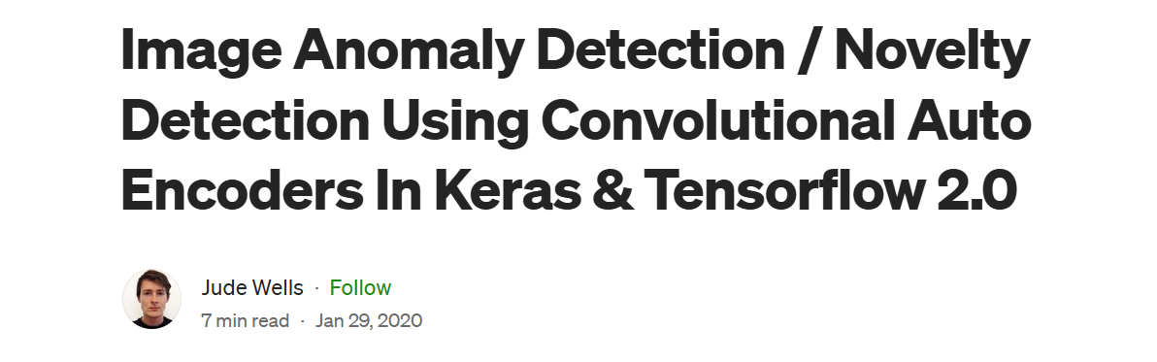
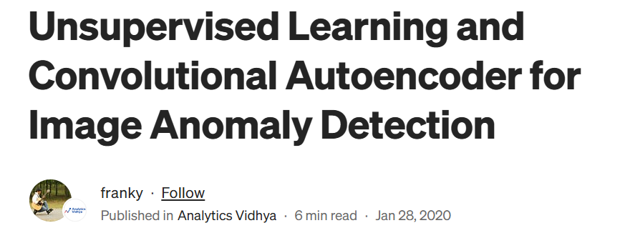
WHY NOT CLASSIFIERS
LITERATURE REVIEW
Aspect | Autoencoder (Anomaly) | Binary Classifier
Data needed | Only healthy scans | Healthy + tumor labels
Supervision | Unsupervised | Supervised
Inference cost | Low–Moderate | Low
Generalizes unseen anomalies | Good | Limited
Labeling effort | Minimal | High
02
OBJECTIVE
Train a CAE only on healthy MRI slices
Enhance reconstruction fidelity using a hybrid loss (MSE + SSIM + gradient)
Detect tumors by thresholding reconstruction error

Slide 5
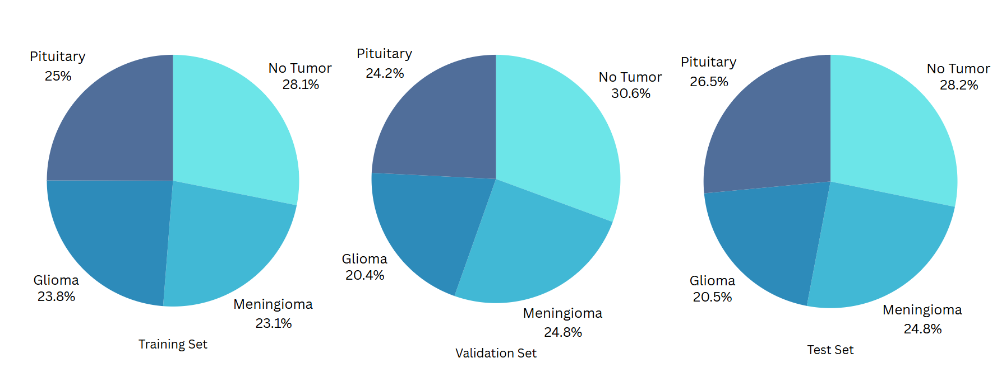
LITERATURE REVIEW
DATASET DESCRIPTION
02
OBJECTIVE
Train a skip‑connected CAE only on healthy MRI slices
Enhance reconstruction fidelity using a hybrid loss (MSE + SSIM + gradient)
Detect tumors by thresholding reconstruction error at 95th percentile
Plus Jakarta Sans
WHY NOT CLASSIFIERS
Aspect | Autoencoder (Anomaly) | Binary Classifier
Data needed | Only healthy scans | Healthy + tumor labels
Supervision | Unsupervised | Supervised
Inference cost | Low–Moderate | Low
Generalizes unseen anomalies | Good | Limited
Labeling effort | Minimal | High

Slide 6
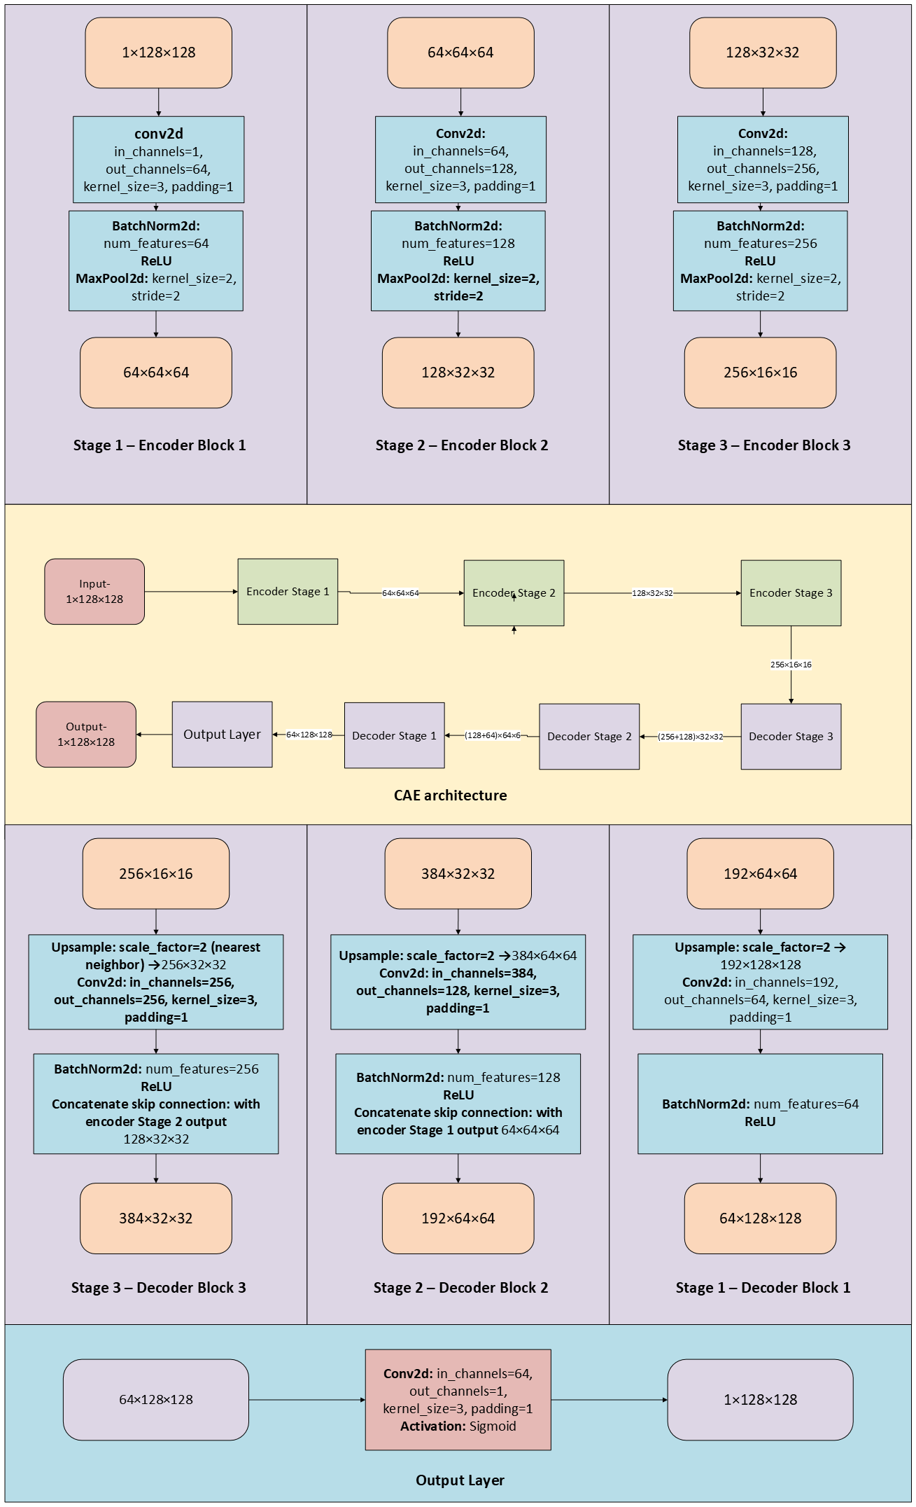
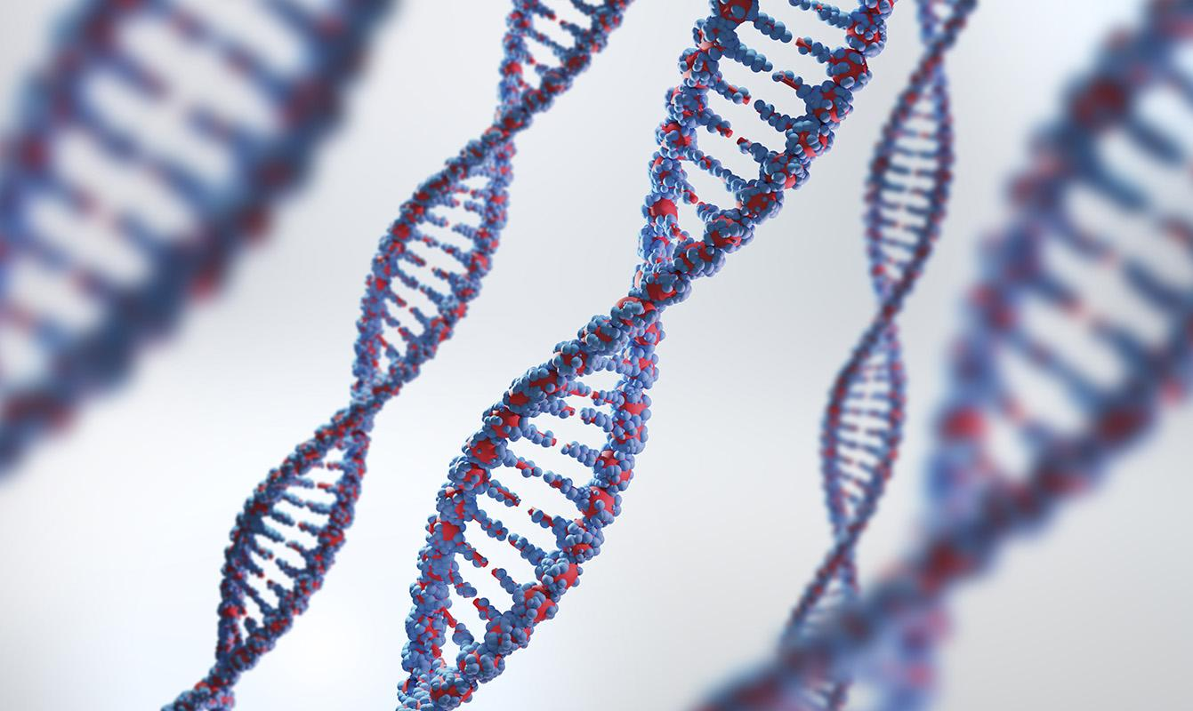
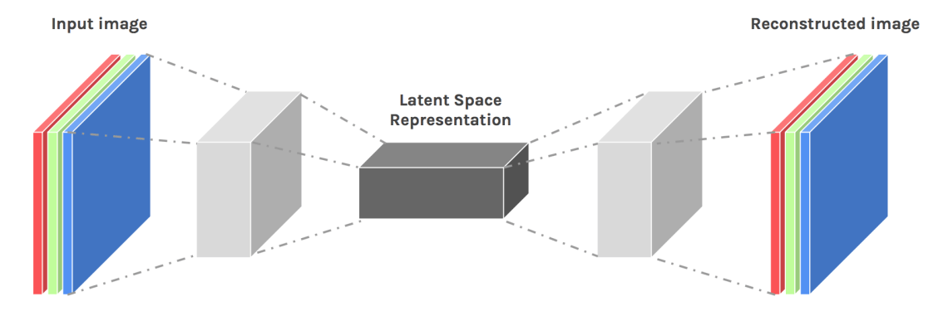
LITERATURE REVIEW
MODEL ARCHITECTURE
DATASET DESCRIPTION
Plus Jakarta Sans
WHY NOT CLASSIFIERS
Aspect | Autoencoder (Anomaly) | Binary Classifier
Data needed | Only healthy scans | Healthy + tumor labels
Supervision | Unsupervised | Supervised
Inference cost | Low–Moderate | Low
Generalizes unseen anomalies | Good | Limited
Labeling effort | Minimal | High

Slide 7
METHODOLOGY
DATASET DESCRIPTION
MODEL ARCHITECTURE
Plus Jakarta Sans
Data Prep: Use only healthy MRI slices, resize to 128×128, normalize, then add light Gaussian and occlusion noise to inputs.
Augmentation & Loading: Wrap images in a PyTorch DataLoader (batch 16) with random rotations and flips each epoch.
CAE Design: Three‑stage encoder/decoder and a final layer.
Training: Optimize a hybrid loss (MSE + SSIM + gradient term) using Adam over 50 epochs with a decaying learning rate.
Anomaly Detection: Reconstruct test slices, compute residuals, and flag scans whose maximum error exceeds the threshold.

Slide 8
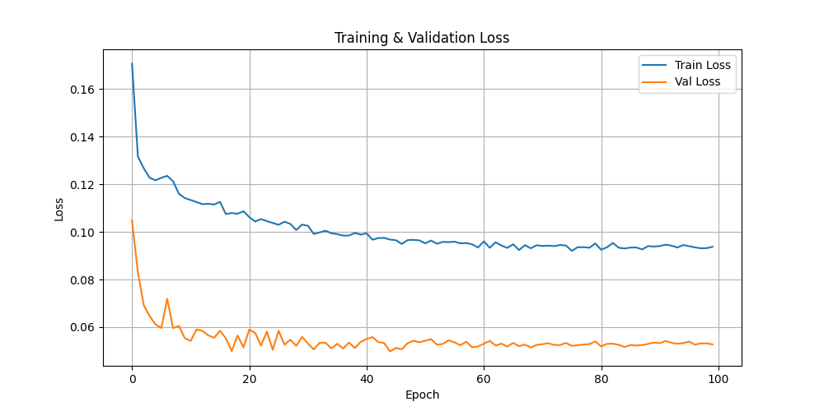
RESULTS
METHODOLOGY
MODEL ARCHITECTURE
Model saved at: D:\conAEbackupnotebooks\models\cae_model6.pth
Anomaly detection threshold: 0.1278
Predictions on Test Images:
Image 01: Recon Error = 0.1914 -> Predicted: Tumor, Actual: Tumor (correct)
Image 02: Recon Error = 0.3891 -> Predicted: Tumor, Actual: Tumor (correct)
Image 03: Recon Error = 0.4008 -> Predicted: Tumor, Actual: Tumor (correct)
Image 04: Recon Error = 0.1921 -> Predicted: Tumor, Actual: Tumor (correct)
Image 05: Recon Error = 0.1748 -> Predicted: Tumor, Actual: Tumor (correct)
Image 06: Recon Error = 0.1226 -> Predicted: Healthy, Actual: Healthy (correct)
Image 07: Recon Error = 0.3343 -> Predicted: Tumor, Actual: Healthy (wrong)
Image 08: Recon Error = 0.3192 -> Predicted: Tumor, Actual: Tumor (correct)
Image 09: Recon Error = 0.2326 -> Predicted: Tumor, Actual: Tumor (correct)
Image 10: Recon Error = 0.1901 -> Predicted: Tumor, Actual: Tumor (correct)
Image 11: Recon Error = 0.3536 -> Predicted: Tumor, Actual: Healthy (wrong)
Image 12: Recon Error = 0.1223 -> Predicted: Healthy, Actual: Healthy (correct)
Image 13: Recon Error = 0.3039 -> Predicted: Tumor, Actual: Tumor (correct)
Image 14: Recon Error = 0.4031 -> Predicted: Tumor, Actual: Tumor (correct)
Image 15: Recon Error = 0.2359 -> Predicted: Tumor, Actual: Tumor (correct)
Image 16: Recon Error = 0.4567 -> Predicted: Tumor, Actual: Tumor (correct)
Image 17: Recon Error = 0.3005 -> Predicted: Tumor, Actual: Healthy (wrong)
Image 18: Recon Error = 0.1969 -> Predicted: Tumor, Actual: Tumor (correct)
Image 19: Recon Error = 0.2924 -> Predicted: Tumor, Actual: Tumor (correct)
Image 20: Recon Error = 0.2054 -> Predicted: Tumor, Actual: Tumor (correct)
Total Correct: 17 correct, Total Wrong: 3 wrong
Data Prep: Use only healthy MRI slices, resize to 128×128, normalize, then add light Gaussian and occlusion noise to inputs.
Augmentation & Loading: Wrap images in a PyTorch DataLoader (batch 16) with random rotations and flips each epoch.
CAE Design: Three‑stage encoder/decoder and a final layer .
Training: Optimize a hybrid loss (MSE + SSIM + gradient term) using Adam over 50 epochs with a decaying learning rate.
Anomaly Detection: Reconstruct test slices, compute residuals, and flag scans whose maximum error exceeds the threshold.

Slide 9
CONCLUSION
CAE achieves ≥ 85% accuracy without tumor labels, using only healthy data
Hybrid loss ensures structural fidelity and edge clarity
Ready for clinical/edge deployment with minimal resource needs
METHODOLOGY
RESULTS
MODEL ARCHITECTURE
Model saved at: D:\conAEbackupnotebooks\models\cae_model6.pth
Anomaly detection threshold: 0.1278
Predictions on Test Images:
Image 01: Recon Error = 0.1914 -> Predicted: Tumor, Actual: Tumor (correct)
Image 02: Recon Error = 0.3891 -> Predicted: Tumor, Actual: Tumor (correct)
Image 03: Recon Error = 0.4008 -> Predicted: Tumor, Actual: Tumor (correct)
Image 04: Recon Error = 0.1921 -> Predicted: Tumor, Actual: Tumor (correct)
Image 05: Recon Error = 0.1748 -> Predicted: Tumor, Actual: Tumor (correct)
Image 06: Recon Error = 0.1226 -> Predicted: Healthy, Actual: Healthy (correct)
Image 07: Recon Error = 0.3343 -> Predicted: Tumor, Actual: Healthy (wrong)
Image 08: Recon Error = 0.3192 -> Predicted: Tumor, Actual: Tumor (correct)
Image 09: Recon Error = 0.2326 -> Predicted: Tumor, Actual: Tumor (correct)
Image 10: Recon Error = 0.1901 -> Predicted: Tumor, Actual: Tumor (correct)
Image 11: Recon Error = 0.3536 -> Predicted: Tumor, Actual: Healthy (wrong)
Image 12: Recon Error = 0.1223 -> Predicted: Healthy, Actual: Healthy (correct)
Image 13: Recon Error = 0.3039 -> Predicted: Tumor, Actual: Tumor (correct)
Image 14: Recon Error = 0.4031 -> Predicted: Tumor, Actual: Tumor (correct)
Image 15: Recon Error = 0.2359 -> Predicted: Tumor, Actual: Tumor (correct)
Image 16: Recon Error = 0.4567 -> Predicted: Tumor, Actual: Tumor (correct)
Image 17: Recon Error = 0.3005 -> Predicted: Tumor, Actual: Healthy (wrong)
Image 18: Recon Error = 0.1969 -> Predicted: Tumor, Actual: Tumor (correct)
Image 19: Recon Error = 0.2924 -> Predicted: Tumor, Actual: Tumor (correct)
Image 20: Recon Error = 0.2054 -> Predicted: Tumor, Actual: Tumor (correct)
Total Correct: 17 correct, Total Wrong: 3 wrong
Data Prep: Use only healthy MRI slices, resize to 128×128, normalize, then add light Gaussian and occlusion noise to inputs.
Augmentation & Loading: Wrap images in a PyTorch DataLoader (batch 16) with random rotations and flips each epoch.
CAE Design: Three‑stage encoder/decoder and a final layer.
Training: Optimize a hybrid loss (MSE + SSIM + gradient term) using Adam over 50 epochs with a decaying learning rate.
Anomaly Detection: Reconstruct test slices, compute residuals, and flag scans whose maximum error exceeds the threshold.

Slide 10
RESULTS
Data Prep: Use only healthy MRI slices, resize to 128×128, normalize, then add light Gaussian and occlusion noise to inputs.
Augmentation & Loading: Wrap images in a PyTorch DataLoader (batch 16) with random rotations and flips each epoch.
CAE Design: Three‑stage encoder/decoder with skip connections to preserve detail.
Training: Optimize a hybrid loss (MSE + SSIM + gradient term) using Adam over 50 epochs with a decaying learning rate.
Anomaly Detection: Reconstruct test slices, compute residuals, and flag scans whose maximum error exceeds the 95th‑percentile threshold.
CONCLUSION
CAE achieves ≥ 85% accuracy without tumor labels, using only healthy data
Hybrid loss ensures structural fidelity and edge clarity
Ready for clinical/edge deployment with minimal resource needs
Model saved at: D:\conAEbackupnotebooks\models\cae_model6.pth
Anomaly detection threshold: 0.1278
Predictions on Test Images:
Image 01: Recon Error = 0.1914 -> Predicted: Tumor, Actual: Tumor (correct)
Image 02: Recon Error = 0.3891 -> Predicted: Tumor, Actual: Tumor (correct)
Image 03: Recon Error = 0.4008 -> Predicted: Tumor, Actual: Tumor (correct)
Image 04: Recon Error = 0.1921 -> Predicted: Tumor, Actual: Tumor (correct)
Image 05: Recon Error = 0.1748 -> Predicted: Tumor, Actual: Tumor (correct)
Image 06: Recon Error = 0.1226 -> Predicted: Healthy, Actual: Healthy (correct)
Image 07: Recon Error = 0.3343 -> Predicted: Tumor, Actual: Healthy (wrong)
Image 08: Recon Error = 0.3192 -> Predicted: Tumor, Actual: Tumor (correct)
Image 09: Recon Error = 0.2326 -> Predicted: Tumor, Actual: Tumor (correct)
Image 10: Recon Error = 0.1901 -> Predicted: Tumor, Actual: Tumor (correct)
Image 11: Recon Error = 0.3536 -> Predicted: Tumor, Actual: Healthy (wrong)
Image 12: Recon Error = 0.1223 -> Predicted: Healthy, Actual: Healthy (correct)
Image 13: Recon Error = 0.3039 -> Predicted: Tumor, Actual: Tumor (correct)
Image 14: Recon Error = 0.4031 -> Predicted: Tumor, Actual: Tumor (correct)
Image 15: Recon Error = 0.2359 -> Predicted: Tumor, Actual: Tumor (correct)
Image 16: Recon Error = 0.4567 -> Predicted: Tumor, Actual: Tumor (correct)
Image 17: Recon Error = 0.3005 -> Predicted: Tumor, Actual: Healthy (wrong)
Image 18: Recon Error = 0.1969 -> Predicted: Tumor, Actual: Tumor (correct)
Image 19: Recon Error = 0.2924 -> Predicted: Tumor, Actual: Tumor (correct)
Image 20: Recon Error = 0.2054 -> Predicted: Tumor, Actual: Tumor (correct)
Total Correct: 17 correct, Total Wrong: 3 wrong

