Slide 1
PRESENTED BY: S P Boornima REGISTER NO:962821104025 DEPT:COMPUTER SCIENCE AND ENGINEERING NM id:au962821104025 Email id: sparklight595@gmail.com
AUTOENCODER FOR IMAGE COMPRESSION USING GAN
(GENERATIVE ADVERSARIAL NETWORK)
3/21/2024 Annual Review

Slide 2
AUTOENCODER IMAGE COMPRESSION USING GAN
Autoencoder:
Image compression and reconstruction using autoencoders.
Deep learning architectures for unsupervised learning.
Dimensionality reduction and feature extraction.
Generative Adversarial Network (GAN):
Generative modeling and image generation using GANs.
Adversarial training and optimization.
Unsupervised learning for image synthesis.
3/21/2024 Annual Review

Slide 3


AGENDA
,
Introduction
Problem Statement
Project Overview
Modeling
Evaluation
Conclusion
3/21/2024 Annual Review

Slide 4

PROBLEM STATEMENT
Image compression is essential for efficient storage and transmission of images in various applications.
Traditional compression methods may lead to loss of important visual details.
There's a need for more advanced techniques that can compress images while preserving essential features.
3/21/2024 Annual Review

Slide 5

PROJECT OVERVIEW
Objective: To develop an autoencoder-based image compression system using Generative Adversarial Networks (GANs).
Approach: Utilize autoencoders to compress images into a lower-dimensional representation, and employ GANs to generate high-quality images from the compressed representation.
Significance: This approach combines the benefits of efficient image compression with the ability to generate realistic images, offering a novel solution for various applications.
3/21/2024 Annual Review

Slide 6

WHO ARE THE END USERS?
Researchers and practitioners in the field of computer vision and image processing.
Developers and engineers working on applications that involve image compression, reconstruction, or generation.
Enthusiasts or hobbyists interested in deep learning and artificial intelligence.
3/21/2024 Annual Review

Slide 7

YOUR SOLUTION AND ITS VALUE PROPOSITION
Innovative Compression:
Our approach combines autoencoder-based compression with GANs, ensuring efficient data reduction while preserving image quality.
Quality Preservation:
By leveraging GANs, we maintain high visual fidelity in reconstructed images, overcoming the limitations of traditional compression methods.
Adaptability and Versatility:
Our solution is adaptable to various image types and can be tailored to specific compression needs, making it suitable for diverse applications.
Practical Applications:
With minimal loss of quality, our method facilitates image storage, transmission over limited networks, and enhances data utilization in machine learning.
3/21/2024 Annual Review

Slide 8

THE WOW IN YOUR SOLUTION
The ability to compress images using autoencoders while preserving important features.
Leveraging the power of GANs to generate high-quality, realistic images.
Potential applications in various domains such as data compression, image editing, and artistic image generation.
Demonstrations of visually appealing generated images and accurate reconstructions.
3/21/2024 Annual Review
8

Slide 9
MODELLING
Autoencoder Architecture:
Autoencoders are selected for their capability to learn compact representations of data.
Our architecture is designed to efficiently encode and decode input images.
Data Preprocessing:
Preprocessing steps are applied to enhance data quality and model robustness.
Techniques such as normalization ensure uniformity across features.
Image resizing and augmentation techniques are utilized to increase dataset diversity.
Training Process:
The dataset is partitioned into training and testing sets to assess model performance.
Model parameters are initialized, and optimization algorithms are selected.
Training iterations and batch sizes are optimized to enhance model convergence and efficiency.
9

Slide 10
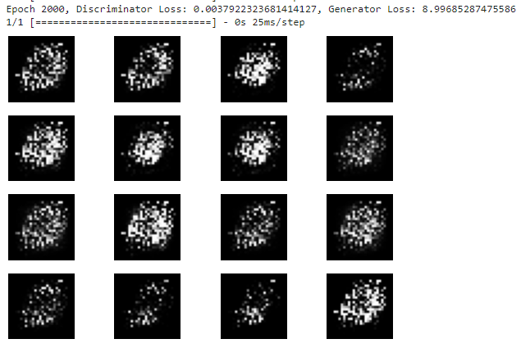
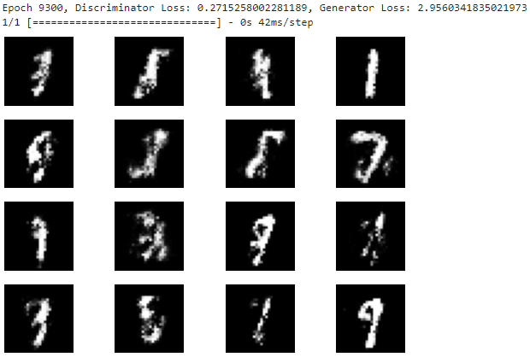
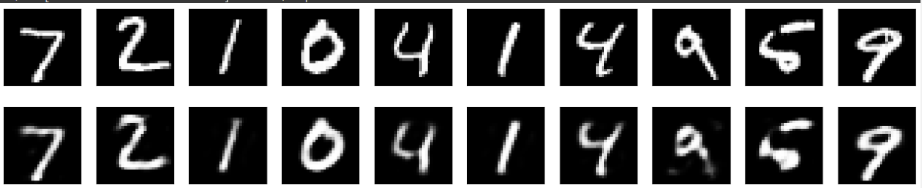
RESULTS
10

