Slide 1
Intents Examples

Slide 2
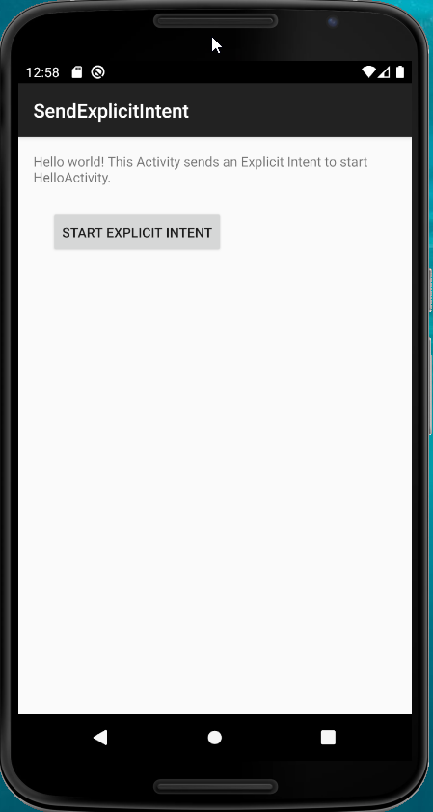
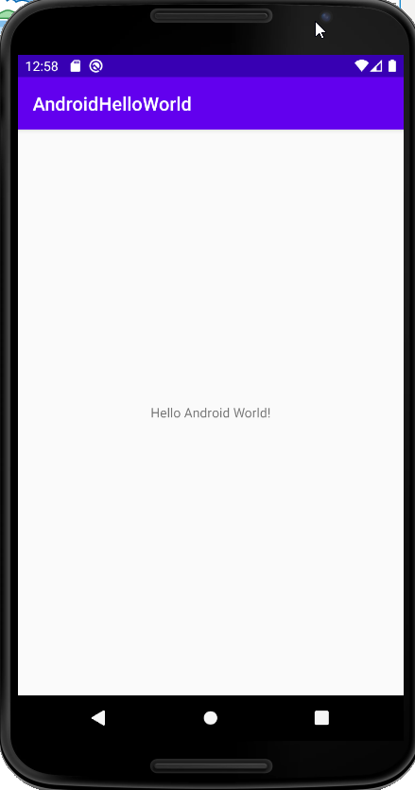
Intents
Implicit Intents specify an action which needs carrying out: a number of apps on the phone may be able to do this
Explicit intents are used to invoke specific components (often used with services)
class SendExplicitIntentActivity : AppCompatActivity(), View.OnClickListener { override fun onCreate(savedInstanceState: Bundle?) { super.onCreate(savedInstanceState) setContentView(R.layout.main) val go = findViewById<View>(R.id.intentButton) as Button go.setOnClickListener(this) } override fun onClick(view: View) { val go = Intent() go.setClassName("android.cs.stir.ac.uk.androidhelloworld",
"android.cs.stir.ac.uk.androidhelloworld.MainActivity") startActivity(go) } }

Slide 3
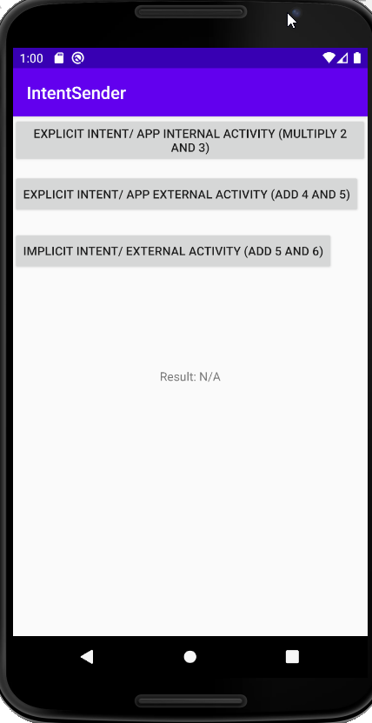
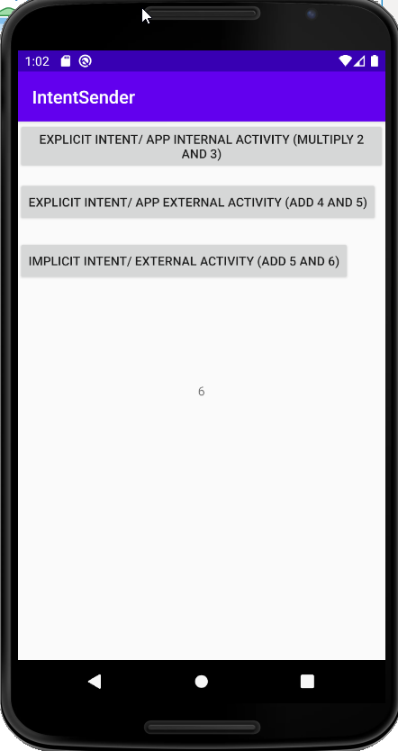
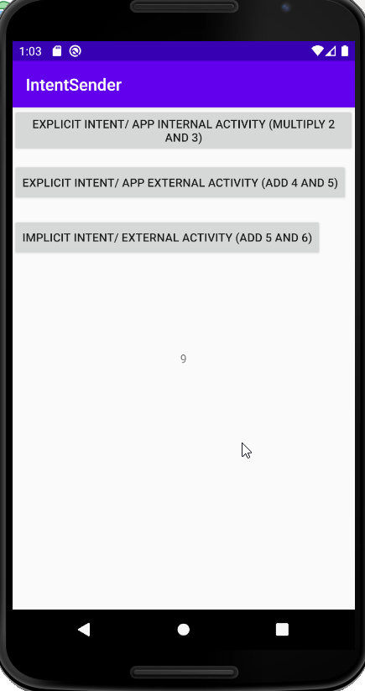
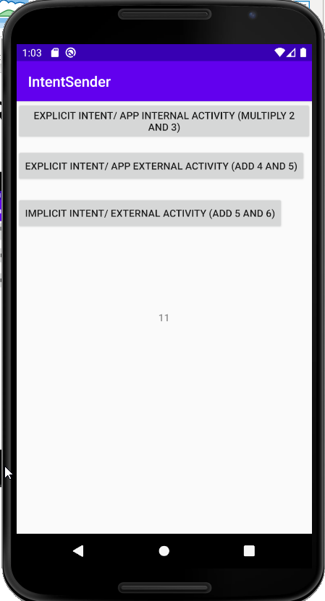
Intent Example App

Slide 4
Intent with Result - 1
package android.cs.stir.ac.uk.lect_intentsender public override fun onCreate(state: Bundle?) { super.onCreate(state) setContentView(R.layout.activity_main) val invokeInternalButton = findViewById<View>(R.id.invokeact) as Button invokeInternalButton.setOnClickListener { val i = Intent() i.setClassName(this, "android.cs.stir.ac.uk.lect_intentsender.IntentReceiver") i.putExtra("i1", 2) i.putExtra("i2", 3) resultLauncher.launch(i) }
var resultLauncher = registerForActivityResult( ActivityResultContracts.StartActivityForResult()) { result ->
if (result.resultCode == Activity.RESULT_OK) {
val data: Intent? = result.data
val r = data!!.getIntExtra("r", 0)
if (r != null) {
val t = findViewById<View>(R.id.invokeact_result) as TextView
t.text = r.toString()
}
}
}

Slide 5
Intent with Result - 2
package android.cs.stir.ac.uk.lect_intentsender class IntentReceiver : AppCompatActivity() { public override fun onCreate(icicle: Bundle?) { super.onCreate(icicle) val extras = intent.extras val i1 = extras!!.getInt("i1") val i2 = extras.getInt("i2") val resIntent = Intent() if (i1 != null && i2 != null) { val result = i1 * i2 resIntent.putExtra("r", result) } setResult(RESULT_OK, resIntent) finish() } }

Slide 6
Intent for external Activity
val invokeExternalButton = findViewById<View>(R.id.invokeext) as Button invokeExternalButton.setOnClickListener { val i = Intent() i.setClassName("android.cs.stir.ac.uk.lect_intentreceiver",
"android.cs.stir.ac.uk.lect_intentreceiver.ExtIntentReceiver") i.putExtra("i1", 4) i.putExtra("i2", 5) resultLauncher.launch(i) }

Slide 7
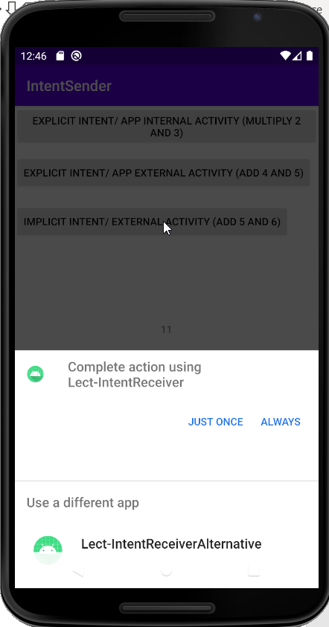
Implicit Intent for external Activity
val invokeImplicitButton = findViewById<View>(R.id.invokeimp) as Button invokeImplicitButton.setOnClickListener { val i = Intent() i.action = "mko.intentsender.add" i.putExtra("i1", 5) i.putExtra("i2", 6) resultLauncher.launch(i)
} }
<?xml version="1.0" encoding="utf-8"?> <manifest xmlns:android="http://schemas.android.com/apk/res/android" package="android.cs.stir.ac.uk.lect_intentreceiver"> <application>
… <activity android:name=".ExtIntentReceiver"> <intent-filter> <action android:name="android.intent.action.MAIN" /> <category android:name="android.intent.category.LAUNCHER" /> </intent-filter> <intent-filter> <action android:name="mko.intentsender.add"/> <category android:name="android.intent.category.DEFAULT"/> </intent-filter> </activity> </application> </manifest>

Slide 8
Issues with Intents
To ensure that your app is secure:
Always use an explicit intent when starting a Service
Do not declare intent filters for your services
Using an implicit intent to start a service is a security hazard because you can't be certain what service will respond to the intent, and the user can't see which service starts.
It's possible that a user won't have any apps that handle the implicit intent you send to startActivity().
In that case the call fails and your app crashes.
To verify that an activity will receive the intent, call resolveActivity() on your Intent object.
If result is non-null, at least one app that can handle the intent. Can call startActivity()
If the result is null, don’t use the intent. If possible, disable the app feature issuing the intent.
if (sendIntent.resolveActivity(packageManager) != null) {
startActivity(sendIntent)
}
If multiple apps can respond to the intent and the user might want to use a different app each time, you should explicitly show a chooser dialog.
val chooser: Intent = Intent.createChooser(sendIntent, title)
if (sendIntent.resolveActivity(packageManager) != null) {
startActivity(chooser)
}

