Slide 1
Boost Metaprogramming Concepts & Frameworks
BoostCon 2007 Edition
Dave Abrahams, Boost Consulting

Slide 2
Agenda
The What, Why, and How
Tour of Boost Metaprogramming Library (MPL)
Using MPL for Dimensional Analysis
Expression Templates
Building Finite State Machines
Tuple Metaprogramming
Preprocessor Metaprogramming
Notes:
Update

Slide 3
Hidden Agenda
Functional Programming
The Role of Polymorphism
Type Systems
Domain Specific Languages (DSLs)
Embedded DSLs

Slide 4

“Meta:”
A prefix meaning one level of description higher. If X is some concept then meta-X is data about, or processes operating on, X.
For example, a metasyntax is syntax for specifying syntax, metalanguage is a language used to discuss language, meta-data is data about data, and meta-reasoning is reasoning about reasoning.
Source: The Free On-line Dictionary of Computing, © 1993-2004 Denis Howe
This is difficult to explain briefly, but much hacker humour turns on deliberate confusion between meta-levels.
Notes:
Ask what some examples are: C++ compiler, lex, YACC.

Slide 5
Metaprogram: Our Definition
Code that explicitly manipulates or generates program elements such as:
  Functions
  Types
  Classes
  Variables
  Constants
  etc.
For example?
Notes:
What’s the point? Abstraction
For example? YACC

Slide 6
Basic Concepts
Domain: Parsing/translation
Domain Abstractions: terminals, nonterminals, parse rules, semantic actions
Domain Language:
  Syntax (Yacc input syntax + `C’ fragments)
  Semantics (The generated parser)
Metaprogram Data: Yacc’s internal representation of those abstractions

Slide 7
Parsing Domain Language (BNF)
expression ➔ term
expression ➔ expression '+' term
expression ➔ expression '-' term
term ➔ factor
| term '*' factor
| term '/' factor
factor ➔ INTEGER
| group
group ➔ '(' expression ')'
3 + 4 / 5
expression
expression
+
term
term
term
/
factor
factor
factor
5
3
4

Slide 8
YACC Domain Language (BNF)
expression : term
| expression '+' term { $$ = $1 + $3; }
| expression '-' term { $$ = $1 - $3; };
term : factor
| term '*' factor { $$ = $1 * $3; }
| term '/' factor { $$ = $1 / $3; };
factor : INTEGER
| group;
group : '(' expression ')';

Slide 9
YACC Target Language (C)
const short yylhs[] = {
-1,
2, 0, 0, 3, 3, 4, 5, 5, 5, 1,
1, 1,
};
const short yylen[] = {
2,
0, 4, 0, 1, 1, 3, 1, 3, 3, 1,
3, 3,
};
const short yydefred[] = { ... };
const short yydgoto[] = { ... };
const short yysindex[] = { ... };
const short yyrindex[] = { ... };
const short yygindex[] = { ... };
...
yym = yylen[yyn];
yyval = yyvsp[1-yym];
switch (yyn)
{
case 1:
{ std::printf("= %d\n", yyvsp[0]); std::fflush(stdout); }
break;
case 8:
{ yyval = yyvsp[-2] * yyvsp[0]; }
break;
case 9:
{ yyval = yyvsp[-2] / yyvsp[0]; }
break;
case 11:
{ yyval = yyvsp[-2] + yyvsp[0]; }
break;
case 12:
{ yyval = yyvsp[-2] - yyvsp[0]; }
break;
}
yyssp -= yym;
...

Slide 10
Template Metaprogramming
No Target Language
Data: potential template arguments
Domain Languages: subsets of native C++
Downside: users constrained by C++ syntax
Upside:
  No hard boundary between metaprograms and “ordinary code”
  Single Translation Step
  Deep manipulation of native program elements.

Slide 11
Embedded Metaprogramming
spirit::rule<> expr, term, factor, integer;
integer = !ch_lit('-') >> +digit;
factor = integer
| '(' >> expr >> ')'
| '-' >> factor;
term = factor >> * ( '*' >> factor | '/' >> factor );
expr = term >> * ( '+' >> term | '-' >> term );
integer → '-'? digit+
factor → integer
| '(' expr ')'
| '-' factor
term → factor ( '*' factor | '/' factor )*
expr → term ( '+' term | '-' term )*
Notes:
Some concessions to C++ syntax...
Advantages of this approach:
1. No runtime spent compiling/interpreting the expression
2. Syntax errors in grammar caught at compile-time
3. Grammars are bigger than regexes, and big strings are hard to manage
Doesn’t handle the evaluation of expressions; I’ll show you that in a minute.

Slide 12
Compile-Time Computation
binary<1101>::value ➔ 13
template <unsigned long N>
struct binary
{
static unsigned const value
= N%10
+ 2 * binary<N/10>::value;
};
template <>
struct binary<0>
{
static unsigned const value
= 0;
};
binary<1101>::value =
1 + 2 * binary<110>::value
binary<110>::value =
0 + 2 * binary<11>::value
binary<11>::value =
1 + 2 * binary<1>::value
binary<11>::value =
1 + 2 * binary<0>::value
binary<0>::value
= 13
= 6
= 3
= 1
= 0

Slide 13
Why Metaprogramming?
Why not runtime computation?
    int binary(unsigned long n)
    {
    return n ? n%10 + binary(n/10) * 2 : 0;
    }
  Metaprogram is faster at runtime
  Metaprogram interacts deeply with host language
Why not user analysis?
    long odd_bits = binary<1010101>::value;
    long even_bits = 0xAA;
  Metaprogram is more convenient
  Metaprogram is more reliable
  Metaprogram brings us closer to the domain abstraction
(duh)

Slide 14
It Takes Some Effort
Metaprogramming is for Lovers
Library Authors

Slide 15
Boost Metaprogramming Concepts & Frameworks
The Boost Metaprogramming Library: A Whirlwind Tour

Slide 16

Aleksey Gurtovoy (in the hat)

Slide 17
Why a TMP Library?
Simplify complicated template system
Hide low-level hacks
Smooth over implementation differences
Readability: reduce the syntactic burden
Conceptual integrity: like STL, the concepts and idioms shape the way we program.
Fun: high-level programming is more productive than using template “assembly language”

Slide 18
MPL Metafunction Concept
A class template
Operating on types only
Single return “value” (i.e. a type)
Called ::type
template <class A₁, class A₂, ...A_{n}>
struct identifier
{
typedef type-expression type;
};
If ::value appears, it’s purely optional.
Notes:
Template instantiation is the unit of computation

Slide 19
Metadata Polymorphism?
template <int N>
template <void(&f)(long)>
template <void(*pf)(long)>
template <int& rx>
template <int* px>
template <int (pair<int,int>::*pm)>
template <template <class,class> class C>
template <class T>
struct foo {};
int obj;
void f(long);
foo<char*> // OK
foo<1> // integral constant
foo<f> // function reference
foo<&f> // function pointer
foo<obj> // object reference
foo<&obj> // object pointer
foo<&pair<int,int>::first> // pointer to data member
foo<std::vector> // class template

Slide 20
Metadata Polymorphism
Solution: turn everything into a type with some kind of wrapper:
template <class T, T x>
struct wrap
{};
Works for almost everything…
wrap<int,5> // OK
wrap< // Also OK
int std::pair<int,int>::*
, &std::pair<int,int>::first >
{};
…except?

Slide 21
MPL Integral Constant Wrappers
template <class T, T n>
struct integral_c
{
typedef T value_type;
static T const value = n;
typedef integral_c<T,n> type; // self
operator T() const { return n; }
};
template <int n>
struct int_ : integral_c<int,n> {};
template <bool x>
struct bool_ : integral_c<bool,x> {};
...
Notes:
Note that int_<3> is a nullary metafunction

Slide 22
Type Logic
typedef bool_<true> true_;
typedef bool_<false> false_;
template <
class C, class T, class F
>
struct if_;
template <class T, class F>
struct if_<true_,T,F>
{
typedef T type;
};
template <class T, class F>
struct if_<false_,T,F>
{
typedef F type;
};

Slide 23
Type Sequences
typedef mpl::vector<int*,long,char[4]> v1;
typedef mpl::deref<
mpl::begin<v1>::type // MPL iterators
>::type pointer_to_int; // *v1.begin()
typedef mpl::at<v1, mpl::int_<2> >::type
four_chars;
typedef mpl::list<int*, long, char[4]> l1;
typedef mpl::set<int*, long, char[4]> s1;

Slide 24
Algorithms
template<class Iter, class T> // STL
void replace(Iter first, Iter last, T const& old, T const& new);
template<class Sequence, class OldType, class NewType…> // MPL
struct replace;
template<class InIter, class OutIter, class UnaryOp> // STL
OutIter transform(InIter first, InIter last, OutIter result, UnaryOp op);
template <class Sequence, class UnaryOp…> // MPL
struct transform;
template <class Iter, class T, class BinaryOp> // STL
T accumulate(Iter first, Iter last, T init, BinaryOp binary_op);
template<class Sequence, class Init, class BinaryOp> // MPL
struct fold; // a.k.a. accumulate

Slide 25
Lazy Logic
    struct dumb_add_ptr<class T>
    { typedef T* type; };
    template <class T>
    struct smart_add_ptr
    : mpl::if_<
    is_reference<T>
    , T
    , dumb_add_ptr<T>::type
    > {};
    typedef smart_add_ptr<int&>::type oops;
template <class T>
struct smart_add_ptr
: mpl::eval_if<
is_reference<T>
, mpl::identity<T>
, dumb_add_ptr<T>
> {};
ok;
Notes:
Note NULLARY METAFUNCTION

Slide 26
Views / Lazy Sequences
template <class Sequence, class UnaryOp>
struct transform_view;
template <class Sequence, class Predicate>
struct filter_view;
template <class SequenceOfSequences>
struct zip_view;
template <class T, T Start, T Finish>
struct range_c;

Slide 27

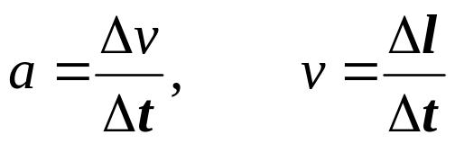
Example: Dimensional Analysis
Computation with units (typechecking for scientists)
Newtons Law:
  Breakdown:
  Units of v: l ∕ t e.g. miles per hour
  Units of a: (l ∕ t) ∕ t = l ∕ t² e.g. feet per sec. squared
  Units of F: ml ∕ t² e.g. kg m/s²

Slide 28
The Challenge
Addition/Subtraction
boring – can’t combine different units
f(m + l); // error!
Multiplication/Division
interesting – produces new types
f(m * l); // OK – a type representing ml
Challenge: compute the new type

Slide 29
MPL Integral Sequence Wrapper
Convenient shorthand for type sequence of integral constant wrappers
mpl::list_c<int, i₁, i₂, …i_{n}>
≈ mpl::list<
mpl::int_<i₁>, mpl::int_<i₁>
, ...mpl::int_<i_{n}>
>

Slide 30
Representing Units
typedef list_c<int,1,0,0,0,0,0,0> mass;
typedef list_c<int,0,1,0,0,0,0,0> length;
typedef list_c<int,0,0,1,0,0,0,0> time;
typedef list_c<int,0,0,0,1,0,0,0> charge;
typedef list_c<int,0,0,0,0,1,0,0> temperature;
typedef list_c<int,0,0,0,0,0,1,0> intensity;
typedef list_c<int,0,0,0,0,0,0,1> amount_of_substance;
typedef list_c<int,0,0,0,0,0,0,0> scalar; // e.g. pi
typedef list_c<int,0,1,-2,0,0,0,0> acceleration;

Slide 31
Representing Quantities
Bind metadata to a runtime value
template <class T, class Units>
class quantity
{
public:
explicit quantity(T x)
: m_value(x) {}
T value() const
{ return m_value; }
private:
T m_value;
};
quantity<float, time> t(99.7);

Slide 32
Addition/Subtraction
Just combine “like quantities”
  template <class T, class U>
  quantity<T,U>
  operator+(quantity<T,U> x, quantity<T,U> y)
  {
  return quantity<T,U>(x.value() + y.value());
  }
  template <class T, class U>
  quantity<T,U>
  operator-(quantity<T,U> x, quantity<T,U> y)
  {
  return quantity<T,U>(x.value() - y.value());
  }

Slide 33
Multiplication/Division
Must compute return units
  template <class T, class U1, class U2>
quantity<T, ?? >
operator*( quantity<T,U1> x, quantity<T,U2> y );
  template <class T, class U1, class U2>
quantity<T, ?? >
operator/( quantity<T,U1> x, quantity<T,U2> y );
Add/subtract corresponding powers:
a = v ∕t = (l ∕t ) ∕ t
= l¹ ∙ t⁻¹ ∙ t⁻¹ = l¹ ∙ t⁻²

Slide 34
Multiplication/Division
Use MPL’s transform algorithm:
template <class Seq1, class Seq2, class BinaryOp>
struct transform; → Result Sequence
Similar to STL transform:
template <
class InIter1, class InIter2,
class OutIter, class BinaryOp
>
void transform(
InIter1 start1, InIter1 finish1, InIter2 start2
, OutIter, BinaryOp
)

Slide 35
What is the BinaryOp?
MPL gives us plus/minus
mpl::plus<mpl::int_<2>, mpl::int_<3> >::type
➔ mpl::int_<5>
mpl::minus<mpl::int_<2>, mpl::int_<3> >::type
➔ mpl::int_<-1>
Are we done now?
template <class T, class U1, class U2>
quantity<
T
, typename mpl::transform<U1,U2,mpl::plus>::type
>
operator*(quantity<T,U1> x, quantity<T,U2> y);
Templates are not polymorphic metadata (types)!
ERROR

Slide 36
Metafunction Classes
Applying familiar type-wrapper idiom:
  struct plus_f
  {
  template <class T1, class T2> // nested metafunction
  struct apply
  {
  typedef typename mpl::plus<T1,T2>::type type;
  };
  };
  template <class T, class U1, class U2>
  quantity<
  T, typename mpl::transform<U1,U2,plus_f>::type // OK
  >
  operator*(quantity<T,U1> x, quantity<T,U2> y);
Definition: MPL Metafunction Class
  a class with a nested metafunction named “apply”

Slide 37
Division – 3 Simplifications
#1: “Metafunction Forwarding”
  struct minus_f
  {
  template <class T1, class T2>
  struct apply : mpl::minus<T1,T2> {};
  };
Replaces
  typedef typename … ::type type;
  with:
  :
Powerful syntactic trick; use it often…
but wrapping metafunctions still boring (no fun)

Slide 38
Simplification #2: Placeholders
  template <class T, class U1, class U2>
  quantity<
  T
  , typename mpl::transform<
  U1,U2,mpl::minus<_1,_2>
  >::type
  >
  operator/(quantity<T,U1> x, quantity<T,U2> y)
  {
  return quantity<
  T
  , typename mpl::transform<
  U1,U2,mpl::minus<_1,_2>
  >::type
  >(
  x.value() / y.value()
  );
  }
Not boring! Fun!

Slide 39
Simplification #3: Refactoring
  template <class U1, class U2>
  divide_units
  : mpl::transform<U1,U2,mpl::minus<_1,_2> >
  {};
  template <class T, class U1, class U2>
  quantity<T, typename divide_units<U1,U2>::type>
  operator/(quantity<T,U1> x, quantity<T,U2> y)
  {
  return quantity<
  T, typename divide_units<U1,U2>::type
  >(
  x.value() / y.value()
  );
  }

Slide 40
Higher-Order (Meta)Functions
Functions which operate on or return other functions, e.g. transform
“Higher-order functional programming”
– Fancy title for a simple concept
…but well-earned!
Possible because metafunctions are polymorphic

Slide 41
Writing a Higher-Order Metafunction
The Task:
twice(f,x) := f ( f (x))
Implementation for metafunction class F:
  template <class F, class X>
  struct twice
  {
  private:
  typedef typename F::template apply<X>::type once;
  public:
  typedef
  typename F::template apply<once>::type
  type;
  };

Slide 42
Writing a Higher-Order Metafunction
Simplified using forwarding:
  template <class F, class X>
  struct twice
  : F::template apply<
  typename F::template apply<X>::type
  >
  {};
Refactored:
  template <class UnaryMFC, class Arg>
  struct apply1
  : UnaryMFC::template apply<Arg>
  {};
  template <class F, class X>
  struct twice
  : apply1<F, typename apply1<F,X>::type>
  {};

Slide 43
Handling Placeholders
Add a number to itself twice
  template <class X>
  struct times4
  : twice< mpl::plus<_1,_1>, X > {};
  typedef times4<int_<4> >::type sixteen; // error!
Why doesn’t it work?
  template <class T1, class T2>
  struct plus
  {
  typedef ... type;
  };
No nested apply<…> – not a metafunction class

Slide 44
The Lambda Metafunction
plus<_1,_1> is called a “lambda expression”
lambda<lambda-expr>::type ➔ Metafunction Class
  template <class X>
  struct times4
  : twice<
  typename mpl::lambda<
  mpl::plus<_1,_1>
  >::type, X
  >
  {};
Note: lambda<…> passes metafunction classes through untouched

Slide 45
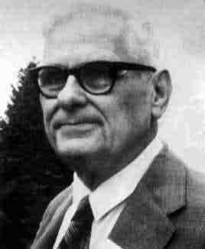
The Lambda Calculus
Branch of mathematical logic
Deals with the application of functions to their arguments
Developed in the late ’30s and early ’40s, by…
Alonzo Church
Notes:
Russell’s paradox: Bertrand Russell (1872-1970). If R is the set of all sets which don't contain themselves, does R contain itself? If it does then it doesn't and vice versa

Slide 46
Internal Lambda
MPL algorithms apply lambda so you don’t have to
MPL’s flexible version of apply1:
  template <class UnaryOp, class Arg>
  struct apply1
  : lambda<UnaryOp>::type
  ::template apply<Arg>
  {};
mpl::apply<F, A1, A2, …An> is the n-ary version
To handle both lambda expressions and metafunction classes as arguments, invoke them with applyN or apply

Slide 47
The Power of Lambda
Transform binary → unary metafunction
    mpl::plus<_1,_1>
Also via currying (arg. binding)
    mpl::plus<_1, mpl::int_<42> >
Functional Composition:
    mpl::times<
    mpl::plus<_1,_2>
    , mpl::minus<_1,_2>
    >

Slide 48
Boost Metaprogramming Concepts & Frameworks
Building a Domain-Specific Embedded Language (DSEL)

Slide 49
Finite State Machines (FSMs)
Uses:
  Embedded system controllers
  Parsing (YACC parsers are stacks of FSMs)
  Pattern Matching
  Hardware Verification
  Natural Language Processing
  Any other stateful process
Not Turing Complete
Maybe that’s a good thing?

Slide 50
1) Understand Domain Abstraction
States e.g. locked, unlocked, ready
Transitions define legal paths from state to state, often with an associated action.
Events trigger transitions, e.g. coin-inserted, tokens (in a parser). May be internally-generated.

Slide 51
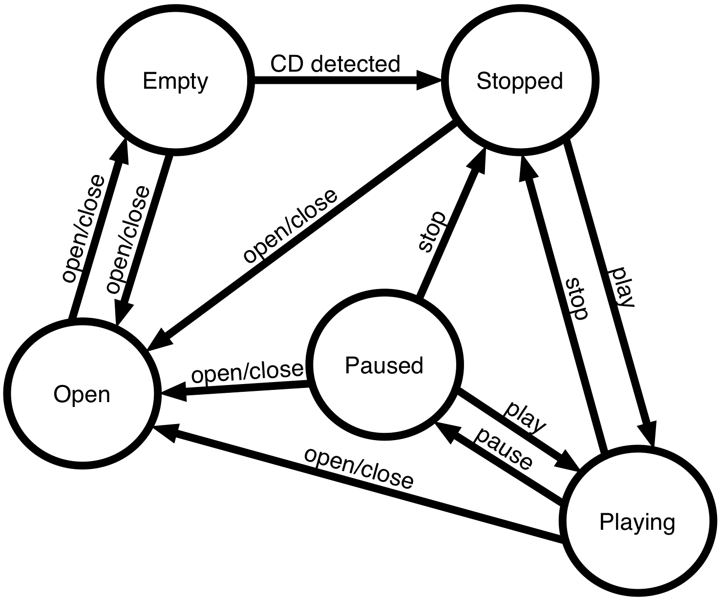
2) Review Standard Notations
Simple CD Player

Slide 52
State Transition Table (STT)
Current State | Event | Next State | Transition Action
Stopped | play | Playing | start playback
Stopped | open/close | Open | open drawer
Open | open/close | Empty | close drawer; collect CD information
Empty | open/close | Open | open drawer
Empty | cd detected | Stopped | store CD information
Playing | stop | Stopped | stop playback
Playing | pause | Paused | pause playback
Playing | open/close | Open | stop playback; open drawer
Paused | play | Playing | resume playback
Paused | stop | Stopped | stop playback
Paused | open/close | Open | stop playback; open drawer

Slide 53
3) Choose an Embedded Notation
// start event finish action
fsm [ stopped, play, playing, start_playback ]
[ playing, pause, paused, pause_playback ]…
fsm [ stopped | play | playing | start_playback ]
[ playing | pause | paused | pause_playback ]…
fsm= +---------+--------------+---------+----------------+
! stopped | on<play>() | playing | start_playback |
+---------+--------------+---------+----------------+
! playing | on<pause>() | paused | pause_playback |
+---------+--------------+---------+----------------+
…end;
// +---------+-------+---------+--------------------+
row< stopped , play , playing , &p::start_playback >,
// +---------+-------+---------+--------------------+
row< playing , pause , paused , &p::pause_playback >
// +---------+-------+---------+--------------------+
Notes:
rows in a mpl::vector

Slide 54
4) Consider Usage of Product
int main()
{
player p; // FSM object
p.process_event(drawer()); // user opens CD player
p.process_event(drawer()); // inserts CD and closes
p.process_event( // CD is detected
cd_detected(
"louie, louie"
, std::vector<std::clock_t>( …track lengths… )
)
);
p.process_event(play()); // etc.
}

Slide 55
Nail Down Representation of Events
struct play {};
struct open_close {};
struct pause {};
struct cd_detected
{
cd_detected(
std::string name,
std::vector<std::clock_t> const& track_lengths
)
: name(name), track_lengths(track_lengths)
{}
std::string name;
std::vector<std::clock_t> track_lengths
};

Slide 56
FSM Declaration
class player // Curiously Recurring Template Pattern
: public state_machine<player>
{
friend class state_machine<player>;
enum states { Empty, Open, Stopped, Playing, Paused,
initial_state = Empty };
void start_playback(play const&); // transition actions
void open_drawer(drawer const&);
void close_drawer(drawer const&);
void store_cd_info(cd_detected const&);
void stop_playback(stop const&);
void pause_playback(pause const&);
void resume_playback(play const&);
void stop_and_open(drawer const&);
typedef mpl::vector11<…STT goes here…> transition_table;
};

Slide 57
FSM and its use (whole enchilada)
class player : public state_machine<player> // player.hpp
{
private:
// the list of FSM states
enum states {
Empty, Open, Stopped, Playing, Paused
, initial_state = Empty
};
void start_playback(play const&);
void open_drawer(open_close const&);
void close_drawer(open_close const&);
void store_cd_info(cd_detected const&);
void stop_playback(stop const&);
void pause_playback(pause const&);
void resume_playback(play const&);
void stop_and_open(open_close const&);
friend class state_machine<player>;
typedef player p; // makes transition table cleaner
// transition table
struct transition_table : mpl::vector11<
// Start Event Next Action
// +---------+-------------+---------+---------------------+
row < Stopped , play , Playing , &p::start_playback >,
row < Stopped , open_close , Open , &p::open_drawer >,
// +---------+-------------+---------+---------------------+
row < Open , open_close , Empty , &p::close_drawer >,
// +---------+-------------+---------+---------------------+
row < Empty , open_close , Open , &p::open_drawer >,
row < Empty , cd_detected , Stopped , &p::store_cd_info >,
// +---------+-------------+---------+---------------------+
row < Playing , stop , Stopped , &p::stop_playback >,
row < Playing , pause , Paused , &p::pause_playback >,
row < Playing , open_close , Open , &p::stop_and_open >,
// +---------+-------------+---------+---------------------+
row < Paused , play , Playing , &p::resume_playback >,
row < Paused , stop , Stopped , &p::stop_playback >,
row < Paused , open_close , Open , &p::stop_and_open >
// +---------+-------------+---------+---------------------+
> {};
};
// player.cpp
void player::start_playback(play const&){}
void player::open_drawer(open_close const&){}
void player::close_drawer(open_close const&){}
void player::store_cd_info(cd_detected const&){}
void player::stop_playback(stop const&){}
void player::pause_playback(pause const&){}
void player::resume_playback(play const&){}
void player::stop_and_open(open_close const&){}
// main.cpp
int main()
{
player p;
p.process_event(open_close()); // user opens CD player
p.process_event(open_close()); // inserts CD and closes
p.process_event( // CD is detected
cd_detected(
"louie, louie"
, std::vector<std::clock_t>( /* track lengths */ )
)
);
p.process_event(play()); // etc.
p.process_event(pause());
p.process_event(play());
p.process_event(stop());
return 0;
}

Slide 58
5) Implementing the Framework
i.e., we need to define the state_machine<…> class template
Note that the definition of our FSM, player, contains no details about how the state machine is implemented
We can choose among various implementation strategies.

Slide 59
Curiously Recurring Template Pattern
template <class FSM>
struct state_machine
{
template <
int FromState, class Event, int ToState
, void (FSM::*action)(Event const&) >
struct row
{
static int const from_state = FromState;
static int const to_state = ToState;
typedef Event event;
typedef FSM fsm_t;
static void execute(FSM& fsm, Event const& e)
{ (fsm.*action)(e); }
};
class FSM,
};

Slide 60
Dispatching Events (By Hand)
template <class FSM>
void state_machine<FSM>::process_event(play const& e)
{
switch (this->state)
{
case Stopped:
this->start_playback(e);
this->m_state = playing;
break;
case Paused:
this->resume_playback(e);
this->m_state = playing;
break;
default:
this->no_transition(e);
}
}

Slide 61

Breakdown for Code Generation
void process_event(play const& e)
{
this->state = case_Stopped(e);
}
int case_Stopped(play const& e)
{
if (this->state == Stopped)
{
this->start_playback(e);
return Playing;
}
else
{
return this->case_Paused(e);
}
}
int case_default(play const& e)
{
return this->no_transition(
this->state, e);
}
int case_Paused(play const& e)
{
if (this->state == Paused)
{
this->resume_playback(e);
return Playing;
}
else
{
return this->case_default(e);
}
}

Slide 62
Generating the Dispatch Functions
int
case_Stopped(play const& e)
{
if (this->state == Stopped)
{
this->start_playback(e);
return Playing;
}
else
{
return
this->case_Paused(e);
}
}
template <int State, class E>
int case_(E const& e)
{
if (fsm.state == State)
{
this->??????(e);
return ?????;
}
else
{
return
this->case_<???>(e);
}
}

Slide 63
Generating the Dispatch Functions
Row, class Next>
template<class
struct event_dispatcher
{
typedef typename Row::fsm_t fsm_t;
typedef typename Row::event event;
static int dispatch(fsm_t& fsm, int state, event const& e)
{
if (state == Row::from_state)
{
Row::execute(fsm, e);
return Row::to_state;
}
else
}
};
Row>
Next::dispatch(fsm, state, e);
????;

Slide 64
“No Transition” Handler
struct default_event_dispatcher
{
template<class FSM, class Event>
static int dispatch(FSM& m, int state, Event const& e)
{
return m.call_no_transition(state, e);
}
};
template <class FSM>
class state_machine
{
template <class Event>
int call_no_transition(int state, Event const& e)
{
return static_cast<FSM*>(this)->no_transition(state, e);
}

Slide 65
Must Assemble This Dispatcher Type
typedef player p;
event_dispatcher<
row<Stopped, play, Playing, &p::start_playback>,
event_dispatcher<
row<Paused, play, Playing, &p::resume_playback>,
default_event_dispatcher
>
>

Slide 66
Generating the Dispatcher
template <class Row, class Event>
struct has_event
: boost::is_same<typename Row::event, Event>
{};
template<class RowSequence, class Event>
struct generate_dispatcher
: mpl::accumulate< // a.k.a. fold
// Select all rows with transitions on Event
mpl::filter_view<RowSequence, has_event<_1,Event> >,
// Terminating case
default_event_dispatcher,
// Accumulator
event_dispatcher<_2,_1>
>
{};

Slide 67
Finally, the Event Processor
template<class Event>
int process_event(Event const& event)
{
typedef typename generate_dispatcher<
typename FSM::transition_table, Event
>::type dispatcher;
this->state = dispatcher::dispatch(
static_cast<FSM&>(*this),
this->state,
event
);
return this->state;
}

Slide 68
Final Details of state_machine<>
public:
template <class Event>
int no_transition(int state, Event const& e)
{
assert(false);
return state;
}
protected:
state_machine()
: state(FSM::initial_state)
{}
private:
int state;

Slide 69
What Have We Achieved?
As expressive as custom (text-based) state machine compiler
Better scalability, maintainability, type safety, expressiveness, and efficiency than State pattern.
Efficiency comparable to hand-coded FSM
Fully Declarative: procedural logic fully replaceable

Slide 70
Boost Metaprogramming Concepts & Frameworks
Other Metaprogramming Paradigms in C++

Slide 71
Tuple – The Quantum Sequence
  typedef boost::tuple<
  int, char const*, bool
  > t;
  t s(3, “hello”, true);
heterogeneous sequence of values (wave):
  3, “hello”, true
also a sequence of types (particle):
  int, char const*, bool

Slide 72
Fusion/MPL Interoperability
Every fusion tuple is a valid MPL sequence
fusion::as_vector(mpl-sequence-type()) ➔ tuple

Slide 73
Fusion: Tuple Metaprogramming
Primitives:
  begin(s), end(s) ➔ iterators
  next(p), prior(q) ➔ adjacent iterators
  Some standard STL iterator operations:
  *p p == q p != q
Algorithms:
  for_each(s, unary_function) ➔ void
  transform(s, unary_function) ➔ transform_view
  push_back(s, value) ➔ ??
  fold(s, init, binary_function) ➔ ??

Slide 74
Why Fusion Algorithms Yield Views
fusion::tuple<std::string, std::string> x( “hello”, “world” );
fusion::for_each(
fusion::push_back(
fusion::push_back(
fusion::push_back(x, 1)
, std::vector<int>(5)
)
, 12
)
, some_function
);
⬅ copy two strings, one int, one vector?
⬅ copy two strings, one int?
⬅ copy two strings?

Slide 75
How to Get a Real Tuple
fusion::tuple<std::string, std::string> x( “hello”, “world” );
fusion::as_vector(
fusion::push_back(
fusion::push_back(
fusion::push_back(x, 1)
, std::vector<int>(5)
)
, 12
)
)

Slide 76
Example: zip_iterator<IterTuple>
Stores a tuple of iterators into different sequences
Traverses the sequences in parallel
operator* yields a tuple of references
"foo"
"bar"
"baz"
"cat"
"hat"
"dad"
"dad"
29
0.125
3
4
7
11
18
29
++
*
3.14
2.73
0.0
0.5
0.25
0.125

Slide 77
Why zip_iterator?
Consider std::transform:
std::transform(start, finish, result, op);
std::transform(start, finish, start2, result, op);
std::transform(start, finish, start2, start3, result, op);
std::transform(start, finish, start2, start3, start4, result, op);
std::transform(start, finish, start2, start3, start4, start5, result, op);
std::transform(start, finish, start2, start3, start4, start5, start6, result, op);
std::transform(start, finish, start2, start3, start4, start5, start6, start7, result, op);
std::transform(start, finish, start2, start3, start4, start5, start6, start7, start8, result, op);
At some point, you want to generalize back to:
std::transform(zip_start, zip_finish, result, op);

Slide 78
From zip_iterator’s Implementation
struct increment
{
template<typename T>
void operator()(T& x) const
{ ++x; }
};
template <class IteratorTuple>
zip_iterator<IteratorTuple>::operator++()
{
fusion::for_each(this->m_iterators, increment());
};

Slide 79
From zip_iterator’s Implementation
template <class IteratorTuple>
zip_iterator<IteratorTuple>::operator++()
{
using namespace boost::lambda;
fusion::for_each( this->m_iterators, ++_1 );
};

Slide 80
Implementing Dereference
struct deref
{
// return type computation
template<typename Iterator>
struct result
{
typedef typename
std::iterator_traits<
Iterator
>::reference type;
};
// runtime function call
template<typename Iter>
typename result<Iter>::type
operator()(Iter const& it)
const
{ return *it; }
};
template <class IteratorTuple>
struct zip_iterator
{
typedef typename
mpl::transform<
IteratorTuple
, deref::apply<mpl::_1>
>::type reference;
reference operator*() const
{
return fusion::transform(
this->m_iterators
, deref()
);
}
…
IteratorTuple m_iterators;
};

Slide 81
Fusion Tuple Metaprogramming
Merges pure type manipulation and runtime computation
Makes manipulation of heterogeneous collections easy
Interoperates seamlessly with MPL
A floor wax and a dessert topping.

Slide 82
Preprocessor Metaprogramming
The preprocessor is a text generator
#define FOO(x) foo x
FOO(bar) ➔ foo bar
You can program it
What if you use it to generate C++ program text?

Slide 83
Preprocessor Abstractions
preprocessing token
2 kinds of macros
  object-like: #define X y
  function-like #define FOO(x) foo x
macro argument
  Sequence of preprocessing tokens
  All parens are balanced
  No commas outside of parens

Slide 84
Problem: Generate Overload Set
tuple<> make_tuple()
{ return tuple<>(); }
template <class A0>
tuple<A0> make_tuple(A0 x0)
{ return tuple<A0>(x0); }
template <class A0, class A1>
tuple<A0,A1> make_tuple(A0 x0, A1 x1)
{ return tuple<A0,A1>(x0,x1); }
template <class A0, class A1, class A3>
tuple<A0,A1> make_tuple(A0 x0, A1 x1, A3 x3)
{ return tuple<A0,A1,A3>(x0,x1,x3); }
template <class A0, class A1, class A3, class A4>
tuple<A0,A1> make_tuple(A0 x0, A1 x1, A3 x3, A4 x4)
{ return tuple<A0,A1,A3,A4>(x0,x1,x3,x4); }
…

Slide 85
Boost.Preprocessor Solution
tuple<> make_tuple()
{ return tuple<>(); }
#define FUSION_make_tuple(z, n, unused) \
template < BOOST_PP_ENUM_PARAMS(n, class A) > \
tuple< BOOST_PP_ENUM_PARAMS(n, A) > \
make_tuple( BOOST_PP_ENUM_BINARY_PARAMS(n, A, x ) ) \
{ \
return tuple< BOOST_PP_ENUM_PARAMS(n, A) >( \
BOOST_PP_ENUM_PARAMS(n, x) \
); \
}
BOOST_PP_REPEAT_FROM_TO(
1, FUSION_MAX_SIZE, FUSION_make_tuple, ~)
#undef FUSION_make_tuple
Notes:
Step through expansion for n == 4

Slide 86
Boost.Preprocessor Solution
tuple<> make_tuple()
{ return tuple<>(); }
#define FUSION_make_tuple(z, n, unused) \
template < class A0, class A1, class A2, class A3 > \
tuple< BOOST_PP_ENUM_PARAMS(n, A) > \
make_tuple( BOOST_PP_ENUM_BINARY_PARAMS(n, A, x ) ) \
{ \
return tuple< BOOST_PP_ENUM_PARAMS(n, A) >( \
BOOST_PP_ENUM_PARAMS(n, x) \
); \
}
BOOST_PP_REPEAT_FROM_TO(
1, FUSION_MAX_SIZE, FUSION_make_tuple, ~)
#undef FUSION_make_tuple
Notes:
Step through expansion for n == 4

Slide 87
Boost.Preprocessor Solution
tuple<> make_tuple()
{ return tuple<>(); }
#define FUSION_make_tuple(z, n, unused) \
template < class A0, class A1, class A2, class A3 > \
tuple< A0, A1, A2, A3 > \
make_tuple( BOOST_PP_ENUM_BINARY_PARAMS(n, A, x ) ) \
{ \
return tuple< BOOST_PP_ENUM_PARAMS(n, A) >( \
BOOST_PP_ENUM_PARAMS(n, x) \
); \
}
BOOST_PP_REPEAT_FROM_TO(
1, FUSION_MAX_SIZE, FUSION_make_tuple, ~)
#undef FUSION_make_tuple
Notes:
Step through expansion for n == 4

Slide 88
Boost.Preprocessor Solution
tuple<> make_tuple()
{ return tuple<>(); }
#define FUSION_make_tuple(z, n, unused) \
template < class A0, class A1, class A2, class A3 > \
tuple< A0, A1, A2, A3 > \
make_tuple( A0 x0, A1 x1, A2 x2, A3 x3 ) \
{ \
return tuple< BOOST_PP_ENUM_PARAMS(n, A) >( \
BOOST_PP_ENUM_PARAMS(n, x) \
); \
}
BOOST_PP_REPEAT_FROM_TO(
1, FUSION_MAX_SIZE, FUSION_make_tuple, ~)
#undef FUSION_make_tuple
Notes:
Step through expansion for n == 4

Slide 89
Boost.Preprocessor Solution
tuple<> make_tuple()
{ return tuple<>(); }
#define FUSION_make_tuple(z, n, unused) \
template < class A0, class A1, class A2, class A3 > \
tuple< A0, A1, A2, A3 > \
make_tuple( A0 x0, A1 x1, A2 x2, A3 x3 ) \
{ \
return tuple< A0, A1, A2, A3 >( \
x0, x1, x2, x3 \
); \
}
BOOST_PP_REPEAT_FROM_TO(
1, FUSION_MAX_SIZE, FUSION_make_tuple, ~)
#undef FUSION_make_tuple
Notes:
Step through expansion for n == 4

Slide 90
What About Debuggability?
A macro expansion never contains line breaks – “horizontal repetition”
All make_tuple overloads ultimately generated by a single BOOST_PP_REPEAT
Resulting code all generated on that line
  template <class A0> tuple<A0> make_tuple(A0 x0) { return tuple<A0>(x0); } template <class A0, class A1> …
Stepping through make_tuple in debugger
  BOOST_PP_REPEAT_FROM_TO(
  1, FUSION_MAX_SIZE, FUSION_make_tuple, ~)

Slide 91
Vertical Repetition
#ifndef FUSION_MAKE_TUPLE_HPP // #include guard
# define FUSION_MAKE_TUPLE_HPP
tuple<> make_tuple() { return tuple<>(); }
#define BOOST_PP_ITERATION_LIMITS ( 1, FUSION_MAX_SIZE – 1)
#define BOOST_PP_FILENAME_1 "make_tuple_overload.hpp"
#include BOOST_PP_ITERATE()
#endif // FUSION_MAKE_TUPLE_HPP
// make_tuple_overload.hpp
#define n BOOST_PP_ITERATION()
template < BOOST_PP_ENUM_PARAMS(n, class A) >
tuple< BOOST_PP_ENUM_PARAMS(n, A) >
make_tuple( BOOST_PP_ENUM_BINARY_PARAMS(n, A, x ) )
{
return tuple< BOOST_PP_ENUM_PARAMS(n, A) >(
BOOST_PP_ENUM_PARAMS(n, x)
);
}

Slide 92
Self-Iteration
#ifndef BOOST_PP_IS_ITERATING
# ifndef FUSION_MAKE_TUPLE_HPP
# define FUSION_MAKE_TUPLE_HPP
tuple<> make_tuple() { return tuple<>(); }
#define BOOST_PP_ITERATION_LIMITS( 1, FUSION_MAX_SIZE – 1)
#define BOOST_PP_FILENAME_1 "make_tuple_overload.hpp"
#include BOOST_PP_ITERATE()
# endif // FUSION_MAKE_TUPLE_HPP
#else
# define n BOOST_PP_ITERATION()
template < BOOST_PP_ENUM_PARAMS(n, class A) >
tuple< BOOST_PP_ENUM_PARAMS(n, A) >
make_tuple( BOOST_PP_ENUM_BINARY_PARAMS(n, A, x ) )
{
return tuple< BOOST_PP_ENUM_PARAMS(n, A) >(
BOOST_PP_ENUM_PARAMS(n, x)
);
}
#endif

Slide 93
Other Boost.Preprocessor Facilities
Sequences: (foo bar)(baz)(1 + 2)
Sequence Algorithms:
  BOOST_PP_SEQ_FOR_EACH( f, data, seq )
  BOOST_PP_SEQ_FOLD_LEFT( f, data, seq )
Token Arithmetic: BOOST_PP_ADD(3, 4) ➔ 7
Token Logic: BOOST_PP_AND( 1, 0 ) ➔ 0
Like MPL, Boost.Preprocessor is a complete programming system.

Slide 94
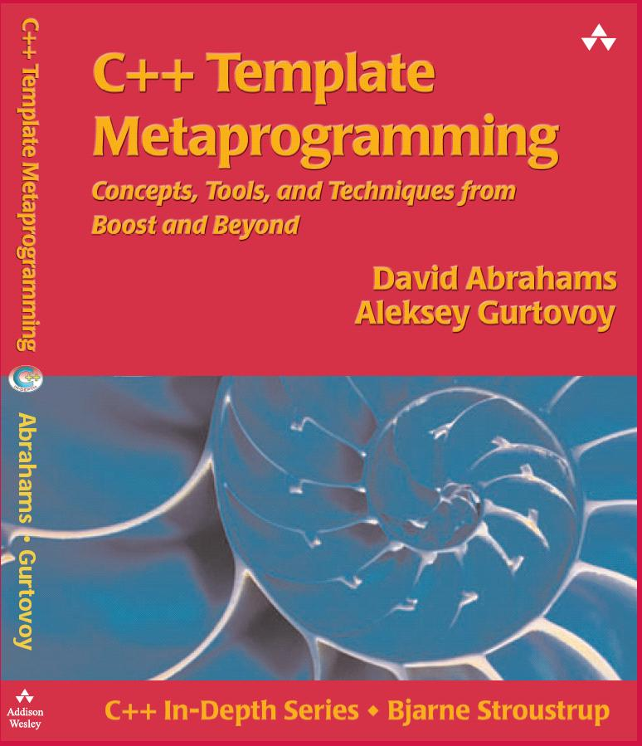
Further Reading
Erwin Unruh, Prime number computation. ANSI X3J16-94-0075/ISO WG21-462. 1994.
Todd Veldhuizen. Using C++ Template Metaprograms, C++ Report, SIGS Publications Inc., ISSN 1040-6042, Vol. 7, No. 4, pp. 36-43. May 1995.
Krzysztof Czarnecki, Ulrich Eisenecker, Metalisp. http://home.t-online.de/home/Ulrich.Eisenecker/meta.htm
Todd Veldhuizen. Active Libraries and Universal Languages. Doctoral Dissertation, Indiana University Computer Science, 17 May 2004. http://www.cs.chalmers.se/~tveldhui/papers/2004/dissertation.pdf
Todd Veldhuizen. Blitz++. http://www.oonumerics.org/blitz/.

