Slide 1
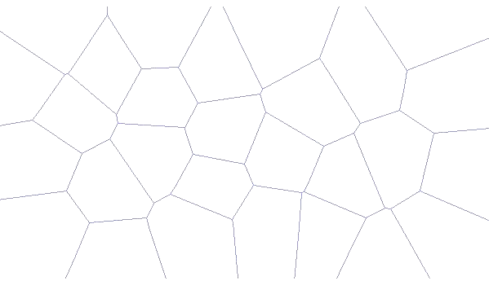
Voronoi Diagram of Line Segments
New Features Added to Boost.Polygon
Google Summer of Code 2010
Experience Report

Slide 2
Outline
Voronoi Problem Statement
Motivation
Timeline and History of the Project
Explanation of Fortune’s Algorithm
Numerical Robustness Problems/Solutions
Output Examples
Benchmark Results
Plans For Integration into Polygon
GSOC 2011 Edge Concepts Project
Q&A

Slide 3
Voronoi Diagram of Points
Given an input set of points called “sites”
Compute bounded regions called “cells” for each site such the site enclosed by each cell is the closest site to all points within the cell
Boundaries between cells called “Voronoi edge” are line segments equidistant from two sites
Intersection of three or more voronoi edges creates a “Vornoi vertex”

Slide 4
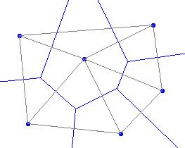
Delaunay Triangulation of Points
Delaunay triangulation is the dual graph of Voronoi diagram
Connecting each pair of sites associated with a voronoi edge with a line segment produces Delaunay triangulation

Slide 5
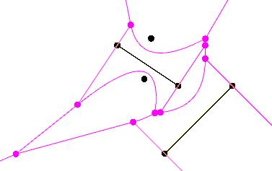
Voronoi Diagram Of Line Segments
Line segments and points are “sites”
Voronoi edge equidistant from point and line segments sites is parabolic arc

Slide 6
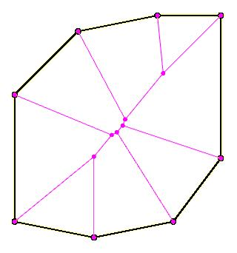
Medial Axis of Polygon
The Voronoi Diagram of edges of a polygon in the interior region of the polygon produces the Medial Axis of the polygon

Slide 7
Nearest Neighbor Query
Optimally find all pairs of closest points in a point set
Optimally find which polygons in a polygon set enclose which points in a point set
Optimally find all pairs of closest polygons in a polygon set
Optimally find which polygons in one polygon set are inside, outside or partially overlapping polygons from another polygon set

Slide 8
One Algorithm to Rule Them All
Solution to Voronoi Diagram of Line Segments solves also Voronoi Diagram of Points, Delaunay Triangulation of Points, Medial Axis and Nearest Neighbor problems
A single implementation of Fortune’s sweepline algorithm for Vornoi Diagram of Line Segments allows interfaces for solving all these problems to be added to Boost.Polygon

Slide 9
Motivation
Voronoi diagrams and the related problems have applications in many fields
  Physics
  Data compression
  VSLI CAD
  CAM (Computer Aided machinery)
  GIS (Geospatial Information Systems)
  Meshing

Slide 10
Timeline and History of the Project
March 2010
  Posted computational geometry project Idea
  Andrii and half a dozen other students expressed interest
April 2010
  Four strong student proposals submitted
  Andrii selected
May 2010
  Work started
  Reasearch of Voronoi Diagram Problem
  Design of Implementation
June 2010
  Polygon released in Boost 1.44
  Voronoi of points initial implemention
  Testing of Voronoi of Points
July 2010 - Midterm
  QT based Voronoi Diagram visualizer implemented
  Voronoi of Points Completed with Robust Predicates
  Voronoi of Segments Started
  Numerical Robustness Research
August 2010 – Final
  Voronoi of segments initial implementation
September, October, November 2010
  Voronoi diagram of line segments completed
  Testing of voronoi of line segments
  Visualizer updated
  Refactoring
  Robustness improvements
  Performance improvements
January 2011
  Boostcon 2011 application
Currently ~4600 lines of library code

Slide 11
Fortune’s Algorithm
Describes a sweepline algorithm for solving Voronoi Diagram of Points
Gives the general idea for extending the algorithm to line segments
O(n log n) complexity
Divide an conquer algorithm and randomized incremental construction is also O(n log n)

Slide 12
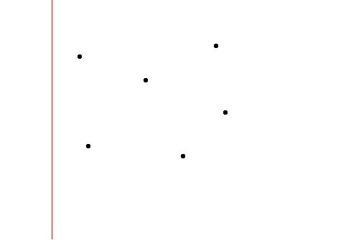
Fortune’s Algorithm
Start with vertical sweepline at the left

Slide 13
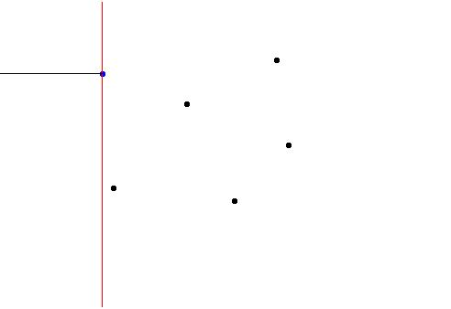
Fortune’s Algorithm
Sweep until first site is reached
Sites are sweepline events where work is done

Slide 14
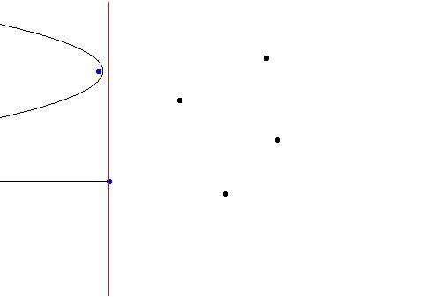
Fortune’s Algorithm
When a site is reached a parabolic region is opened behind the sweep line
The parabolic arc is equidistant from the site and the sweepline

Slide 15
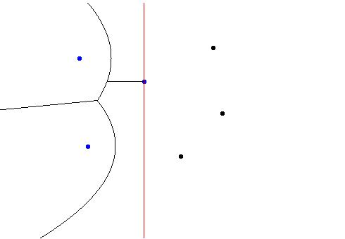
Fortune’s Algorithm
These parabolic regions form what is called the “beach line”
The point where two parabolic arcs join on the beach line describe a line segment equidistant from their sites as the sweepline progresses

Slide 16
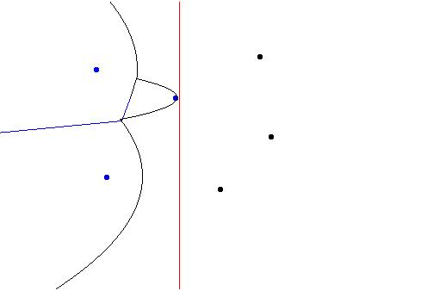
Fortune’s Algorithm
When three parabolic arcs come together this is called a “circle event” and a Voronoi vertex is formed

Slide 17
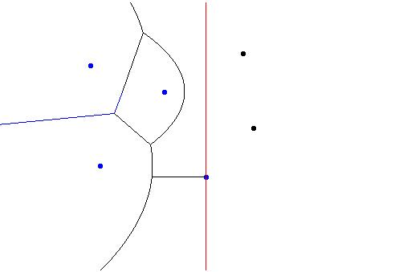
Fortune’s Algorithm
Sweepline proceeds to process all site events and circle events

Slide 18
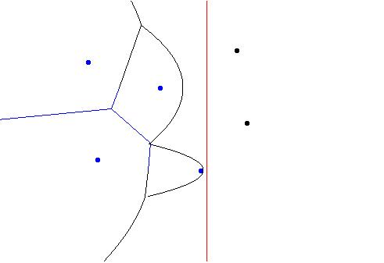
Fortune’s Algorithm
When vornoi vertices on both sides of a vornoi edge have been processed that edge is output
The edge is associated with the sites on either side as well as the voronoi vertices on either end

Slide 19
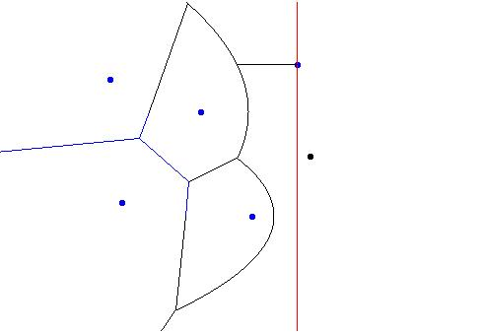
Fortune’s Algorithm
Insertion of new sites on the beachline is done optimally using a std::map for the beachline data structure

Slide 20
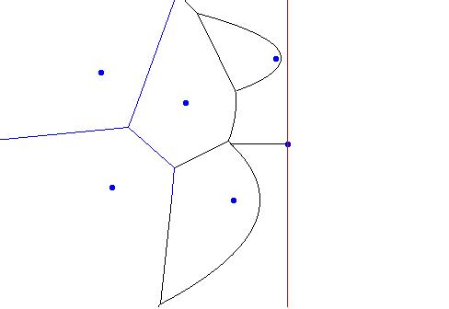
Fortune’s Algorithm
The output is a planar graph of site, edge and vertex nodes where topological information about the diagram is represented through edges
Data structure is called a quad-edge

Slide 21
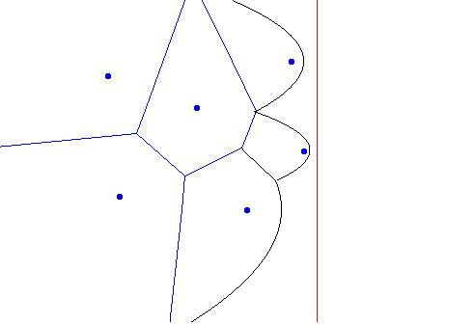
Fortune’s Algorithm
When a site is no longer associated with active arcs of the beachline its Vornoi cell has been completed

Slide 22
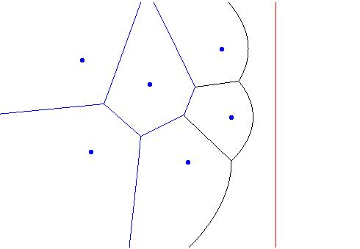
Fortune’s Algorithm
Once there are no further sites to process the algorithm is complete

Slide 23
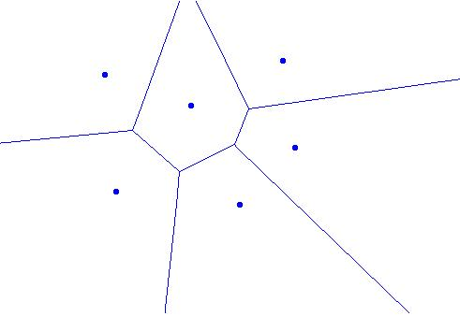
Fortune’s Algorithm
Voronoi edges on the periphery of the diagram extend to infinity

Slide 24
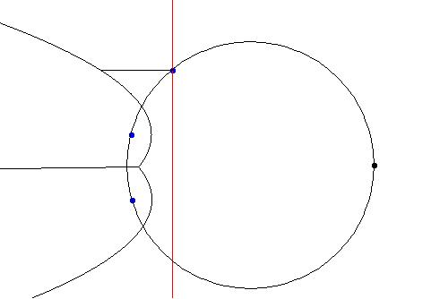
Fortune’s Algorithm
A circle event is the circle inscribed on three sites
The event point is the rightmost point of the circle
When the sweepline reaches the circle event the three input sites associated with it are equidistant from the beachline at a single point, the center of the circle

Slide 25
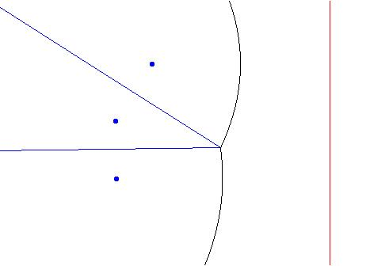
Fortune’s Algorithm
The beachline at this point is updated by removing one parabolic arc
The algorithm writes out two Voronoi edges and one Voronoi vertex

Slide 26
Fortune’s Algorithm
The order of circle events is used to maintain a priority queue of circle events yet to be processed
  It is not a fatal error if the predicate used for the circle event priority queue is not robust but the output topology will be incorrect
The order of parabolic arcs on the sweepline is maintained by a map
  It is a fatal error if the predicate used for the sweepline data structure is not robust because the data structure will throw an exception or hang

Slide 27
Fortune’s Algorithm for Segments
Works the same way
Each end point of the segment is a site as well as a third site for the body of the segment
  In our case we make two sites for the body, one for each “side” of the line segment
The portion of the beachline associated with the body of the line segment is a straight line equidistant from the sweep line and the line segment
Computing beachline events become complex because the three sites involved may be
  point, point, point
  point, point, segment
  point, segment, segment
  segment, segment, segment
And solving for the point equidistant from points and segments is a different complex expression involving square roots for each of the four cases
Computing the relative ordering of circle events in the progress of the sweepline is critically important for correct topology of the output
  difficult to make numerically robust because you can’t compare the computed point if its coordinates contain approximation error

Slide 28
Numerical Robustness
We assume integer input coordinates and integer output coordinates
We want to bound the error of the output coordinates of Vornoi vertices to integer rounding error
We want the topology of the diagram to be correct
We want the algorithm to be fast, with minimal use of infinite precision arithmetic
We need a reliable way to deal with irrational values of square roots

Slide 29
Computing Relative Error
For floating point expressions between arguments of the same sign the relative error is computed as follows
re(A*B) = re(A) + re(B)
re(A/B) = re(A) + re(B)
re(A+B) = max(re(A), re(B))
re(A-B) = (re(A)*A-re(B)*B)/(A-B)
re(sqrt(A)) = re(A) / 2
Subtraction may result in catastrophic cancellation and arbitrarily large numerical error

Slide 30
How to use Relative Error
Lets say the sign of a cross product (a*d – b*c) is our predicate
Let re(a*d) be re1 and re(b*c) be re2
For a*b and b*c the intervals of error are
  [a*d*(1-re1), a*d*(1+re1)]
  [b*c*(1-re2), b*c*(1+re2)]
If these intervals don’t overlap then we know that the sign for a*d – b*c is correct

Slide 31
EPS versus ULP
Machine epsilon is called EPS and is the maximum error produced by most floating point operations
ULP (Units in Last Place) is units of precision of the least significant bit of a floating point value
0.5 ULP <= 1EPS <= 1 ULP
So we can safely use units in last place as a proxy for the epsilon interval
We can tell if two floating point numbers differ only by a value that falls within the ULP error range by unpacking the bits of the IEEE floating point standard by converting to unsigned integer portably using a memcpy
To compute ULP for floating point operations just add one to the expressions on the previous slide for each operation
ULP of a floating point expression can be computed off line and used to place a reasonably tight bound on error that can be used to reject the result of a floating point operation as untrustworthy

Slide 32
Relative Error Floating Point Type
Calculates relative error and floating point result of arithmetic expressions
template <typename _fpt>
class robust_fpt {
public:
typedef _fpt floating_point_type;
typedef double relative_error_type;
…
robust_fpt& operator*=(const robust_fpt &that) {
this->re_ += that.re_ + ROUNDING_ERROR;
this->fpv_ *= that.fpv_;
return *this;
}
…
};

Slide 33
Boost.Interval
Boost.Interval can be used to compute tighter bounds on relative error
Represent a floating point value v as an interval [v, v] and another floating point value u as an interval [u, u]
Use Boost.Interval to add those intervals with rounding modes: [round_down(u+v), round_up(u+v)]
round_up and round_down mean manipulating the rounding mode of the floating point unit
The resulting interval is the relative error interval for u+v
The round closest behavior that produces machine epsilon error will produce a result that lies in that interval
Further interval arithmetic accumlates relative error in a similar manner
Comparison of intervals tells us whether the result of comparing the floating point calculations might be untrustworthy
This produces a tighter error bound than the ULP method
The documentation of Boost.Interval doesn’t describe this motivating use case (that I could find)
We will explore applying Boost.Interval

Slide 34
Fall Back on Infinite Precision
If floating point may be lying
Infinite precision is very expensive
But if good bounds on error are applied the use of infinite precision is very rare
The result is an algorithm that runs almost as fast as the unreliable floating point algorithm
This technique is known as lazy exact arithmetic
It is commonly employed to solve numerical robustness challenges in computational geometry and computing in general

Slide 35
GMP Integration
Use of GMP will be optional for Voronoi algorithm
  same to current Polygon library
Will allow for alternative data types

Slide 36
GMP Performance Problem
GMP has a C++ wrapper that we use
GMP runtime can be dominated by allocation/de-allocation time
You want to recycle your GMP variables
Allocation of temporaries generated by complex expressions kills your performance
Writing one arithmetic operation per line isn’t a satisfying solution

Slide 37
Current GMP Performance Solution
This works to fix the problem
I hate it because it has static members and isn’t thread safe
How can we solve this problem better?
template <typename mpt, int N>
class mpt_wrapper {
public:
…
mpt_wrapper& operator+(const mpt_wrapper& that) const {
temp_[cur_].m_ = this->m_ + that.m_;
return temp_[next_cur()];
}
…
private:
static int next_cur() {
int ret_val = cur_++;
if (cur_ == N)
cur_ = 0;
return ret_val;
}
mpt m_;
static int cur_;
static mpt_wrapper temp_[N];
};

Slide 38
Idea For Better Solution
I was thinking along these lines
template <typename mpt>
class mpt_tmp {
public:
…
mpt_tmp& operator+(const mpt_wrapper& that) const {
return (*this) += that;
}
…
private:
mutable mpt m_;
};
template <typename mpt>
class mpt_wrapper {
public:
…
mpt_tmp& operator+(const mpt_wrapper& that) const {
tmp = m_ + that.m_; return tmp;
}
…
private:
mpt m_;
mutable mpt_tmp<mpt> tmp;
};

Slide 39
SQRT Woes
If we want to compute a – sqrt(b) and a is greater than zero and almost equal to sqrt(b) then the error will be huge
If we have several such sub expressions we probably can’t trust even the sign bit of the final result
We need to avoid catastrophic cancellation error

Slide 40
Refactoring By Conjugates
If we want to have robust floating point evaluation of the expression:
A*sqrt(a) + B*sqrt(b)
We need to handle two cases seperately
A*B >= 0
  A*sqrt(a) + B*sqrt(b)
A*B < 0
  ((A*A*a)-(B*B*b))/(A*sqrt(a) – B*sqrt(b))
We multiply numerator and denominator by
  A*sqrt(a) – B*sqrt(b)
to prevent cancelation

Slide 41
Refactoring By Conjugates
We can cover all cases of positive and negative factors of square roots up to four square root terms
  A*sqrt(a) + B*sqrt(b) + C*sqrt(c) + D*sqrt(d)
without cancelation error by using enough conditionals and alternative equivalent expressions
But five or more cannot be handled
We are “lucky” that we only have up to four square roots in voronoi diagram of line segments
We would be luckier not to have square roots at all

Slide 42
Lazy Exact Computations for Voronoi of Points case
Sweep-line predicate
  Lazy-exact
  Floating point approximation with relative error calculation
  Emulates 65 bit integer arithmetic for exact result
Circle-event
  Lazy-exact to within small bounded relative error
  Uses refactoring by conjugates floating point approximation with relative error calculation
  Uses wrapped gmp numerical data type for exact result with recycled temporaries and minimal relative error introduced by sqrt

Slide 43
Quick Glance at Code
// Find parameters of the inscribed circle that is tangent to three
// point sites.
template <typename T>
static bool create_circle_event_ppp(const site_event<T> &site1,
const site_event<T> &site2,
const site_event<T> &site3,
circle_event<T> &c_event) {
double dif_x1 = site1.x() - site2.x();
double dif_x2 = site2.x() - site3.x();
double dif_y1 = site1.y() - site2.y();
double dif_y2 = site2.y() - site3.y();
double orientation = robust_cross_product(dif_x1, dif_y1, dif_x2, dif_y2);
if (orientation_test(orientation) != RIGHT_ORIENTATION)
return false;
robust_fpt<T> inv_orientation(0.5 / orientation, 3.0);
double sum_x1 = site1.x() + site2.x();
double sum_x2 = site2.x() + site3.x();
double sum_y1 = site1.y() + site2.y();
double sum_y2 = site2.y() + site3.y();
double dif_x3 = site1.x() - site3.x();
double dif_y3 = site1.y() - site3.y();
epsilon_robust_comparator< robust_fpt<T> > c_x, c_y;
c_x += robust_fpt<T>(dif_x1 * sum_x1 * dif_y2, 2.0);
c_x += robust_fpt<T>(dif_y1 * sum_y1 * dif_y2, 2.0);
c_x -= robust_fpt<T>(dif_x2 * sum_x2 * dif_y1, 2.0);
c_x -= robust_fpt<T>(dif_y2 * sum_y2 * dif_y1, 2.0);
c_y += robust_fpt<T>(dif_x2 * sum_x2 * dif_x1, 2.0);
c_y += robust_fpt<T>(dif_y2 * sum_y2 * dif_x1, 2.0);
c_y -= robust_fpt<T>(dif_x1 * sum_x1 * dif_x2, 2.0);
c_y -= robust_fpt<T>(dif_y1 * sum_y1 * dif_x2, 2.0);
epsilon_robust_comparator< robust_fpt<T> > lower_x(c_x);
lower_x -= robust_fpt<T>(std::sqrt(sqr_distance(dif_x1, dif_y1) *
sqr_distance(dif_x2, dif_y2) *
sqr_distance(dif_x3, dif_y3)), 5.0);
c_event = circle_event<double>(c_x.dif().fpv() * inv_orientation.fpv(),
c_y.dif().fpv() * inv_orientation.fpv(),
lower_x.dif().fpv() * inv_orientation.fpv());
bool recompute_c_x = c_x.dif().ulp() >= 128;
bool recompute_c_y = c_y.dif().ulp() >= 128;
bool recompute_lower_x = lower_x.dif().ulp() >= 128;
if (recompute_c_x || recompute_c_y || recompute_lower_x) {
return create_circle_event_ppp_gmpxx(
site1, site2, site3, c_event, recompute_c_x, recompute_c_y, recompute_lower_x);
}
return true;
}

Slide 44
Error Bounded Output
We are computing the values for the circle event and then comparing these values in the circle event queue
There is no way to compute the exact values because they contain square root
Our output is correct to within bounded relative error
128 ULP translates into 7 bits in the bottom of double or 2^-45 at integer scale
I’d rather use long double than double and intend to switch
If we used long double our relative error would be less than machine epsilon for double
It may be provable that with a sufficient error bound no miss-ordering of circle events is possible but the numerical analysis is challenging
Such proof may be possible for floating point input coordinates also

Slide 45
Segment Predicates
The comparison of beach line events with line segment sites involved is similar to the points case
The floating point expressions for each are complicated
Bound error to many orders of magnitude smaller than integer grid
Currently use infinite precision arithmetic to reduce error bound to minimal error introduced by square roots operations only
We use refactoring by conjugates to minimize the error introduced by square roots
Each needs to be written in floating point and have ULP calculated off line to ensure it is small enough
May contain up to four square roots in a single expression
Floating point approximate with relative error computation also implemented but currently not used

Slide 46
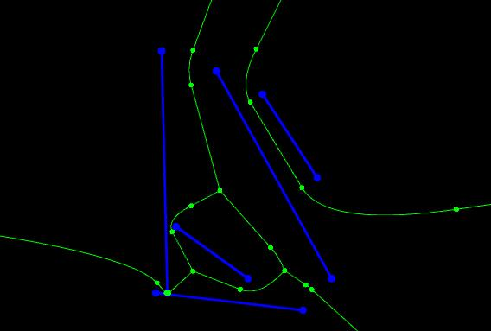
Example Output
Example of diagram of segments with near touch

Slide 47
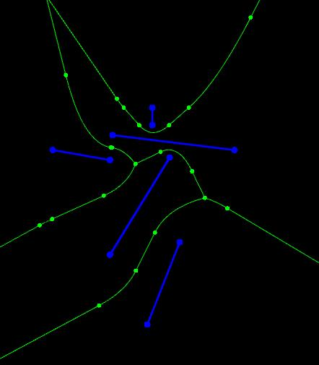
Example Output
Example of diagram of segments

Slide 48
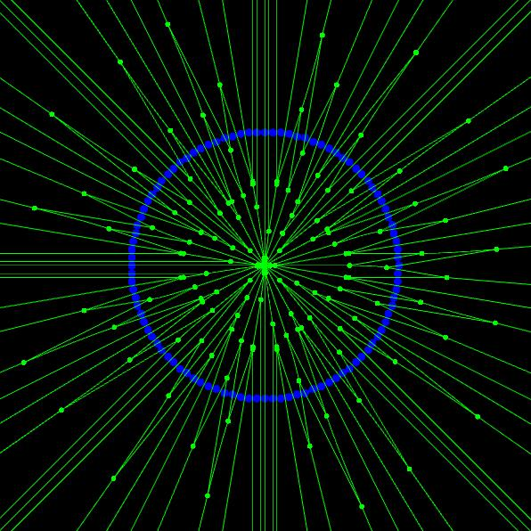
Example Output
Example of diagram of points
Co-circular points are the worst case input for Voronoi diagram

Slide 49
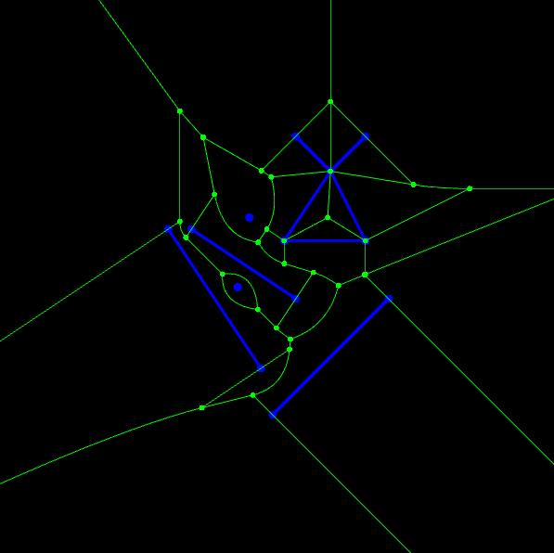
Example Output
Example diagram of polygon, points and segments

Slide 50
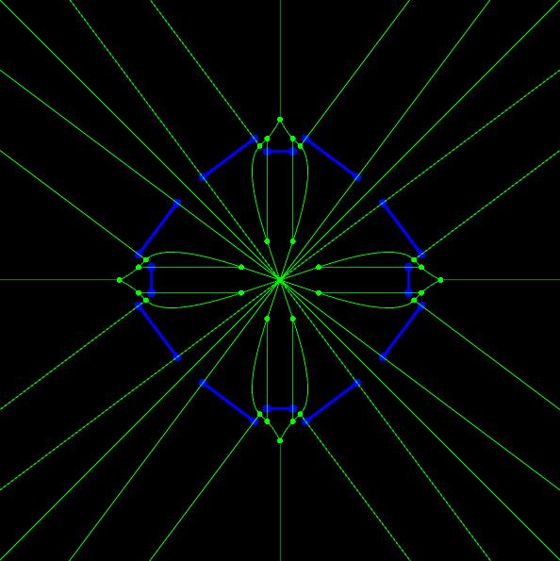
Example Output
Co-circular line segments
Note the high order voronoi vertex in the center

Slide 51
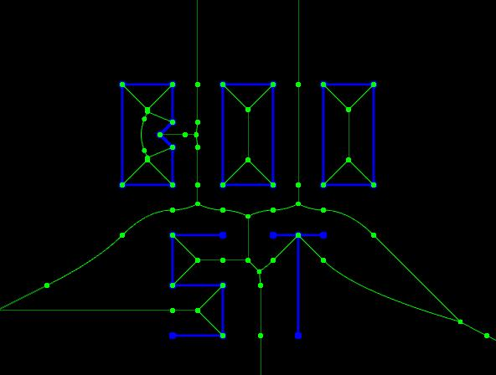
Example Output
Diagram of letters:
B, O, O, S, T

Slide 52
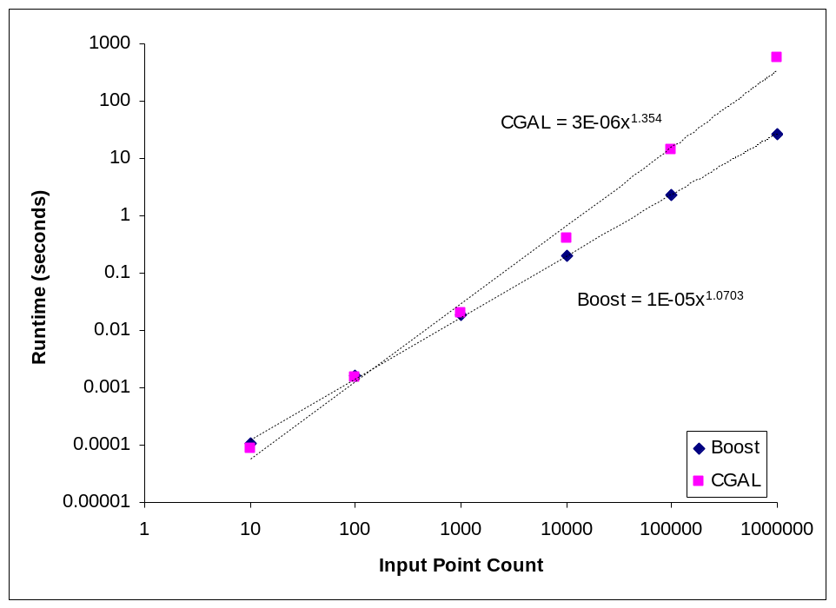
Benchmark
Voronoi diagram of points compared to CGAL
22X faster than CGAL at 1,000,000 points

Slide 53
New Boost.Polygon APIs
Voronoi diagram of Points
  Populates a container of polygon concept with voronoi cells given a iterator range over point concept
  void voronoi_diagram(container_type& cells,
  iterator_type begin_points, iterator_type end_points);
Delaunay diagram of Points
  Populates a container of polygon concept with Delaunay triangles given an iterator range over point concept
  void delaunay_triangles(container_type& triangles,
  iterator_type begin_points, iterator_type end_points);
Voronoi diagram of Polygon Set
  Populates a container of polygon concept with voronoi cells given a model of polygon set concept or one of its refinements
  Uses the threshold provided to segment parabolic arcs into line segments such that the line segments lie no further than threshold from the true curve
  void voronoi_diagram(container_type& cells, const polygon_set_type& polygons, const coordinate_distance_type& threshold);

Slide 54
GSOC 2011
Input line segments must not be intersecting is a pre-condition of Voronoi diagram of line segments
It is also a post condition of the line segment intersection algorithm used in the first stage of polygon clipping implemented already in Boost.Polygon
Vornoi diagram of line segments needs edge concepts to implement generic interfaces

Slide 55
GSOC 2011
Implement new generic C++ concepts for
  Line segment
  Directed line segment
  Set of line segments
  Set of directed line segments
Directed line segment is a refinement of line segment
Line segment is a refinement of set of line segments
Set of directed line segments is a refinement of set of line segments
Directed line segment is a refinement of set of directed line segments
Polygon set is a refinement of set of directed line segments
Expose a concept based user interface to line segment intersection
Expose a concept based user interface to robust predicates for
  line segment slope comparison
  point on above or below line segment
  whether two line segments intersect
The user will be able to pass rectangle concept into a generic interface expecting set of line segments concept because rectangle is a refinement of polygon, is a refinement of polygon set, is a a refinement of set of directed line segments is a refinement of set of line segments

Slide 56
GSOC 2011
New segment concepts in Boost.Polygon will enable new interfaces based on Vornoi Diagram of line segments
Voronoi diagram of Points
  Populates a container of line segment concept with voronoi edges given a iterator range over point concept
  void voronoi_diagram(container_type& edges,
  iterator_type begin_points, iterator_type end_points);
Voronoi diagram of Segments
  Populates a container of line segment concept with voronoi edges given a iterator range over line segment concept
  void voronoi_diagram(container_type& edges, iterator_type begin_segments,
  iterator_type end_segments , const coordinate_distance_type& threshold);
Voronoi diagram of Segments
  Populates a container of line segment concept with voronoi edges given a model of set of line segments concept
  void voronoi_diagram(container_type& edges, const line_segments_type& sites,
  const coordinate_distance_type& threshold);
Medial Axis of Polygon Set
  Populates a container of line segment concept with medial axis edges given a model of polygon set concept
  void medial_axis(container_type& edges, const polygon_set_type& polygons,
  const coordinate_distance_type& threshold);

Slide 57
Q&A

