Slide 1
Boost Phoenix V3
Thomas Heller
Hartmut Kaiser

Slide 2


Boost Phoenix V3
5/16/2011

Slide 3
Overview
Boost Phoenix V3
5/16/2011
What’s Phoenix?
  Short History, Why a new version, Motivation
  Phoenix as C++ in C++
  Building a simple Asio echo server
Boost Proto: The Phoenix’ Workhorse
Phoenix’ Extension Mechanism
  Building a parallel for construct
Code as Data
Compile Times

Slide 4

Boost Phoenix V3
5/16/2011

Slide 5
What’s Phoenix? Short history
Boost Phoenix V3
5/16/2011
Together with Joel de Guzman and Eric Niebler, Thomas implemented a new incarnation of the Boost.Phoenix library
Started off as a Google Summer of Code project in 2010
Passed Boost mini review early this year
Will be part of Boost starting with V1.47, however it is in SVN already

Slide 6
What’s Phoenix? Why a new Version?
Boost Phoenix V3
5/16/2011
Phoenix V2 was developed as a supporting library for Spirit
  Features similar to Boost.Bind and Boost.Lambda
  Hand-rolled Expression Templates (ET)
Boost review in 2008
  Unification of functional libraries with minimal disruption for users
  Use Boost.Proto for unified placeholders and cross library integration
  Use of C++11 features (rvalues, variadics)
Improve and document extension mechanism

Slide 7
What’s Phoenix? Really?
Boost Phoenix V3
5/16/2011
Enables functional programming techniques in C++
  Higher order functions
  Lambda (unnamed functions)
  Currying (partial function application)
C++ Embedded Domain Specific Language (EDSL) in C++
Focus is more on usefulness and practicality than purity, elegance and strict adherence to FP principles

Slide 8
Motivation
Boost Phoenix V3
5/16/2011
Functional Programming style in the C++ standard library algorithms use function objects as “callbacks”
int init = 0;
std::accumulate (
container.begin(), container.end(), init
, std::plus<int>()
);
Phoenix is the next evolutionary step

Slide 9
Motivation
Boost Phoenix V3
5/16/2011
Functional Programming style in the C++ standard library algorithms use function objects as “callbacks”
int init = 0;
std::accumulate (
container.begin(), container.end(), init
, arg1 + arg2
);
Phoenix is the next evolutionary step

Slide 10
Phoenix as C++ in C++
Boost Phoenix V3
5/16/2011
Values and References
Arguments
Operators
Statements
Partial function application
Construct, New, Delete, Casts
Adapt arbitrary functions
…
Everything is a function object!

Slide 11
Phoenix as C++ in C++
Boost Phoenix V3
5/16/2011
Values and References
cout << val(42)(); // 42
int i = 42;
cout << ref(i)(); // 42

Slide 12
Phoenix Function Objects
Boost Phoenix V3
5/16/2011
Pseudo code for val():
template <typename T>
struct val_impl {
T value;
val_impl(T t) : value(t) {}
T operator()(…) const { return t; }
};
template <typename T> val_impl<T> val(T t)
{
return val_impl<T>(t);
}

Slide 13
Phoenix Function Objects
Boost Phoenix V3
5/16/2011
Pseudo code for ref():
template <typename T>
struct ref_impl {
T& value;
ref_impl(T& t) : value(t) {}
T& operator()(…) const { return t; }
};
template <typename T> ref_impl<T> ref(T& t)
{
return ref_impl<T>(t);
}

Slide 14
Phoenix as C++ in C++
Boost Phoenix V3
5/16/2011
Values and References
Arguments
cout << arg1(42); // 42
const char* s = "Hello World!";
cout << arg1(s); // Hello World!
  Alternative placeholder names available
cout << _1(i); // 42
cout << _1(s); // Hello World!

Slide 15
Phoenix Function Objects
Boost Phoenix V3
5/16/2011
Pseudo code for arg1:
struct arg1_impl {
template <typename T1, …>
T1 operator()(T1 t1, …) const { return t1; }
};
arg1_impl const arg1 = arg1_impl();

Slide 16
Phoenix as C++ in C++
Boost Phoenix V3
5/16/2011
Values and References
Arguments
Operators
cout << (arg1 * arg2)(2, 3); // 6
int x = 3, z = 5;
(ref(x) = arg1 + ref(z))(4);
cout << x; // 9
(arg1 = arg2 + (3 * arg3))(ref(x), 3, 4)
cout << x; // 15

Slide 17
Phoenix Function Objects
Boost Phoenix V3
5/16/2011
Pseudo code for +:
template <typename F1, typename F2> struct plus_impl {
F1 f1; F2 f2;
plus_impl(F1, f1, F2 f2) : f1(f1), f2(f2) {}
template <typename T1, …>
T1 operator()(T1 t1, …) const
{ return f1(t1, …) + f2(t1, …); }
};
template <typename F1, typename F2>
plus_impl<F1, F2> operator+(F1 f1, F2 f2)
{
return plus_impl<F1, F2>(f1, f2);
}

Slide 18
Phoenix as C++ in C++
Boost Phoenix V3
5/16/2011
Values and References
Arguments
Operators
  Unary prefix: ~, !, -, +, ++, --,
  & (reference), * (dereference)
  Unary postfix: ++, --
  Binary: =, [], +=, -=, *=, /=, %=, &=, |=, ^=, <<=, >>= +, -, *, /, %, &, |, ^, <<, >> ==, !=, <, >, <=, >= &&, ||, ->*
  Ternary: if_else(c, a, b)

Slide 19
Phoenix as C++ in C++
Boost Phoenix V3
5/16/2011
Values and References
Arguments
Operators
Statements
cout << (if_(arg1 > 5)[std::cout << arg1])(6); // 6
vector<int> v = { 4, 5, 6, 7 };
std::for_each(v.begin(), v.end(),
if_(arg1 > 5)[
cout << arg1 << ", "
]); // 6, 7

Slide 20
Phoenix as C++ in C++
Boost Phoenix V3
5/16/2011
Values and References
Arguments
Operators
Statements
Partial function application
void foo (int x, int y)
{
std::cout << x+y << std::endl;
}
int i = 4;
bind(&foo, arg1, 3)(i); // 7

Slide 21
Phoenix as C++ in C++
Boost Phoenix V3
5/16/2011
Values and References
Arguments
Operators
Statements
Partial function application
Construct, New, Delete, Casts
construct<std::string>(arg1, arg2)
new_<std::string>(arg1, arg2)
delete_(arg1)
static_cast_<int*>(arg1)

Slide 22
Phoenix as C++ in C++
Boost Phoenix V3
5/16/2011
Values and References
Arguments
Operators
Statements
Partial function application
Construct, New, Delete, Casts
Adapt arbitrary functions
  Factorial
    cout << fact(4)(); // 24
    vector<double> v = { 1, 2, 3, 4 };
    for_each(v.begin(), v.end(), cout << fact(_1)); // 1 2 6 24

Slide 23
Phoenix Function Function Objects
Boost Phoenix V3
5/16/2011
Factorial code:
struct fact_impl {
template <typename Sig>
struct result;
template <typename This, typename Arg>
struct result<This(Arg const &)>
{ typedef Arg type; }
template <typename Arg>
Arg operator()(Arg const & n) const
{ return (n <= 1) ? 1 : n * (*this)(n-1); }
};
function<fact_impl> const fact = fact_impl();

Slide 24
Phoenix vs. C++11 Lambdas
Boost Phoenix V3
5/16/2011
C++11 Lambdas
Phoenix
Built-in language feature
No significant compile time hit
Constructs monomorphic function objects
Expressions need to be wrapped into lambda syntax
Library
Expression are placed directly into code
Constructs polymorphic function objects
Constructs variadic function objects
Significant compile time hit

Slide 25

Boost Phoenix V3
5/16/2011

Slide 26
More Examples
Boost Phoenix V3
5/16/2011
// simple function object invocation
template <typename F>
void print(F f) { std::cout << f() << std::endl; }
print(val(3)); // 3
print(val("Hello World")); // Hello World
// find the first odd number in a vector
std::vector<int> c = { 2, 10, 4, 5, 1, 6, 8, 3, 9, 7 };
auto it = std::find_if(c.begin(), c.end(), arg1 % 2 == 1);
if (it != c.end()) cout << *it << std::endl;

Slide 27

Boost Phoenix V3
5/16/2011
Minimal Asio Echo Server

Slide 28
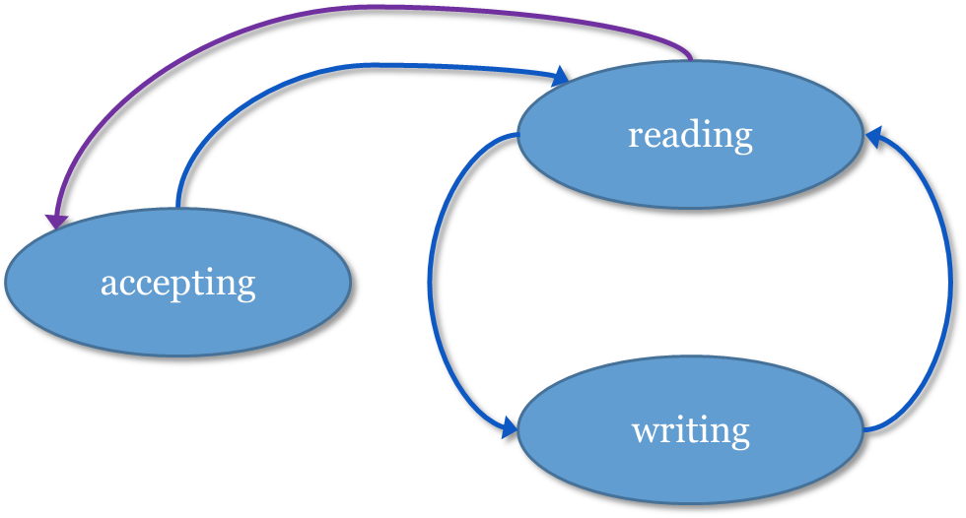
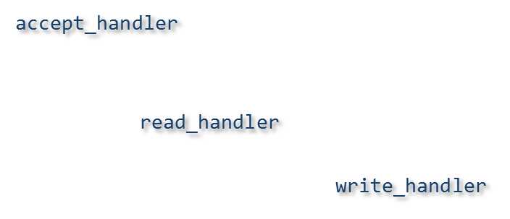
Full Example: Asio Echo Server
Boost Phoenix V3
5/16/2011
Adapt existing code, for example ASIO
  Writing a simple asynchronous echo server
start
asio::accept

Slide 29
Full Example: Asio Echo Server
Boost Phoenix V3
5/16/2011
Adapt existing code, for example ASIO
read:
BOOST_PHOENIX_ADAPT_FUNCTION(void, read, asio::async_read, 3)
write:
BOOST_PHOENIX_ADAPT_FUNCTION(void, write, asio::async_write, 3)
buffer:
BOOST_PHOENIX_ADAPT_FUNCTION(
asio::mutable_buffers_1, buffer, asio::buffer, 2)

Slide 30
Full Example: Asio Echo Server
Boost Phoenix V3
5/16/2011
Adapt existing code, for example ASIO
accept:
template <typename Acceptor, typename Socket, typename Handler>
void accept_impl(Acceptor& acceptor, Socket& socket,
Handler const& handler)
{
acceptor.async_accept(socket, handler);
}
BOOST_PHOENIX_ADAPT_FUNCTION(void, accept, accept_impl, 3)

Slide 31
Full Example: Asio Echo Server
Boost Phoenix V3
5/16/2011
Adapt existing code, for example ASIO
Using these functions we construct handlers:
  read_handler
    boost::function<void(system::error_code&, size_t)>
  write_handler
    boost::function<void(system::error_code&, size_t)>
  accept_handler
    boost::function<void(system::error_code&)>

Slide 32
Full Example: Asio Echo Server
Boost Phoenix V3
5/16/2011
Adapt existing code, for example ASIO
  accept_handler, will be called by ASIO when connection was accepted (or refused)
    boost::function<void(system::error_code&)>
    accept_handler =
    if_(!_1)[
    read(ref(socket), buffer(ref(buf), max_length),
    phx::ref(read_handler))
    ]
    .else [
    bind(&asio::ip::tcp::socket::close, ref(socket)),
    accept(ref(acceptor), ref(socket), ref(accept_handler))
    ];

Slide 33
Full Example: Asio Echo Server
Boost Phoenix V3
5/16/2011
Adapt existing code, for example ASIO
  read_handler: will be called by ASIO after read_async
    boost::function<void(system::error_code& &, size_t)>
    read_handler =
    if_(!_1)[
    write(ref(socket), buffer(ref(buf), _2),
    phx::ref(write_handler)
    ]
    .else [
    bind(&asio::ip::tcp::socket::close, ref(socket)),
    accept(ref(acceptor), ref(socket), ref(accept_handler))
    ];

Slide 34
Full Example: Asio Echo Server
Boost Phoenix V3
5/16/2011
Adapt existing code, for example ASIO
  write_handler: will be called by ASIO after write_async
    boost::function<void(system::error_code& &, size_t)>
    write_handler =
    if_(!_1)[
    read(ref(socket), buffer(ref(buf), max_length),
    phx::ref(read_handler)
    ]
    .else [
    bind(&asio::ip::tcp::socket::close, ref(socket)),
    accept(ref(acceptor), ref(socket), ref(accept_handler))
    ];

Slide 35
Full Example: Asio Echo Server
Boost Phoenix V3
5/16/2011
Adapt existing code, for example ASIO
  Start server
    asio::io_service io_service;
    asio::ip::tcp::acceptor acceptor(io_service,
    asio::ip::tcp::endpoint("localhost:1234"));
    asio::ip::tcp::socket socket(io_service);
    acceptor.async_accept(socket, accept_handler);

Slide 36

Boost Phoenix V3
5/16/2011
The workhorse behind Phoenix V3

Slide 37
Boost Proto: The Phoenix’ Workhorse
Boost Phoenix V3
5/16/2011
The facilities of proto are used to form the backend of phoenix
  Creation of expression template (ET) classes and composition
  Formulation of transformations on the created ET tree

Slide 38
Boost Proto: The Phoenix’ Workhorse
Boost Phoenix V3
5/16/2011
Provides facilities to generate your abstract syntax tree (AST)
  Representation of your expression in terms of proto::expr<>, a hierarchical type holding terms of the expression by reference
Describe your EDSL in terms of grammar rules
  Not all expressions are valid
  These grammars describe valid expressions
Based on these rules, perform actions on the AST
  Every rule is associated with an action, which is executed for the node the rule matched

Slide 39
Boost Proto: Phoenix’ Workhorse
Boost Phoenix V3
5/16/2011
The type generated from a Proto expression is an instantiation of the Proto expression class
_1 + _2
template <typename Lhs, typename Rhs>
proto::expr<proto::tag::plus, Lhs, Rhs>
operator+ (Lhs const & lhs, Rhs const & rhs)
{
return proto::make_expr<proto::tag::plus>(lhs, rhs);
}
SIMPLIFIED!

Slide 40
Boost Proto: Phoenix’ Workhorse
Boost Phoenix V3
5/16/2011
This type can be interpreted as a tree. This tree is what we call the AST for our language.
1 + 2 → proto::make_expr<proto::tag::plus>(1, 2)

Slide 41
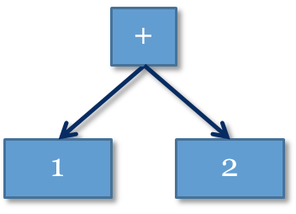
Boost Proto: Phoenix’ Workhorse
Boost Phoenix V3
5/16/2011
This type can be interpreted as a tree. This tree is what we call the AST for our language.
val(1) + 2 → proto::make_expr<proto::tag::plus>(1, 2)
proto::expr<
proto::tag::plus, proto::list2<
proto::expr<proto::tag::terminal, int>,
proto::expr<proto::tag::terminal, int>
> >
plus(terminal(1), terminal(2))

Slide 42
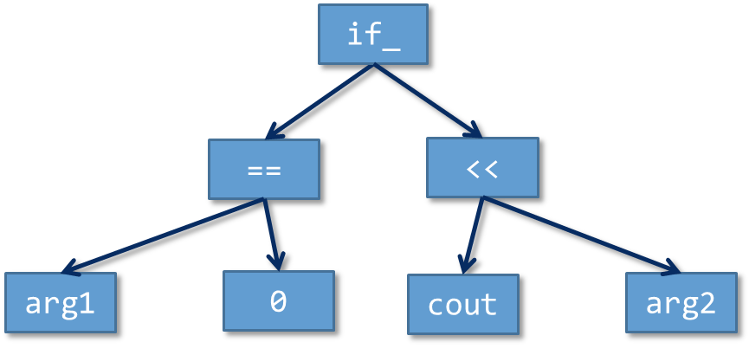
The Phoenix AST in Proto’s world
Boost Phoenix V3
5/16/2011
Every Phoenix construct can be seen as an AST node of our Phoenix EDSL
By composing these we create a bigger AST
if_(_1 == 0)
[
std::cout << _2
]

Slide 43
The Phoenix AST in Proto’s world
Boost Phoenix V3
5/16/2011
By using Proto we are able to introspect and transform this AST in any way we like
The (lazy) evaluation inside Phoenix can be seen as a transformation of this AST
Default (predefined) evaluation in Phoenix corresponds to ‘normal’ operator semantics
By defining your own nodes you can extend Phoenix in any way you wish
By customizing the evaluation of certain (predefined) nodes you can change the overall scheme
By transforming the tree before evaluation you can do additional tricks

Slide 44

Boost Phoenix V3
5/16/2011
Add New Constructs: Define your own Node

Slide 45
Phoenix’ Extension Mechanism
Boost Phoenix V3
5/16/2011
Add new constructs
Let's start simple. Assume you have the following code:
#pragma omp parallel for
for (int i = 0; i < NUM; ++i)
c[i] = a[i] + b[i];
And you want to express exactly this with Phoenix. How would you do that?

Slide 46
Phoenix’ Extension Mechanism
Boost Phoenix V3
5/16/2011
Add new constructs
Anticipated syntax:
omp::for_(<init>, <cond>, <reinit>)
[
<parallel work>
]
Phoenix expression takes 4 arguments
  Each is a Phoenix expression on its own

Slide 47
Phoenix’ Extension Mechanism
omp::for_(<init>, <cond>, <reinit>)
[
<parallel work>
]
Boost Phoenix V3
5/16/2011
Add new constructs
Step 1: A function object:
namespace omp
{
struct for_eval
{
typedef void result_type;
template <typename I, typename C, typename S, typename D,
typname Ctx>
void operator()(I init, C cond, S step, D do_, Ctx ctx) const
{
#pragma omp parallel for
for(eval(init, ctx); eval(cond, ctx); eval(step, ctx))
eval(do_, ctx);
}
};
}

Slide 48
Phoenix’ Extension Mechanism
omp::for_(<init>, <cond>, <reinit>)
[
<parallel work>
]
Boost Phoenix V3
5/16/2011
Add new constructs
Step 2: Create the Phoenix expression type:
BOOST_PHOENIX_DEFINE_EXPRESSION(
(omp)(for_) // define omp::for_
, (boost::phoenix::meta_grammar) // Cond
(boost::phoenix::meta_grammar) // Init
(boost::phoenix::meta_grammar) // Step
(boost::phoenix::meta_grammar) // Do
)
Defines:
omp::make_for_, omp::result_of::make_for_, omp::expression::for_
omp::rule::for_, omp::tag::for_, omp::functional::make_for_
Four Arguments

Slide 49
Phoenix’ Extension Mechanism
omp::for_(<init>, <cond>, <reinit>)
[
<parallel work>
]
Boost Phoenix V3
5/16/2011
Add new constructs
Step 3: Create expression generator: omp::for_
namespace omp {
template <typename Init, typename Cond, typename Step>
struct for_gen {…};
template <typename Init, typename Cond, typename Step>
inline for_gen<Init, Cond, Step> const
for_(Init const& init, Cond const& cond, Step const& step)
{
return for_gen<Init, Cond, Step>(init, cond, step);
}
}

Slide 50
Phoenix’ Extension Mechanism
omp::for_(<init>, <cond>, <reinit>)
[
<parallel work>
]
Boost Phoenix V3
5/16/2011
Add new constructs
Step 3: Create expression generator
template <typename Init, typename Cond, typename Step>
struct for_gen {
for_gen(Init const& init, Cond const& cond, Step const& step)
: init(init), cond(cond), step(step) {}
template <typename Do>
typename omp::result_of::make_for_<Init, Cond, Step, Do>::type const
operator[](Do const& do_) const
{
return omp::make_for_(init, cond, step, do_);
}
Init init; Cond cond; Step step;
};
Phoenix “Magic”

Slide 51
Phoenix’ Extension Mechanism
omp::for_(<init>, <cond>, <reinit>)
[
<parallel work>
]
Boost Phoenix V3
5/16/2011
Add new constructs
Step 4: Define how to evaluate the new expression
namespace boost { namespace phoenix
{
template <>
struct default_actions::when<omp::rule::for_>
: phoenix::call<omp::for_eval>
{};
}}
Use ...::when to associate a grammar rule with an action

Slide 52
Phoenix’ Extension Mechanism
omp::for_(<init>, <cond>, <reinit>)
[
<parallel work>
]
Boost Phoenix V3
5/16/2011
Add new constructs
Step 5: Use it
std::vector<int> a(NUM, 1), b(NUM, 2), c(NUM, 0);
(
let(_a = begin(_1), _b = begin(_2), _c = begin(_3))
[
omp::for_(nothing, _a != end(_1), (++_a, ++_b, ++_c))
[
*_c = *_a + *_b // executed in parallel!
]
, std::cout << accumulate(_3, 0) << "\n"
]
)
(a, b, c);

Slide 53
Boost Phoenix V3
5/16/2011
Customizing Existing Constructs: Changing the Evaluation Scheme

Slide 54
Phoenix’ Extension Mechanism
Boost Phoenix V3
5/16/2011
Reusing for_ - Changing the evaluation scheme
Anticipated syntax:
omp::parallel(
<parallel work>
for_(<init>, <cond>, <reinit>) []
)
Any Phoenix expression inside omp::parallel() will be (optionally) parallelized
  We show how to parallelize for_

Slide 55
omp::parallel(
<parallel work>
for_(<init>, <cond>, <reinit>) []
)
Boost Phoenix V3
5/16/2011
Phoenix’ Extension Mechanism
Reusing for_ - Changing the evaluation scheme
Step 1: Define how to evaluate the new expression
// Define new a new action
namespace omp {
struct parallel_actions
{
template <typename Rule>
struct when : phoenix::default_actions::when<Rule>
{};
};
// only change what we are interested in:
template <>
struct parallel_actions::when<phoenix::rule::for_>
: phoenix::call<omp::for_eval>
{};
}

Slide 56
Phoenix’ Extension Mechanism
omp::parallel(
<parallel work>
for_(<init>, <cond>, <reinit>) []
)
Boost Phoenix V3
5/16/2011
Reusing for_ - Changing the evaluation scheme
Step 2: Change the evaluation scheme on the fly
// omp::make_parallel, omp::rule::parallel, etc.
BOOST_PHOENIX_DEFINE_EXPRESSION(
(omp)(parallel), (phoenix::meta_grammar))
namespace boost { namespace phoenix
{
template <>
struct default_actions::when<omp::rule::parallel>
: proto::call<phoenix::evaluator(
proto::_child0,
phoenix::functional::context(
phoenix::_env, omp::parallel_actions()),
phoenix::unused)>
{};
}}
One Argument

Slide 57
Phoenix’ Extension Mechanism
omp::parallel(
<parallel work>
for_(<init>, <cond>, <reinit>) []
)
Boost Phoenix V3
5/16/2011
Reusing for_ - Changing the evaluation scheme
Step 3: Create expression generator
namespace omp
{
template <typename Expr>
typename omp::result_of::make_parallel<Expr>::type const
parallel(Expr const& expr)
{
return omp::make_parallel(expr);
}
}
One Argument

Slide 58
Phoenix’ Extension Mechanism
parallel(
<parallel work>
for_(<init>, <cond>, <reinit>) []
)
Boost Phoenix V3
5/16/2011
Reusing for_ - Changing the evaluation scheme
Step 4: Use it
std::vector<int> a(NUM, 1), b(NUM, 2), c(NUM, 0);
(
let(_a = begin(_1), _b = begin(_2), _c = begin(_3))
[
omp::parallel( // now being executed in parallel!
for_(nothing, _a != end(_1), (++_a, ++_b, ++_c))
[
*_c = *_a + *_b
]
)
, std::cout << accumulate(_3, 0) << "\n"
]
)(a, b, c);

Slide 59

Boost Phoenix V3
5/16/2011
Code as Data

Slide 60
Code as Data
Boost Phoenix V3
5/16/2011
“Any sufficiently complicated C or Fortran program contains an ad hoc, informally-specified, bug-ridden, slow implementation of half of Common Lisp”
        Greenspun's Tenth Rule of Programming

Slide 61
Code as Data
Boost Phoenix V3
5/16/2011
We now have both,
  the possibility of implementing custom expressions and
  the ability to transform these expressions,
We gained a powerful implementation of scheme like AST macro capabilities at compile time

Slide 62
Boost Phoenix V3
5/16/2011
Code as Data
Example – Using proto to transform the AST
Inverting arithmetic expressions
struct invert_actions
{
// By default, just return the expression itself
template <typename Rule>
struct when : proto::_
{};
};

Slide 63
Boost Phoenix V3
5/16/2011
Code as Data
Example – Using proto to transform the AST
Inverting arithmetic expressions
// When there is a plus, make a minus out of it
template <>
struct invert_actions::when<phoenix::rule::plus>
: proto::call<
phoenix::functional::make_minus(
phoenix::evaluator(
proto::_left, phoenix::_context, phoenix::unused),
phoenix::evaluator(
proto::_right, phoenix::_context, phoenix::unused)
>
{};

Slide 64
Boost Phoenix V3
5/16/2011
Code as Data
Example – Using proto to transform the AST
Inverting arithmetic expressions
// When there is a minus, make a plus out of it
template <>
struct invert_actions::when<phoenix::rule::minus>
: proto::call<
phoenix::functional::make_plus(
phoenix::evaluator(
proto::_left, phoenix::_context, phoenix::unused),
phoenix::evaluator(
proto::_right, phoenix::_context, phoenix::unused)
)
>
{};

Slide 65
Code as Data
Boost Phoenix V3
5/16/2011
Example – Using proto to transform the AST
Creating the generator
template <typename Expr>
typename phoenix::result_of::eval<
Expr const&,
phoenix::result_of::make_context<
phoenix::make_env<>, invert_actions>::type
>::type
invert(Expr const& expr)
{
return phoenix::eval(
expr,
phoenix::make_context(phoenix::make_env(), invert_actions())
);
}
(_1 * invert(_2 - _3))(2, 3, 4); // 14

Slide 66

Boost Phoenix V3
5/16/2011

Slide 67
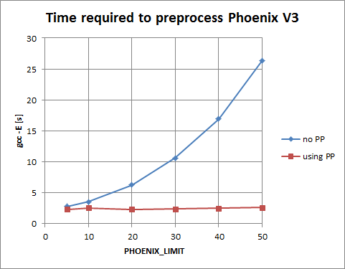
Phoenix Compile Times
Boost Phoenix V3
5/16/2011
Effect of partial preprocessing of Phoenix Headers on compile times
  No PP: without partially preprocessed headers
  Using PP: when using partially preprocessed headers

Slide 68
Phoenix Compile Times
Boost Phoenix V3
5/16/2011
T1: bind_member_function_tests.cpp
PHOENIX_LIMIT = 10 | T1 (gcc) | T1 (VC2010)
Phoenix V2 | 2.9 [s] | 2.58 [s]
Phoenix V3, no PP | 3.4 [s] | 4.05 [s]
Phoenix V3, no PP, Proto PP | 2.6 [s] | 3.43 [s]
Phoenix V3, full PP | 2.3 [s] | 2.96 [s]

Slide 69

Boost Phoenix V3
5/16/2011

Slide 70
Imagine the unimaginable
Boost Phoenix V3
5/16/2011
We modeled C++ inside C++
With the help of Proto, we created a powerful compiler toolkit
Enabling the creation of new technologies:
  Multi stage programming, completely done in C++
  Optimize code based on the high level information of the AST
  Change the evaluation of a Phoenix expression to whatever you like

