Slide 1
DeBruijn Bind
David Sankel
Stellar Science
C++Now 2013
https://github.com/camio/de-bruijn-bind
Notes:
Why are we doing this? Example of denotational design.

Slide 2
Is bind still relevant?
Yes
Polymorphic Functions
Low syntactic overhead
Performant higher order functions
Stellar Science
Notes:
Also, we don’t have an anonymous function syntax for templates . . . yet

Slide 3


How cities are made.
This is a house
struct House {…};
This is a house generator
typedef function<House ()>
HouseGenerator;
This is a city generator:
typedef function<City ()> CityGenerator;
Stellar Science

Slide 4
Lets make a city generator
struct House {…};
typedef function<House ()> HouseGenerator;
typedef function<City ()> CityGenerator;
We also have:
House make_house( int size );
City make_city( HouseGenerator g);
Task: make a CityGenerator with size 1 houses.
Stellar Science

Slide 5
City Generator
struct House {…};
typedef function<House ()> HouseGenerator;
typedef function<City ()> CityGenerator;
House make_house( int size );
City make_city( HouseGenerator g);
const CityGenerator cg = bind
( make_city
, bind( make_house, 1 ) );
Stellar Science
Notes:
This won’t compile

Slide 6
City Generator
struct House {…};
typedef function<House ()> HouseGenerator;
typedef function<City ()> CityGenerator;
House make_house( int size );
City make_city( HouseGenerator g);
const CityGenerator cg = bind
( make_city
, protect( bind( make_house, 1 ) ) );
Stellar Science
Notes:
This will

Slide 7
Flip
Takes in a two argument function and returns another version where its arguments are flipped:
Foo make_foo( Bar, Baz );
const Foo foo = flip( make_foo )( baz, bar);
template< typename F >
auto flip( F f ) -> decltype( boost::bind( f, _2, _1 ) )
{
return boost::bind( f, _2, _1 );
}
Stellar Science
Notes:
Fine and dandy, but why can we just do this as a bind statement?

Slide 8
Flip completely with bind
template< typename F >
auto flip( F f ) -> decltype( boost::bind( f, _2, _1 ) )
{
return boost::bind( f, _2, _1 );
}
Or,
auto flip = boost::bind( _1, ?
boost::apply?
boost::protect?
Stellar Science
Notes:
How do we know if this is possible at all? What we’d like to do is be able to prove that this isn’t possible if it isn’t. For this we’ll need to understand the semantics of bind.

Slide 9
λ-calculus
λ-calculus, for us, is a simple mathematical system for creating functions without values.
Let x,y,z denote identifiers (variables)
Let m,n denote lambda expressions
A lambda expression is either:
x : An variable
m n : An application. m is applied to n.
λx. m : An abstraction.
Stellar Science
Notes:
Note that we only have single argument functions here.

Slide 10
λ-calculus: Reduction Rule
(λx. m) n ⇒ m [x↦n]
m [x↦n] means to substitute all ‘x’’s in the m expression with n (doing the right thing with scoping)
Example:
(λx. (λx.x) x) y
⇒ (λx.x) x [x↦y]
⇒ (λx.x) y
⇒ x [x↦y]
⇒ y
Stellar Science
Notes:
Doing the right thing can be somewhat complicated. In the example, we skipped the substitution within the (λx.x) abstraction. This can be more complex than this though. Imagine if the substituted term had variables that were used internally to the abstraction. Generally what’s done is that substituted terms are given “fresh” variables.

Slide 11
multi-arg calculus
Grow lambda calculus to allow for functions of multiple arguments. We’ll call this language multiarg.
Let c,d denote constants
Let x_{i},y_{i},z_{i} denote identifiers (variables) where i is a positive integer.
Let m,n,o denote multiarg expressions
A multi expression is either:
c : A constant
x_{i} : A variable
m( n, o, …) : An application. 0 or more arguments
λ_{i}x. m : An abstraction. i is a non-negative integer referring to the number of arguments for this function.
Stellar Science

Slide 12
multi-arg calculus
Reduction rule:
(λ_{i}x. m)(n,o,...) ⇒ m [x₁↦n,x₂↦o,...]
Example:
(λ₃x. x₁( x₃, x₂ ) )(n, m, o) ⇒
x₁( x₃, x₂) [x₁↦n, x₂↦m, x₃↦o] ⇒
n( o, m )
Stellar Science

Slide 13
Semantics of bind in multiarg-calculus
μ⟦ bind( f, a₁ … a_{n} ) ⟧ = ?
μ⟦ bind( f, a₁ … a_{n} ) ⟧ = λ?x.?
where x is free
μ⟦ bind( f, a₁ … a_{n} ) ⟧ = λ?x.f(?)
where x is free
μ⟦ bind( f, a₁ … a_{n} ) ⟧ = λ_{maxarg(a1…an)}x.f(?)
where x is free
Stellar Science
Notes:
We’re ignoring that functions created with bind can be called with any number of parameters greater than the minimum.

Slide 14
Semantics of bind in multiarg-calculus
μ⟦ bind( f, a₁ … a_{n} ) ⟧ = λ_{maxarg(a1…an)}x.f(?)
where x is free
maxarg( a₁ … a_{n} ) = maximum( maxarg( a₁ ), … maxarg( a_{n} ) )
maxarg( _i ) = i
maxarg( bind( g, b₁ … b_{n} ) ) = maxarg(b₁ … b_{n} )
maxarg( c ) = 0
where c is anything else
Stellar Science
Notes:
We’re ignoring that functions created with bind can be called with any number of parameters greater than the minimum.

Slide 15
Semantics of bind in multiarg-calculus
μ⟦ bind( f, a₁ … a_{n} ) ⟧ = λ_{maxarg(a1…an)}x.f(?)
where x is free
μ⟦ bind( f, a₁ … a_{n} ) ⟧ = λ_{maxarg(a1…an)}x.f(α(a₁) … α(a_{n}))
where x is free
α(_i) = x_{i}
α( bind( g, b₁ … b_{n}) ) = g( α(b₁) … α(b_{n}) )
α( c ) = c
where c is anything else
Stellar Science
Notes:
We’re ignoring that functions created with bind can be called with any number of parameters greater than the minimum.

Slide 16
Back to Flip
template< typename F >
auto flip( F f ) -> decltype( boost::bind( f, _2, _1 ) )
{
return boost::bind( f, _2, _1 );
}
Flip in mutiarg-calculus:
λ₁f. (λ₂x. f₁(x₂,x₁))
Bind semantics:
μ⟦ bind( f, a₁ … a_{n} ) ⟧ = λ_{maxarg(a1…an)}x. f(α(a₁) … α(a_{n}))
where x is free
Stellar Science
Notes:
We’ve proven, via. the semantics that the flip function cannot be implemented. All is not lost however. We just need one more piece of inspiration.

Slide 17
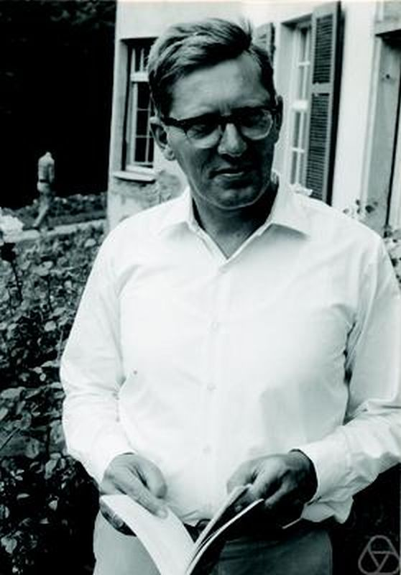
De Bruijn Indices
Nicolaas Govert de Bruijn, 1972
Created for automatic λ-calculus “formula manipulation”.
Basic Idea, instead of variables, use a number that represents the “distance” to the relevant abstraction.
Stellar Science
Notes:
He called them nameless dummies.

Slide 18
De Bruijn Indices
λx. λy (x (λx.x) y)
Stellar Science

Slide 19
De Bruijn Indices
1
λx. λy (x (λx.x) y)
Stellar Science

Slide 20
De Bruijn Indices
2
1
λx. λy (x (λx.x) y)
Stellar Science

Slide 21
De Bruijn Indices
2
1
1
λx. λy (x (λx.x) y)
Stellar Science

Slide 22
De Bruijn Indices
2
1
1
λx. λy (x (λx.x) y)
λ λ (2 (λ 1) 1)
Stellar Science
Notes:
We’ve removed all of our variable names, but haven’t changed the essential semantics. Just surface notation. Another bonus is that we no longer have the ‘hairy’ “do the right thing” issue with substitution.

Slide 23
DeBruijn-multi calculus
Grow lambda calculus to allow for functions of multiple arguments. We’ll call this language multiarg.
Let c,d denote constants
Let i_{j} denote identifiers (variables) where i and j are positive integers.
Let m,n,o denote De-bruijn-multi expressions
A De-bruijn-multi expression is either:
c : A constant
i_{j} : A variable
m( n, o, …) : An application. 0 or more arguments
λ_{i} m : An abstraction. i is a non-negative integer referring to the number of arguments for this function.
Stellar Science

Slide 24
DeBruijn-multi calculus
Reduction rule:
(λ_{i} m)(n,o,...) ⇒ m [1↦n,o,...]
Our new substitution operator works as follows:
i_{j} [i↦n₁,...,n_{j}...] ⇒ n_{j}
(λ_{k} m) [i↦n₁,...] ⇒ (λ_{k} m) [i+1↦n₁,...]
m( o₁... ) [i↦n₁,...] ⇒ (m [i↦n₁,...]) (o [i↦n₁,...] ... )
m [i↦n₁,...] ⇒ m
for any other m
Stellar Science
Notes:
The basic idea is that you increment the substitution number with every incoming lambda.

Slide 25
De Bruijn Bind
μ⟦ lam<i>( e ) ⟧ = λ_{i} μ⟦ e ⟧
μ⟦ _i_j ⟧ = i_{j}
μ⟦ app( e₁, e₂ … ) ⟧ = μ⟦ e₁ ⟧( μ⟦e₂⟧ …)
Stellar Science
Notes:
Because we’ve removed all use of variables in the semantics it is easy to write an edsl that directly translates. This is a very simple semantics.

Slide 26
De Bruijn Flip
template< typename F >
auto flip( F f ) -> decltype( boost::bind( f, _2, _1 ) )
{
return boost::bind( f, _2, _1 );
}
Recall the multi-arg meaning:
λ₁f. (λ₂x. f₁(x₂,x₁))
And in DeBruijn-multi:
λ₁ (λ₂ 2₁ (1₂,1₁))
And in De Bruijn Bind:
const auto flip = lam<1>( lam<2>( app( _2_1, _1_2, _1_1 ) ) );
Stellar Science

Slide 27
De Bruijn City Generator
struct House {…};
typedef function<House ()> HouseGenerator;
typedef function<City ()> CityGenerator;
House make_house( int size );
City make_city( HouseGenerator g);
Boost.Bind syntax:
const CityGenerator cg = bind
( make_city
, protect( bind( make_house, 1 ) ) );
De Bruijn Bind syntax:
const CityGenerator cg = lam<0>
( app( make_city
, app( make_house, 1 ) ) );
Stellar Science
Notes:
Note that there’s no need for a special “protect” syntax. The semantics handle this case cleanly.

Slide 28
Powerful Polymorphic Functions
// compose( f, g )( x ) = f( g( x ) );
const auto compose
= lam<2>
( lam<1>
( app( _2_1, app( _2_2, _1_1 ) ) ) );
// always( x )( y ) = x (for any y)
const auto always
= lam<1>
( lam<1>
( _2_1 ) );
Stellar Science
Notes:
None of these are possible with bind. We would otherwise require making a ‘functor’ to do this.

Slide 29
Powerful Polymorphic Functions
// curry( f )( a )( b ) = f( a, b )
const auto curry
= lam<1>
( lam<1>
( lam<1>
( app( _3_1, _2_1, _1_1 ) ) ) );
Stellar Science
Notes:
Remember that all these functions will have inlined execution.

Slide 30
Bind and De Bruijn Bind
 | Boost.Bind | De Bruijn Bind
Function Coverage | Incomplete | Complete
Lexemes | 4 | 3
Semantics | Complex | Simple
Polymorphic results | No | Yes
Stellar Science

Slide 31
Extending De Bruijn Bind
Lazy lambdas
Recursive functions
Stellar Science

Slide 32
Lazy Lambdas
const auto f
= lam<0>(
app(
lam<1>( app( plus, _1_1, _1_1 ) ),
app( plus, 3, 5 ) ) );

Slide 33
Recursion
_i_j is now defined for when j=0
When j=0 the syntax references the function itself being defined.
fib:

Slide 34
Fibbonacci function
const auto fib
= lam<1>(
app(
iff,
app( lessThan, _1_1, 2 ),
1,
app( plus
, app( _1_0, app( subtract, _1_1, 1 ) )
, app( _1_0, app( subtract, _1_1, 2 ) )
) ) );
Notes:
Assembly language for sugared lambda languages. This is a good example to show the readability limitations. Names are nice.

Slide 35
DeBruijn Bind
A more powerful bind that retains its simplicity.
Credits:
Larry Evans, Robert Stewart, Stefan Strasser, Dave Abrahams, OvermindDL1, Joel de Guzman, Scott McMurray, Manjunath Kudlur, and Jacob Smith for stimulating discussion on Boost-dev which led to the current look-and-feel.
Stellar Science

