Slide 1

The Concepts of Concepts
Sandor DARGO (TEC-RES-MNI)
22nd April 2021

Slide 2

Who Am I?
Sándor DARGÓ
Software developer in Amadeus
Enthusiastic blogger https://www.sandordargo.com
(A former) Passionate traveller
Curious home baker
Happy father of two
‹#›
Notes:
‹#›

Slide 3
Agenda
Why do we need concepts?
4 ways to use concepts with functions
Concepts with classes
What is in the STL?
How to write concepts?
Real-life examples

Slide 4
Why do we need concepts?

Slide 5
What are concepts?
One of the new major features of C++20
Extension for templates
Compile-time validation of template arguments

Slide 6
Overloads don’t scale
Tedious to write all
Verbose
Difficult to maintain
long double add(long double a, long double b) {
return a+b;
}
int add(int a, int b) {
return a+b;
}
int main() {
add(42, 66);
}

Slide 7
Templates allow just anything
No constraints
Potentially unexpected behaviour
Is that really what you want?
template <typename T>
T add(T a, T b) {
return a+b;
}
int main() {
add(42, 66);
add(42.42L, 66.6L);
add('a', 'b');
}

Slide 8
Forbid template specializations
It works
But it doesn’t scale!
template <typename T>
T add(T a, T b) {
return a+b;
}
template<>
std::string add(std::string, std::string) = delete;
int main() {
add(std::string{"a"}, std::string{"b"});
}

Slide 9
What about type traits?
template <typename T>
T add(T a, T b) { static_assert(std::is_integral_v<T> || std::is_floating_point_v<T>, "add can be called only with numbers");
return a+b;
}
int main() {
add(std::string{"a"}, std::string{"b"});
}
Nice(r) error messages!
Less overhead
Everything is at one place
Not intuitively easily reusable

Slide 10
Concepts to the rescue
Readable
Scalable
Reusable
template <typename T>
concept Number = std::integral<T> || std::floating_point<T>;
template <Number T>
auto add(T a, T b) {
return a+b;
}
int main() {
add(1, 2);
}

Slide 11
How concepts help us?
Make templates more safe
Make generic programming scalable
Allow putting more domain knowledge into code

Slide 12
4 ways to use concepts with functions

Slide 13
Disclaimer: concept incomplete!
We are going use the concept Number
It’s incomplete
Bear with me
#include <concepts>
template <typename T>
concept Number = std::integral<T> || std::floating_point<T>;

Slide 14
Using the requires clause (I)
requires following the template parameter list
After requires write your concept(s) to be satisfied
template <typename T>
requires Number<T>
auto add(T a, T b) {
return a+b;
}

Slide 15
Using the requires clause (II)
Concepts can be combined in different ways*
In fact not only concepts
template <typename T>
requires std::integral<T> || std::floating_point<T>
auto add(T a, T b) {
return a+b;
}

Slide 16
Using the requires clause (III)
Multiple template parameters can be constrained
template <typename T, typename U>
requires Number<T> && Number<U>
auto add(T a, U b) {
return a+b;
}

Slide 17
Using the requires clause (IV)
Function calls “as usual”
Better error messages!
add(2, 3);
add(2, 3.14);
no matching function for call to 'add(int, double)'
17 | std::cout << add(2, 3.14);
candidate: 'template<class T> requires Number<T> auto add(T, T)'
9 | auto add(T a, T b) {
template argument deduction/substitution failed:
deduced conflicting types for parameter 'T' ('int' and 'double')
17 | std::cout << add(2, 3.14);

Slide 18
Trailing requires clause
requires comes after cv qualifiers
Apart from that, same as “normal” requires clause
Supports
combinations
multiple parameter types
template <typename T>
auto add(T a, T b) requires Number<T> {
return a+b;
}

Slide 19
Constrained template parameter
No more requires clause
typename is replaced by the concept
Supports multiple parameters
Doesn’t support a combination of concepts
template <Number T>
auto add(T a, T b) {
return a+b;
}

Slide 20
Abbreviated function templates
No requires, no template parameter list
Use ConceptName auto in the parameter list
Parameter types can be implicitly different
No support for combinations
auto add(Number auto a, Number auto b) {
return a+b;
}

Slide 21
How to choose among the 4 ways?
Do you have a complex requirement?
Choose requires or trailing requires!
Only a simple requirement?
Take abbreviated function templates!
Simple requirements? Want to keep it short and want to control to binded types of the parameters?
Go with the constrained template parameter!

Slide 22
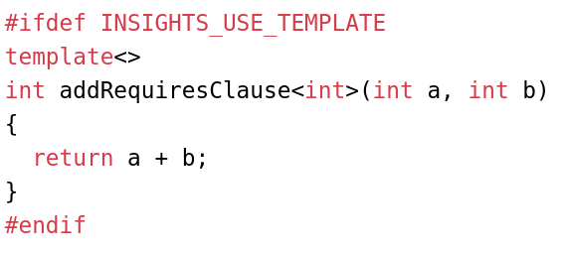
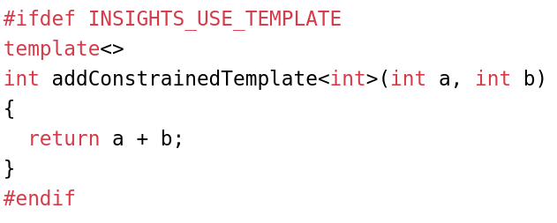
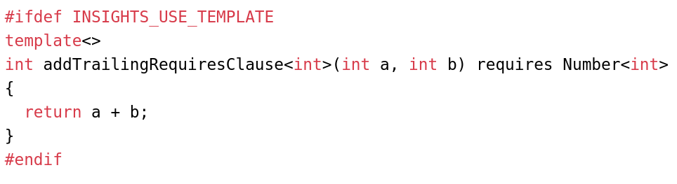
Are they all the same after all?

Slide 23
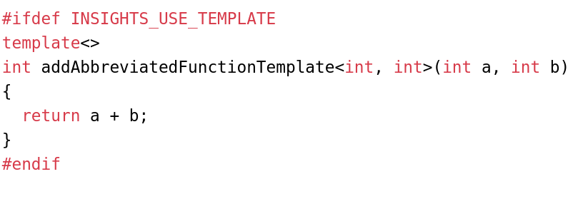
There is an expected difference

Slide 24
How to use concepts with classes

Slide 25
Fewer syntactical choices
Abbreviated function templates wouldn’t make sense
Trailing requires clause only in certain circumstances

Slide 26
The requires clause
template <typename T>
requires Number<T>
class WrappedNumber {
public:
WrappedNumber(T num): m_num(num) {}
private:
T m_num;
};
requires following the template parameter list
After requires write your concept(s) to be satisfied
You can use complex constraints

Slide 27
Constrained template parameters
Instead of typename keyword use simply a concept
No complex constraints
template <Number T>
class WrappedNumber {
public:
WrappedNumber(T num): m_num(num) {}
private:
T m_num;
};

Slide 28
Have different paths
template <typename T> class MyNumber { public:
T divide(const T& divisor) requires std::integral<T> { // … }
T divide(const T& divisor) requires std::floating_point<T> { // … } };
Class level templates with concepts on functions
Provide different “overloads” for different parameter types

Slide 29
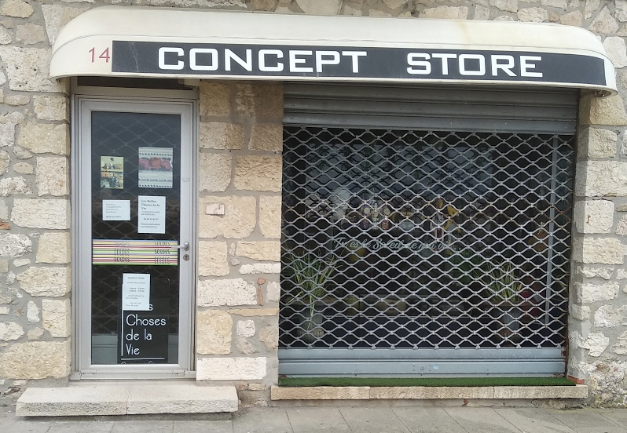
What is in the STL?

Slide 30
~50 concepts in 3 headers
<concepts>
<iterator>
<ranges>

Slide 31
Concepts in the <concepts> header
Core language concepts (same_as, integral, constructible_from...)
Comparison concepts (totally_ordered...)
Object concepts (copyable, regular...)
Callable concepts (invokable, predicate…)

Slide 32
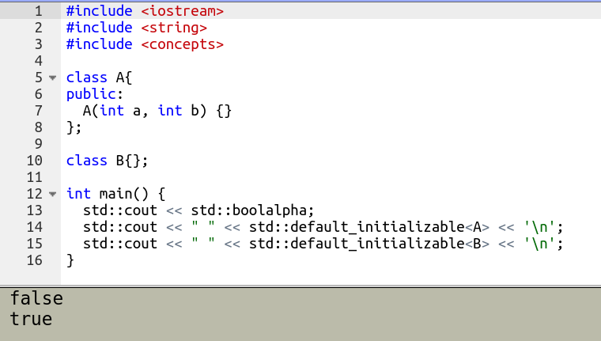
Can a type be default initialized: std::default_initializable
template<class T>
concept default_initializable = std::constructible_from<T> &&
requires { T{}; } &&
requires { ::new (static_cast<void*>(nullptr)) T; };

Slide 33
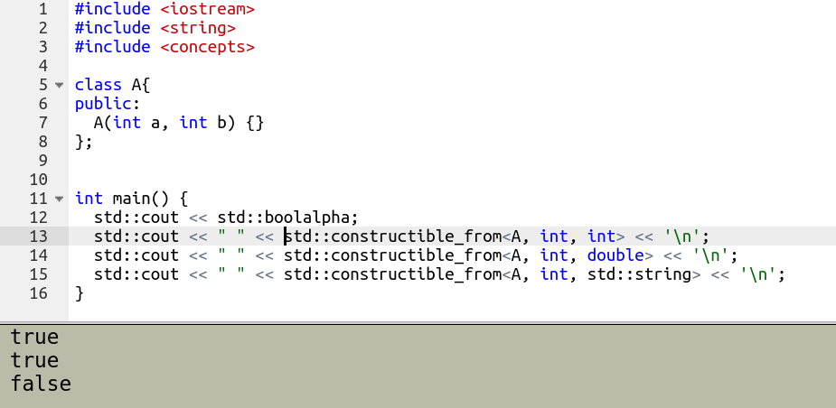
Is a type constructible from a list of types:
std::constructible_from
template < class T, class... Args >
concept constructible_from =
std::destructible<T> && std::is_constructible_v<T, Args...>;

Slide 34
Concepts in the <iterator> header
Iterator concepts (incrementable, input_iterator...)
Indirect callable concepts (indirectly_unary_invocable...)
Common algorithm requirements (mergeable, sortable...)

Slide 35
std::output_iterator
template <class I, class T>
concept output_iterator = std::input_or_output_iterator<I> && std::indirectly_writable<I,T> && requires(I i, T&& t) {
*i++ = std::forward<T>(t); // not required to be equality-preserving
};
A refinement of input/output iterator
Writeable
Not required to preserve equality

Slide 36
std::indirect_unary_predicate<F, I>
Is the passed in type a unary predicate?
Callable
Returning a bool
Taking one parameter
template<class F, class I>
concept indirect_unary_predicate =
std::indirectly_readable<I> &&
std::copy_constructible<F> &&
std::predicate<F&, std::iter_value_t<I>&> &&
std::predicate<F&, std::iter_reference_t<I>> &&
std::predicate<F&, std::iter_common_reference_t<I>>;

Slide 37
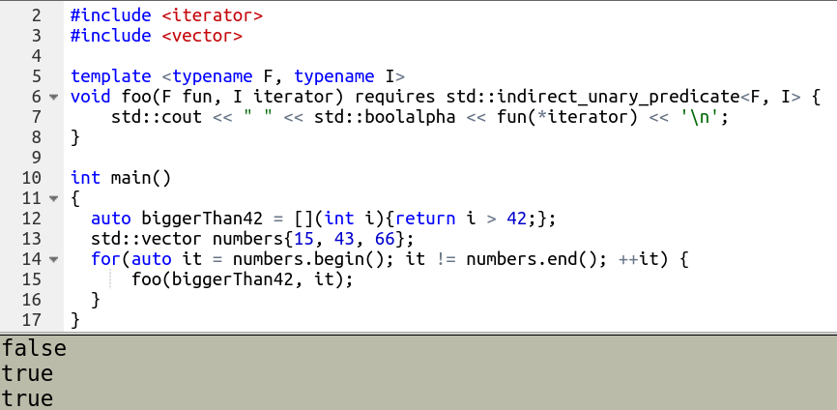
std::indirect_unary_predicate<F, I>

Slide 38
How to write concepts?

Slide 39
What is the simplest concept?
List all template parameters
After the keyword concept comes the name
Then the requirements
template<typename T>
concept Any = true;

Slide 40
Combine already defined concepts
Existing concepts can be recombined
User defined ones also!
Use them in any logical combination*
#include <concepts>
template<typename T>
concept Number = std::integral<T> || std::floating_point<T>;

Slide 41
What does combining concepts mean?

Slide 42
Conjunctions (&&) and disjunctions (||) are OK
You are free to combine
concepts
bool literals
bool expressions
type traits (::value, _v)
requires expressions
Beware of the !
#include <concepts>
template <typename T>
concept Number = std::integral<T> || std::floating_point<T>;

Slide 43
What does the ! say?
For boolean expressions, subexpressions
Are well-formed
Compile
Return false
For concepts, a subexpression
Can be ill-formed
Might return false
The rest can be still satisfied

Slide 44
The opposite of true is not false
template <typename T, typename U>
requires std::unsigned_integral< typename T::Blah> || std::unsigned_integral< typename U::Blah>
void foo(T bar, U baz) { /*...*/ }
class MyType { public: using Blah = unsigned int; // … };
It doesn’t have to be compilable
It can return false
Expecting false is possible
With a cast to bool
Or with a more explicit way

Slide 45
There is always another way
template <typename T, typename U> requires ( requires {typename T::Blah;} && requires { typename U::Blah;}) && (std::unsigned_integral< typename T::Blah> || std::unsigned_integral< typename U::Blah>) void foo(T bar, U baz) { /*...*/ }
template <typename T, typename U>
requires (bool(std::unsigned_integral< typename T::Blah> || std::unsigned_integral< typename U::Blah>))
void foo(T bar, U baz) { /*...*/ }

Slide 46
How to find the most constrained constraint?

Slide 47
The constrained one will be automatically chosen
The right path will be chosen based on the call
template <typename Key> class Ignition {
public:
void start(Key key) requires (!Smart<Key>) { // … }
void start(Key key) requires Smart<Key> { // … } };

Slide 48
The constrained one will be automatically chosen
No need for negating a constraint
template <typename Key> class Ignition {
public:
void start(Key key) requires (!Smart<Key>) { // … }
void start(Key key) requires Smart<Key> { // … } };

Slide 49
The most constrained will be automatically chosen
The most appropriate overload will be chosen at compile-time
All this happens via concepts subsumption
template <typename Key> class Ignition {
public:
void start(Key key){}
void start(Key key) requires Smart<Key> {} void start(Key key) requires Smart<Key> && Personal<Key> {} };

Slide 50


Negations bring ambiguity - use named concepts
template <typename Key> class Ignition {
public:
void start(Key key){}
void start(Key key) requires (!Smart<Key>) {} void start(Key key) requires (!Smart<Key>) && Personal<Key> {} };
template <typename Key> class Ignition {
public:
void start(Key key){}
void start(Key key) requires NotSmart<Key> {} void start(Key key) requires NotSmart<Key> && Personal<Key> {} };

Slide 51
So how to write concepts?

Slide 52
Requirements on operations
Use wishful writing!
Write down the operation expected to be supported by the template parameters
List all the variables used in the requirements after the requires keyword
#include <concepts>
template <typename T>
concept Addable = requires (T a, T b) {
a + b;
};

Slide 53
Simple requirements on the interface
You can name any function too
You can even use parameters, just list them along with their types
template <typename T> concept HasSquare = requires (T t){ t.square(); };
template <typename T> concept HasPower = requires (T t, int exponent) { t.power(exponent); };

Slide 54
Requirements on return types (compound requirements)
Constraint the return types
std::convertible_to<T>
std::same_as<T>
Pay attention to the braces!
No bare type for future generalizations
template <typename T>
concept HasSquare = requires (T t) {
{t.square()} -> std::convertible_to<int>;
};

Slide 55
Type requirements
A certain nested type exists
A class template specialization names a type
An alias template specialization names a type

Slide 56
Require nested types
std::vector has inner member type value_type
int doesn’t have any member type =>
error: deduced initializer does not satisfy placeholder constraints ... the required type 'typename T::value_type' is invalid
template<typename T> concept TypeRequirement = requires { typename T::value_type; };
int main() { TypeRequirement auto myVec = std::vector<int>{1, 2, 3}; // TypeRequirement auto // myInt {3}; }

Slide 57
Require nested template specializations
Make sure that a type can be used as a template parameter for another type
Error: the required type 'Other<T>' is invalid
template <typename T> requires (!std::same_as<T, std::vector<int>>) struct Other {};
template<typename T> concept TypeRequirement = requires { typename Other<T>; };
int main() { TypeRequirement auto myVec = std::vector<char>{'a', 'b', 'c'}; // TypeRequirement auto myVec2 = // std::vector<int>{1, 2, 3}; }

Slide 58
Requirements on alias template specializations
To make sure that an alias template specialization names a type
template<typename T> using Reference = T&;
template<typename T>
concept TypeRequirement = requires {
typename Reference<T>;
};

Slide 59
Concepts can be nested
Introduce additional constraints without new named concepts
template<typename C> concept Car = requires (C car) { car.startEngine(); };
template<typename C> concept Convertible = Car<C> && requires (C car) { car.openRoof(); };
template<typename C> concept Coupe = Car<C> && requires (C car) { requires !Convertible<C>; };

Slide 60
But it would be easier if we wrote...
template<typename C>
concept Coupe = Car<C> && !Convertible<C>;

Slide 61
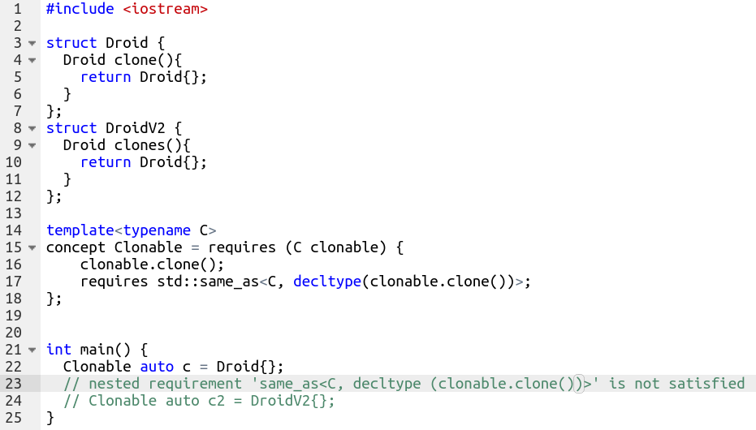
Still a complex nested requirement
Use nested requirements on local variables/parameters
Nested requirement to check what Clonable returns
But...

Slide 62
But there is often a simpler option
template<typename C>
concept Clonable = requires (C clonable) {
{ clonable.clone() } -> std::same_as<C>;
};

Slide 63
Nest to simulate boolean expressions
template <typename T, typename U> requires ( requires {typename T::Blah;} && requires { typename U::Blah;}) && (std::unsigned_integral< typename T::Blah> || std::unsigned_integral< typename U::Blah>) void foo(T bar, U baz) { /*...*/ }
template <typename T, typename U>
requires (bool(std::unsigned_integral< typename T::Blah> || std::unsigned_integral< typename U::Blah>))
void foo(T bar, U baz) { /*...*/ }

Slide 64
Nested requirements on requires parameters
Though it can be constrained one level higher
Question of readability
template <typename Base, typename Exponent>
concept HasPower = requires (Base base, Exponent exponent) {
base.power(exponent);
requires std::integral<Exponent>;
};

Slide 65
Real-life examples

Slide 66
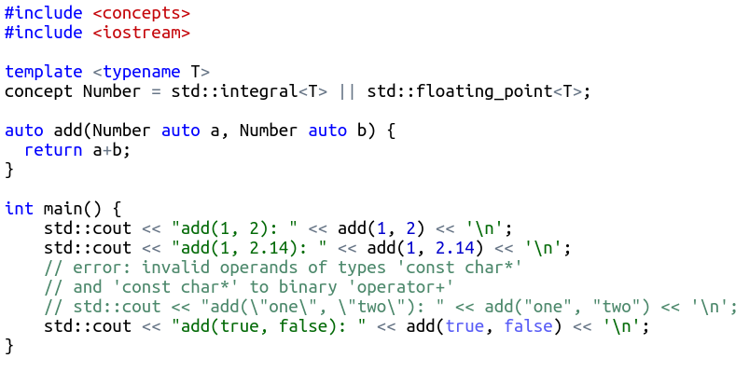
Numbers, please nothing else
Some integral types are not numbers:
bool
char et al.

Slide 67
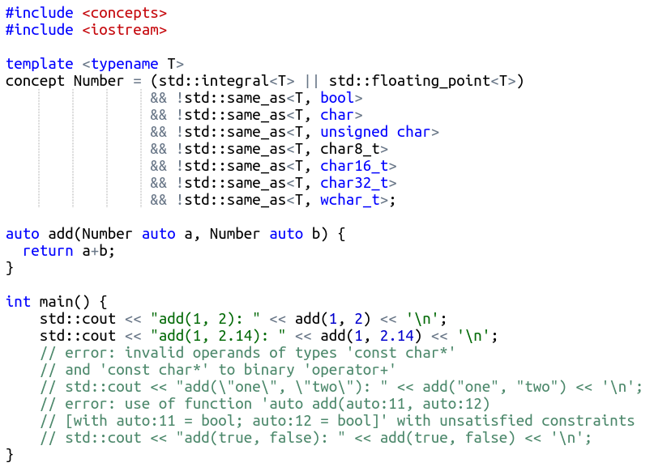
Let’s forbid unwanted types
No bools
No chars

Slide 68
Turn poorly documented utility functions...
They usually take any templates
No static assertions
Bad template parameter names (T, U, etc.)
No documentation
template <typename BusinessObjectT>
void encodeSomeStuff( BusinessObjectT iBusinessObject) {
// ...
}

Slide 69
… into self-documenting code
template <typename BOWithEncodeableStuff_t> concept BOWithEncodeableStuff = requires (BOWithEncodeableStuff_t bo) { bo.interfaceA(); bo.interfaceB(); { bo.interfaceC() } -> std::same_as<int>; };
void encode(BOWithEncodeableStuff auto iBusinessObject) { /*...*/ }
No more naked Ts
No more unconstrained typenames

Slide 70
Even if some concepts are not for reuse
Concept can be “inlined”
Cannot use a parameter in an unnamed context
Hence the nested requires clause
template <typename BOWithEncodeableStuff_t> requires requires (BOWithEncodeableStuff_t bo) {
bo.interfaceA(); bo.interfaceB(); { bo.interfaceC() } -> std::same_as<int>; } void encodeSomeStuff(BOWithEncodeableStuff_t iBusinessObject) { /*...*/ }

Slide 71
Conclusion

Slide 72
Key takeaways
Concepts help validate template arguments at compile-time
Concepts provide a reusable and scalable way to constrain templates
The standard library gives dozens of generic concepts
There are plenty of ways to define our concepts

Slide 73
Call to action
Start using concepts as soon as you switch to C++20
Use them for your applications
No more naked Ts and typenames

Slide 74

Q&A!

Slide 75
The Concepts of Concepts
Sandor DARGO (TEC-RES-MNI)
22nd April 2021

