Slide 1


Slide 2
We start, as always, with a poem
Matt Bentley, CPPNow! 2021
mattreecebentley@gmail.com

Slide 3

Cowards

Slide 4
Cheap Shot

Slide 5
Purpose of talk
Hey I’m matt and stuff. https://plflib.org
The CPPcon 2016 talk (https://youtu.be/wBER1R8YyGY) was high-level overview, benchmarks, etc. Now is outdated in terms of tech description.
Code and std::colony proposal give combinations of low-level and high-level instruction.
This talk is designed to give you mid-level nuts-and-bolts implementation information so you can interpret the code and papers with more ease.

Slide 6
Colony has?
Low and constant latency for most ops
High iteration speed
Extremely high erase and insert speed
Valid pointers/iterators/references to non-erased elememts regardless of subsequent erase/insert/emplace

Slide 7
Good for scenarios where
You have a lot of unordered data and you're erasing/inserting on the fly, and/or
You have multiple collections of interrelated data, and/or
Preserving the pointer/iterator validity of non-erased elements is important.

Slide 8
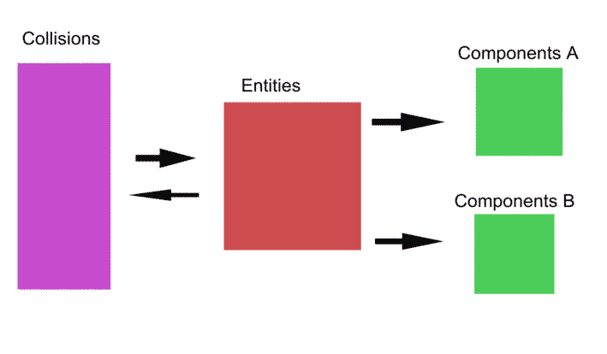
Game example

Slide 9
Three Core Aspects
A collection of element memory blocks + metadata, to prevent reallocation during insertion (as opposed to a single memory block).
A method of skipping erased elements in O(1) time during iteration (as opposed to reallocating subsequent elements during erasure, or doing individual allocation of elements).
An erased-element location recording mechanism, to enable the re-use of memory from erased elements in subsequent insertions, which in turn increases cache locality and reduces the number of block allocations/deallocations.

Slide 10
1. Collection of element memory blocks + metadata
Can do linked list of blocks, or vector of pointers to blocks.
Blocks have growth factor, so cannot do vector of blocks.
Minimum/maximum block capacities can be user-defined.
Can house block metadata separately, or together in a struct.
Metadata includes skipfield or other erasure-skipping mechanism, and any data related to erased-location recording.
Necessary metadata: size (in order to remove blocks once empty) and capacity (in order to ascertain end-of-block).

Slide 11
Why remove memory blocks once empty?
Stops iteration from being O(1).
Introduces unacceptable latency.
However:
We can remove blocks from the iterative chain and retain them as ‘reserved’ blocks (as reserve() does). Either at back of list/vector of memory blocks, or in separate list/vector.

Slide 12
What blocks to retain?
Want to avoid retaining small blocks for cache locality reasons.
Could retain back blocks and maximum-capacity blocks.
My benchmarking has shown only back blocks are worthwhile to keep, performance-wise.
Retaining back blocks also reduces allocation/deallocation with stack-like scenarios.
One can end up with many retained blocks, scenario-dependent. Hence trim() was introduced (different to shrink_to_fit()).

Slide 13
2. A method of skipping erased elements in O(1) time - Definitions
LCJC: Abbreviation of ‘low complexity jump-counting’.
HCJC: Abbreviation of ‘high complexity jump-counting’.
Block: Refers to the colonys’ element memory block.
Skipfield: An array of integers or bits used to skip over certain objects in an accompanying data structure during iteration.
Skipblock: A run of skipped nodes within a skipfield.
Start node: The first node in any skipblock.
End node: The last node in any skipblock.
Middle node: Any non-start/end node in a skipblock.

Slide 14
Boolean Skipfields
Disadvantages:
Non-O(1)
Unacceptable latency
Branching
Advantages:
Simple
Potentially useful for a multi-threaded version of colony (atomics, etc)

Slide 15
Low & high-complexity jump-counting skipfields
See https://plflib.org for full papers.
Refers to time-complexity of algorithms.
Previously referred to as advanced and simple jump-counting skipfields – inaccurate.
Both provide O(1) iteration between any two non-erased elements. Time complexity differs for modification of fields.
HCJC allows recording of middle nodes, LCJC doesn’t.
Acronym - Theyaton: Traversing homogenous elements yielding amortised time O(n).

Slide 16
High-complexity jump-counting skipfield
Boolean:
0 0 0 1 1 1 1 1 1 0 0 0
Equivalent HCJC:
0 0 0 6 2 3 4 5 6 0 0 0
Start/end nodes record length of runs of erased elements.
Middle nodes record left distance to first non-erased element.
Useful when recording/reusing individual skipped nodes rather than skipblocks.

Slide 17
Low-complexity jump-counting skipfield
Boolean:
0 0 0 1 1 1 1 1 1 0 0 0
Equivalent LCJC:
0 0 0 6 2 6 7 3 6 0 0 0
OR
0 0 0 6 0 0 0 0 6 0 0 0
OR
0 0 0 6 0 5 2 1 6 0 0 0

Slide 18
Low-complexity jump-counting skipfield
Start/end nodes record skip length as per HCJC, middle nodes record nothing, are essentially random and unmaintained.
Good when recording and re-using skipblocks rather than individual skipped nodes.
Lower time-complexity – O(1) in all operations, as opposed to undefined time complexity for some equivalent HCJC ops.
Fewer instructions overall.

Slide 19
++ iteration code
Boolean skipfield (where S is skipfield array and i is index):
do {++i;} while (S[i] == 1);
Jump-counting skipfield:
++i;
i += S[i];
No branching, no loops, no reliance on branch prediction.
See plflib.org/skipfield_comparison.htm for benchmarking.

Slide 20
Per-memory-block vs global skipfields
Global skipfields create reallocation when empty blocks are removed from the iterative chain, invalidating pointers. Hence not workable if iterator uses a pointer to the skipfield. Also, this creates unacceptable and unpredictable latency during erase.
Global skipfields also force use of platform-bit-width integers nodes due to the potential width of a skipblock.
Per-element-memory-block skipfields obviate these problems, making removing element blocks trivial.
With a bit of magic, skipfields can be allocated in same block as element memory block, reducing allocations/deallocations.

Slide 21
Memory block capacities and skipfield bit-widths
Bit-width of the skipfield effectively limits the capacity of element memory blocks, as a jump-counting skipfield node must be able to skip numbers of elements up to (capacity – 1).
So a 16-bit unsigned integer skipfield makes the maximum block capacity 65536 elements. 32-bit performs worse, as with very large memory blocks, the statistical likelihood of large numbers of erased elements between non-erased elements, and resultant low cache locality & memory waste, becomes high. And due to the limits of CPU cache capacities.
8-bit unsigned skipfields, which make the maximum block capacity 256, perform better for < 1000 elements.

Slide 22
Things which might have occurred to you by now:
You could, with a LCJC skipfield, use multiple consecutive skipfield nodes of a lower bit-width to define larger skips eg. 2 x 8-bit integers. But this forces a branch to check for a marker of this eg. numeric_limits::max(). Reduces memory use at the cost of performance. Untested, unbenchmarked.
Another approach uses bit-arrays to determine whether a given node is skipped and stores the jump-counting data in the erased-element memory space instead. This reduces skipfield memory usage to 1 bit per element but increases over-alignment of type, forces a branch, bit-shift & logical AND, plus increases reads from memory. Untested, unbenchmarked.

Slide 23
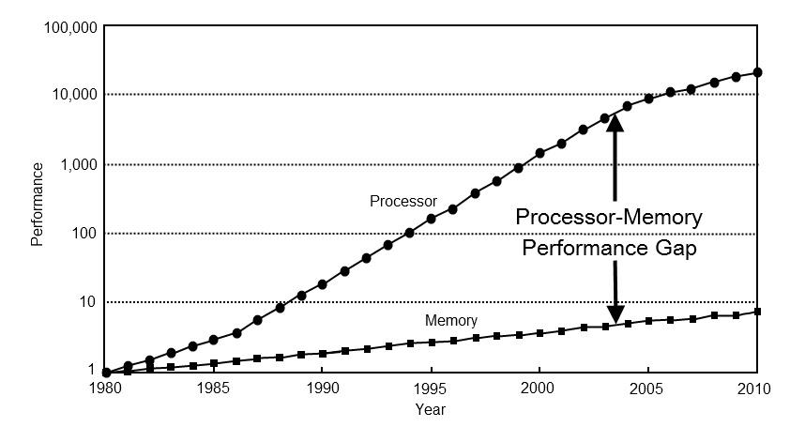
3. An erased-element location recording mechanism
If we don’t re-use erased locations,
cache locality of element reading
drops (you understand that problem
by now, of course), and end up doing
more allocations/deallocations than
we need to.
Can’t use a stack of pointers to erased element locations, due to allocation potentially causing exceptions during erase.
Scanning skipfields for skipblocks is time-consuming, non-O(1).
A ‘free list’ is (probably) the only realistic possibility.

Slide 24
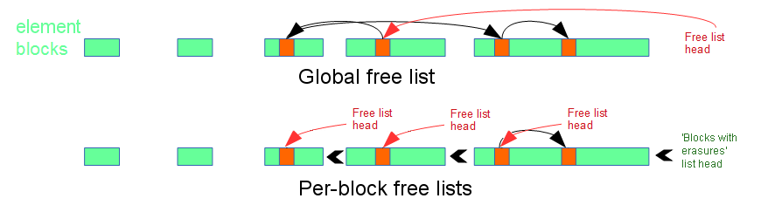
Free lists explained
Linked list of erased elements (typically singly-linked) using erased element memory space reinterpret_cast’d via pointers as linked list nodes:

Slide 25
Free lists, continued
Using a free list means (in the context of a container) that you have to over-align your type to the width of a free list node.
Using pointers means over-alignment to potentially 64 bits, or 128 bits for a doubly-linked list.
Per-block index-based free-lists reduce the necessary bit-depth of the free list node down to the minimum bit-depth necessary to describe the capacity of the memory block.
A global free list requires pointers instead of indexes in the context of a bidirectional container like colony. It also requires traversing the list when memory blocks are erased (non-O(1)).

Slide 26
Free-lists + HCJC Skipfields
In a HCJC skipfield it’s possible to record the location of a middle node & update its skipblock if the element memory space that node corresponds to is re-used.
But reusing only the start or end nodes of a skipblock is faster, as it doesn’t split skipblocks in two, which involves more operations.
This also reduces the number of jumps during iteration and increases cache locality.
Therefore a free list of skipblocks, instead of a free list of individual skipped nodes, is optimal.

Slide 27
Free-lists + LCJC skipfields
In a LCJC skipfield it is not possible to determine the location of the start and end nodes of a skipblock from the values of the middle nodes. So using this instead of a HCJC actually requires a free list of skipblocks instead of skipped nodes. Remember, all three of these are valid LCJC skipfields and all do the same thing:
0 0 0 6 2 6 7 3 6 0 0 0
OR
0 0 0 6 0 0 0 0 6 0 0 0
OR
0 0 0 6 0 5 2 1 6 0 0 0

Slide 28
Free-lists + HCJC or LCJC Skipfields, continued
If we’re only recording skipblocks in our free lists, we have to have a doubly-linked free-list.
The reason is that when an erasure of a node between two skipblocks occurs, this forces the removal of one of the two skipblocks from the free list, as they join together. This problem does not occur when only recording individual skipnodes.
The doubly-linked free list allows us to update the previous/next nodes for both free list entries of the two skipblocks. If we were using a singly-linked free list, we would have to traverse the entire free list to find the previous nodes of the two free lists.

Slide 29
Current implementation, summary
Intrusive linked list of group structs (pointers to memory blocks + block metadata, including pointer to skipfield). Growth factor is 2x, minimum capacity is algorithmic based on type size. Maximum capacity is numeric_limits::max() of skipfield type.
LCJC skipfield using unsigned 16-bit integers by default, switchable to 8-bit for reduced memory usage and higher performance on lower numbers of elements.
Per-memory-block doubly-linked index-based free lists of skipblocks, with a per-container intrusive singly-linked list of ‘blocks with erasures’ (head is member variable).

Slide 30
Iterator structure
Pointers to: group (memory block + metadata struct), element, and corresponding skipfield node.
Could alternatively use a group pointer (or group index if using a vector of pointers to groups) + index. However on all three separate occasions where I’ve implemented and benchmarked this, it has been slower than the pointer approach.
Obviously if you use a different approach for the skipping mechanism, such as the bit-array + jump-counting skipfield mentioned, the structure will be very different.

Slide 31
Iterator structure - details
Extra node added in skipfield to enable faster iteration code ie.
++i;
i += S[i];
// Check for end of block here
Not:
++i;
// Check for end of block here
i += S[i];
// Check for end of block here

Slide 32
Fun stuff :)
Advance/next/prev/distance/range-erase optimisation
Range/fill/initializer_list insert/assign optimisation
Splicing (briefly)
Sorting (briefly)

Slide 33
Advance/next/prev/distance/range-erase optimisation
Results in time complexity between O(1) and O(n), depending on location of iterator(s), the specified distance, and the state of the colony memory blocks. Statistical average of O(log n). Typically better than O(n).
For first and last blocks, we use ++ iteration (O(n)) or pointer arithmetic (O(1)) depending on whether those blocks contain erasures (ie. does capacity == size?). Back block is special case.
Intermediary blocks are skipped using size metadata. In distance() these are identified as any blocks aside from the first block which do not contain the second iterator.

Slide 34
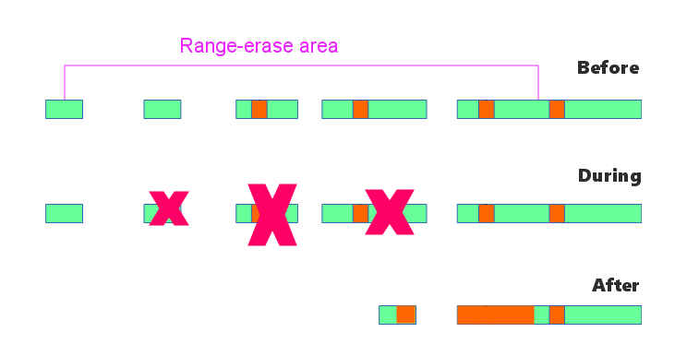
Range-erase example

Slide 35
Additional notes for range-erase
If the first and last blocks in the range have erasures, areas of skipfield within the range are iterated over to find any skipblocks – if found these are removed from the blocks’ free list. Having a doubly-linked free list makes the removals O(1).
Alternatively one could iterate over the blocks’ free list to find skipblocks within the erased area, but this is non-linear memory traversal and slow for blocks with large numbers of skipblocks.
If element type is trivially-destructable, removing intermediary blocks is O(1). Otherwise it’s O(n) ie. we iterate & destruct.

Slide 36
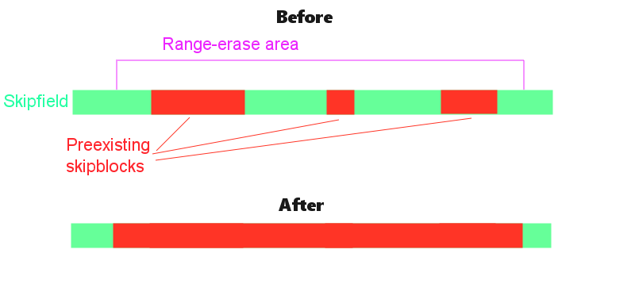
Range-erase example 2

Slide 37
Range/fill/initializer_list insert/assign optimisation
If the colony is empty, this is a reserve + block-fill, creating as many blocks as are necessary to hold the range. If not empty, we:
Reuse any available skipblocks in their entirety, zero-wiping their entries from the skipfield & removing from the free list.
Only once we find a skipblock larger than the remainder of elements to be inserted do we truncate that skipblock instead of removing it.
If there is a remainder after all skipblocks have been used up, at that point back-of-colony space is used and/or new blocks allocated.

Slide 38
Splicing
Splicing must maintain pointer validity.
Range splicing would mean splitting up memory blocks so is not possible & only full container splicing is available in colony.
Location of spliced blocks is implementation-defined to allow for optimisations – for example, when the back block has more empty space at the end in the destination than the source.
Operation transfers ownership of blocks, creates skipblock out of the unused space at the back of whichever colony is placed first, then updates the linked list of ‘blocks with erasures’ to include new blocks.

Slide 39
Sorting
Yes, unordered insertion but sortable. May be useful to some.
Sort technique implementation-defined.
My implementation uses indiesort technique (an outgrowth of plf::list). Similar to Morwenn’s Mountainsort, allows use of random-access sort techniques (eg. std::sort) with non-random-access containers. Sorts pointers to elements based on the values they point to, then subsequently reallocates elements based on the order of pointers. Full details: https://plflib.org/indiesort.htm

Slide 40
Questions/queries/peccadilloes/bemusements?
https://plflib.org
mattreecebentley@gmail.com

Slide 41

Fare thee well
Courtesy of XKCD (https://xkcd.com/license.html)

