Slide 1


Slide 2
Personal Log: Where No Init Has Gone Before
An Exploration on the C++ Fringe…

Slide 3
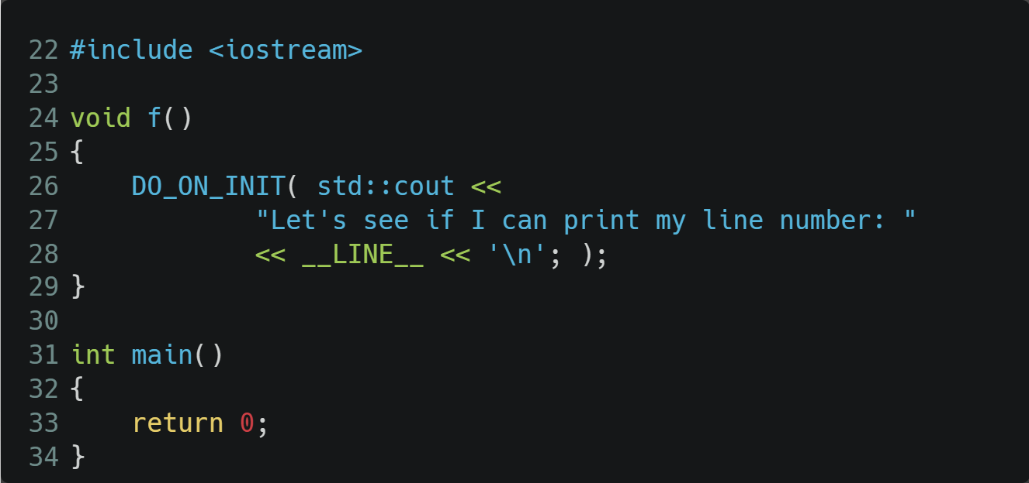
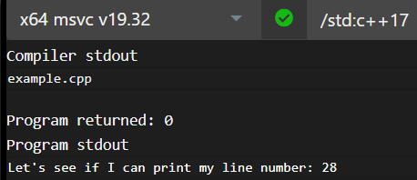
…Where the Uncalled for Happens Anyway
Notes:
https://godbolt.org/z/GGWeMYeeY
https://carbon.now.sh/euFYBBvHUqmJPi0CA0FW
…or in our case where uncalled code happens anyway

Slide 4
Before We Go Any Further
I won’t be showing you actual logging stuff:
File IO
Parameter handling
I will be showing you:
Text encoding & decoding without any pre-processing
The implementation of DO_ON_INIT
In C++ 17
Notes:
This is about the logged payload, not about the logger itself.
No preprocessor other than the built-in one (I do need macros, sorry)

Slide 5
Who Am I?
Andrei Zissu
Israeli C++ programmer
Multiple industries over the past 2 decades
Mobile, cyber, multimedia and more
Member of WG21 Israeli NB
Special interest in reflection, and lately also in contracts
Working as Windows Tech Lead at Morphisec – provider of Automated Moving Target Defense

Slide 6
A Few Things Have Happened Since I Last Presented This
A few errors were pointed out to me
A few things can be done in a simpler way
Compiler Explorer lost support for MSVC executors
I started experimenting with reflection

Slide 7
How It All Started
“Hi Andrei. Please remove sensitive log strings from our shipped binaries”
Simple…

Slide 8
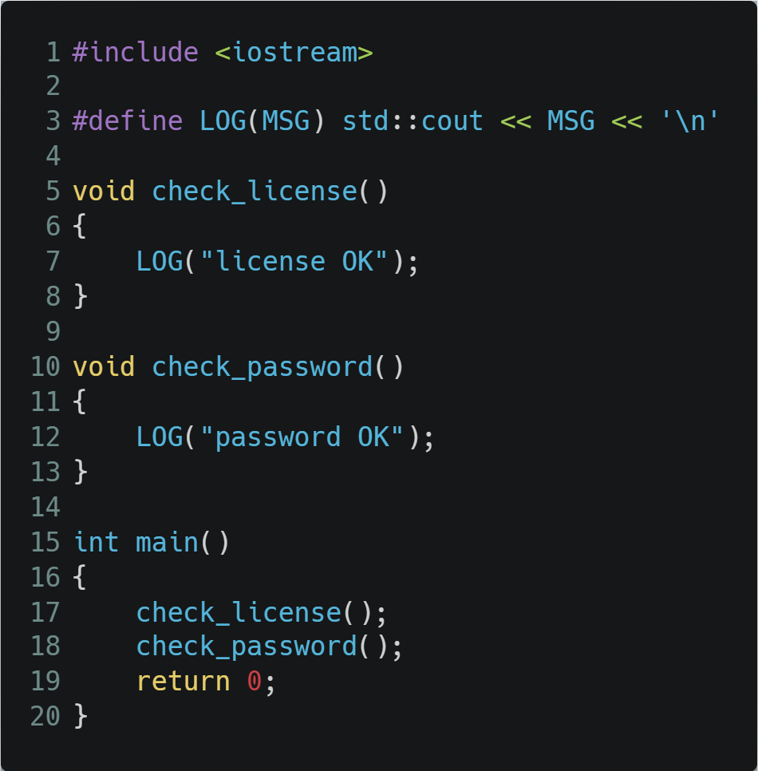
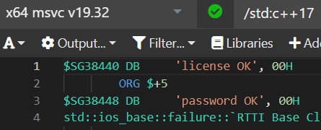
Here’s the Problem
Notes:
https://godbolt.org/z/bf47Y6MjP
https://carbon.now.sh/euFYBBvHUqmJPi0CA0FW

Slide 9
So How Do We Fix This (In C++17)?
Replace strings with something else
With what?
Encrypted string?
But how would we produce one at compile time in C++17?
Some numeric representation

Slide 10
Perhaps an enum With Log Msg Ids?
Perhaps. Except…
We'd need one for each unique message - upfront effort
Lots of maintenance - when adding or modifying log messages
Bug prone - stems directly out of the required maintenance

Slide 11
So Then…
Could We Do It Automatically?
Perhaps With Hashing?
Advantages:
Constant size regardless of input size - smaller binary, better security
May be produced by a C++17 constexpr function (easy to find online, as I did)
Drawbacks:
Can't be reversed (unlike encryption) - production code can't retrieve the original strings
Hash collisions
Highly unlikely assuming a good hash function
Easily mitigated by guaranteed early detection (can just retry with a different hash key)

Slide 12
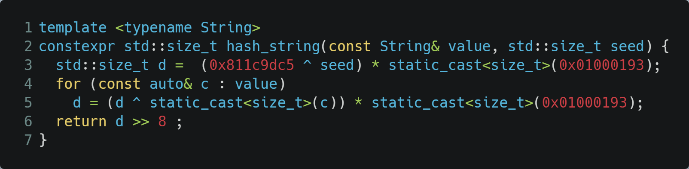
First Things First Though - Let’s Implement Log Hashing, We’ll Take Care of Decoding Later
Easily found constexpr hash function online (https://github.com/serge-sans-paille/frozen/blob/1f006e45adf600280bd3924513b80023e8dfdc80/include/frozen/bits/hash_string.h#L19)
Notes:
https://carbon.now.sh/euFYBBvHUqmJPi0CA0FW
Must take in string + optional seed, must return 64-bit hash

Slide 13
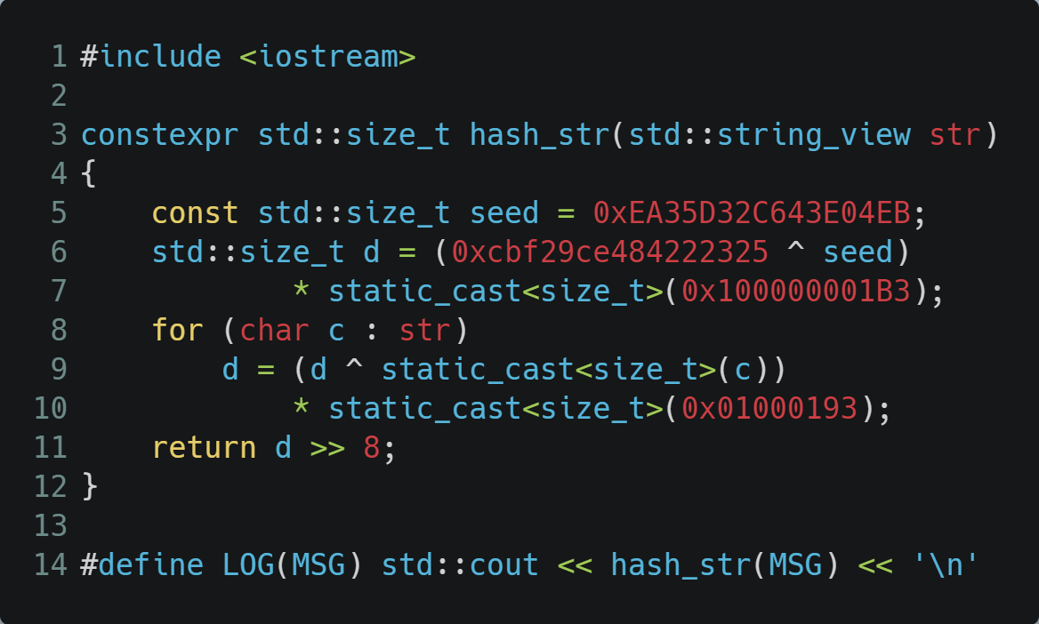
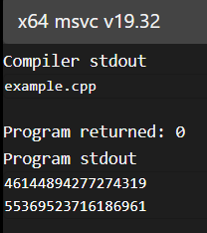
And Now With a Little Tweaking for My Needs…
Let’s just make sure the binary is indeed now clean of incriminating text…
Notes:
https://godbolt.org/z/6TYe1cd9K

Slide 14
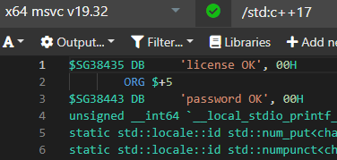
Oops…
We might need to actually force a const evaluation…
Notes:
https://godbolt.org/z/G7fWfTh5e

Slide 15
…Which Only Takes a Single Extra Line of Code
Notes:
https://godbolt.org/z/n1fsz3GEM

Slide 16
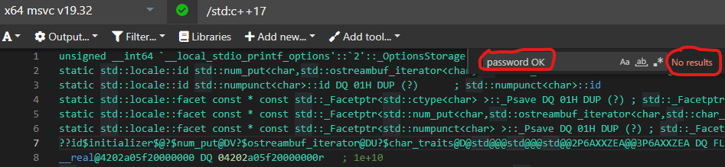
Good!
Oh yeah, got rid of the log strings!
Oh, got rid of the log strings…
So… How do we get them back?
Notes:
https://godbolt.org/z/Tb7ax6q3h

Slide 17
Decoding Hurdles
Original strings are gone
Hash functions are one way only
Result: production code cannot access original strings
Log files contain only hash values, no strings
Conclusion: we need a separate decoding tool with access to the original strings
Which lucky for us are still there in the source code…
Notes:
All of this took place during one Thursday back in March.

Slide 18
Decoder Design
What would the decoder tool do with the original strings?
Calculate their hash values again, this time at run time
But where exactly would it get them from?
The logger macros
But we are not invoking that code in the decoder…
And we need all of them…

Slide 19
What If…
What if we could somehow collect all the logged strings?
Without actual invocations…
Before anything else happens…
What would it take to do that?

Slide 20
How Can You Do Something Automatically in C++?
Global object
But we need this done from local scopes. No way.
Static data member of a class.
Locally defined classes are in the language (e.g. lambdas)
Let’s try this…
Notes:
Obviously this requires some constructor.

Slide 21
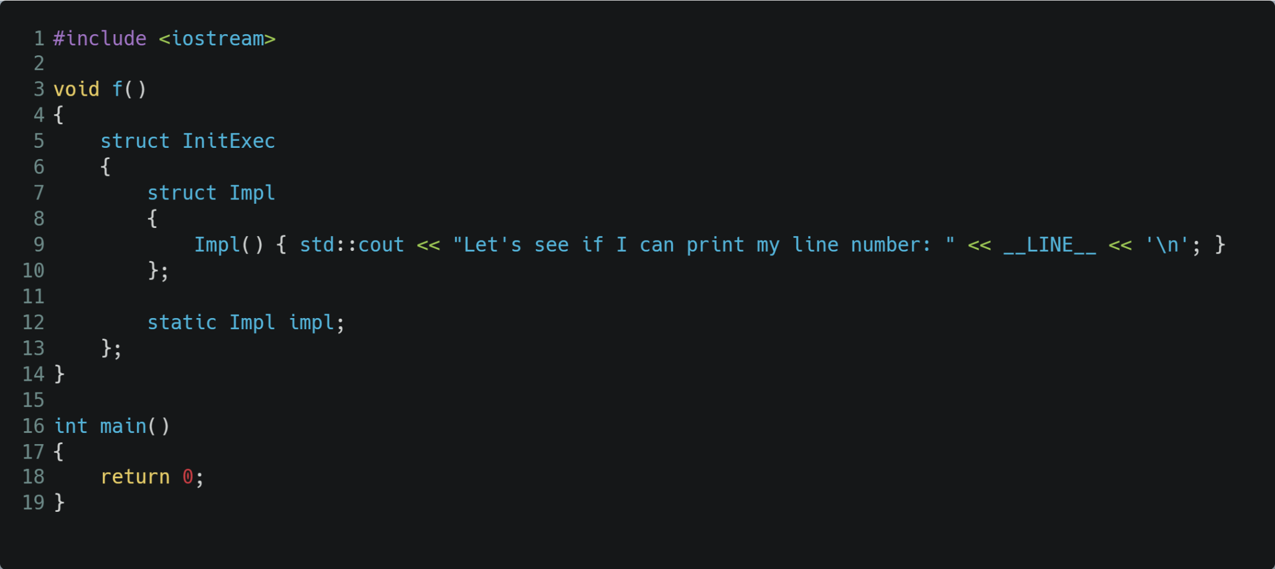
This Should Work. Right?
Notes:
https://godbolt.org/z/h9TojbqPr
Ask the audience

Slide 22
Wrong!
Locally defined classes cannot have static data members…
Now what?
Notes:
https://godbolt.org/z/h9TojbqPr

Slide 23
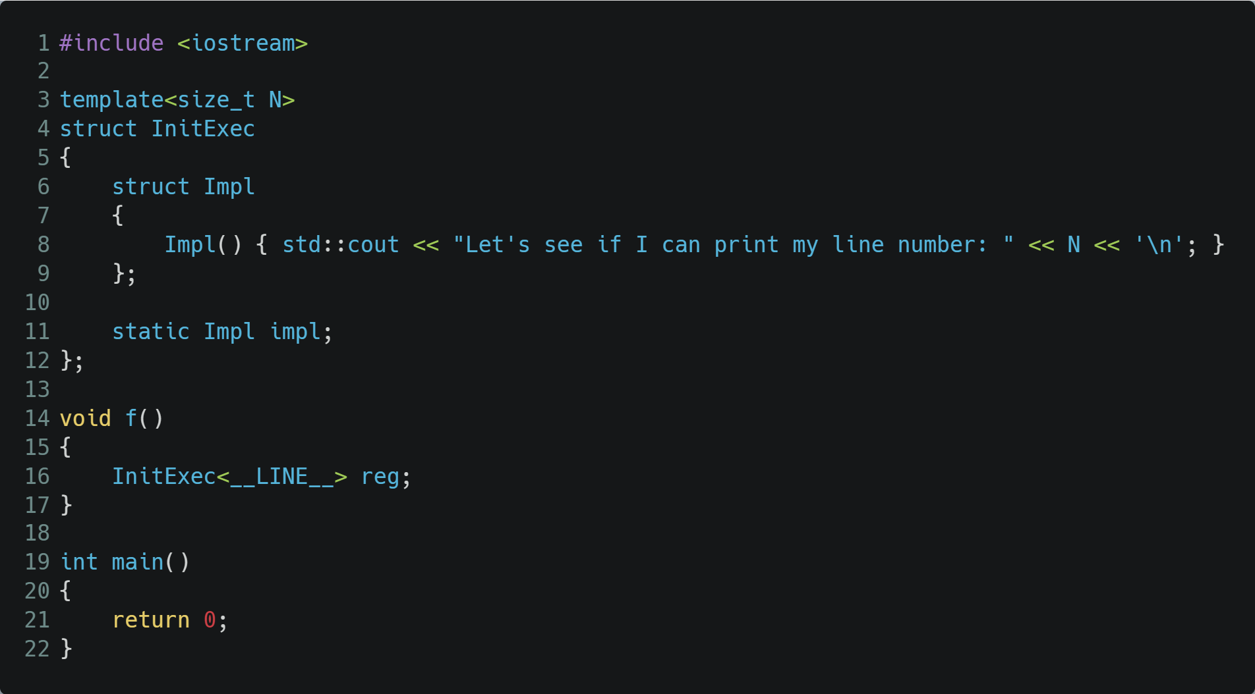
How About We Extract InitExec Into a Template Class?
Notes:
https://godbolt.org/z/zPovYT3fr

Slide 24

Yes!!!
Managed to Build It
Notes:
ask the audience – will it run?

Slide 25
No… Where’s Our Log?
I originally thought this was the optimizer’s fault
But there’s actually more to the story
Notes:
ask the audience – will it run?

Slide 26
Only Referenced Parts of Template Classes Are Actually Instantiated
And in our case we are not referencing the static data member
So it’s not instantiated
Therefore denying us the desired constructor invocation

Slide 27
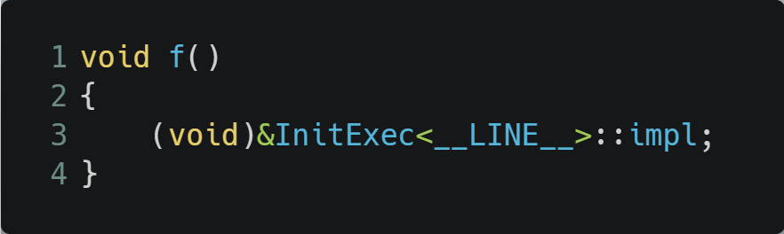
So Let’s Reference the Static Data Member Directly
Still no cigar…
Notes:
https://godbolt.org/z/Yfs45sfjG

Slide 28
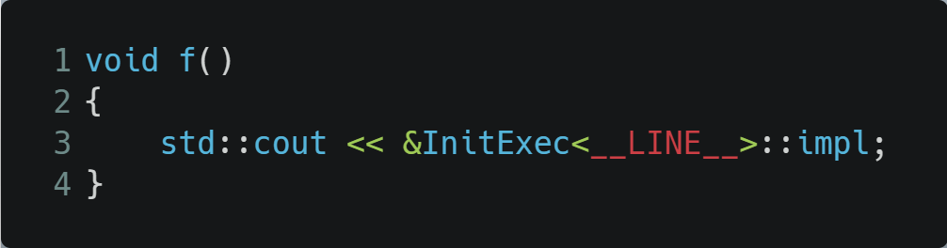

Let’s Make Sure the Template Is Actually Instantiated, via a Side Effect
Only now are we finally getting a linker error
Meaning we were also being optimized out after all
And this one is quite easy to fix. Back to statics 101…
Notes:
https://godbolt.org/z/nEda5jfbb

Slide 29


Let’s Calm Down the Linker Too
Notes:
https://godbolt.org/z/14GPen3hP

Slide 30

But Since Inline Static Doesn’t Always Work, We’ll Stick With the Old Less Classy Way
Notes:
https://godbolt.org/z/GoTPG394d

Slide 31

Looks Like We Could Actually Remove the (void)
But in more complex code this tends to produce unused variable warnings.
Notes:
https://godbolt.org/z/ejqTb1r11

Slide 32
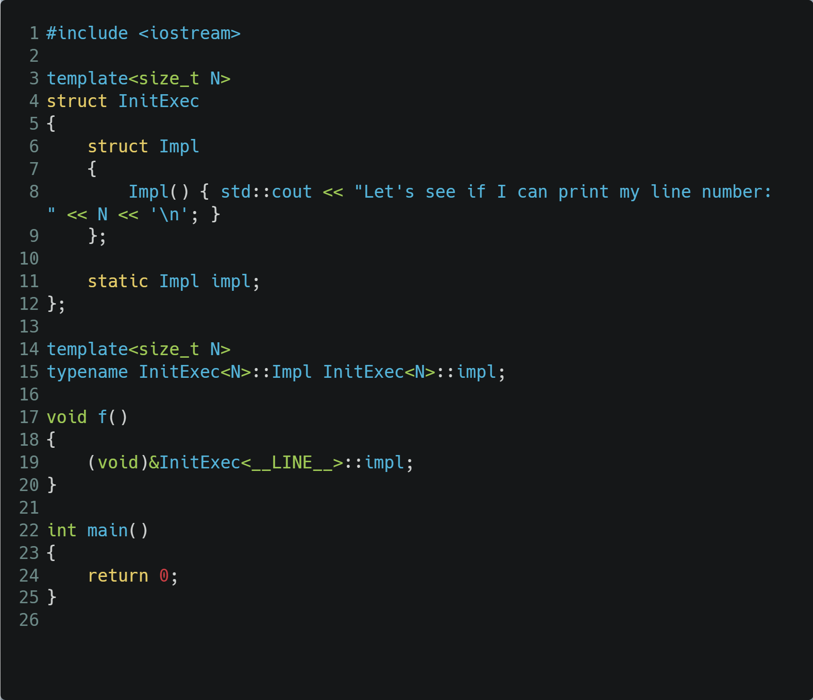
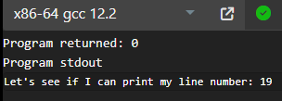
Where We’re at So Far
Notes:
https://godbolt.org/z/3T8MEv9az
Notice 19 in both places

Slide 33
That’s Nice, but We’re Not Quite There Yet
We need the action (cout in this case) to be generated by local code!
Notes:
https://godbolt.org/z/eGvfzqT1K

Slide 34
That’s Nice, but We’re Not Quite There Yet
We need the action (cout in this case) to be generated by local code!
Actually we’ve already taken a small step…
We’ve passed a small piece of state - the line number
Could we go all the way and carry out any custom action?
That sounds like… a lambda!
Notes:
https://godbolt.org/z/eGvfzqT1K

Slide 35
So How Do We Get a Lambda All the Way From f() To InitExec?
As constructor parameter - static member, no way
Template parameter it is then…

Slide 36
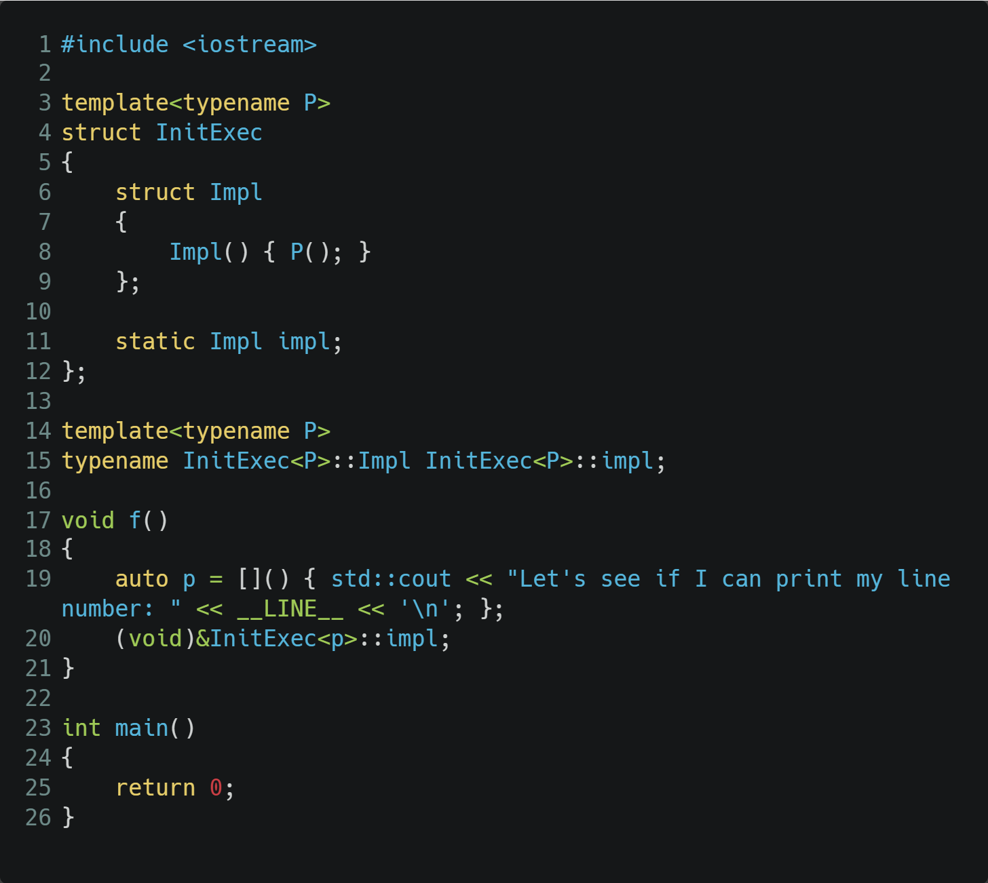
1st Try
error C2923: 'InitExec': 'p' is not a valid template type argument for parameter 'P'
error C2955: 'InitExec': use of class template requires template argument list
Nope, we can’t just pass a lamda as a template argument
Notes:
https://godbolt.org/z/dhP6bM8v4
Not even with constexpr auto

Slide 37
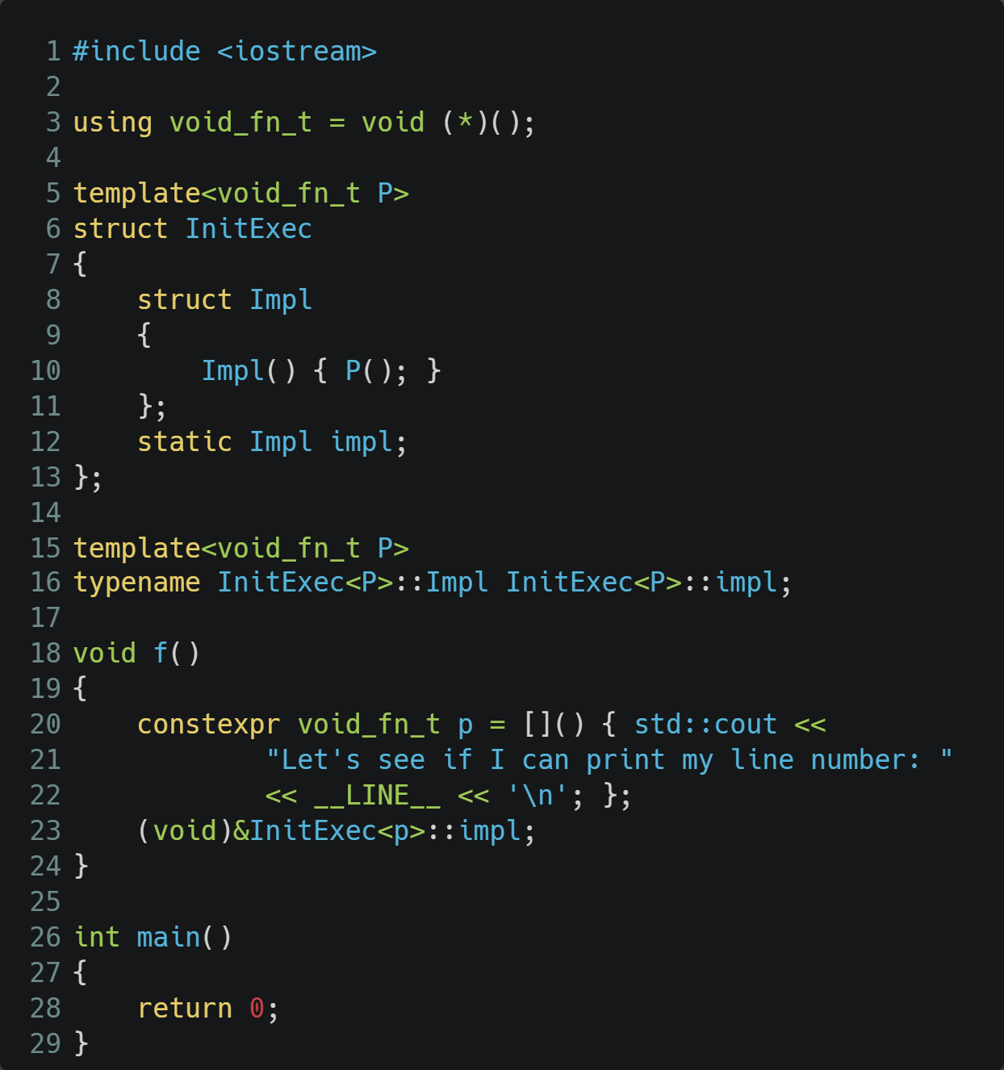

But Maybe There’s Another Way After All…
Let’s See What We Can Dig up Online 🖧
Notes:
https://godbolt.org/z/xxGjd716e

Slide 38
But Maybe There’s Another Way After All…
Let’s See What We Can Dig up Online 🖧
Notes:
https://godbolt.org/z/xxGjd716e

Slide 39
But Maybe There’s Another Way After All…
Let’s See What We Can Dig up Online 🖧
Notes:
https://godbolt.org/z/xxGjd716e

Slide 40
But Maybe There’s Another Way After All…
Let’s See What We Can Dig up Online 🖧
Notes:
https://godbolt.org/z/xxGjd716e

Slide 41
And There You Have It!
Custom code executed at global init from a non-invoked context
In C++ 17!
Unfortunately not in all compilers (more about this later)
This is the basis, now we’ll package it nicely as DO_ON_INIT

Slide 42
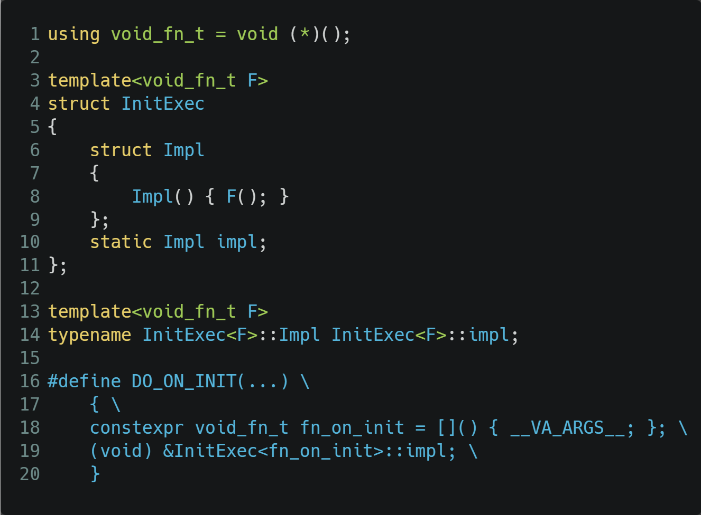
Introducing DO_ON_INIT
Notes:
https://godbolt.org/z/1d61Mv4qa

Slide 43
And Now This Is Finally Possible
Notes:
https://godbolt.org/z/GGWeMYeeY
https://carbon.now.sh/euFYBBvHUqmJPi0CA0FW

Slide 44
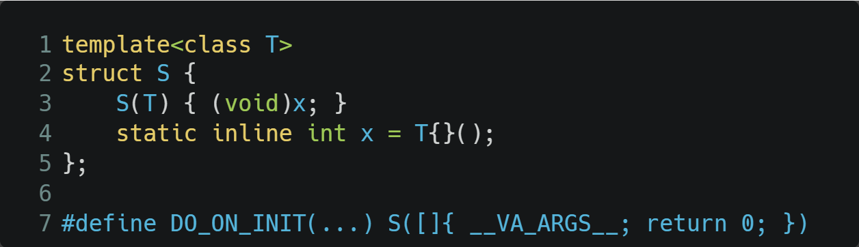
And It’s Even Easier In C++ 20
* Based on code contributed by Arthur O'Dwyer
Notes:
https://godbolt.org/z/T9ba15r96
C++ 20 allows lambda type as template parameter (not NTTP) + instantiation and invocation

Slide 45
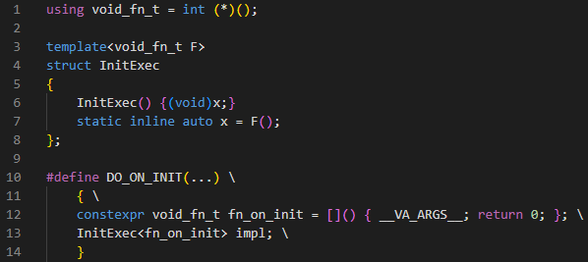
And as It Turns Out, the C++17 Version Can Also Be Simplified
Notes:
https://godbolt.org/z/YqsrKx3cq
Same as the C++20 version, except we still need the NTTP.

Slide 46
Putting It All Together
We started off with encoding our log strings at compile time:
#define FORCE_CONST_EVAL(expr) std::integral_constant<decltype(expr), (expr)>::value
#define LOG(MSG) std::cout << FORCE_CONST_EVAL(hash_str(MSG)) << '\n'

Slide 47
So How Do We Build the Decoder Tool?
Production code doesn’t have the original strings
But the source code does!
Same LOG macros, different implementation when built for decoding
Doing what? - mapping the string hash values to the original strings
When? - before all else, to have the mapping handy when needed
How? - well, with DO_ON_INIT of course!

Slide 48
Overall Design
BUILD_FOR_ENCODING compile-time switch
If on
LOG macro substitutes logged string with hash at compile time
If off
LOG macro uses DO_ON_INIT to register the logged string and its hash, at run time
Any hash encountered in the log file is replaced with the original string
Out of scope in this talk
File IO (both ways)
Log parameters
Notes:
Single compiler-time flag, for demo simplicity (meaning either encode or decode must always be on)

Slide 49
Let’s Start, Top to Bottom
#ifdef BUILD_FOR_ENCODING
#define LOG(MSG) std::cout << HASH(MSG) << '\n'
#else
#define LOG(MSG) DO_ON_INIT(register_message(MSG))
#endif

Slide 50
Let’s Start, Top to Bottom
We’ve already seen the encoding part, so let’s just focus on the decoder
#ifdef BUILD_FOR_ENCODING
#define LOG(MSG) std::cout << HASH(MSG) << '\n'
#else
#define LOG(MSG) DO_ON_INIT(register_message(MSG))
#endif

Slide 51
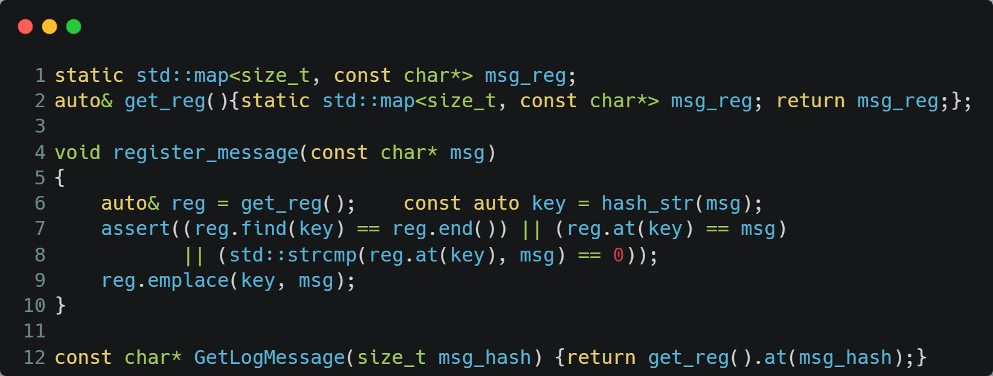
Registration Is Pretty Straightforward
Notes:
https://godbolt.org/z/7edTaWoWT

Slide 52
Registration Is Pretty Straightforward
Lazy init in get_reg() insures lifetime control during global init sequence
Notes:
https://godbolt.org/z/7edTaWoWT

Slide 53
Registration Is Pretty Straightforward
Lazy init in get_reg() insures lifetime control during global init sequence
The assert is our safety net against hash collisions
Every log message is registered, so the assert is guaranteed to be checked for all logs (in debug builds)
Last check may never be reached if compiler does string pooling
Notes:
https://godbolt.org/z/7edTaWoWT

Slide 54
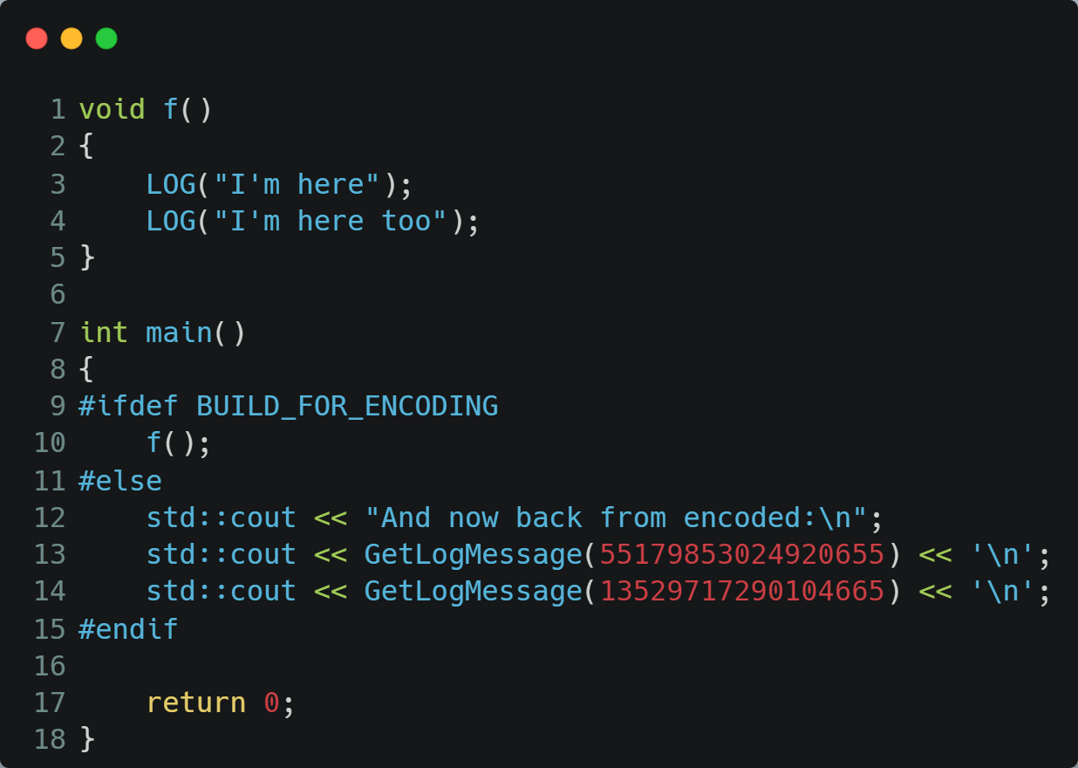
And Now Let’s Test It!
Notes:
https://godbolt.org/z/7edTaWoWT

Slide 55
And Now Let’s Test It!
Where did these two hash values come from?
Notes:
https://godbolt.org/z/7edTaWoWT

Slide 56

This Is Where:
Notes:
https://godbolt.org/z/7qY34Kq3d

Slide 57
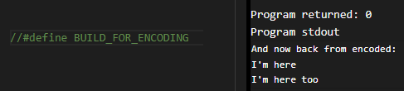
And Now Back to Decoder Mode:
Notes:
https://godbolt.org/z/EjM3hcY6T

Slide 58
f() Is Not Called, Log Strings Materialize “Out of Nowhere”

Slide 59
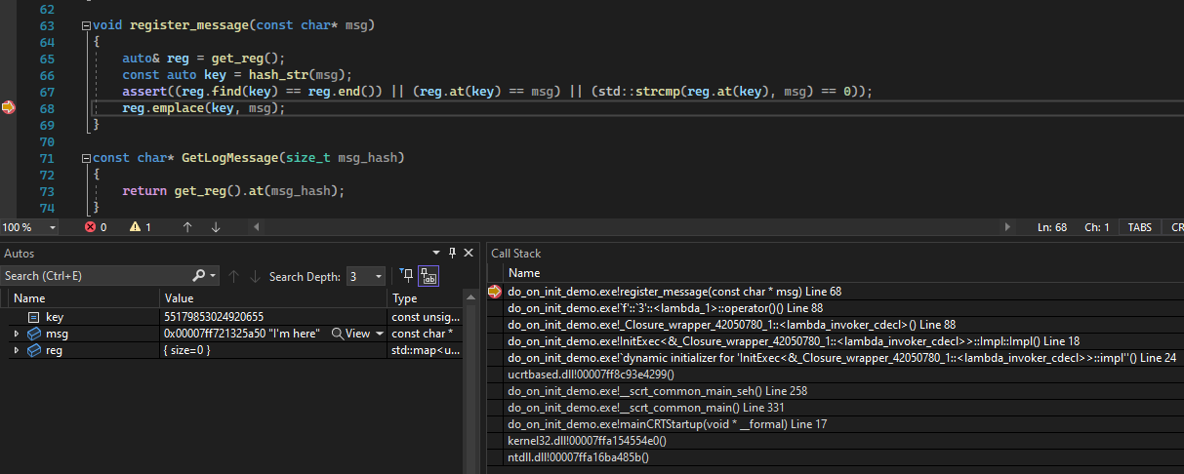
“Magic” Call Stack

Slide 60
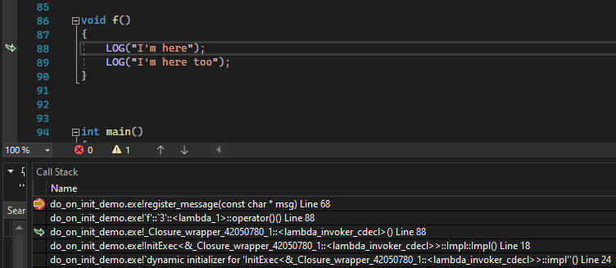
Which Log Is It?
Just Inspect the Call Stack!

Slide 61
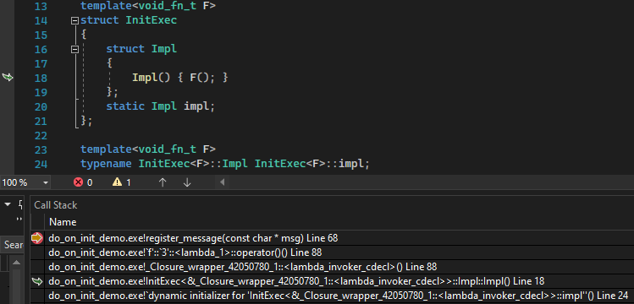
Next up in the Call Stack:
Nested Class Constructor Call

Slide 62
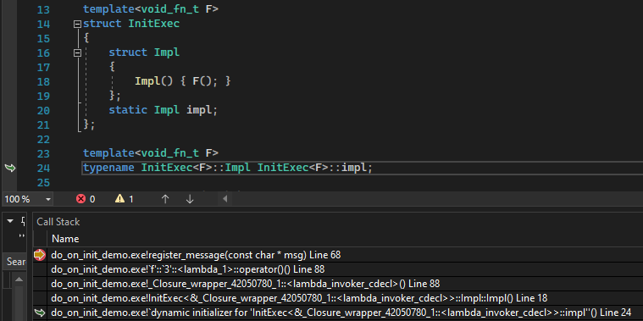
And Last but Not Least:
The Static Member Global Initialization

Slide 63

Demo Time!
https://github.com/cppal/hashed_logger

Slide 64
Some Lucky Coincidences Along the Way
A need that presented itself.
This “hack” just recently happened to become possible in C++17.
I didn’t know locally defined classes can’t have static data members.
I happened to try this out first with the right compiler (msvc)…
gcc - can’t compile this at all (more on the next slide)
clang - segfaulted due to the dangers of the global init context…
Notes:
I didn’t know this was impossible…

Slide 65
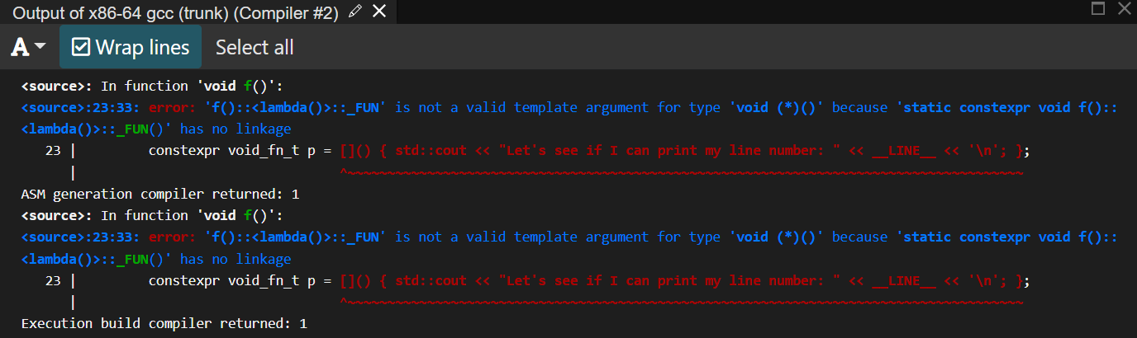
Lucky I Didn’t Try This First in Gcc…
Notes:
https://godbolt.org/z/Wf8bcsj1c

Slide 66
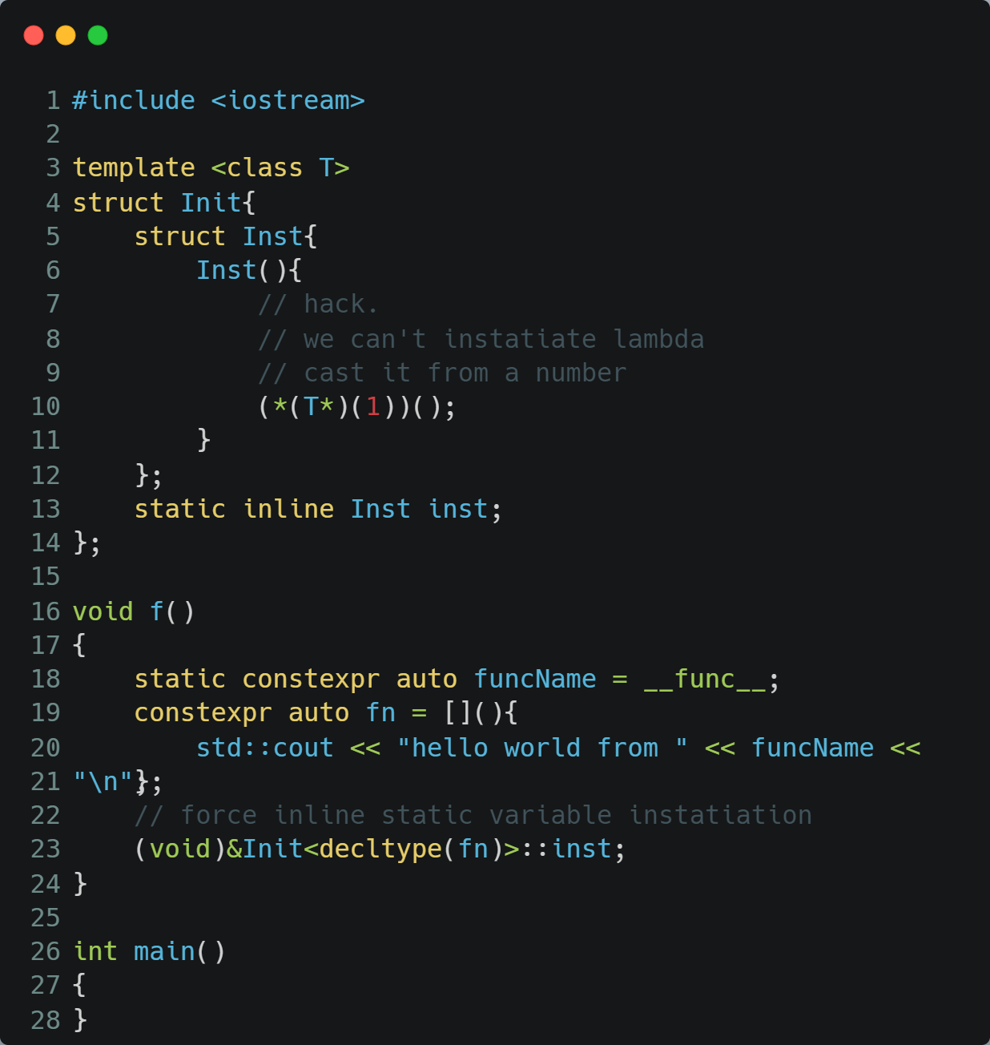
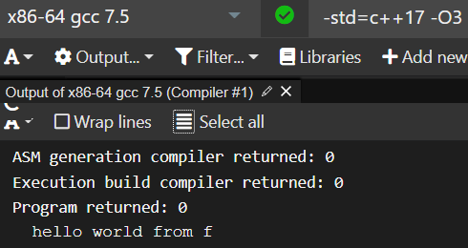
… Or at Least Not Without Some Crazy Hacks
*Contributed by Alexander Vaisman
Notes:
https://godbolt.org/z/b8bxaMxo7

Slide 67
Digging a Bit Deeper Into Gcc
https://gcc.gnu.org/bugzilla/show_bug.cgi?id=83258
Bug 83258 - Rejecting function pointer non-type template parameter without linkage
https://gcc.gnu.org/bugzilla/show_bug.cgi?id=92320
“Generally speaking it seems that GCC is perfectly happy instantiating a template with a constexpr (as you would hope) and with a constexpr function pointer even, but only if that function pointer derives from a free function.” (Joshua Leahy)
Gcc also has __attribute__((__used__, section(".init_array") as a vendor-specific extension. Not sure that works on all platforms. (Kudos Erez Strauss for pointing me to this)

Slide 68
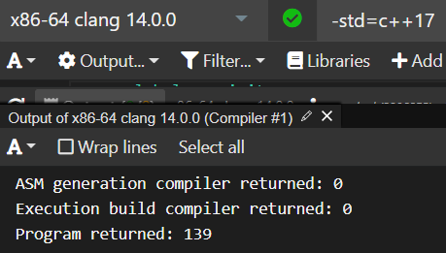
Lucky I Didn’t Try This First in Clang…
Notes:
https://godbolt.org/z/ocrj8x1n8

Slide 69
As It Turns Out, I Was Doing It Wrong
*Figured out thanks to Alexander Vaisman
DO_ON_INIT( std::cout <<
"Let's see if I can print my line number: "
<< __LINE__ << '\n'; );
DO_ON_INIT( printf( "Let's see if I can print my line number: %d\n", __LINE__) );
Notes:
https://godbolt.org/z/Koq8qozev
https://godbolt.org/z/nh9sTKcWj

Slide 70
Recap
Used constexpr hash function to obfuscate log messages
DO_ON_INIT implementation
Class templated on constexpr function pointer NTTP
Executes NTTP function via either:
The constructor of a nested class of which we store a static instance
Initialization of a nested int
Template class is instantiated with local lambda
Via constexpr function pointer
Static data member is forcefully ODR-used
DO_ON_INIT is used to map text hash values back to original texts

Slide 71
Analysis
Main drawback - be careful with this in production code
Not on all compilers (gcc in particular)
May encounter compiler limitations
Perhaps even UB?
But it can be great for internal tools (e.g. log decoder)
Secondary drawback - this technique currently requires macros
Be careful what you do with DO_ON_INIT (cout as cautionary tale)

Slide 72
Analysis - Performance Impact
No serious performance/memory footprint
Production code may actual benefit on both counts
Decoding tool has proven small and fast (on our 200+ logs)
Impact on production code
Small hash values instead of full strings
May need to be converted back to strings if warranted by underlying logger - but those can be cached with statics
Impact on build times should be negligible - depending on the hash function

Slide 73
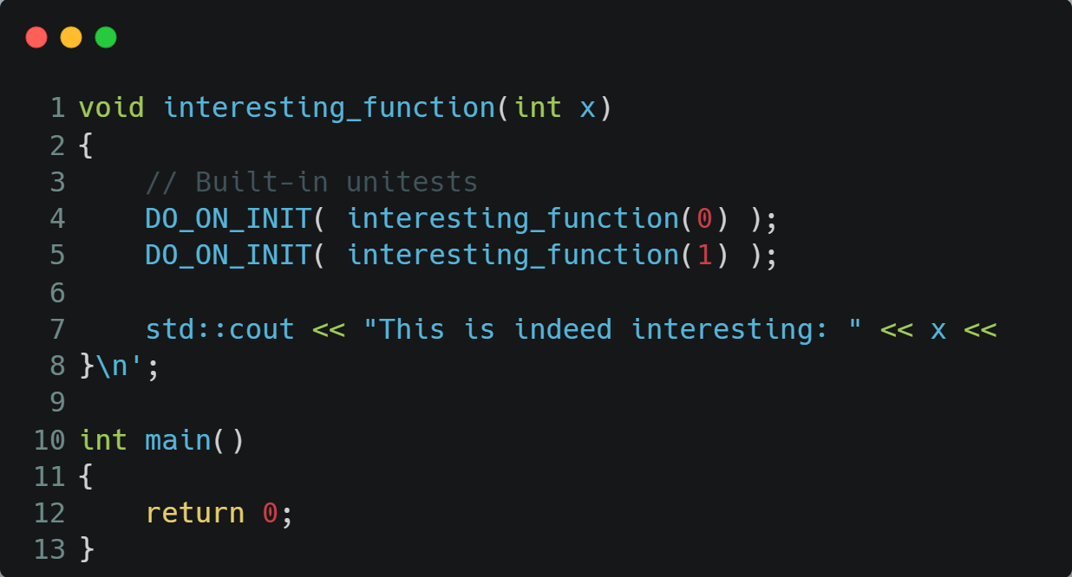
What Else Could DO_ON_INIT Be Used For?
Default initial API call - probably not the best idea until we’re sure we can trust DO_ON_INIT in production code
Built-in unitests:
* Unitests can easily be left out of production code via #ifdef

Slide 74
Bonus Content: Time Travel to the Future, a.k.a. Reflection!
Lock3 clang fork
At least 2 years old
Supports a slightly old version of value-based reflection + fragment injection
P1240 + some elements from other reflection papers
Lacks support for some C++20 features such as source_location

Slide 75
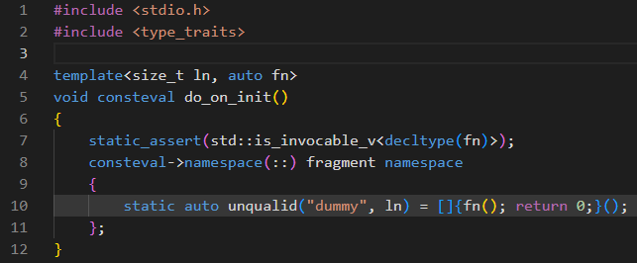
Let’s Have It Then
Notes:
https://cppx.godbolt.org/z/GM1h1dsbY

Slide 76
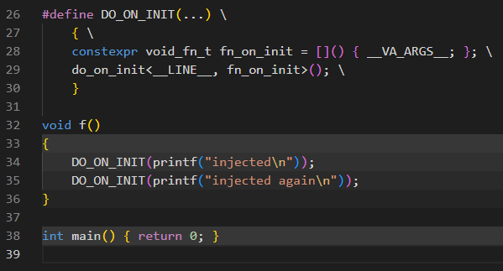
And how do we invoke it?
Unfortunately still with a macro…
Because we need to generate unique names.
And for those we need the line number.

Slide 77
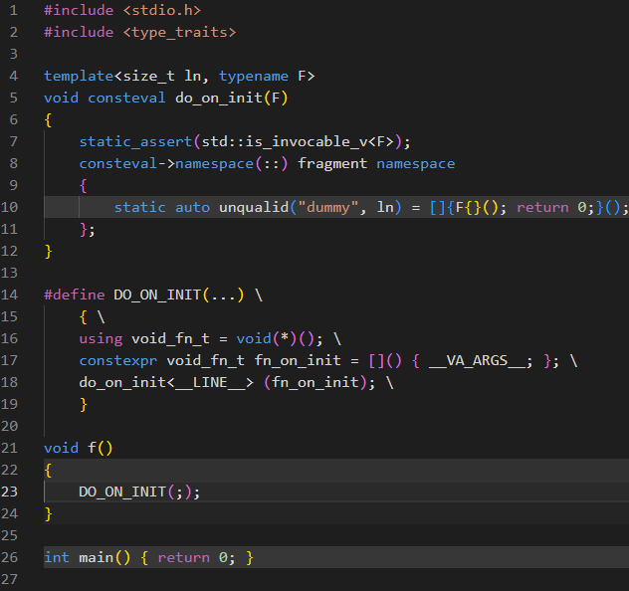
I Also Tried the C++20 non-NTTP flavor
Notes:
https://cppx.godbolt.org/z/Te9a8sbWa

Slide 78

Resulting In…
Notes:
https://cppx.godbolt.org/z/Te9a8sbWa

Slide 79
And Still, Why a Macro?
The lock3 fork doesn’t support source_location, which might have helped
Static variables can’t be used in constexpr functions
We cannot reflect on a sequence of statements - must be captured and injected as a lambda
Or possibly as a do expression (P2806)
Perhaps have an automatic conversion from sequence of statements to block fragment?
Different directions
P2169 proposes placeholder _ instead of explicit names
But doesn’t propose it for global scope
Being able to inject a block fragment into any function
Would allow a single global function, with each DO_ON_INIT adding a lambda invocation to its body
Notes:
https://www.open-std.org/jtc1/sc22/wg21/docs/papers/2023/p2169r3.pdf - A nice placeholder with no name
https://github.com/lock3/meta/wiki

Slide 80


Live, Log and Prosper
Thank You!
Get in touch:
andrziss@gmail.com
https://www.linkedin.com/in/andreizissu/

