Slide 1
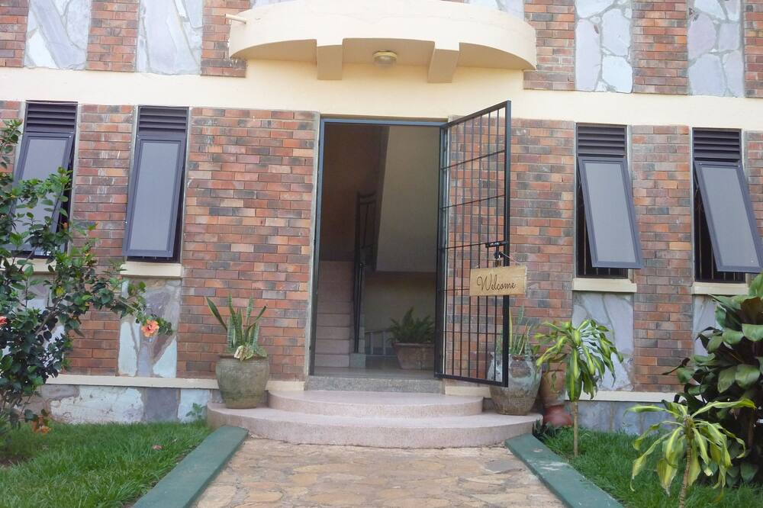

Victoria Breeze Suites Serviced apartments
For Bookings
+256 784 016385 / +256 705289627
victoriabreezesuites@gmail.com

Slide 2
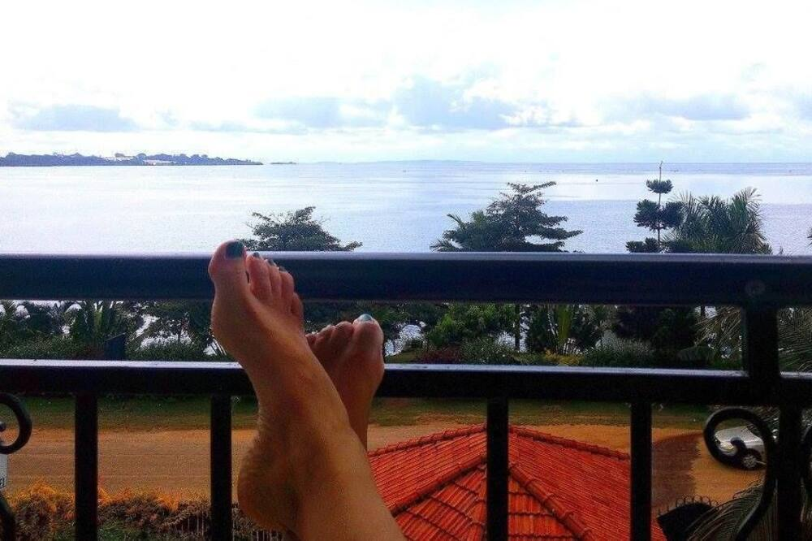
Discounts 2 bedroom apartment
1- 7 days at 80 USD / UGx 280,000 per night
over 7 days at 50 USD per night
Free breakfast inclusive
For Bookings
+256 784 016385 / +256 705289627
victoriabreezesuites@gmail.com
Victoria Breeze Suites Serviced apartments

Slide 3
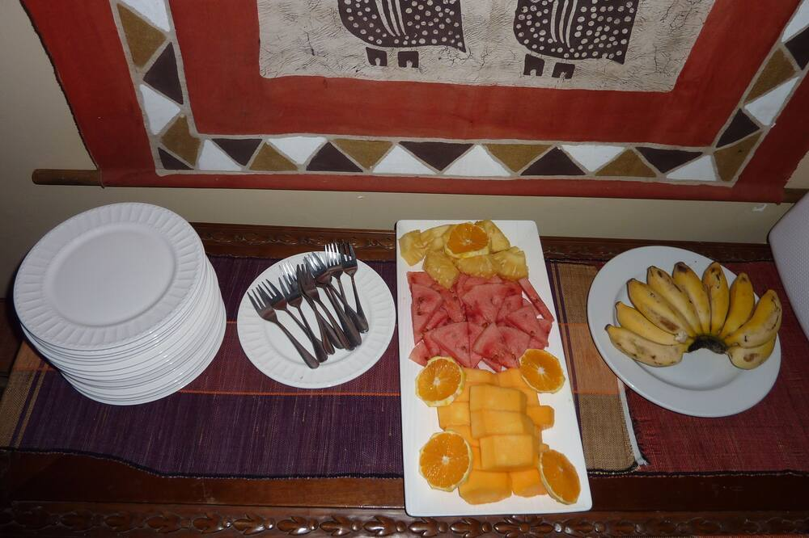
Discounts Bedsitter
1- 7 days at 45 USD / UGx 150,000 per night
over 7 days at 35 USD per night
Free breakfast inclusive
For Bookings
+256 784 016385 / +256 705289627
victoriabreezesuites@gmail.com
Victoria Breeze Suites Serviced apartments

Slide 4
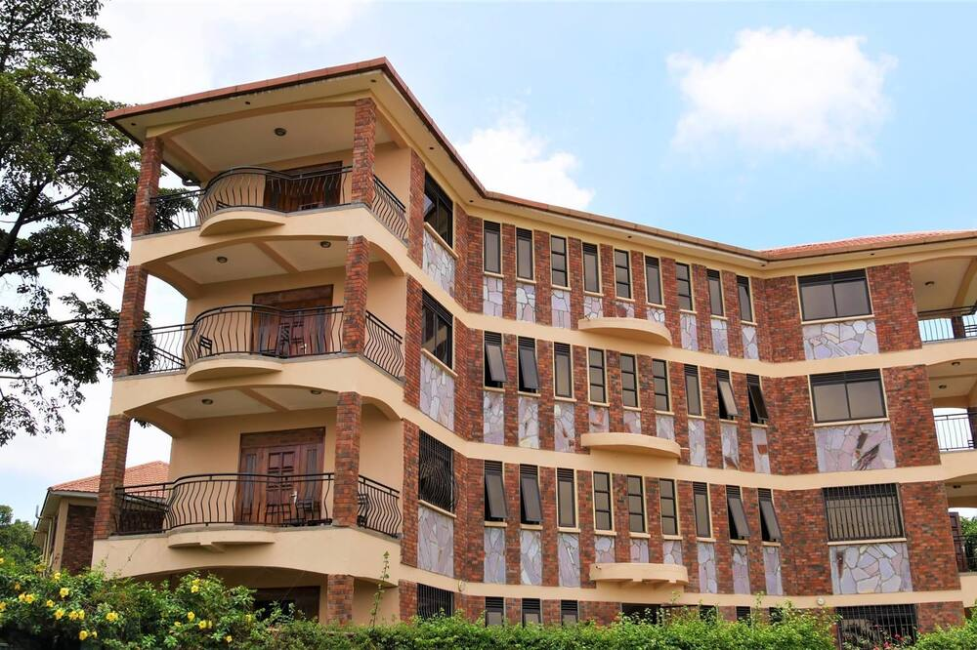
For Bookings
+256 784 016385 / +256 705289627
victoriabreezesuites@gmail.com
Victoria Breeze Suites Serviced apartments

Slide 5
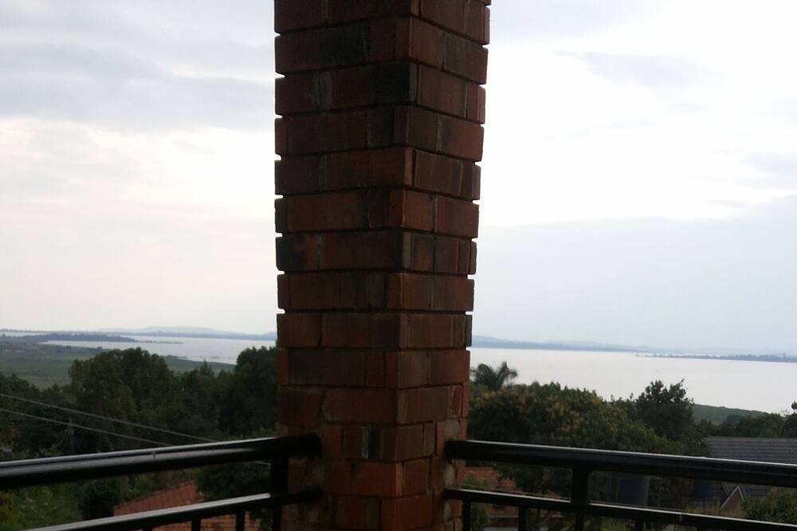
For Bookings
+256 784 016385 / +256 705289627
victoriabreezesuites@gmail.com
Victoria Breeze Suites Serviced apartments

Slide 6
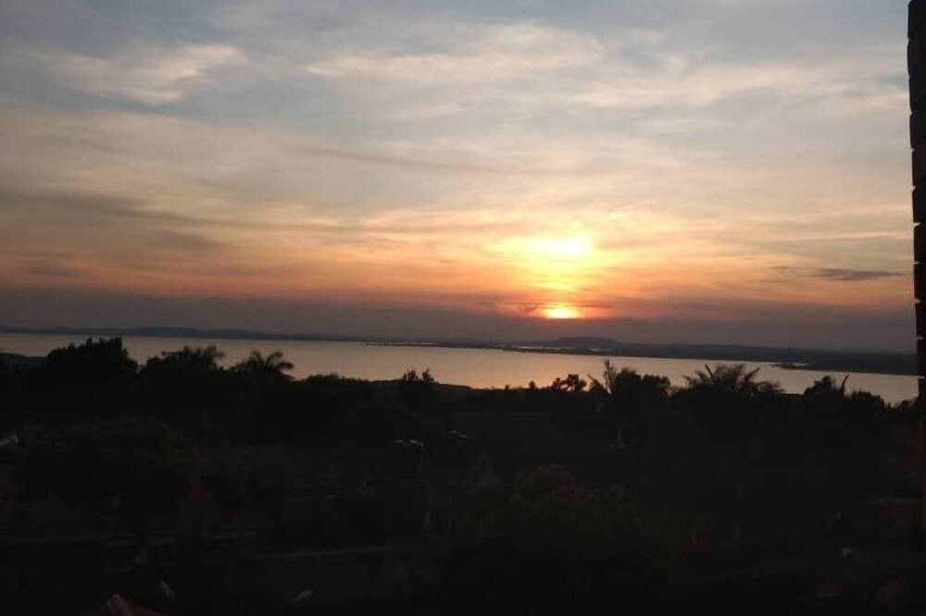
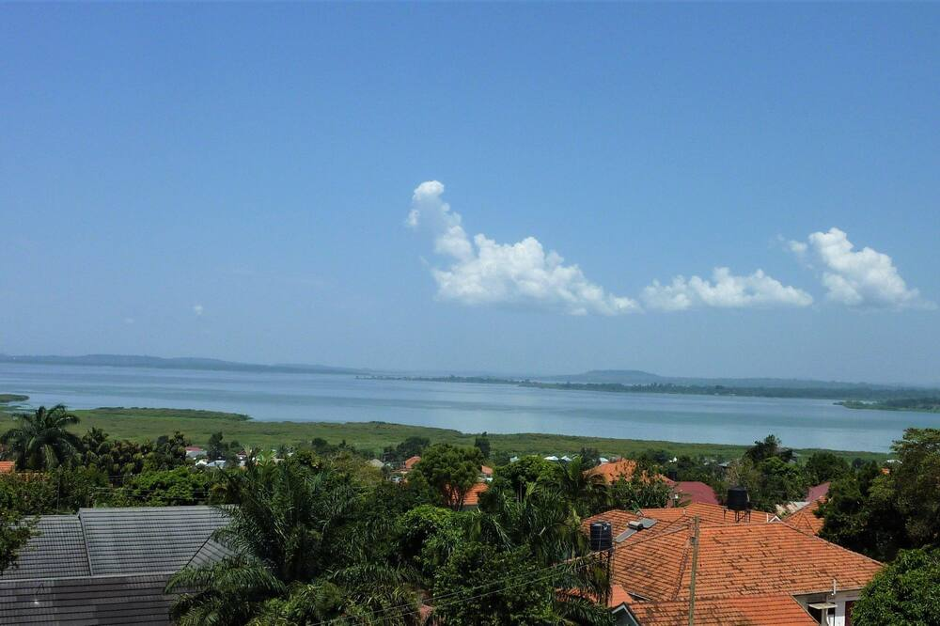
For Bookings
+256 784 016385 / +256 705289627
victoriabreezesuites@gmail.com
Victoria Breeze Suites Serviced apartments

Slide 7
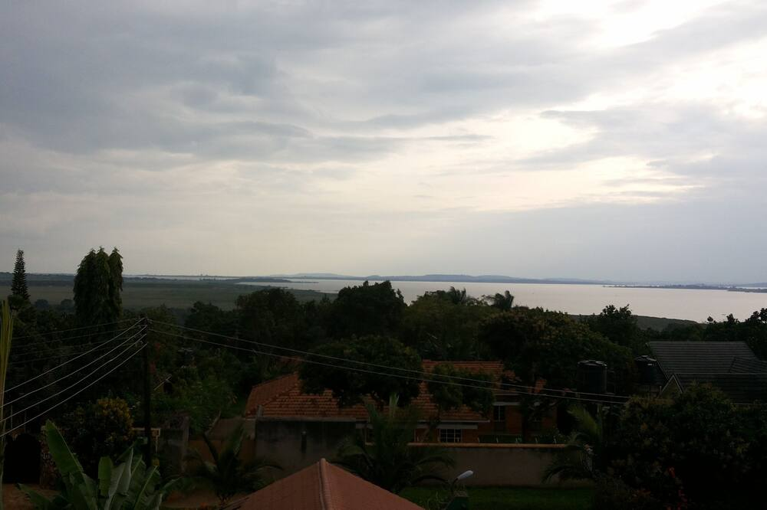
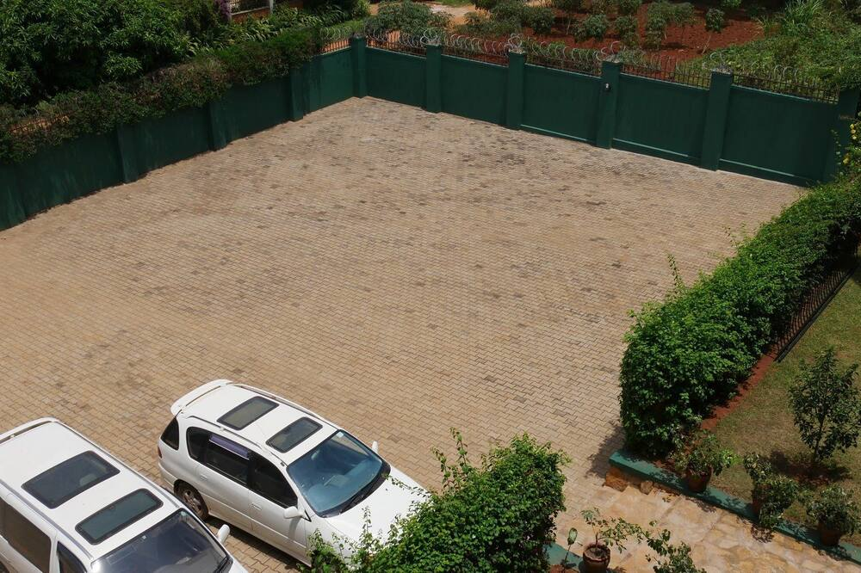
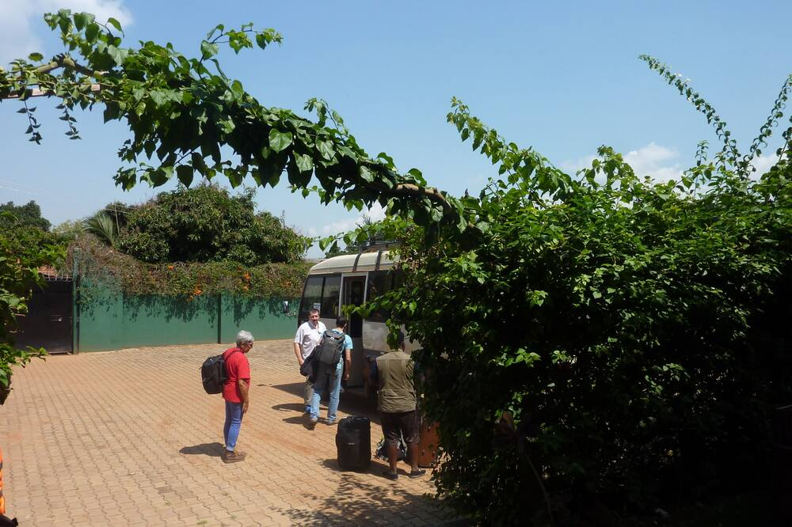
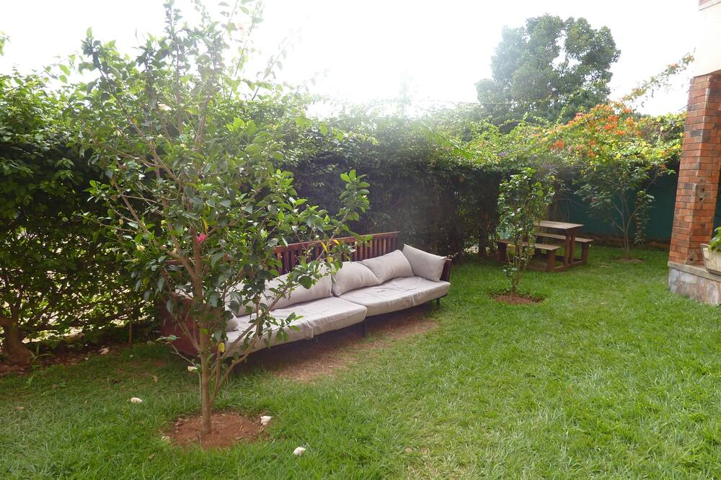

Slide 8

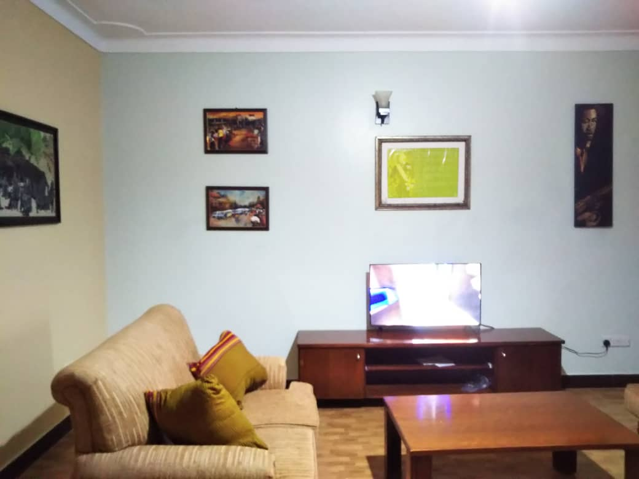
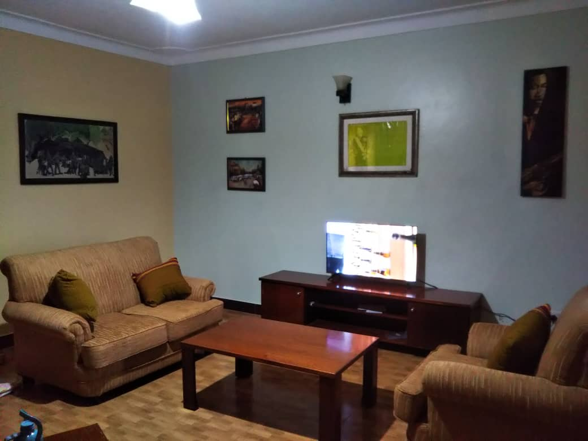
Available services
Long and short stays with a beautiful and comfortable view of lake Victoria and the Airport
A place to rest as you wait for your travel transfer
Tour guide within Entebbe as you wait for your flight
Airport pick ups and drop offs
Arrangements and bookings for tours and accommodation throughout the country
Laundry and Cleaning services
Food and Drinks of your choice delivered at your doorstep
Full time internet connection and security

Slide 9
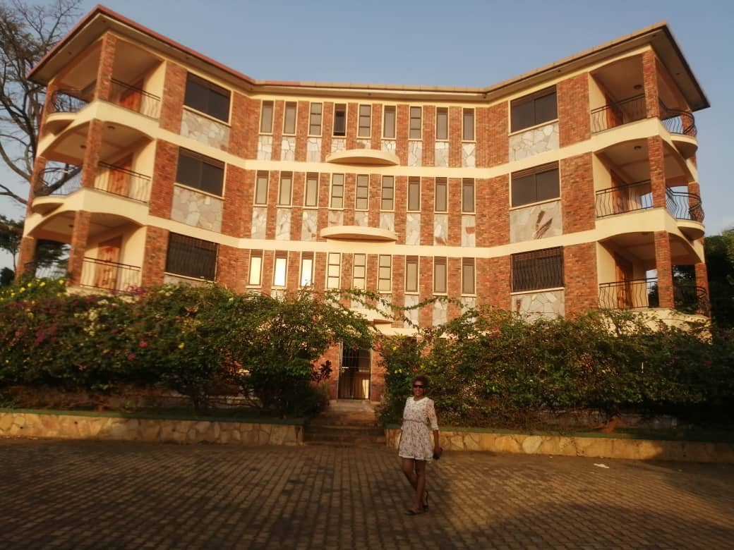
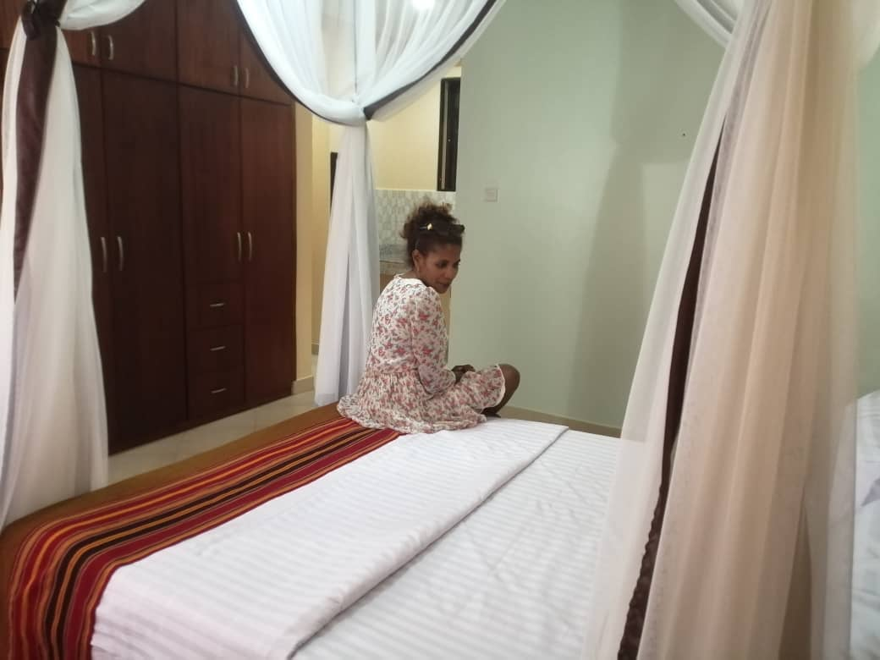
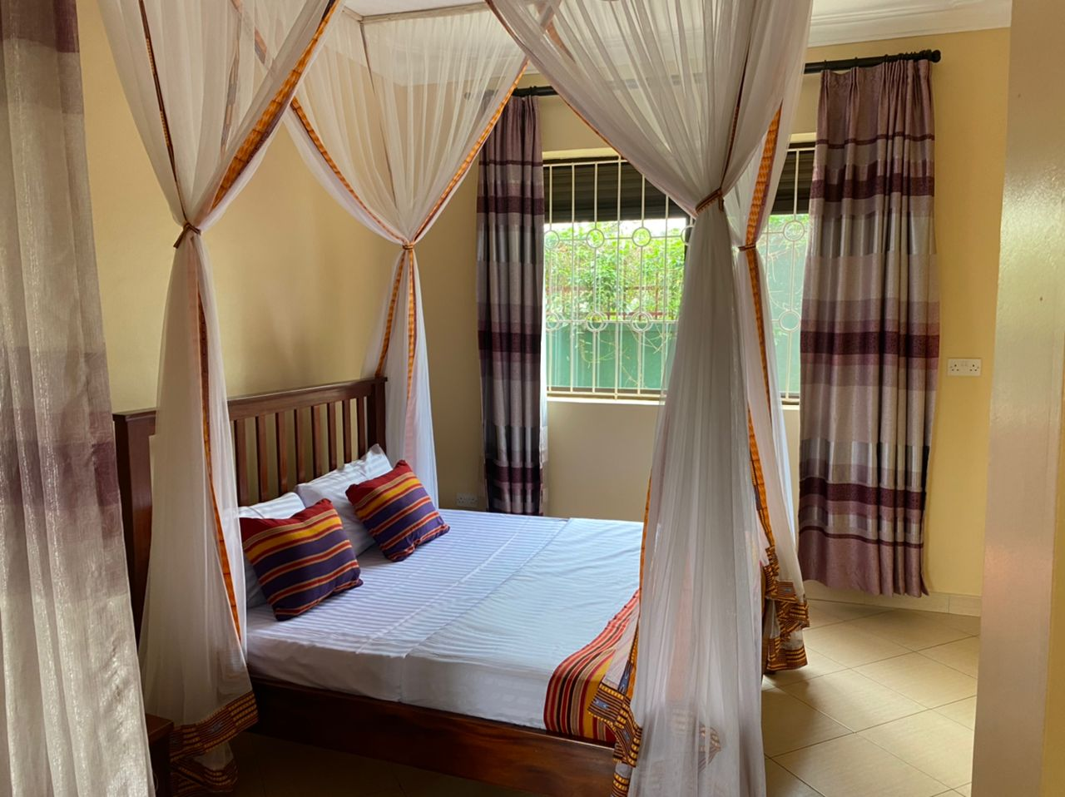
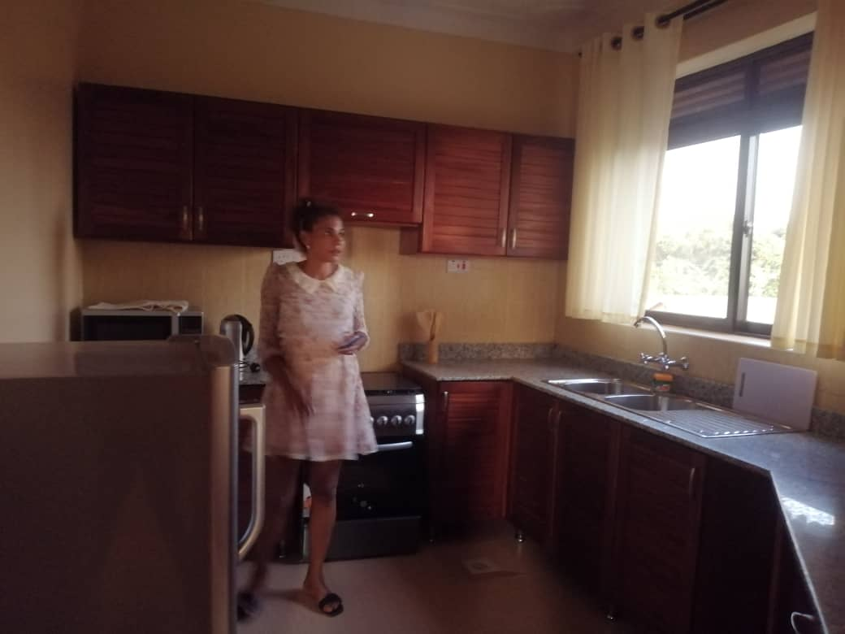
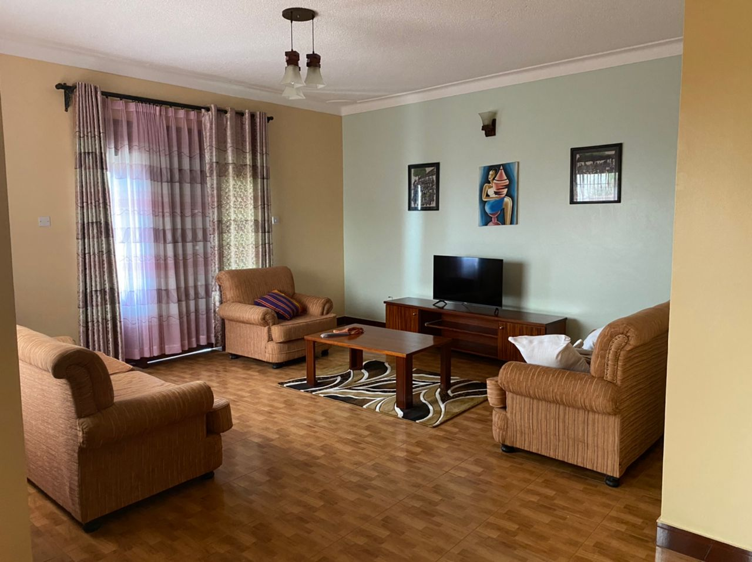
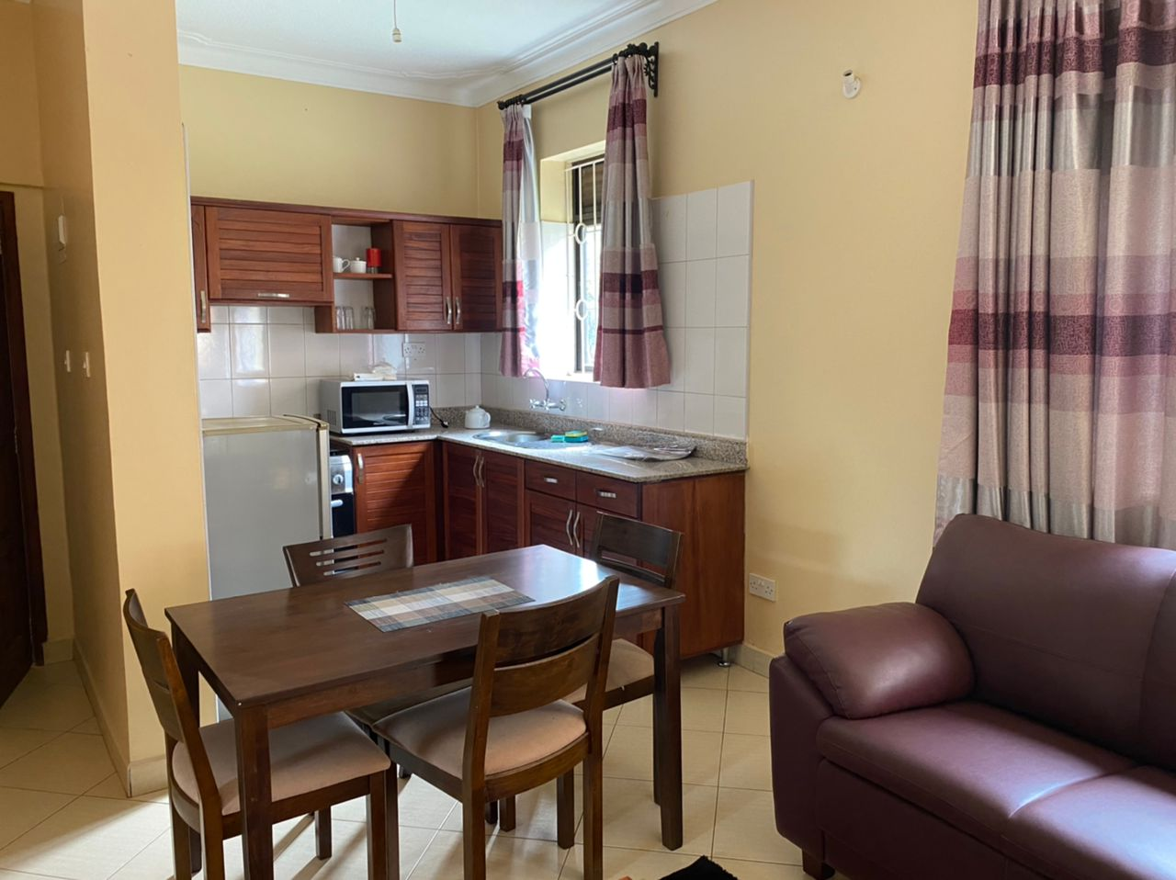

Slide 10
