Slide 1

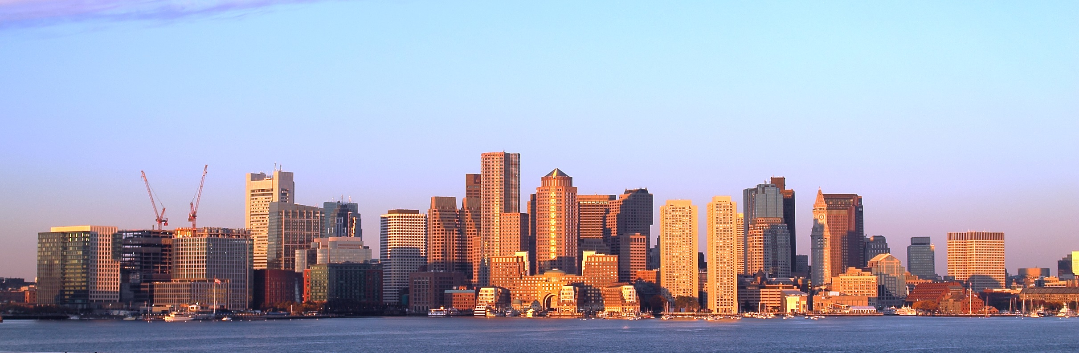
Team Boston

Slide 2


Members:
Georgi Damyanov
iLiyan Grekov
Teodor Karadjov
Danail Batev

Slide 3


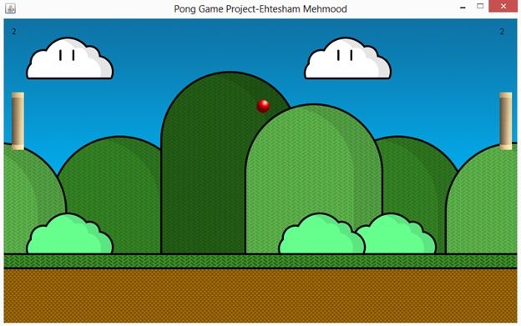
OUR PROJECT:
Pong game

Slide 4
