Slide 1
Climbing to the top of the test pyramid with Playwright

Slide 2

Me
Developer since 2001
Used to be a Java guy. Now I hate all languages equally ;P
Currently working for Sopra Steria, formerly Pro Consulting, Axxessit, Directorate of Fisheries, Bouvet, Frende
Lazy, like to automate things
https://www.linkedin.com/in/oystein-ovrebo/

Slide 3
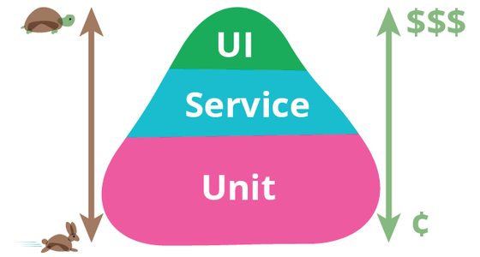
Test pyramid
Read more at https://martinfowler.com/bliki/TestPyramid.html, where I stole borrowed this image

Slide 4
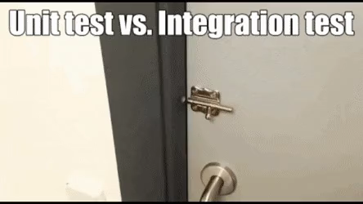

Slide 5
Playwright is a
Cross-browser
Cross-language
Cross-platform
}
Web Testing and Automation Framework
…by Microsoft
…and the people who made Puppeteer
https://playwright.dev/
Notes:
Platforms: Chromium, WebKit, and Firefox.
Languages: TypeScript, JavaScript, Python, .NET, Java.

Slide 6
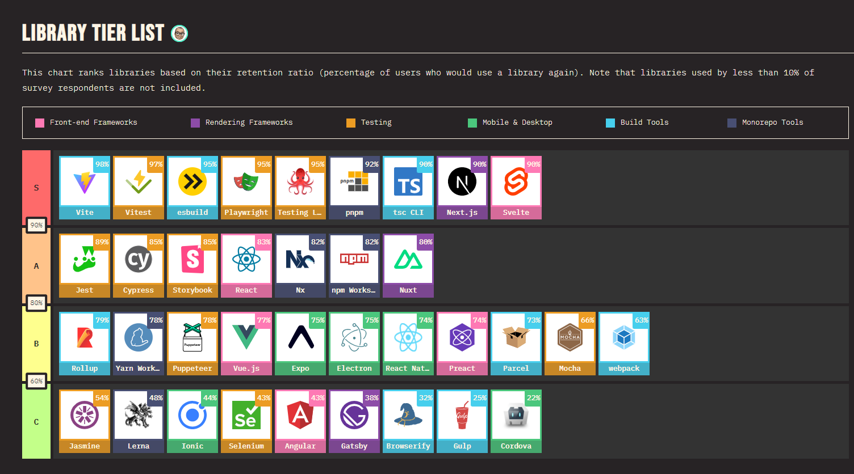
https://2022.stateofjs.com/en-US/libraries/

Slide 7
Disclaimer
This is not me telling you Playwright is better than other libraries or frameworks.
This is just ONE way of doing E2E testing.

Slide 8
Auto-wait. Playwright waits for elements to be actionable prior to performing actions. It also has a rich set of introspection events. The combination of the two eliminates the need for artificial timeouts - the primary cause of flaky tests.
Web-first assertions. Playwright assertions are created specifically for the dynamic web. Checks are automatically retried until the necessary conditions are met.
Tracing. Configure test retry strategy, capture execution trace, videos, screenshots to eliminate flakes.

Slide 9
Anatomy of a test
Write a test function describing what you are testing
Load the page your test starts on
Find elements on the page and act on them
Find results on the page/navigation and assert that they are what you expect

Slide 10
Tools for creating and debugging tests
Codegen
Inspector
Trace viewer
New: UI mode

Slide 11
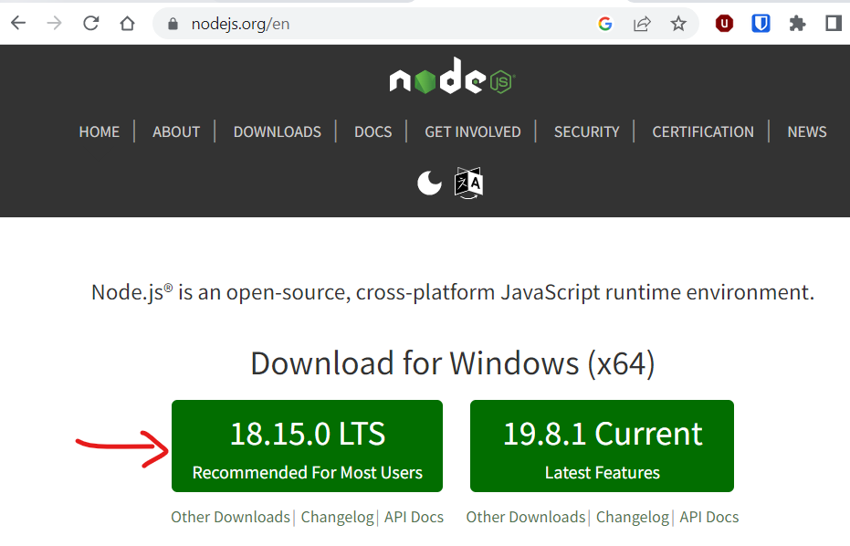
Let’s get started!

Slide 12
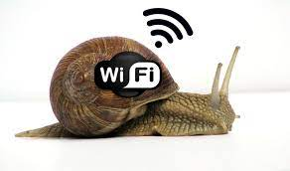

Installing Playwright
Before you start – please say NO to download Playwright browsers during the install wizard!
We will install chromium in the next step!

Slide 13
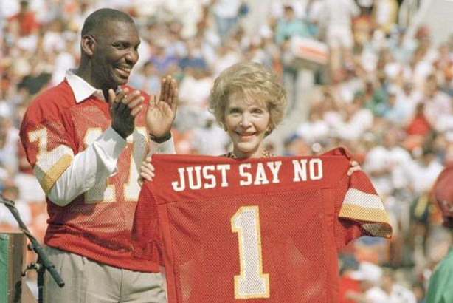
Let’s install Playwright
npm init playwright@latest
Install Playwright
browsers?

Slide 14
Let’s install Chromium
npx playwright install chromium

Slide 15
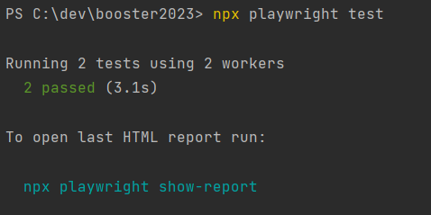
Running tests (headless)
npx playwright test

Slide 16
What just happened?
Playwright
found a test file in /tests – example.spec.ts
ran 2 tests in parallel (“using 2 workers”)
and created a test report.

Slide 17
Let’s see it!
npx playwright test --debug
This lets us see the test in “headed” mode along with a test inspector

Slide 18
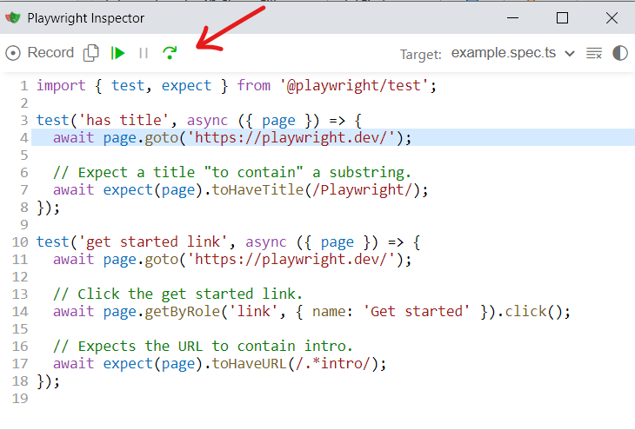
Recap
Each test() gets a fresh browser
Step through the test with this button:

Slide 19
Let’s make a simple test
add a new file “mytest.spec.ts”

Slide 20
The test definition
import { test, expect } from '@playwright/test’;
test('your test description', async ({ page }) => {
//act and assert
//the page fixture is your friend
});
https://playwright.dev/docs/api/class-test
https://playwright.dev/docs/api/class-fixtures

Slide 21
Load the shiny new UI
npx playwright test --ui

Slide 22
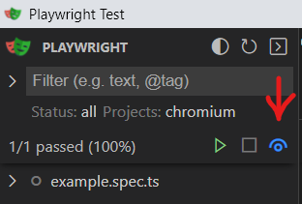
Turn on watch mode

Slide 23
Load a page with goto
page.goto(‘https://2023.boosterconf.no/")

Slide 24
Verify that something exists (with autowait)
await expect(page.locator('#sponsor-area')).toBeVisible()
await expect(page.getByRole('link', { name: 'Sopra Steria' })).toBeVisible()

Slide 25
Find things with locators
Locators are the central piece of Playwright's auto-waiting and retry-ability.
In a nutshell, locators represent a way to find element(s) on the page at any moment
To make tests resilient, we recommend prioritizing user-facing attributes and explicit contracts such as page.getByRole().
https://playwright.dev/docs/locators

Slide 26
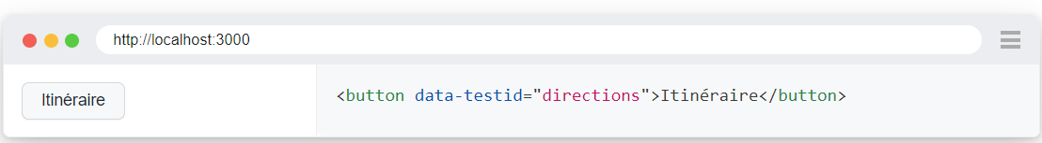
How do I find a good locator?
Use the “pick locator” button in the Inspector or UI
Avoid using CSS or XPath if possible
Test ids can be a resilient alternative, but are not user facing
await page.getByTestId('directions').click();

Slide 27
User-facing locators
page.getByRole()
to locate by explicit and implicit accessibility attributes.
page.getByLabel()
to locate a form control by associated label's text.
page.getByPlaceholder()
to locate an input by placeholder.
page.getByText()
to locate by text content.
page.getByAltText()
to locate an element, usually image, by its text alternative.
page.getByTitle()
to locate an element by its title attribute.

Slide 28
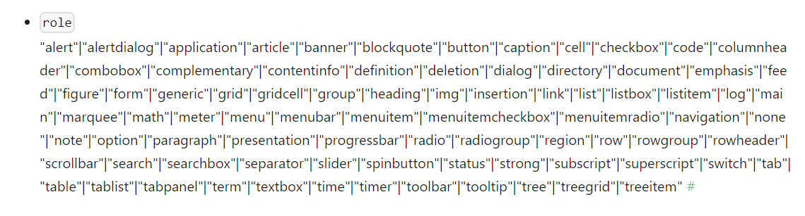
getByRole
These roles are how assistive technologies see your page.
If these don’t work – what does it tell you about your web page code?

Slide 29
Acting on locators
page.getByRole('button').click();
page.getByRole('checkbox').check();
page.getByRole('checkbox’).uncheck();
page.getByRole('textbox').fill('example value’);
await locator.highlight();
await page.getByRole('link').hover();
await page.getByRole('textbox').press('Backspace’);

Slide 30
Generic assertions via expect
import { test, expect } from '@playwright/test’; test('assert a value', async ({ page }) => {
const value = 1; await expect(value).toBe(2);
});
https://playwright.dev/docs/api/class-genericassertions

Slide 31
Generic assertion methods
toBe
toBeCloseTo
toBeDefined
toBeFalsy
toBeGreaterThan
toBeGreaterThanOrEqual
toBeInstanceOf
toBeLessThan
toBeLessThanOrEqual
toBeNaN
toBeNull
toBeTruthy
toBeUndefined
toContain(expected)
toContain(expected)
toContainEqual
toEqual
toHaveLength
toHaveProperty
toMatch
toMatchObject
toStrictEqual
toThrow
toThrowError
https://playwright.dev/docs/api/class-genericassertions

Slide 32
Web-specific assertions via locators
import { test, expect } from '@playwright/test'; test('status becomes submitted', async ({ page }) => { await page.getByRole('button').click(); await expect(page.locator('.status')).toHaveText('Submitted');
});
https://playwright.dev/docs/api/class-locatorassertions

Slide 33
Locator Assertion methods – expect(locator)
toBeHidden
toBeInViewport
toBeVisible
toContainText
toHaveAttribute
toHaveClass
toHaveCount
toBeChecked
toBeDisabled
toBeEditable
toBeEmpty
toBeEnabled
toBeFocused
toHaveCSS
toHaveId
toHaveJSProperty
toHaveScreenshot(name)
toHaveScreenshot()
toHaveText
toHaveValue
toHaveValues

Slide 34
Codegen records steps for you
npx playwright codegen

Slide 35
Playwright downsides
Too slow to run all the time
Expensive to maintain
Still hard to avoid “flakiness”
Yet another thing to learn and keep up to date

Slide 36
Playwright upsides
Will uncover bugs that you couldn’t find in your unit tests
Can buy testers more time to do all that stuff they are great at
Developers can use it to automate flows that are useful to them
You can move fast and still be pretty sure you didn’t break all the things

Slide 37
My experience…
Playwright is useful, even run manually while developing
Playwright documentation is awesome
If finding a good locator is hard – change your app code!
Regex text matching can be good
Codegen can help you get started – but real code is your friend in the long run

Slide 38
…
Make running the tests part of your flow before merge
Remember that the pyramid should be heaviest at the bottom. Add unit tests when you find bugs.
E2E tests are allowed to be long – embrace the suck!
Read the https://playwright.dev/docs/best-practices

Slide 39
...
Don’t overdo it – if something can be tested as a unit test or component/service test, do that!
Playwright lives outside your project and does not understand your code, you will have no help from your compiler when things change!

Slide 40
More stuff to explore
Trace viewer lets you see what happened when a test failed
https://playwright.dev/docs/trace-viewer-intro
Reuse authentication between tests: https://playwright.dev/docs/test-global-setup-teardown
Do API calls: https://playwright.dev/docs/test-api-testing
Download files: https://playwright.dev/docs/downloads
Mock the backend or other APIs: https://playwright.dev/docs/mock
Websockets: https://playwright.dev/docs/network
Screenshot page/element: https://playwright.dev/docs/screenshots
and compare https://playwright.dev/docs/test-snapshots
Record video: https://playwright.dev/docs/videos
Run in CI: https://playwright.dev/docs/ci

Slide 41
Explore!
npx playwright codegen https://demo.playwright.dev/todomvc
npx playwright open https://demo.playwright.dev/todomvc
npx playwright test --ui (remember watch mode)
https://playwright.dev/docs

Slide 42
Thank you for participating! ❤

