Slide 1



Introduction to BOOST
By Sanjay and Arvind Seshan

Slide 2
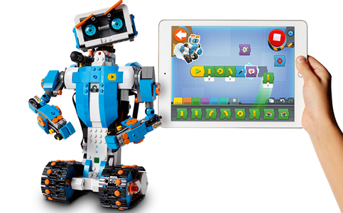
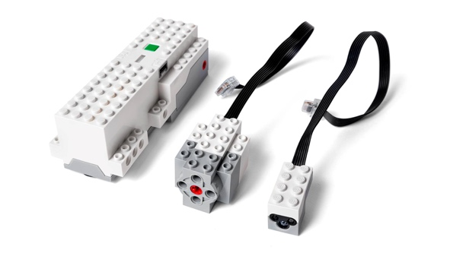
About Boost
What is BOOST?
BOOST Creative Toolbox is a new product by LEGO(R) is for ages 7 and up. Like MINDSTORMS, BOOST has a programmable Hub, which connects via Bluetooth LE to a tablet (iOS/Android).
Your kit comes with the following electronics:
Move Hub (With 2 encoded motors)
1 Additional Encoded Motor
1 Color/Distance Sensor Combination
It also includes:
1 Poster
Playmat for Testing Programs
844 Extra LEGO Brick Assortment
You will need 6 AAA batteries to power the BOOST
Image Credit: LEGO

Slide 3
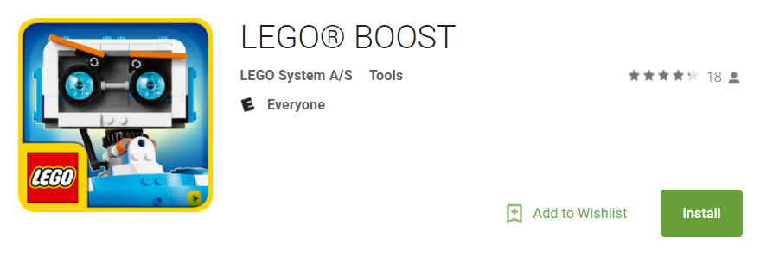
Installing the Software
The BOOST only supports Android 5.1.1+ and iOS 10+ Tablets (as of 2017)
To download the app, click on the links below:
Android: https://play.google.com/store/apps/details?id=com.lego.boost.boost#xlink
iOS: https://itunes.apple.com/app/lego-boost/id1217385613#xlink
If you are using a PC/Mac, you can try this project: http://www.android-x86.org/ to install the app.

Slide 4
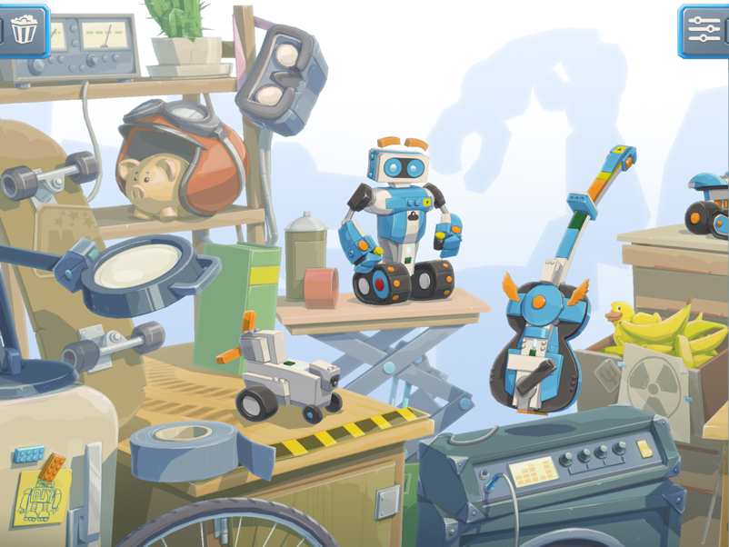
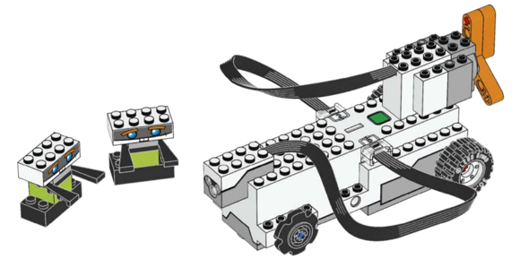
Build your Robot
Start by building the “Getting Started Vehicle”
The App contains the Build Instructions for each of the models.
The BOOST experience is centered around the concept of Build-Code-Play. Users should to begin to code each model’s behavior when indicated within the App.
Image Credit: LEGO

Slide 5

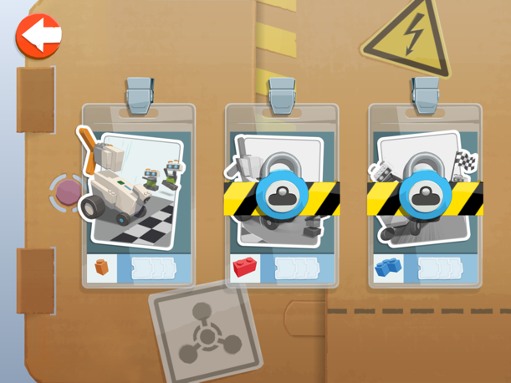
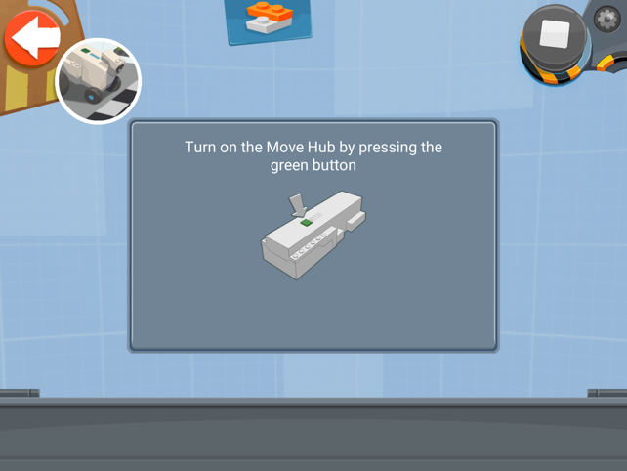
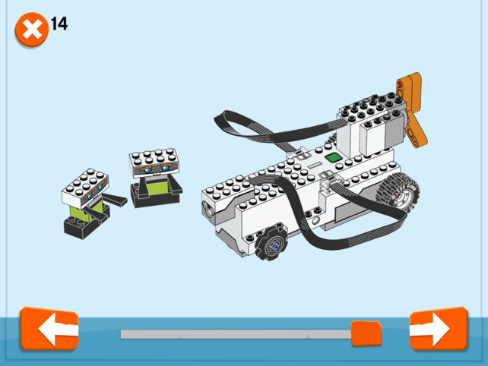
Connect to your BOOST
Click on your robot
Select the first option
Press the green button on the hub
Build your robot, or if you already have built one, skip to the last page. Click next.
Once your robot is built, follow the instructions on the screen and connect to your BOOST Hub

Slide 6
Now you are ready to start programming!

Slide 7

Credits
Lesson by Sanjay and Arvind Seshan
This work is licensed under a Creative Commons Attribution-NonCommercial-ShareAlike 4.0 International License.
Photo Credits: LEGO, Screenshots taken from the LEGO BOOST App

