Slide 1
Traffic Light: Loops & Switches
By Sanjay and Arvind Seshan

Slide 2
Objectives
You will use Vernie to learn about loops and switches
You will program Vernie to follow instruction based on the color of a traffic light
Vernie will move forward when the color sensor detects green, slow down when it identifies yellow, and stop when it detects red
In addition, Vernie will say out loud the color he detected. You will be programming using the Creative Canvas area of the App

Slide 3
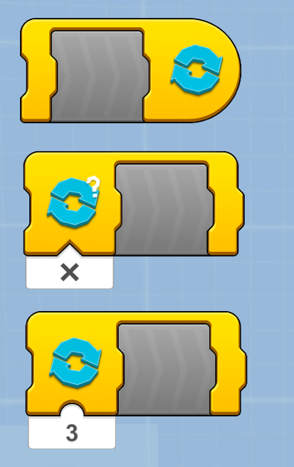
What is a loop?
A loop lets you repeat any code you want to as many times as you want to. Boost has three Loop Blocks which can be found in the Yellow Flow Palette.
In this lesson, we will use the Loop Forever Block.
This is a Loop Forever Block. It will run your code forever.
This is a Loop While True Block. It will run your code while that condition is true. For example, if you want Vernie to move forward until he sees red, the condition would be “does not see red”.
This is a Loop For Count Block. It will run your code a certain number of times. For example, you might want Vernie to turn exactly three times.

Slide 4
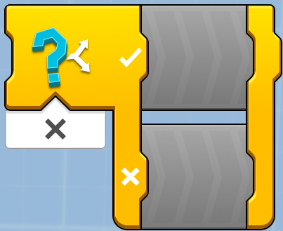
What is a Switch?
A Switch Block allows you to decide between different actions. The block can be found in the Yellow Flow Palette.
In Boost, you can choose between two actions at a time using the Switch Block. If the condition is true, the top sequence is executed. Else, the bottom sequence is executed.
The Switch Block is like the answer to a Yes/No question.
In this lesson, we will have to use the Switch Block to choose between three conditions: whether Vernie sees a Red Light, a Yellow Light or a Green Light.
Since the Boost Switch Block does not allow for three conditions, you will need to program each decision at a time using Switches inside Switches.
The first switch will check to see if Vernie sees Red and then make a decision. If Vernie does not see Red, then we use a second Switch to ask if Vernie sees Yellow. If not, we use a third Switch to ask if Vernie sees Green It can be found in the Yellow Flow Palette

Slide 5
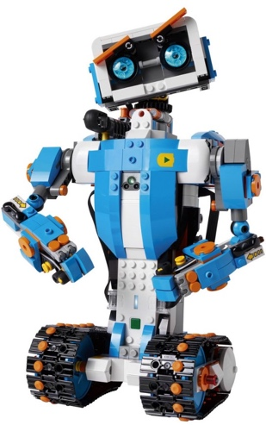
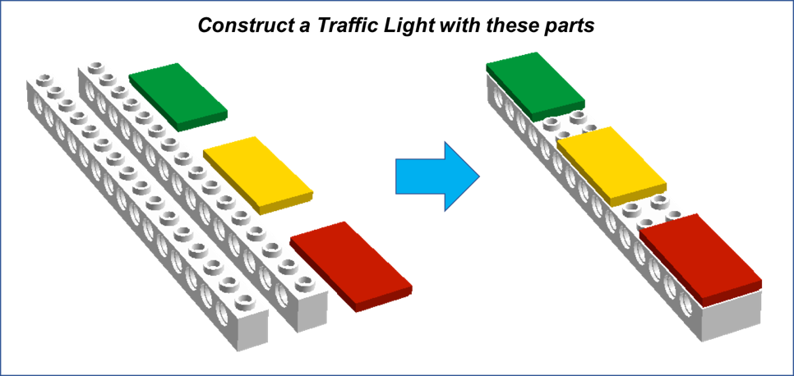
What do you need to build for this project?
Follow the build instructions in the Boost App to construct Vernie.
Construct a traffic light using pieces leftover after constructing Vernie

Slide 6
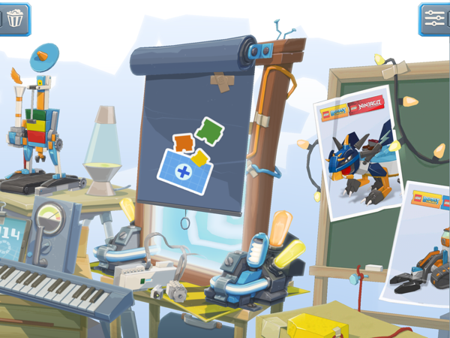
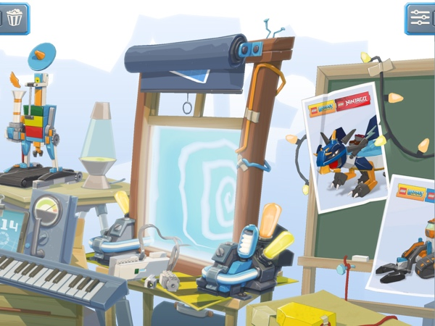
Creative Canvas
The Creative Canvas area of the App allows you to use the App in a free play mode
You will have access to all the programming blocks needed to complete this project

Slide 7
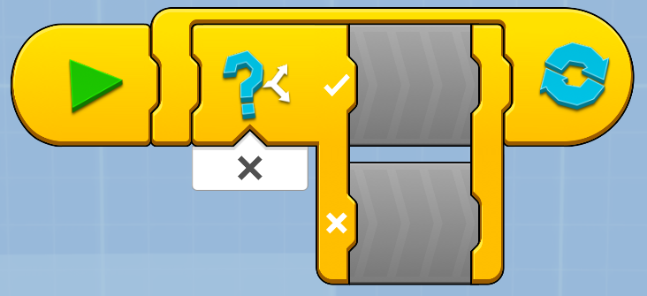
First steps with a loop and a switch
Step 1: Drag in a Start Sequence Block from the Yellow Palette Step 2: Drag in a Loop Forever Block Step 3: Drag in a If/Else Block inside the Loop Forever Block

Slide 8
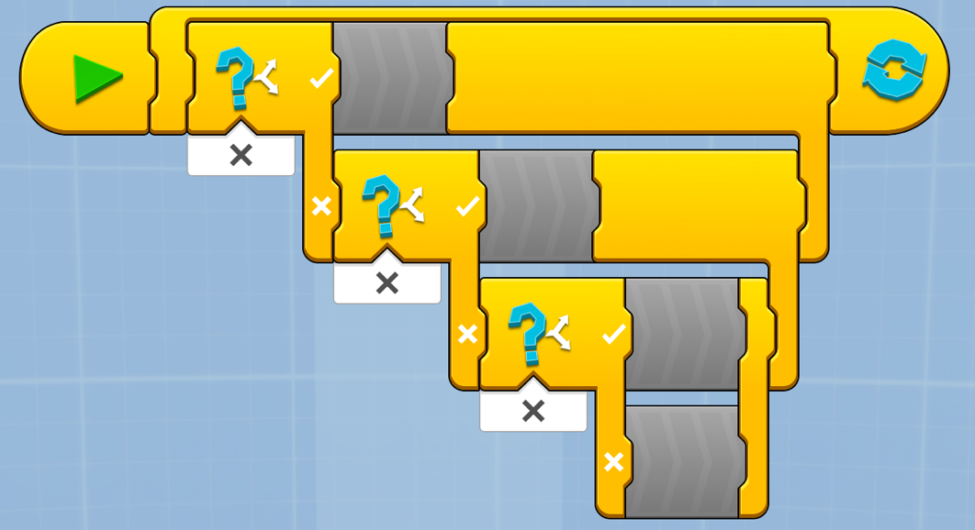
Switch inside a switch for three cases
Step 4: Drag a If/Else Block inside the lower half (false “x” condition) on the previous If/Else Block.
Repeat until you have three If/Else Blocks like in the image (one for each case: Red Light, Yellow Light and Green Light)

Slide 9
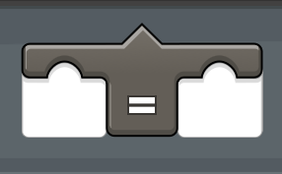
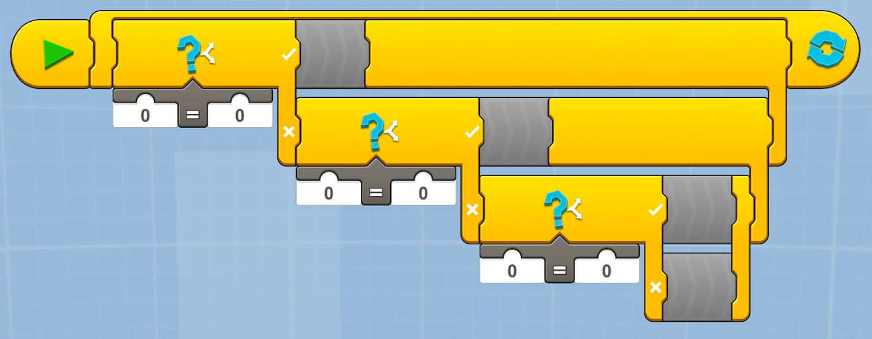
Adding Math Blocks
Step 5: From the White Math Pallet, select the Equal To Comparison Block. Place one in each of If/Else Blocks.

Slide 10
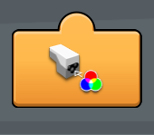
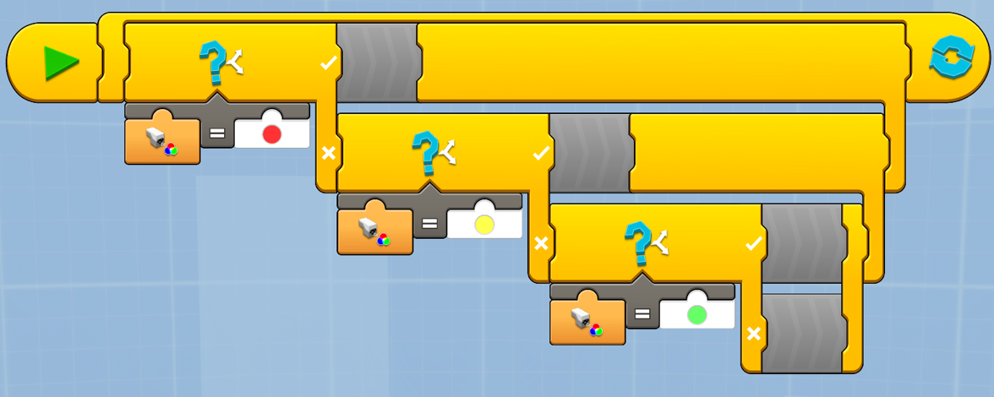
Adding Sensor Blocks
Step 6: From the Orange Sensor Pallet, add in a Color Sensor Reporter Block into each condition in Step 5.
On the right side, change the parameter to equal each of the colors (Red, Yellow and Green)

Slide 11
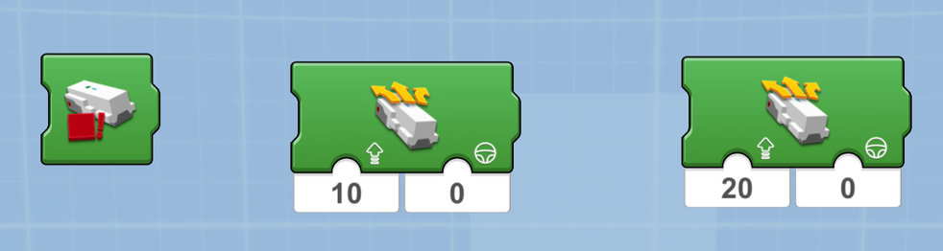
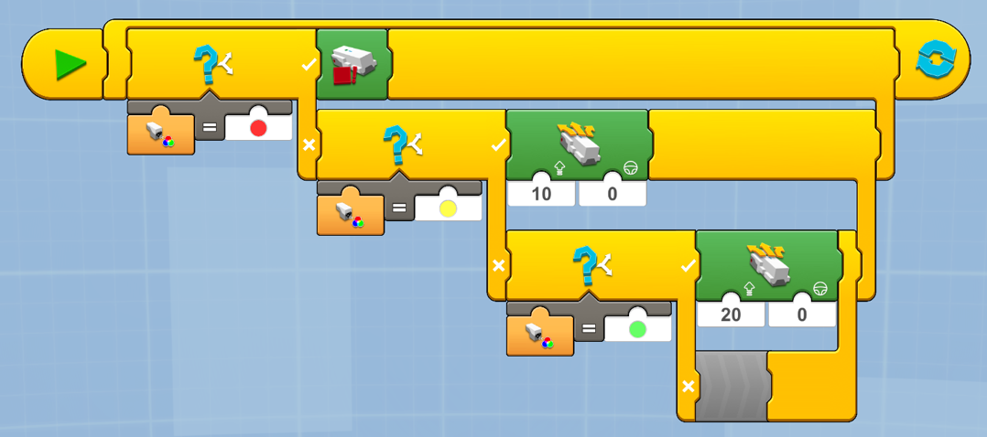
Stopping, Slowing and Speeding Up
Step 7: In each of the If/Else Blocks, add the appropriate Green Movement Block to stop the motors, slow them down or speed up
Red Light: Use the Drivebase Stop Block
Yellow Light: Use the Drivebase Move Steering Block and set power = 10
Green Light: Use the Drivebase Move Steering Block and set power = 20

Slide 12
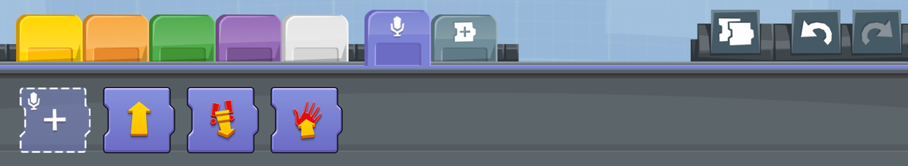
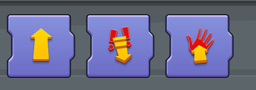
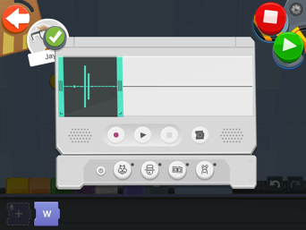
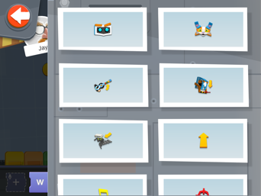
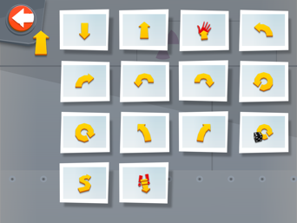
Adding Custom Sounds
Step 7:. To make custom sounds, select the Violet Microphone Pallet. Click on the “+” to get started. Record “Red”. Click on the icon the shape of the Block to create an icon. Click on the arrow shape to pick direction icons. Pick the icon with a red hand for your recording of the word “Red”.
Repeat process to create a custom sound for “Yellow” and “Green”. Pick a different icon each time.

Slide 13
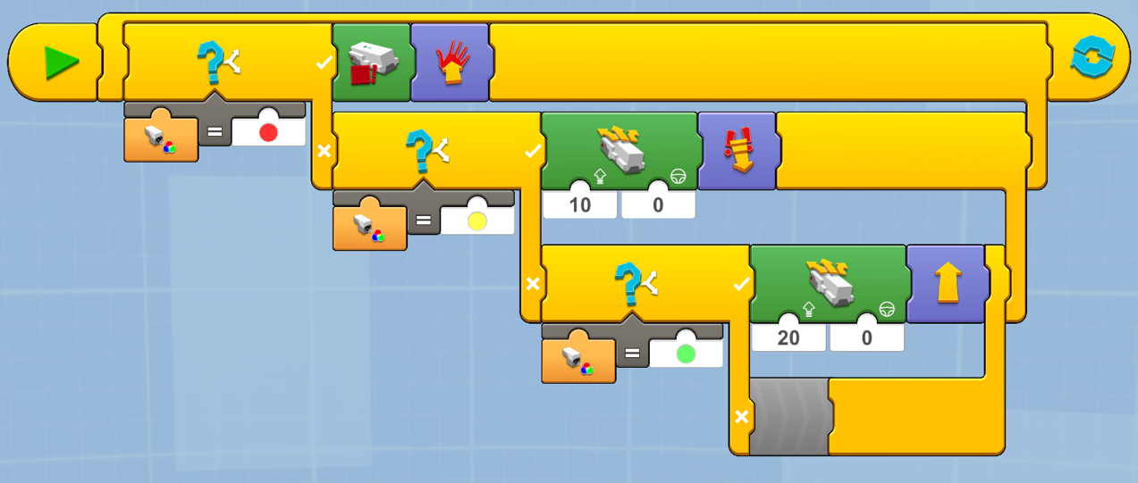
Step 8: From the Violet Microphone Pallet, select the three sounds you created and insert them into each of the switches: Red, Yellow and Green.

Slide 14
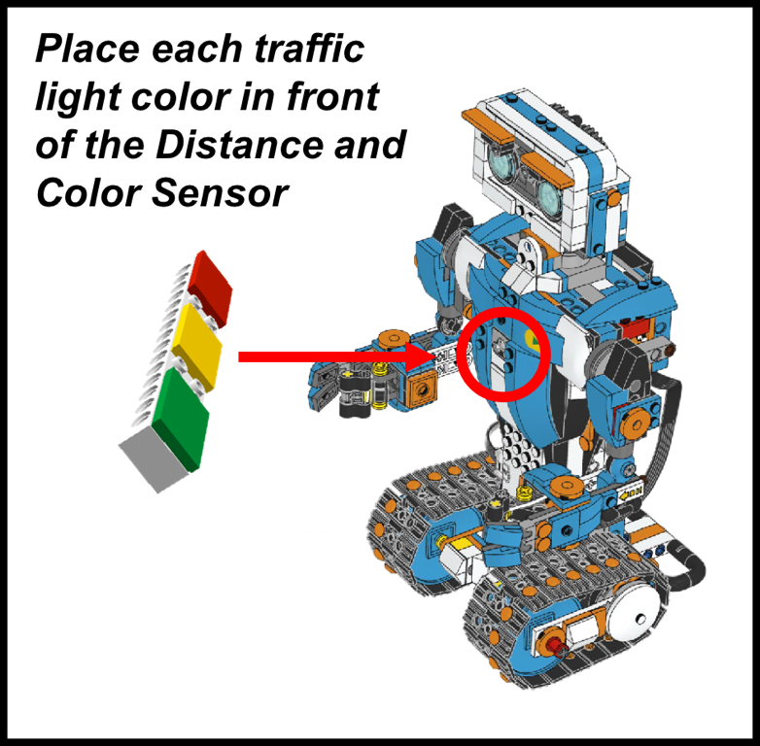
Ready to play
Connect to the hub. Hit play
Show each color of the Traffic Light you made earlier in front of Vernie’s Color and Distance Sensor
Vernie will respond based on the color you show him.

Slide 15
Credits
Lesson by Sanjay and Arvind Seshan
More lessons available at BoostLessons.com
MINDSTORMS lessons available at EV3Lessons.com
This work is licensed under a Creative Commons Attribution-NonCommercial-ShareAlike 4.0 International License.

