Slide 1
Use the Force: Proportional Control
By Sanjay and Arvind Seshan

Slide 2
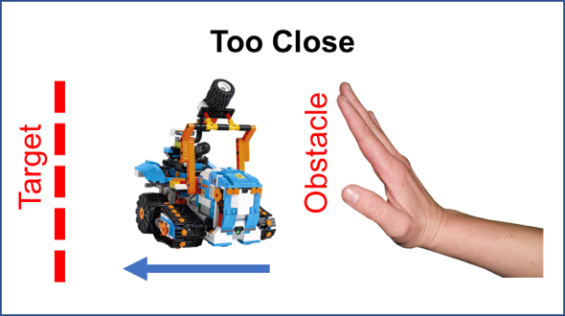
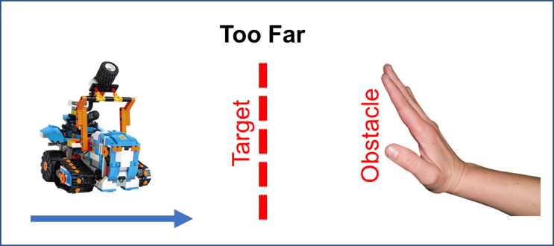
Objectives
You will learn the concept of proportional control
You will program your robot to stay at a target distance from an obstacle
The robot will back away from the obstacle if it is too close and move forward if the obstacle is further away
In addition, Vernie will say out loud the color he detected
You will be programming using the Creative Canvas area of the App

Slide 3
What is Proportional Control?
We will be implementing this movement with proportional control, which makes the robot move slower or faster based on how close it is to the target distance. The pseudocode for every proportional control program consists of two stages:
Computing an error → how far is the robot from a target
Making a correction → make the robot take an action that is proportional to the error (this is why it is called proportional control). You must multiply the error by a scaling factor to determine the correction
For this task, error will be how far the robot is from the target distance and correction will be moving the robot forward or backward at a particular speed.

Slide 4
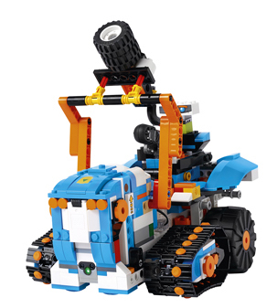
What do you need to build for this project?
Build any design you like with two wheels or treads such that the robot can move forward and backwards
Be sure to include the Color & Distance Sensor somewhere on the front of your design

Slide 5
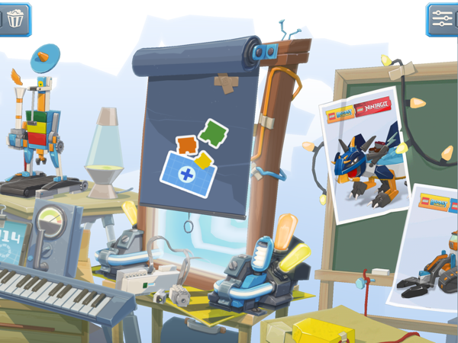
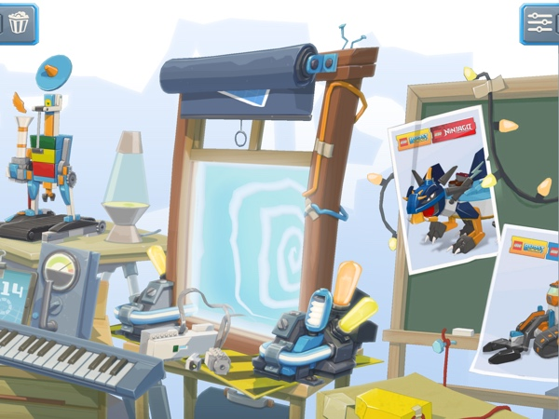
Creative Canvas
The Creative Canvas area of the App allows you to use the App in a free play mode
You will have access to all the programming blocks needed to complete this project

Slide 6
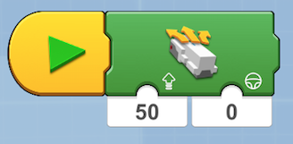
Getting Started
Step 1: Drag in a Start Sequence Block from the Yellow Palette
Step 2: Drag in a Drivebase Move Steering Block from the Green Palette and place near Start Sequence Block

Slide 7
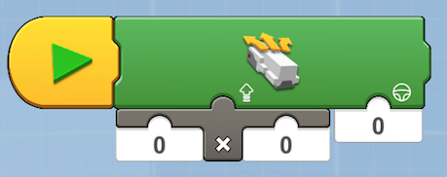
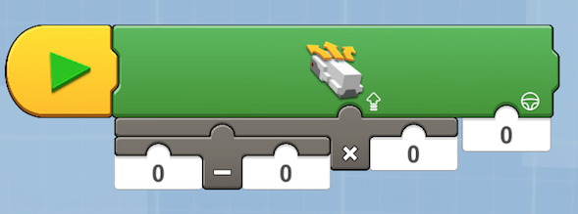
Adding Math Blocks
Drag in the Multiply Operator Block from the White Palette and place as indicated. This will be the part of the code that computes the proportional response to the distance from the target (i.e. the correction).
Step 4: Drag in the Subtraction Operator Block from the White Palette and place as indicated on the left parameter of the Motor Block. This part of the code will compute the distance from the target (i.e. the error)

Slide 8
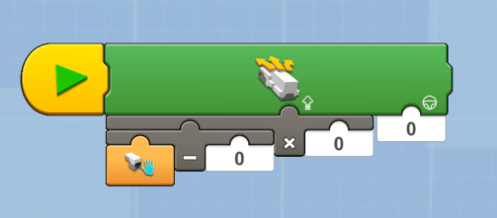
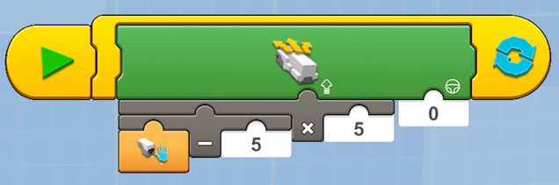
Adding Sensors
Step 5: Drag in the Sensor Distance Reporter Block from the Orange Palette and place as indicated in the left parameter of the subtraction block.
Step 6: Change all the parameters to 5. The 5 in the subtraction block sets the target because the range of the sensor is 0-10 and 5 is halfway in between. The multiplication block scales the power so that instead of going 0–5 power, the robot will go 0-25 power. When you take the output from the sensor and subtract 5, the result may be a negative number. Since negative power makes the motor move backwards, the robot will move away from the obstacle.
Step 7: Drag in a Loop Forever Block from the Yellow Palette so that the code is repeated again and again forever.

Slide 9
Ready to play
Place your hand in front of the robot (really close or far) and see what the robot does
Surprise your friends with you new Force!

Slide 10
Credits
Lesson by Sanjay and Arvind Seshan
More lessons available at BoostLessons.com
MINDSTORMS lessons available at EV3Lessons.com
This work is licensed under a Creative Commons Attribution-NonCommercial-ShareAlike 4.0 International License.

