Slide 1
Cloud Native Göteborg
Cloud Native and Machine
Learning at the Edge:
ARM and NVIDIA

Slide 2
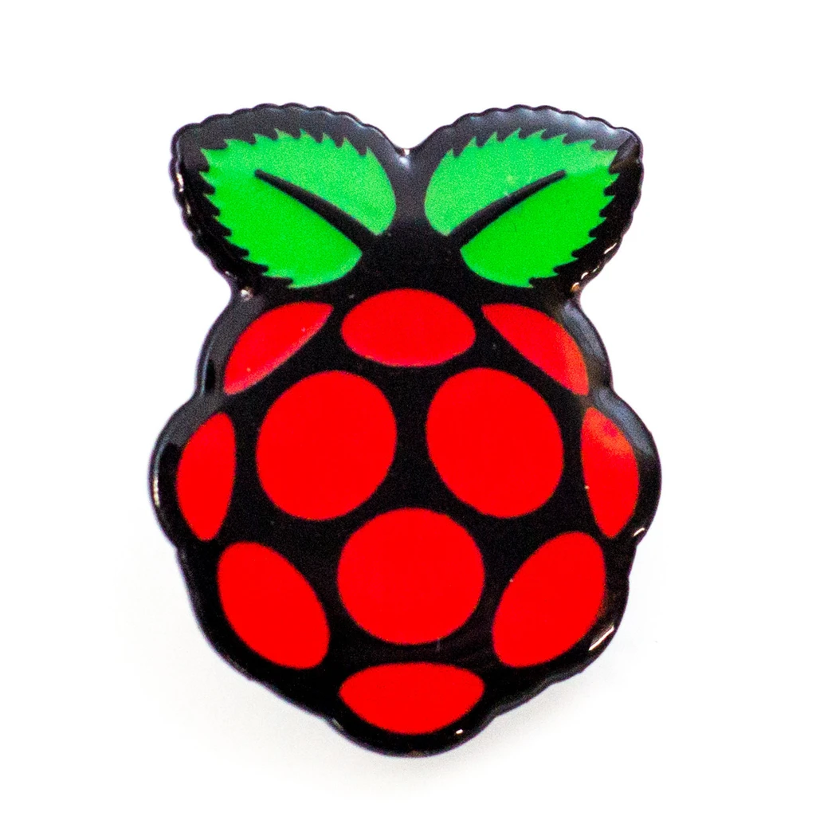
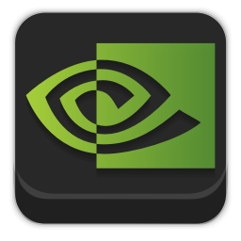
Overview
Cloud Native
Containers
Kubernetes
Raspberry Pi
Machine Learning
CPU: ARM64
GPU: NVIDIA
Jetson Family

Slide 3

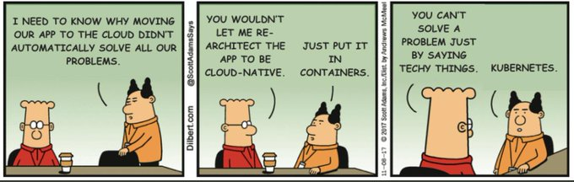
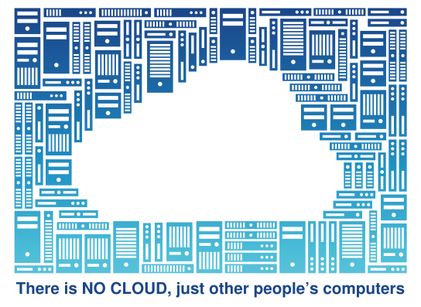
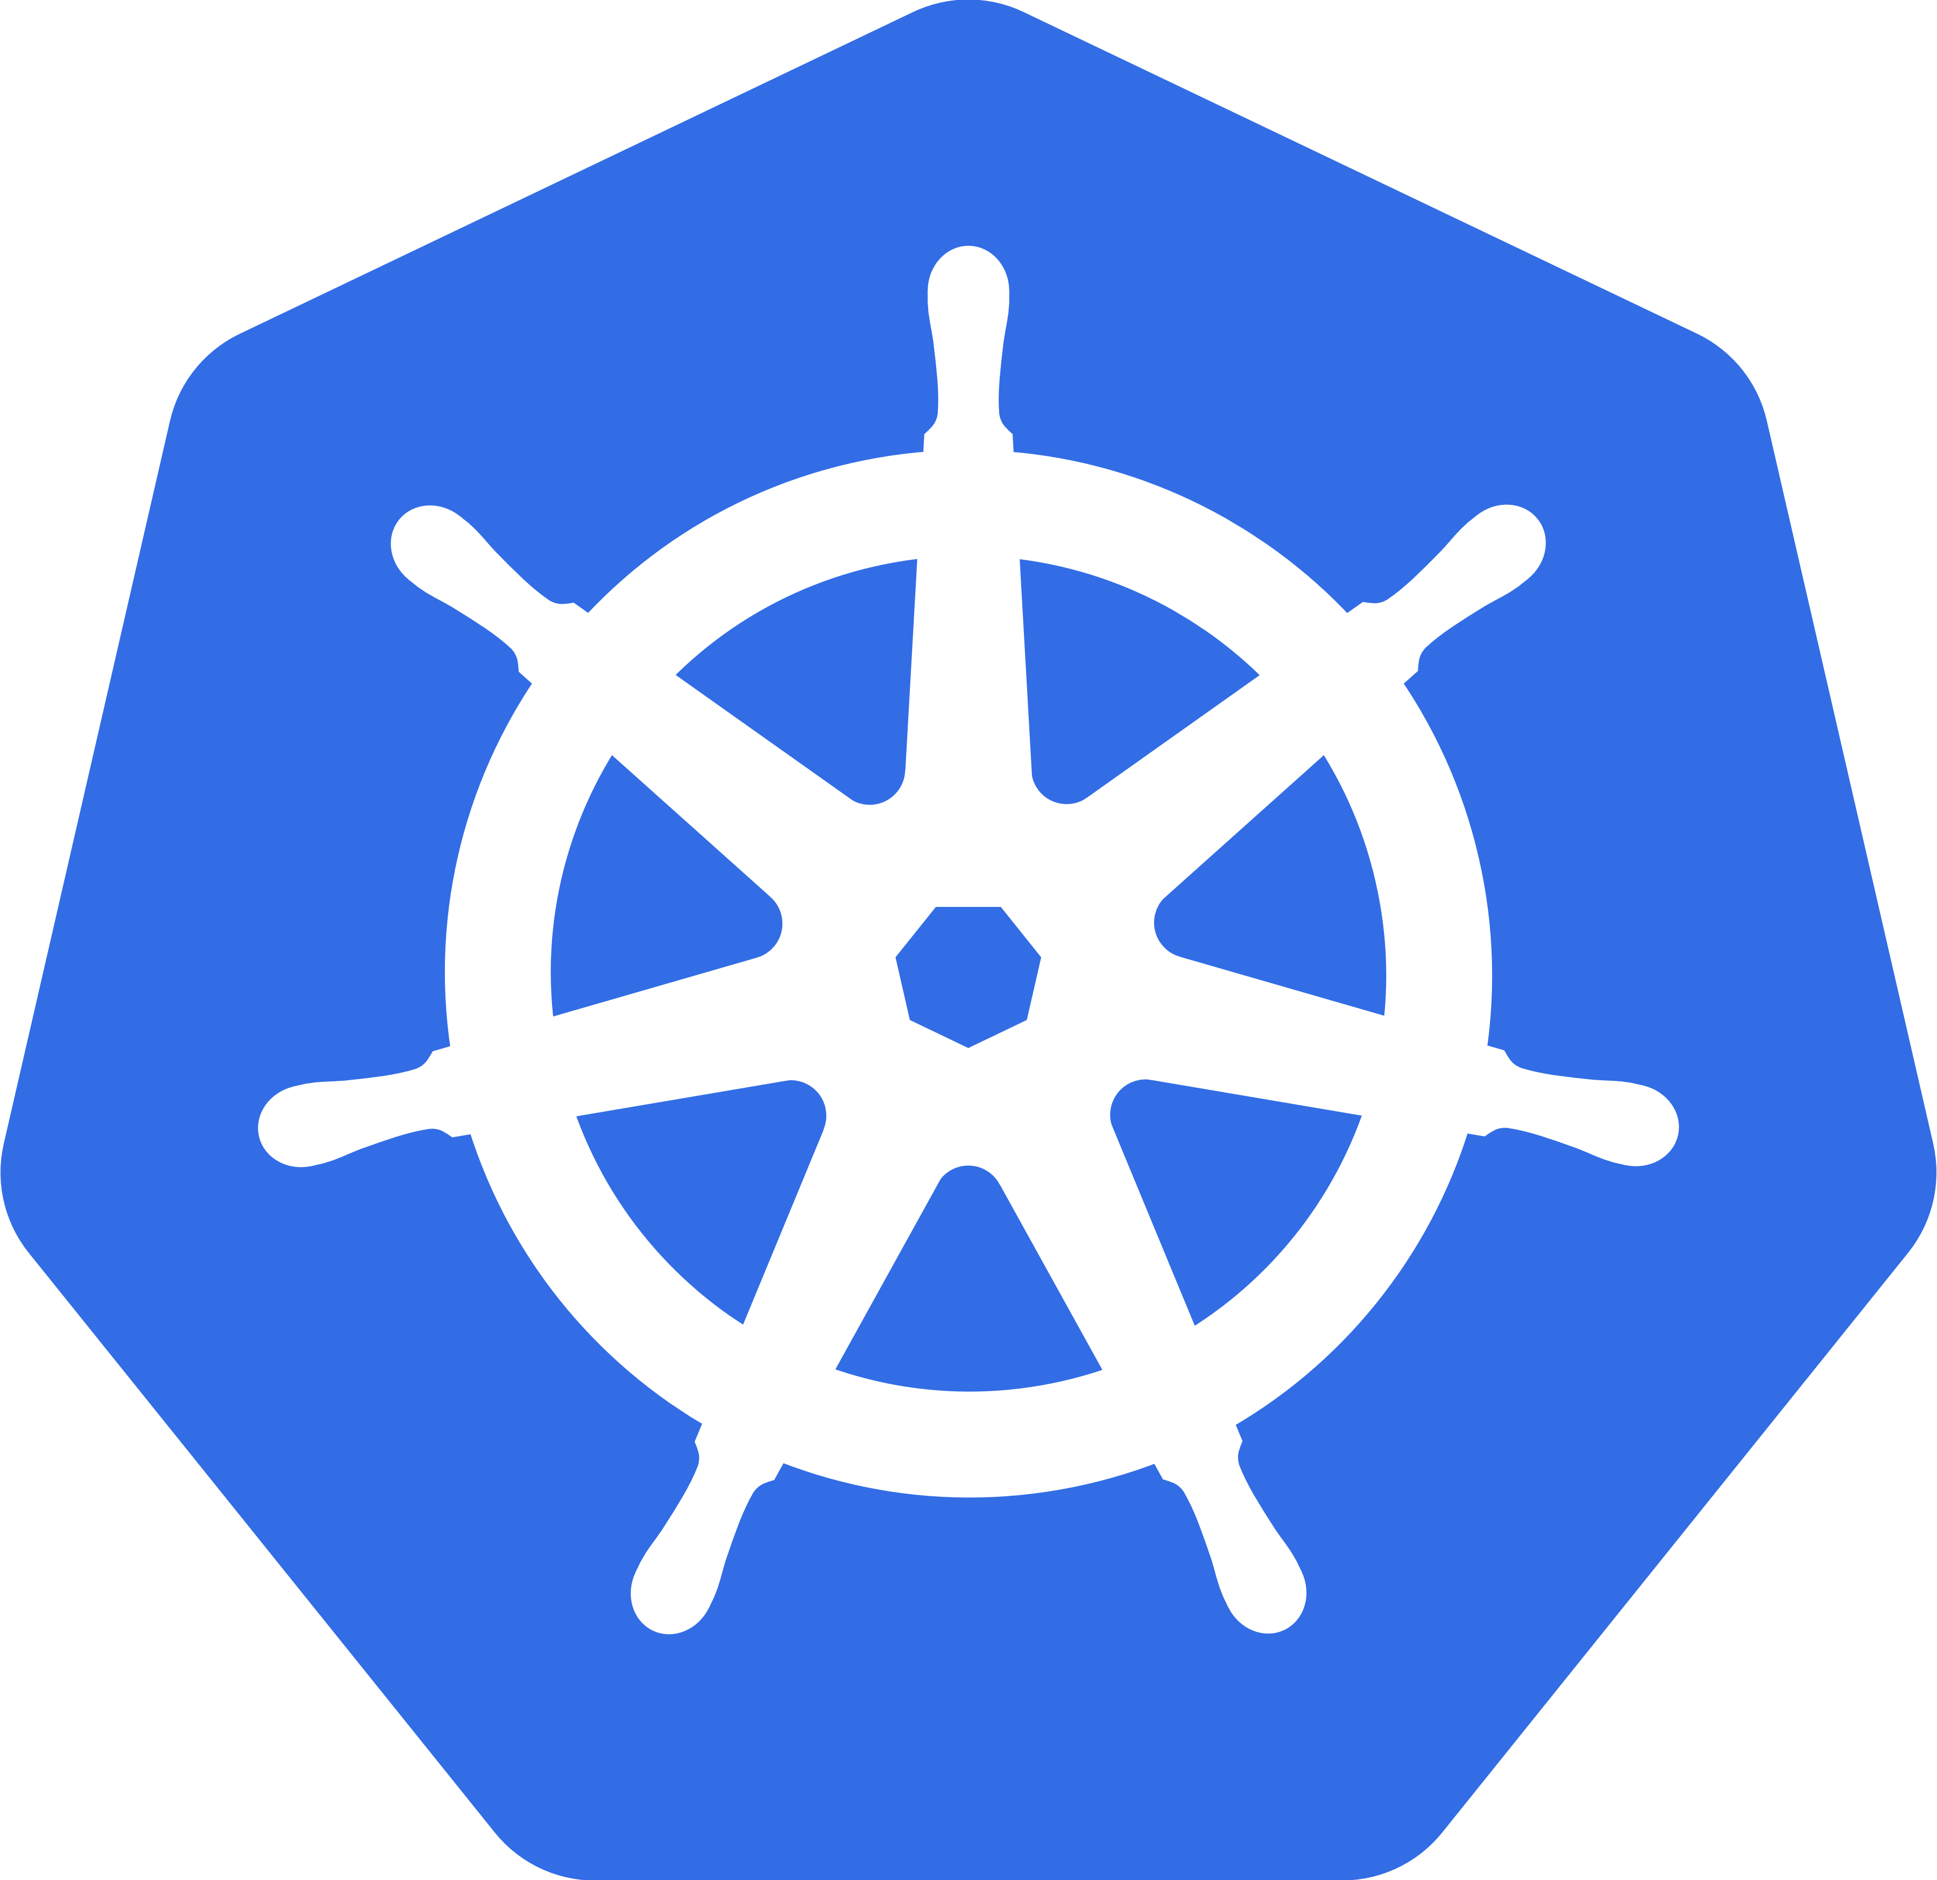
Cloud Native
“Cloud native technologies empower organizations to build and run scalable applications in modern, dynamic environments such as public, private, and hybrid clouds. Containers, service meshes, microservices, immutable infrastructure, and declarative APIs exemplify this approach.”
Here we will just talk about the technology: Containers and Kubernetes
https://www.cncf.io/about/faq/#what-is-cloud-native
“Barry Dingle” https://dilbert.com/strip/2017-11-08
https://fsfe.org/nocloud
https://kubernetes.io

Slide 4

Containers?
1982: Chroot (Unix)
2000: Jails (FreeBSD)
2002: Zones (Solaris)
2005: OpenVZ (Linux)
2008: LXC (also Linux)
2013: Docker (Linux)
2016: Docker (Windows)
image: Freepik.com

Slide 5

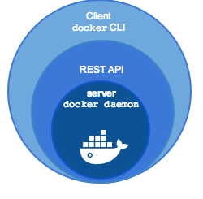

Docker / Moby
2013: Docker announced
https://www.docker.com/
Docker Engine
  Client (docker)
  Server (daemon)
2017: Moby introduced
https://mobyproject.org/
2013: Docker announced
https://www.docker.com/
Docker Desktop
  macOS (Linux VM)
  Windows (Linux VM)
2017: Moby introduced
https://mobyproject.org/

Slide 6
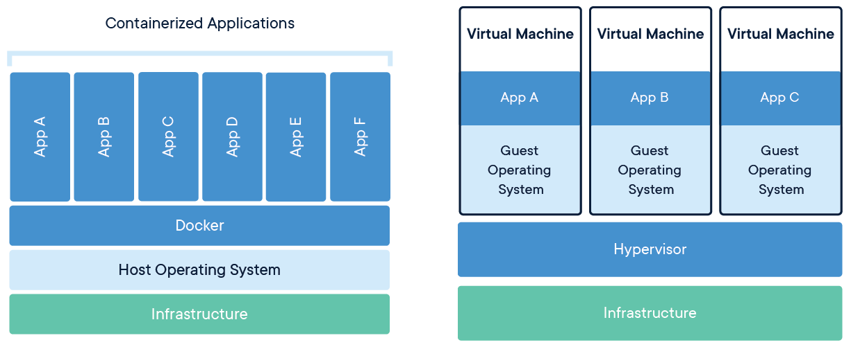
Containers vs. Virtual Machines
”A container is a standard unit of software that packages up code and all its dependencies ...”
https://www.docker.com/resources/what-container

Slide 7
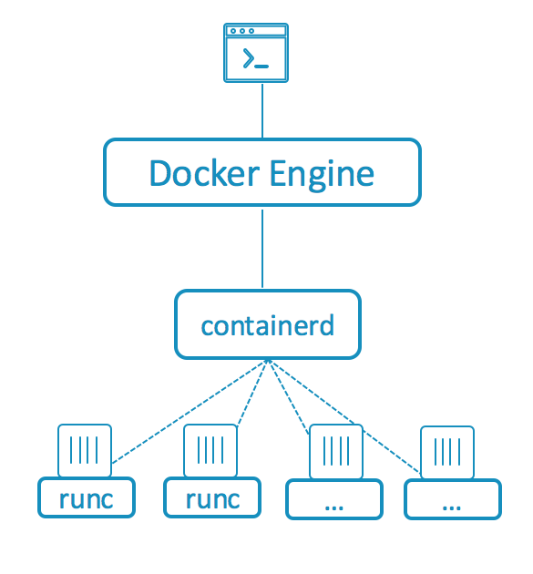

containerd
”Containerd is a daemon providing a GRPC API to manage containers on the local system. Containerd leverages runC to [...] provide advanced functionality.”
https://github.com/containerd/containerd
1.11+
https://blog.docker.com/2015/12/containerd-daemon-to-control-runc/

Slide 8
runC
”runC is a lightweight, portable container runtime.
It includes all of the plumbing code used by Docker to interact with system features related to containers.”
https://github.com/opencontainers/runc
1.11+
https://blog.docker.com/2015/06/runc/

Slide 9
Kubernetes
Kubernetes is an open-source container orchestration system for automating deployment, scaling, and management of containerized applications.
https://kubernetes.io
Google open-sourced the Kubernetes project in 2014.
“ Kubernetes builds upon a decade and a half of experience that Google has with running production workloads at scale, combined with best-of-breed ideas and practices from the community. “

Slide 10
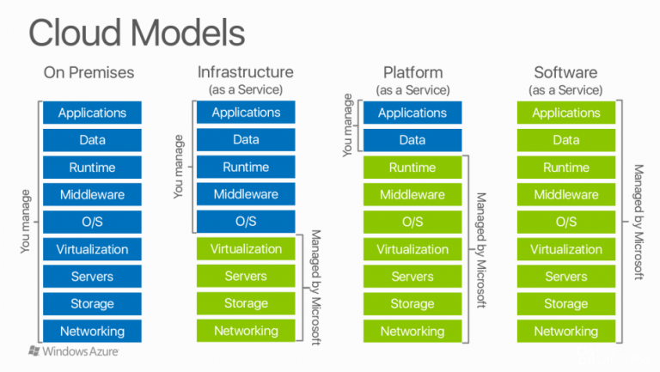
Kubernetes
Why containers ? (Containers-as-a-Service, CaaS)
“ Kubernetes provides a container-centric management environment. It orchestrates computing, networking, and storage infrastructure on behalf of user workloads. This provides much of the simplicity of Platform as a Service (PaaS) with the flexibility of Infrastructure as a Service (IaaS), and enables portability across infrastructure providers. “
On-Prem
IaaS
PaaS
SaaS
https://kubernetes.io/docs/concepts/overview/what-is-kubernetes/#why-containers

Slide 11
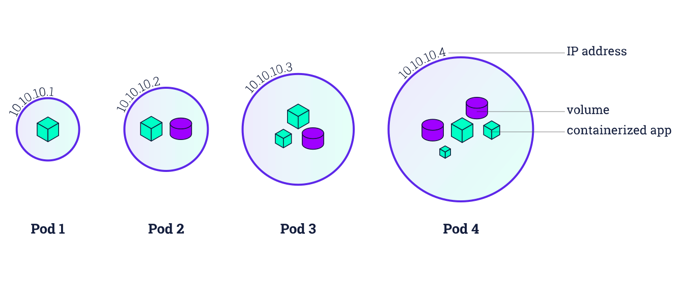
Pod?
A pod (as in a pod of seals or peas) is a group of one or more containers, with shared storage/network, and a specification for how to run the containers.
https://kubernetes.io/docs/tutorials/kubernetes-basics/

Slide 12
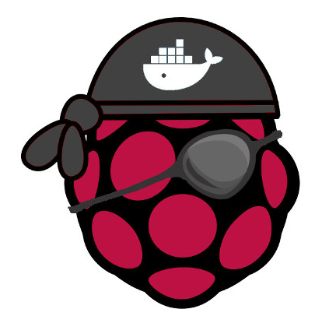
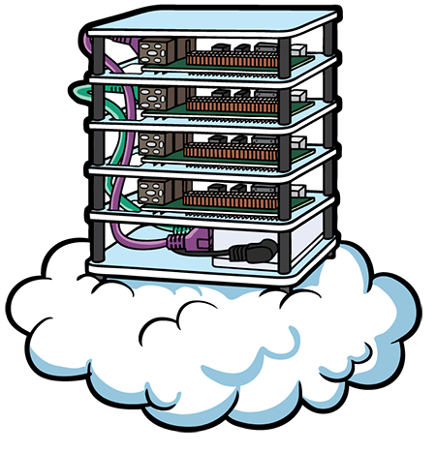
Hypriot and Kubecloud
2015
https://hypriot.com/
“HypriotOS - the fastest way to get Docker up and running on any Raspberry Pi.”
2016
https://kubecloud.io/
“KubeCloud is a tangible cloud computing environment … a small-scale datacenter.”

Slide 13


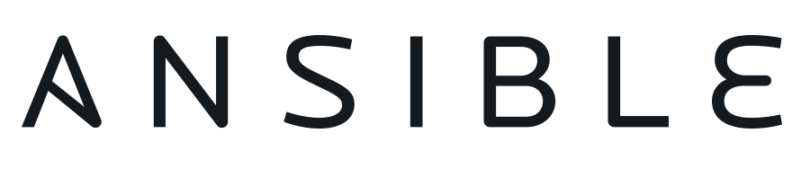
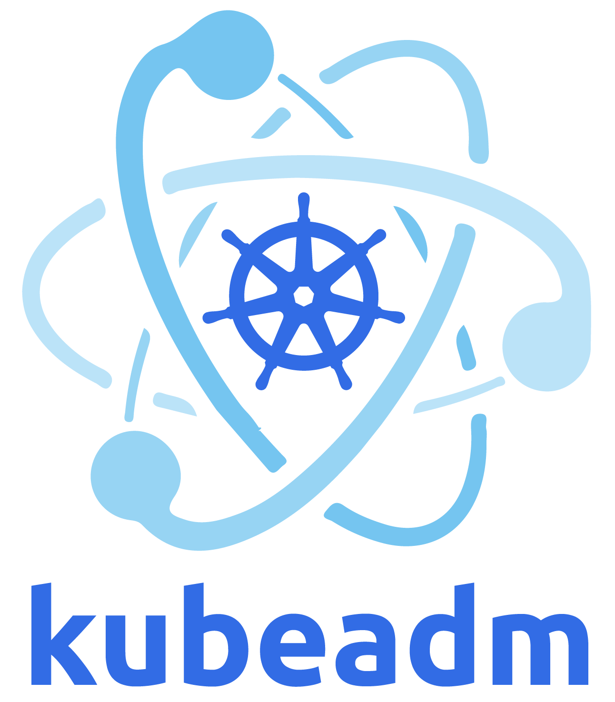


Installation
cloud-init
  add ssh/sudo
ansible
  needs python
K8s (kubeadm)
  docker/moby
K3s (rancher)
  containerd

Slide 14
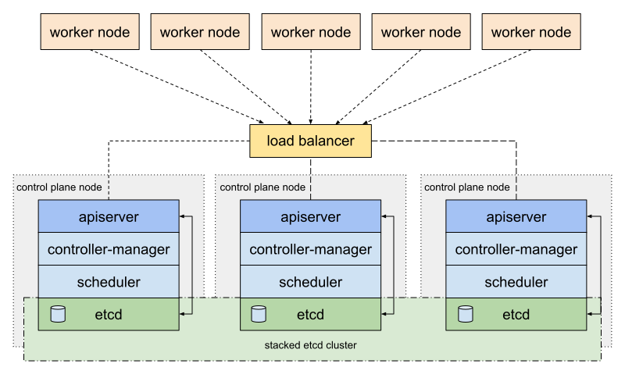
High Availability
kubeadm
Stacked CP
  control plane
  etcd (database)
Virtual IP
  keepalived
  haproxy
https://kubernetes.io/docs/setup/production-environment/tools/kubeadm/high-availability/

Slide 15
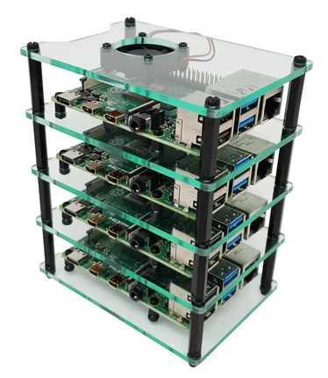
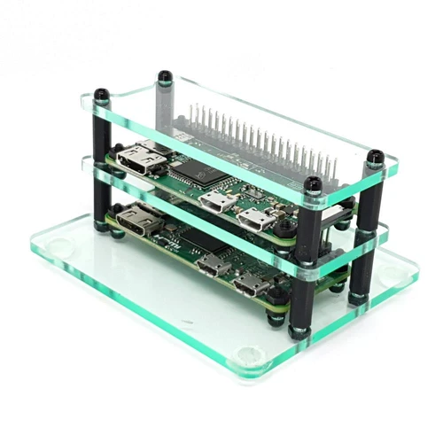
Raspberry Pi
1 B | 2 B | 3 B | 4 B
armv6 700 MHz | armv7 900 MHz | armv8 1.2 GHz | armv8 1.5 Ghz
512 MB RAM | 1 GB RAM | 1 GB RAM | 2-8 GB RAM
2012 | 2015 | 2016 | 2019
$35 | $35 | $35 | $35*
* 2 GB

Slide 16

Demo – Raspbernetes

Slide 17
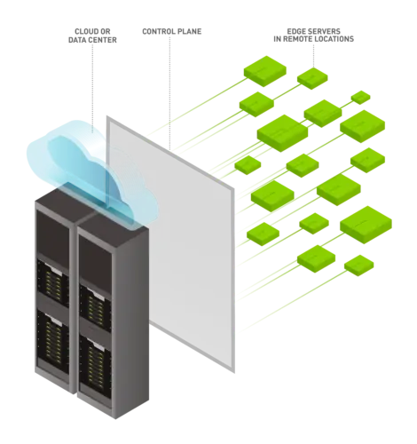
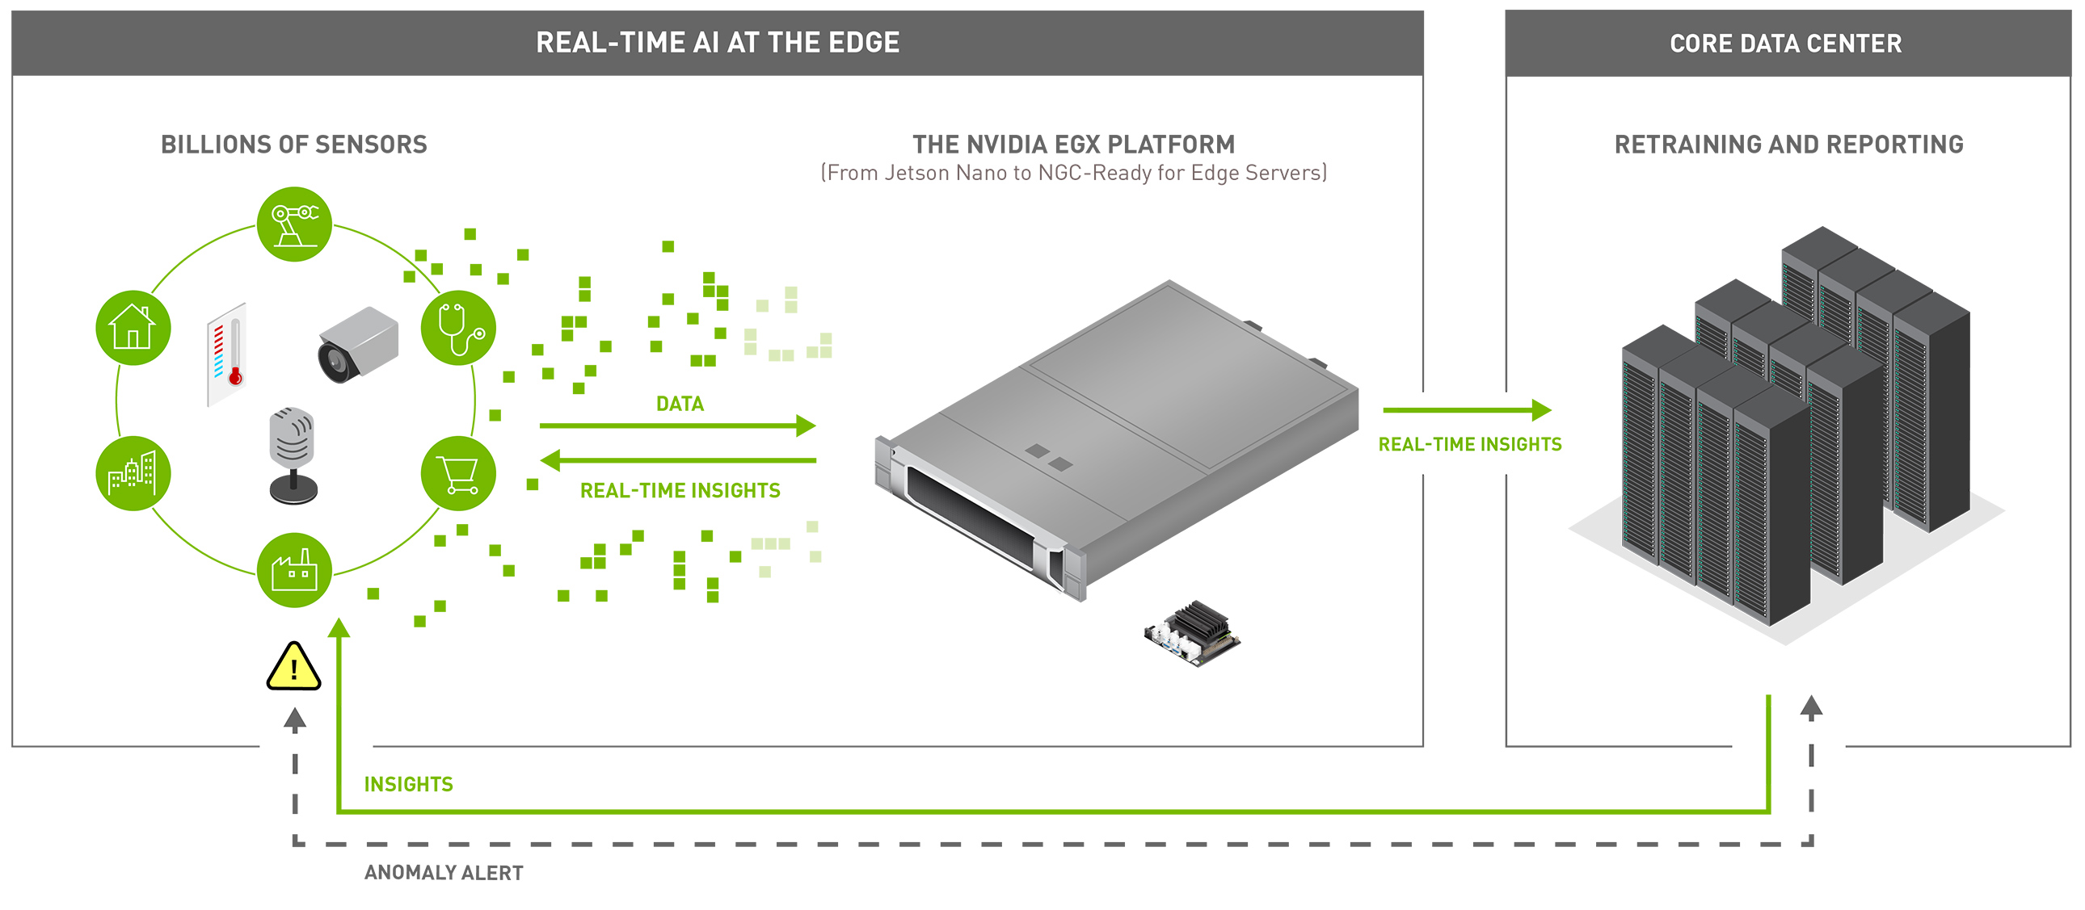
Machine Learning
Artifical Intelligence (AI)
Machine Learning
Deep Learning
image: NVIDIA.com
Cloud
(Data Center)
Edge
(Remote Location)

Slide 18

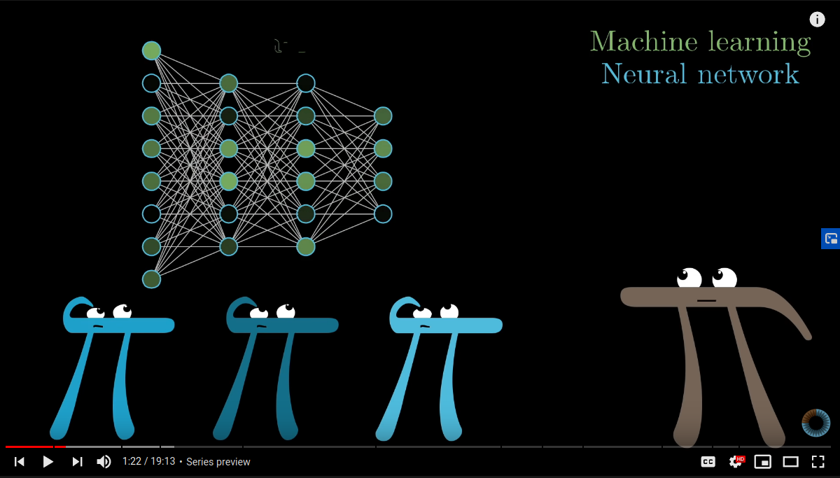

Neural Network
“But what is a Neural Network? | Deep learning, chapter 1”
https://www.youtube.com/c/3blue1brown/playlists

Slide 19

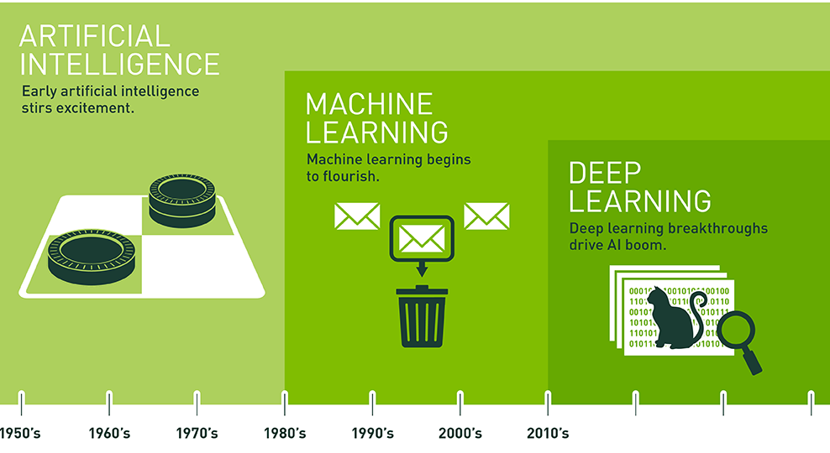
Free Courses
Elements of AI
AI of Sweden
NVIDIA Deep Learning Institute
Practical Deep Learning for Coders
https://www.elementsofai.se/
https://ai.se/
https://developer.nvidia.com/
https://fast.ai/
image: NVIDIA.com

Slide 20
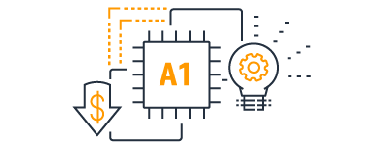
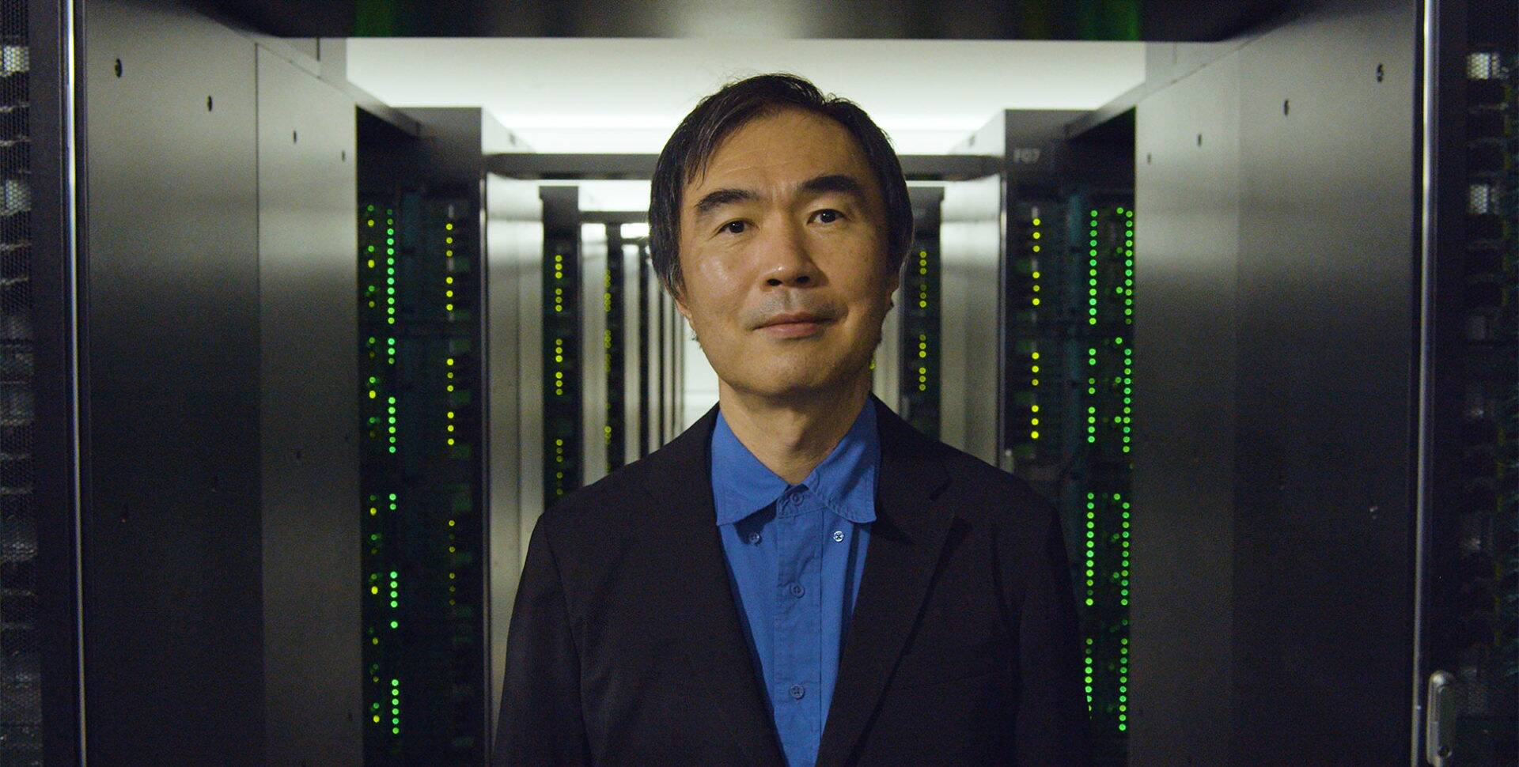
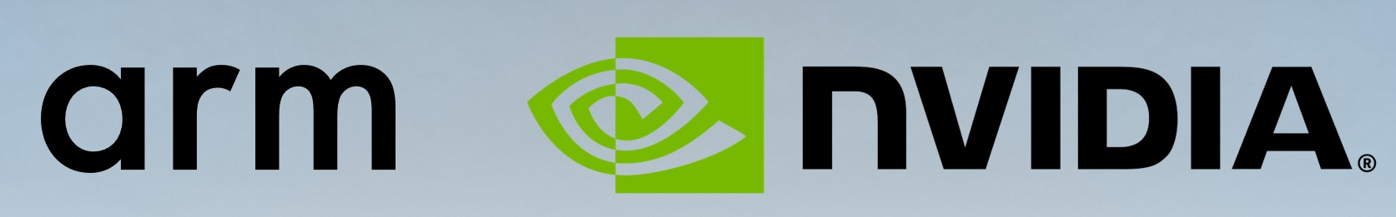
CPU
2018
amd64 (x86_64)
arm64 (aarch64)
Apple
Amazon
NVIDIA!
Amazon EC2 A1 Instances: AWS Graviton Processors
2020
Fugaku supercomputer: 8 million ARM cores
https://nvidianews.nvidia.com/news/nvidia-to-acquire-arm-for-40-billion-creating-worlds-premier-computing-company-for-the-age-of-ai

Slide 21
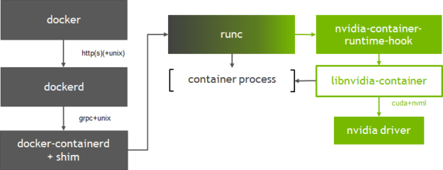
GPU
CUDA (nvidia)
nvidia-docker2
https://developer.nvidia.com/blog/gpu-containers-runtime/

Slide 22
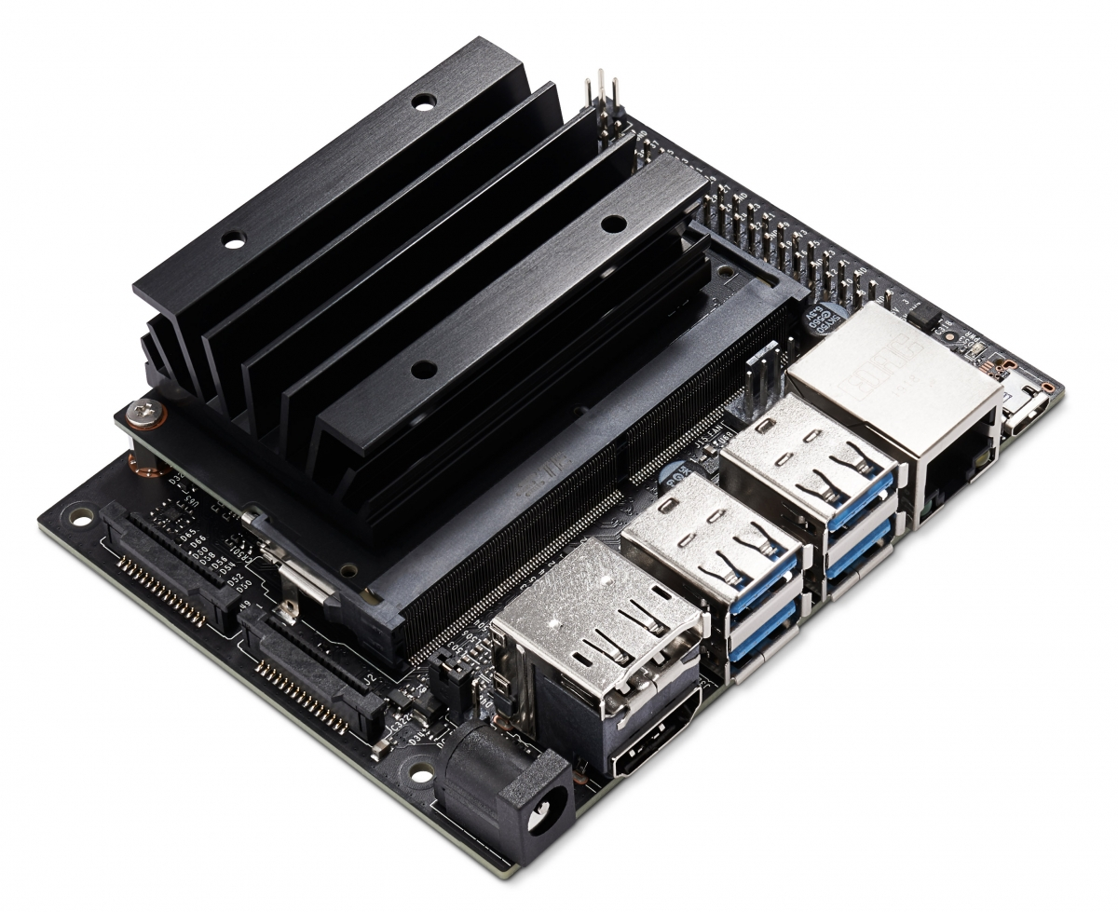
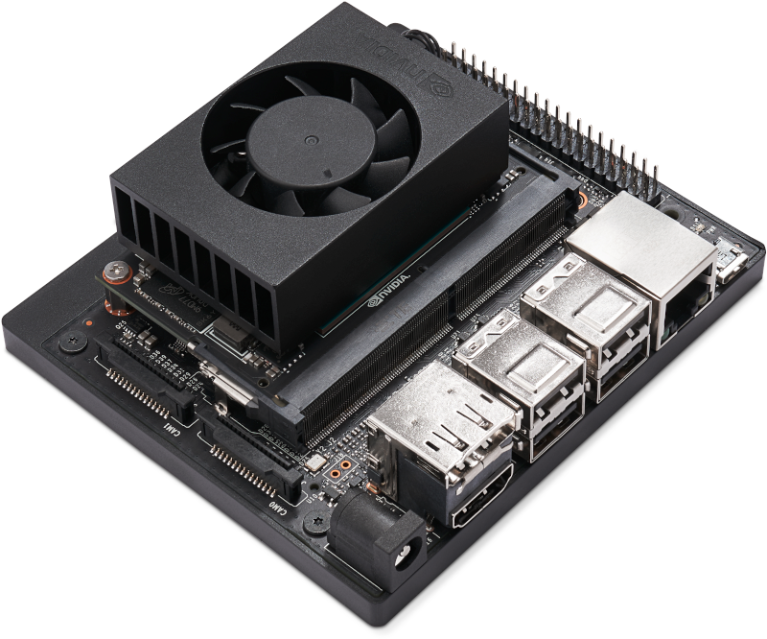
Jetson Family
 | Jetson Nano | Jetson TX2 | Jetson Xavier NX | Jetson AGX Xavier
CPU | 4 core ARM A57 | 6 core Denver and A57 | 6 Core Carmel ARMv8.2 | 8 core Carmel ARM v8.2
RAM | 4 GB | 8 GB | 8 GB | 16 GB
GPU | 128 core Maxwell | 256 core Pascal | 384 core Volta | 512 core Volta
 | 0.5 TFLOPS | 1.3 TFLOPS | 6 TFLOPS | 11 TFLOPS
Dev Kit | $99 |  | $399
5 – 10W (5V)
45mm x 70mm
10-15W (19V)
45mm x 70mm

Slide 23
Demo – Jetson Nano

Slide 24
Questions?
Anders F Björklund
github.com/afbjorklund
For more info on boot2podman:
https://boot2podman.github.io/

