Slide 1
FOSS Gbg
Podman and Kubernetes:
Running Linux Containers
without a Docker daemon

Slide 2
Overview
Containers?
Docker
OCI - standard
runC
containerd
podman
buildah
CRI - conmon
CNI - plugins
boot2podman
Kubernetes
Pod?
Minikube
CRI-O - runtime

Slide 3
Containers?
1982: Chroot (Unix)
2000: Jails (FreeBSD)
2002: Zones (Solaris)
2005: OpenVZ (Linux)
2008: LXC (also Linux)
Virtual Private Servers
Virtual Environments
Now called: Containers
File Tree
/ (root)
Process Tree
1 (init)
User
0 (root)
Group
0 (root)

Slide 4
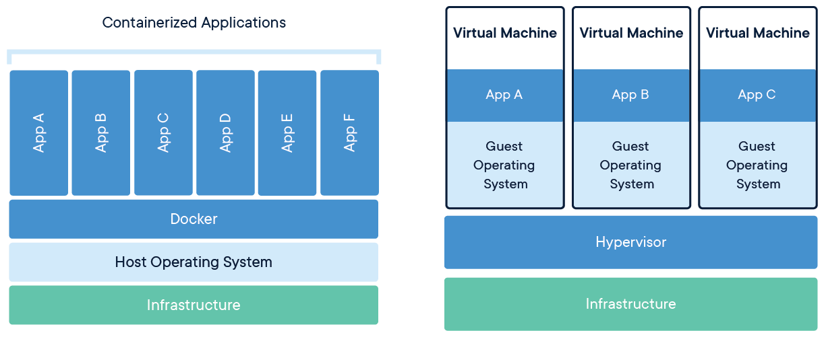
Containers vs. Virtual Machines
” A container is a standard unit of software that packages up code and all its dependencies ...”
https://www.docker.com/resources/what-container

Slide 5
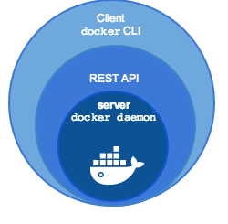
Docker
2013: Docker announced
https://www.docker.com/
Docker Engine
  Client (docker)
  Server (daemon)

Slide 6
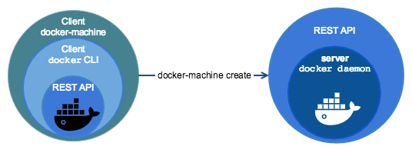
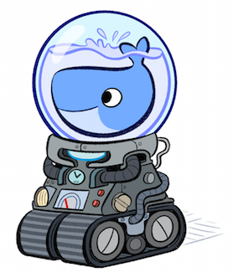
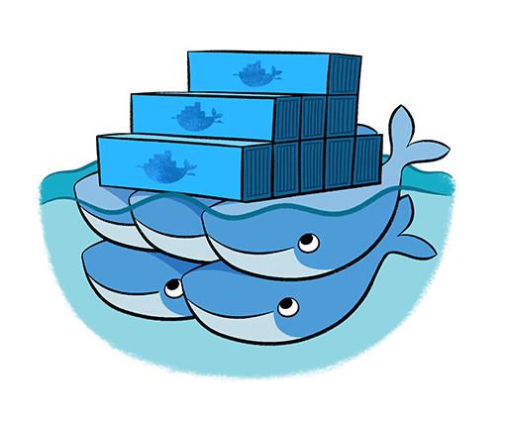
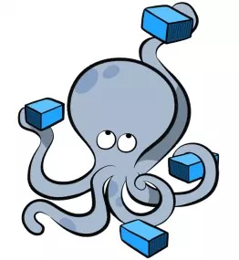
Docker
(Boot2Docker)
Docker Machine
Docker Swarm
Docker Compose
https://blog.docker.com/2014/12/announcing-docker-machine-swarm-and-compose-for-orchestrating-distributed-apps/

Slide 7
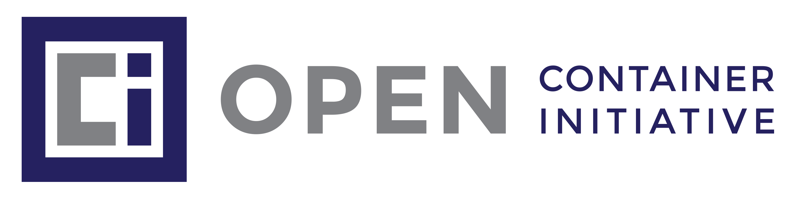
OCI (Open Container Initiative)
2015: OCI Announced
https://www.opencontainers.org/
Runtime specification
Image specification

Slide 8
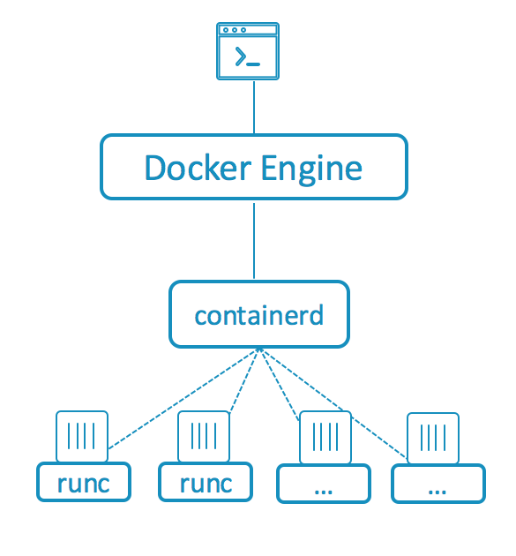

runC
” runC is a lightweight, portable container runtime.
It includes all of the plumbing code used by Docker to interact with system features related to containers.”
https://github.com/opencontainers/runc
1.11+
https://blog.docker.com/2015/06/runc/

Slide 9
containerd
” Containerd is a daemon providing a GRPC API to manage containers on the local system. Containerd leverages runC to [...] provide advanced functionality.”
https://github.com/docker/containerd
1.11+
https://blog.docker.com/2015/12/containerd-daemon-to-control-runc/

Slide 10
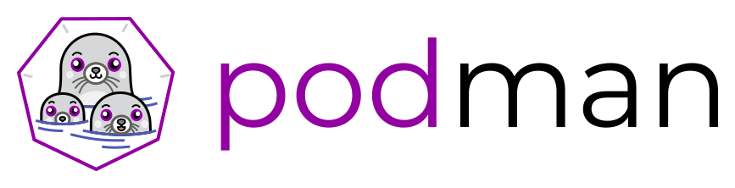
podman
Running containers – similar to docker
https://podman.io/
$ sudo podman ps
$ sudo podman images
$ sudo podman run -d busybox sleep 3600
$ sudo podman stop --latest

Slide 11
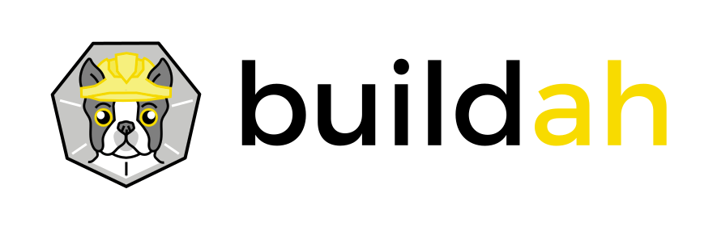
buildah
Building images – similar to Dockerfile
https://buildah.io/
# buildah images
# buildah containers
# newcontainer=$(buildah from scratch)
# scratchmnt=$(buildah mount $newcontainer)

Slide 12
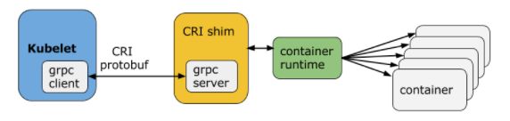
CRI (Container Runtime Interface)
Conmon is a utility within CRI-O that is used to monitor the containers, handle logging from the container process, serve attach clients and detects Out Of Memory (OOM) situations.
https://kubernetes.io/blog/2016/12/container-runtime-interface-cri-in-kubernetes/

Slide 13
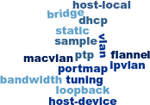
CNI (Container Network Interface)
CNI consists of a specification and libraries for writing plugins to configure network interfaces in Linux containers, along with a number of supported plugins.
https://kubernetes.io/blog/2016/01/why-kubernetes-doesnt-use-libnetwork/

Slide 14
boot2podman
Boot2podman is a lightweight Linux distribution made specifically to run Linux containers.
Virtual Machine
  Linux
  Windows
  Darwin (macOS)
https://github.com/boot2podman/boot2podman

Slide 15
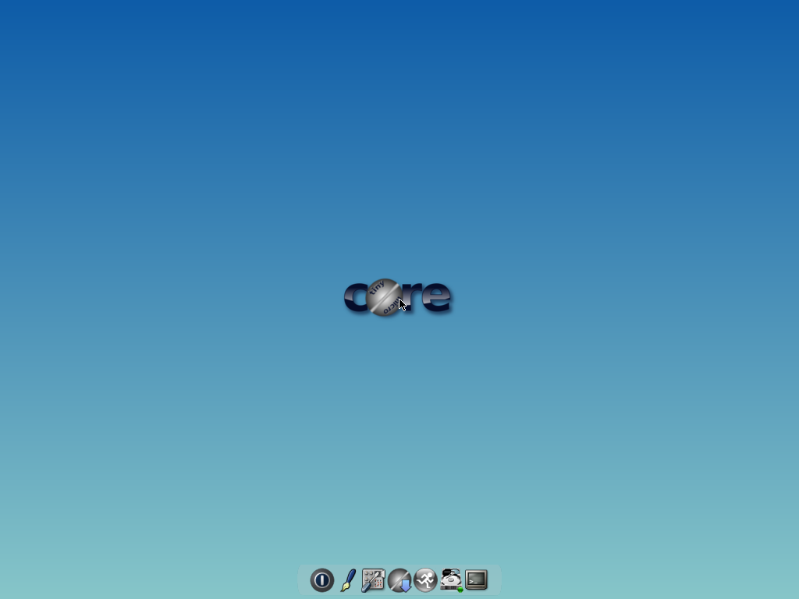
Base: Tiny Core Linux
Kernel (4.14)
Initrd (9.4M!)
Multiple Arch
  Pure64 = x86_64
Desktop (Tiny)
  X11 with FLWM
Packages (.tcz)
Containers
15M CorePure64-9.0.iso
28M TinyCorePure64-9.0.iso

Slide 16
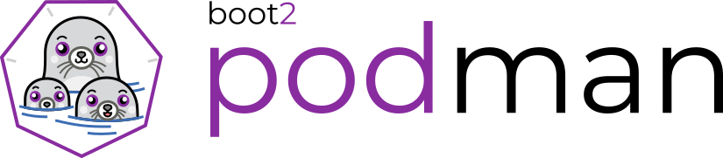
Add: boot2podman
Custom kernel
  vmlinuz64
Add-on initrd
  corepure64.gz
  boot2podman.gz
Build Tools
  Compile TC
  Go compiler

Slide 17
podman-machine
Machine lets you create servers with Podman,
then configures the Podman clients.
$ podman-machine create box
$ podman-machine ssh box
tc@box:~$ sudo podman
$ eval $(podman-machine env box)
$ pypodman version

Slide 18

Demo - Podman

Slide 19
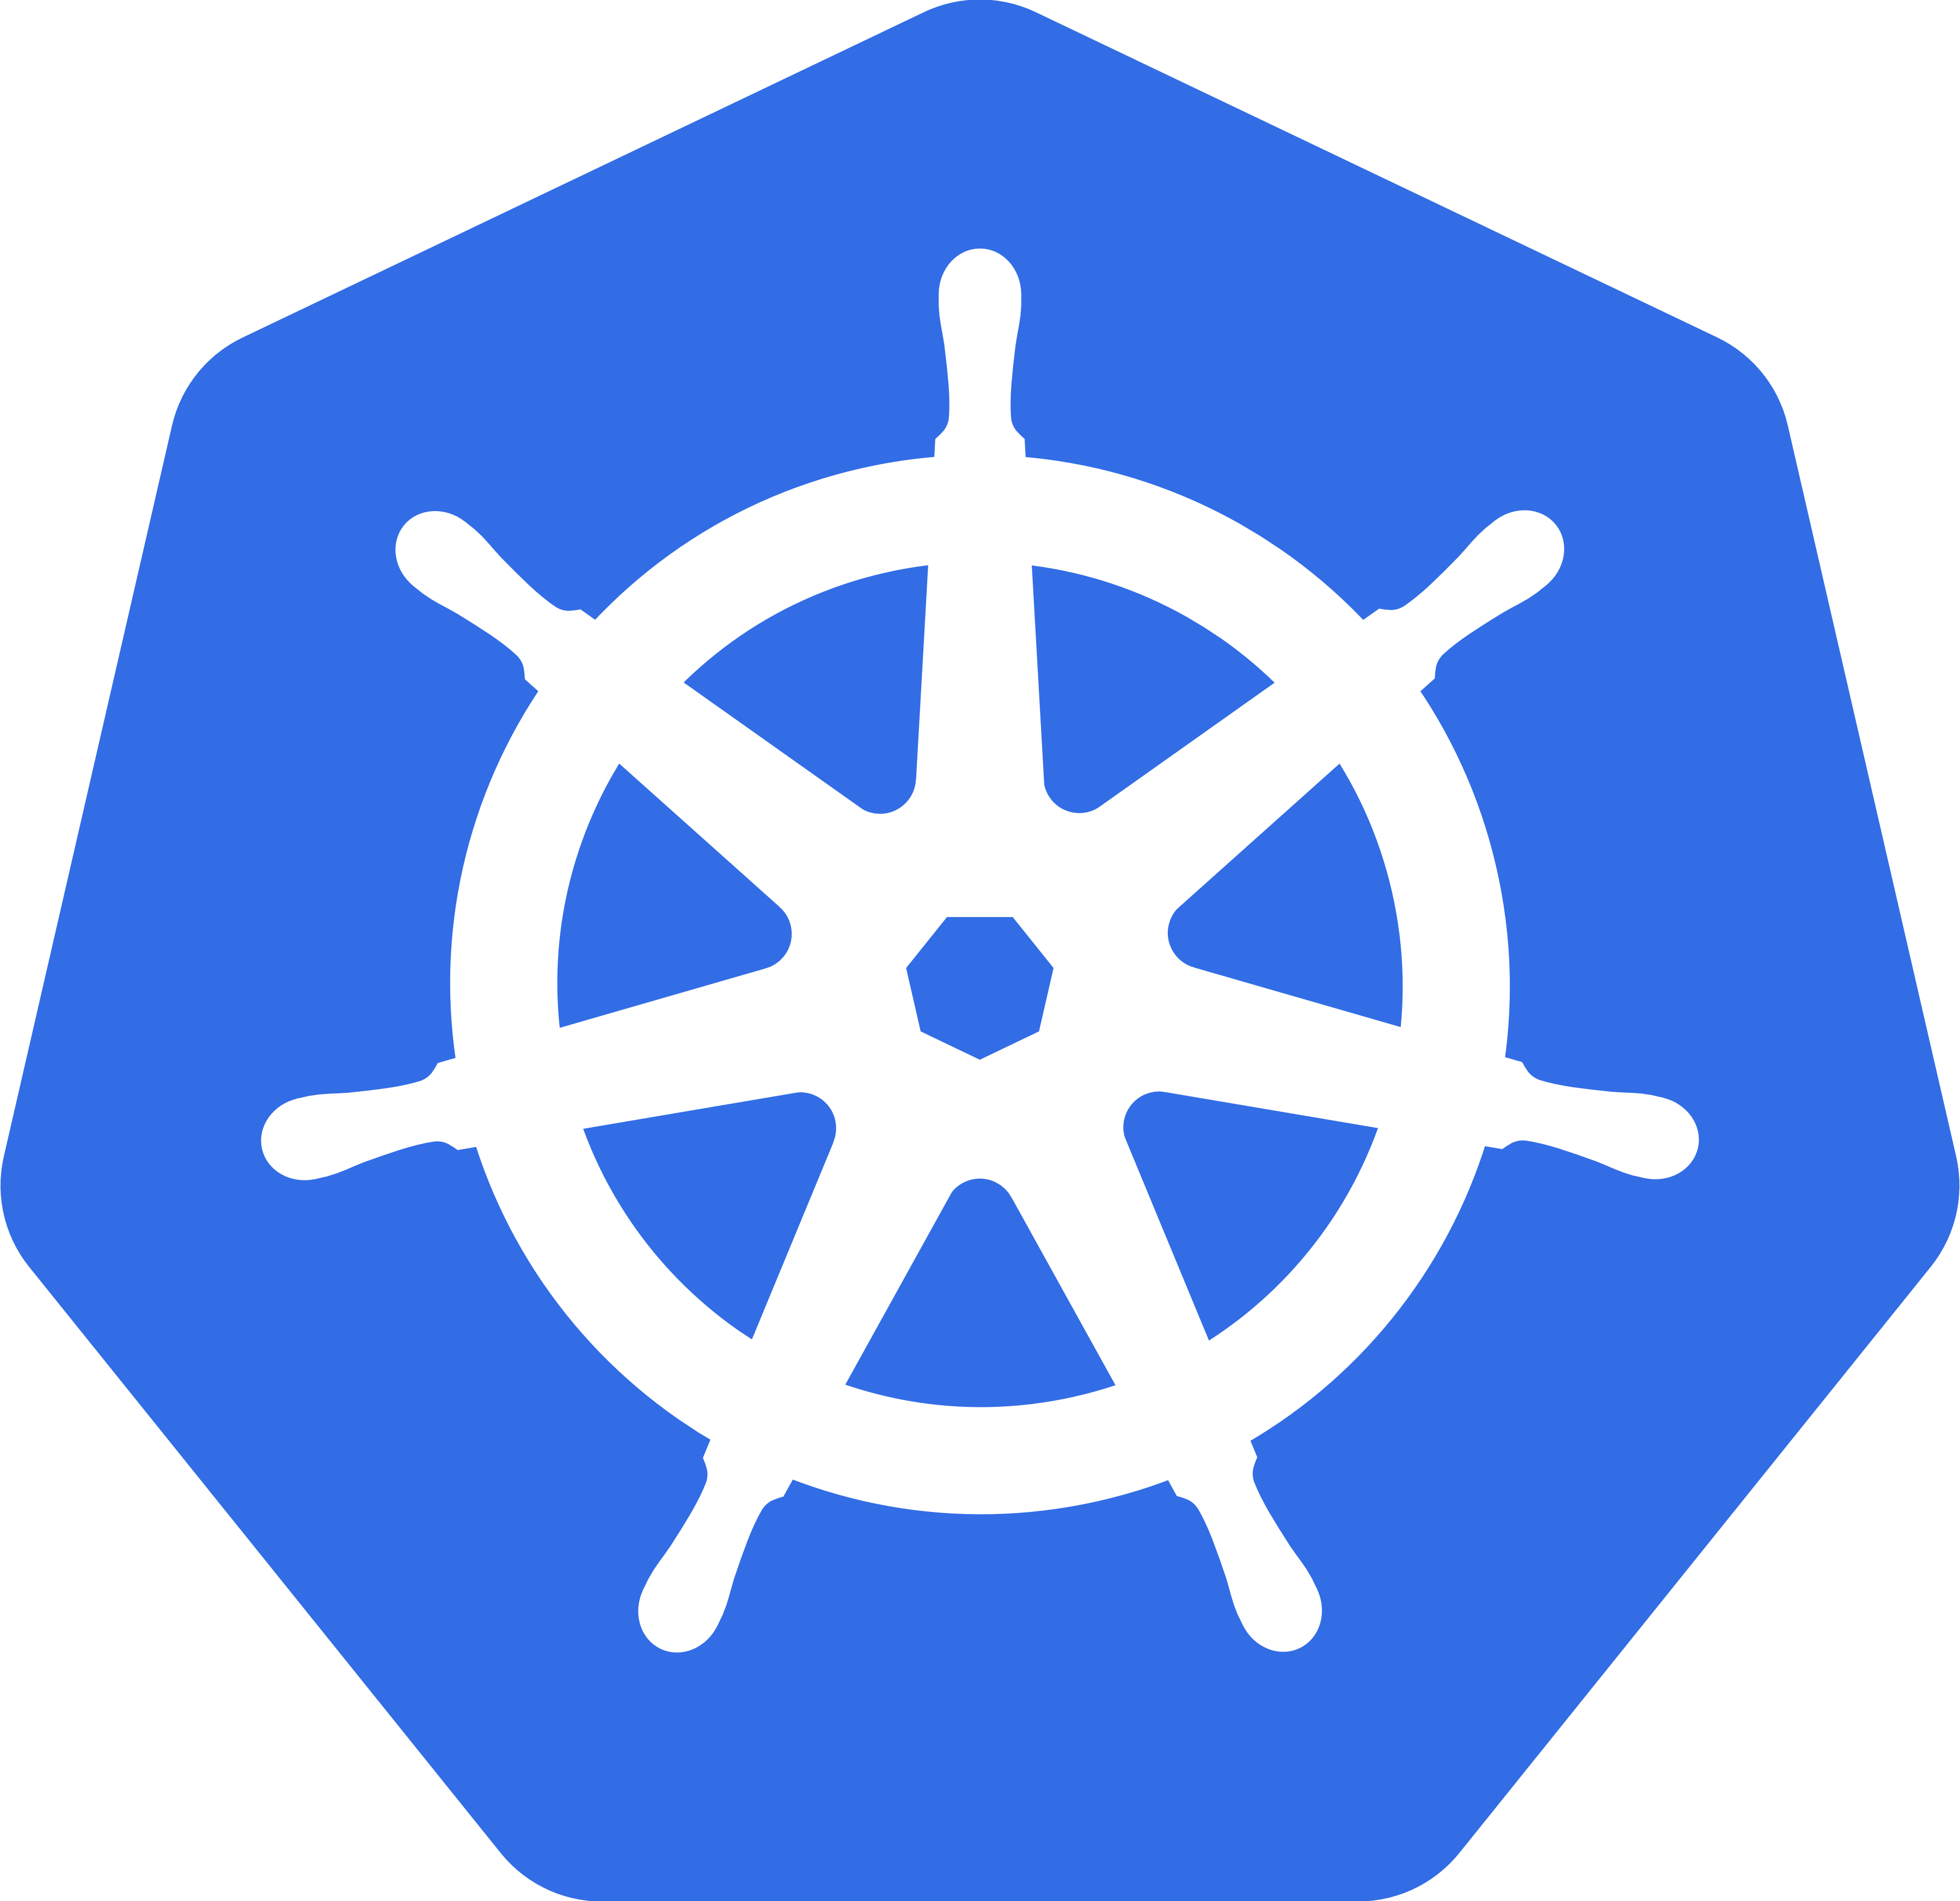
Kubernetes
Kubernetes is an open-source container orchestration system for automating deployment, scaling, and management of containerized applications.
https://kubernetes.io
$ kubectl get pods
Google open-sourced the Kubernetes project in 2014.
“ Kubernetes builds upon a decade and a half of experience that Google has with running production workloads at scale, combined with best-of-breed ideas and practices from the community. “

Slide 20
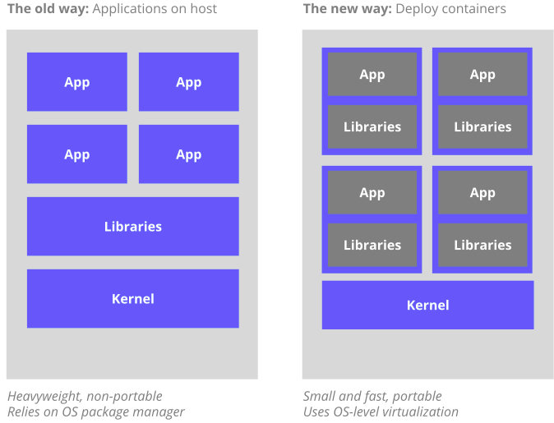
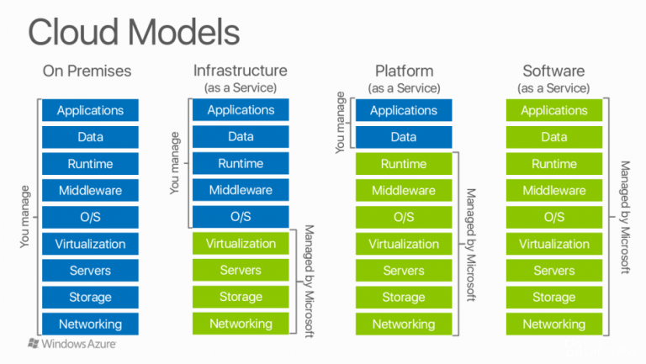
Kubernetes
Why containers ? (Containers-as-a-Service, CaaS)
“ Kubernetes provides a container-centric management environment. It orchestrates computing, networking, and storage infrastructure on behalf of user workloads. This provides much of the simplicity of Platform as a Service (PaaS) with the flexibility of Infrastructure as a Service (IaaS), and enables portability across infrastructure providers. “
On-Prem
IaaS
PaaS
SaaS
https://kubernetes.io/docs/concepts/overview/what-is-kubernetes/#why-containers

Slide 21
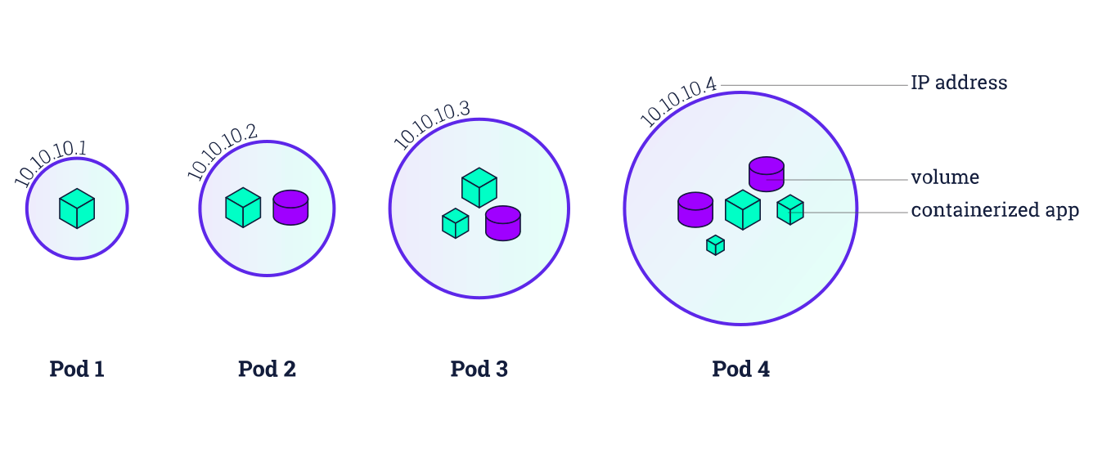
Pod?
A pod (as in a pod of seals or peas) is a group of one or more containers, with shared storage/network, and a specification for how to run the containers.
https://kubernetes.io/docs/tutorials/kubernetes-basics/

Slide 22
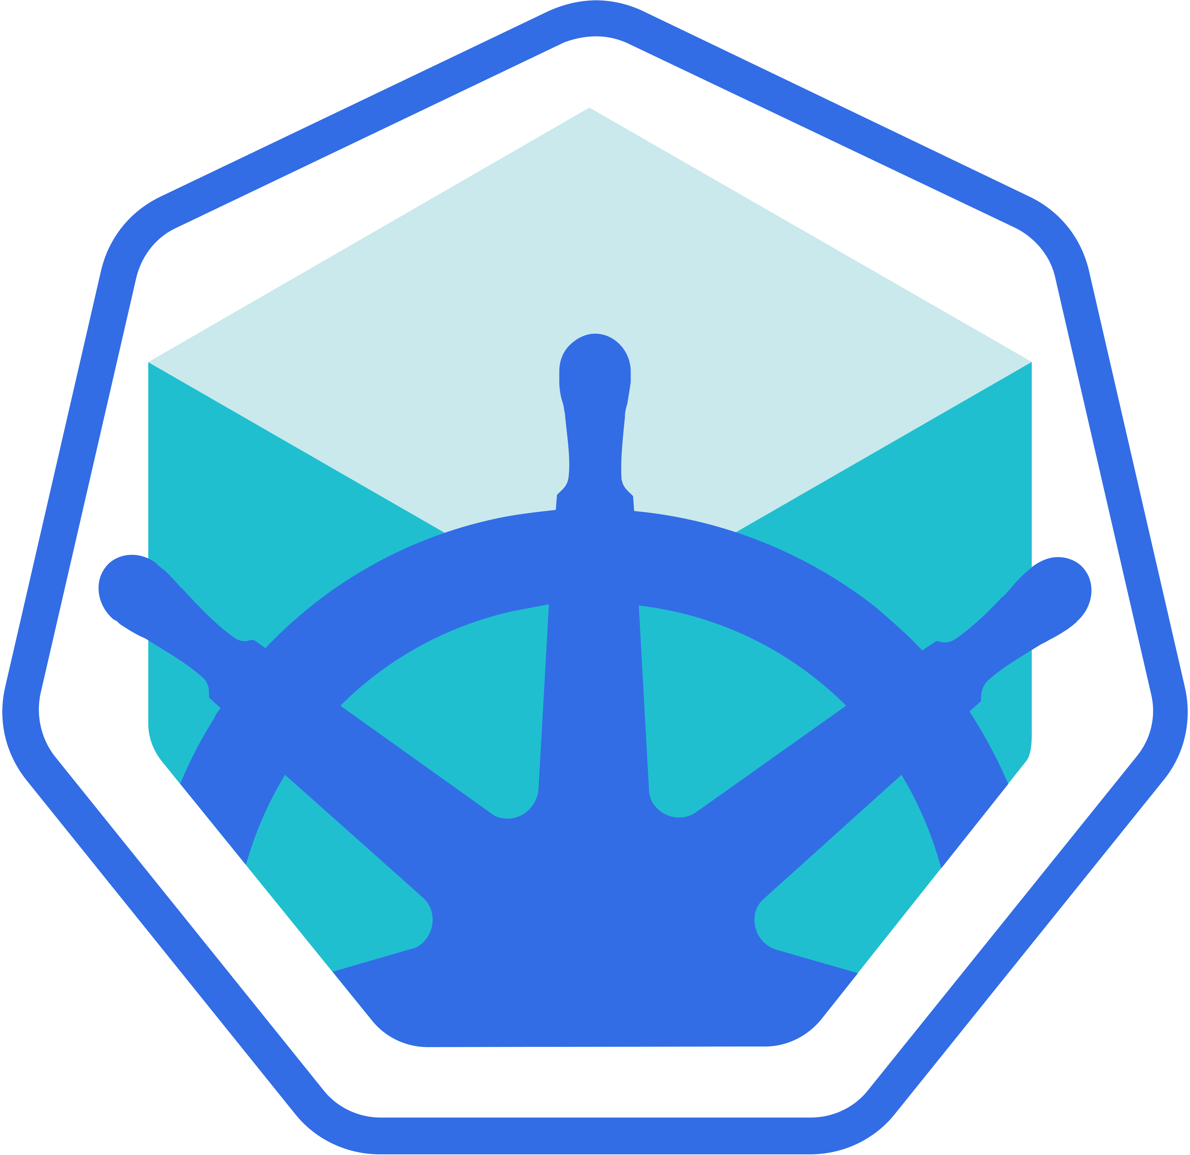
Minikube
“ Minikube runs a single-node Kubernetes cluster inside a VM on your laptop for users looking to try out Kubernetes or develop with it day-to-day. ”
https://github.com/kubernetes/minikube
$ minikube start
https://kubernetes.io/blog/2016/07/minikube-easily-run-kubernetes-locally/

Slide 23

CRI-O
CRI-O is an implementation of the Kubernetes CRI to enable using OCI (Open Container Initiative) compatible runtimes. It is a lightweight alternative to using Docker as the runtime for Kubernetes.
$ minikube start --container-runtime=cri-o
https://www.redhat.com/en/blog/introducing-cri-o-10 (2017/10)

Slide 24
Demo - Kubernetes

Slide 25
Questions?
Anders F Björklund
github.com/afbjorklund
For more info on boot2podman:
https://boot2podman.github.io/

