Slide 1
FOSS North
Podman and Kubernetes
(OCI Containers with CRI)

Slide 2
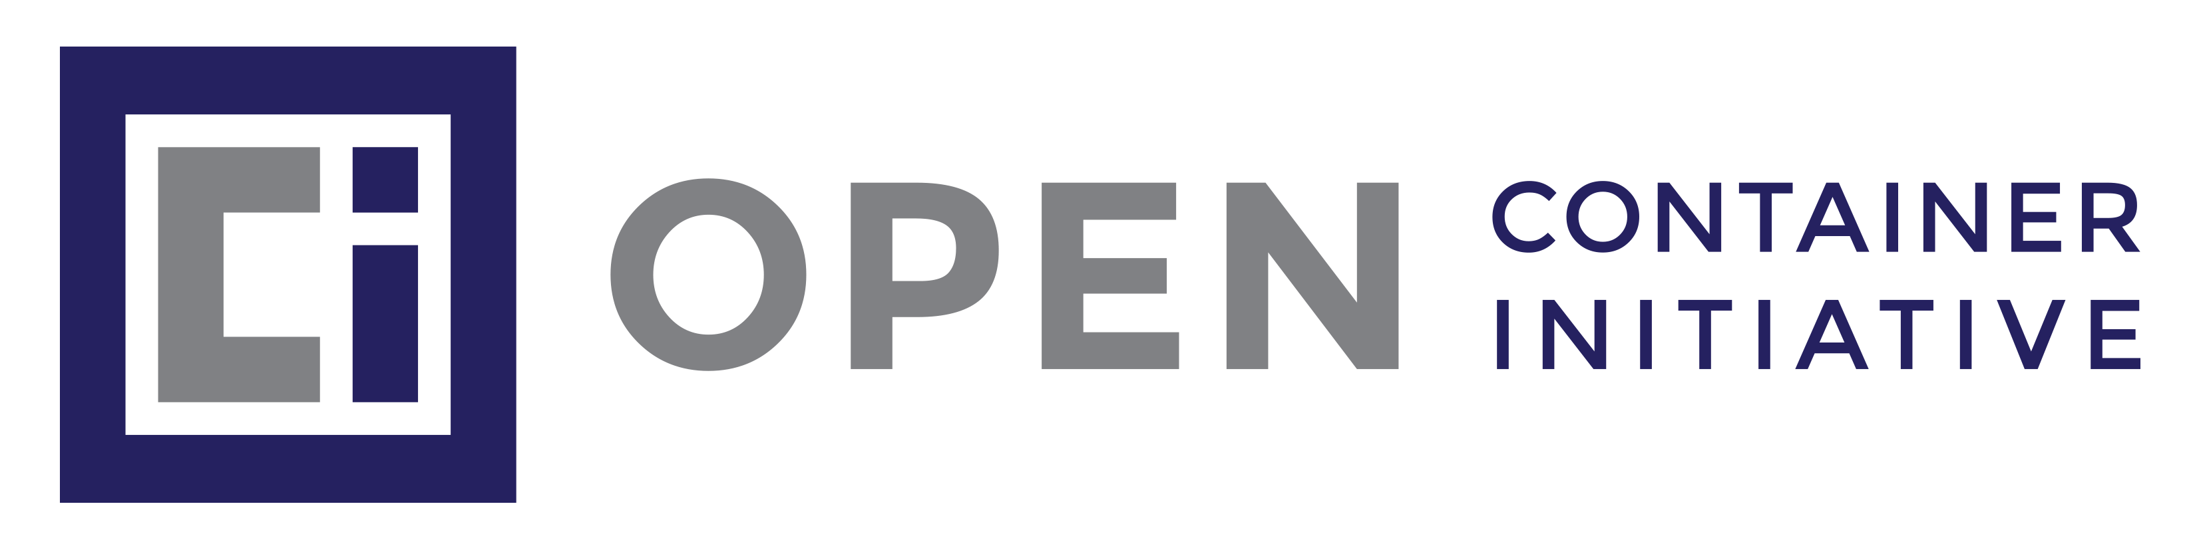
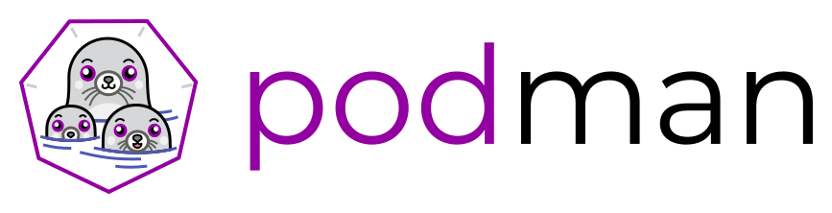

Podman and Buildah
https://www.opencontainers.org/
CRI (Container Runtime Interface)
CNI (Container Network Interface)
podman
Running containers/pods
https://podman.io/
buildah
Building container images
https://buildah.io/

Slide 3
Podman and Buildah
https://www.opencontainers.org/
CRI (Container Runtime Interface)
CNI (Container Network Interface)
podman
Running containers/pods
https://podman.io/
buildah
Building container images
https://buildah.io/

Slide 4
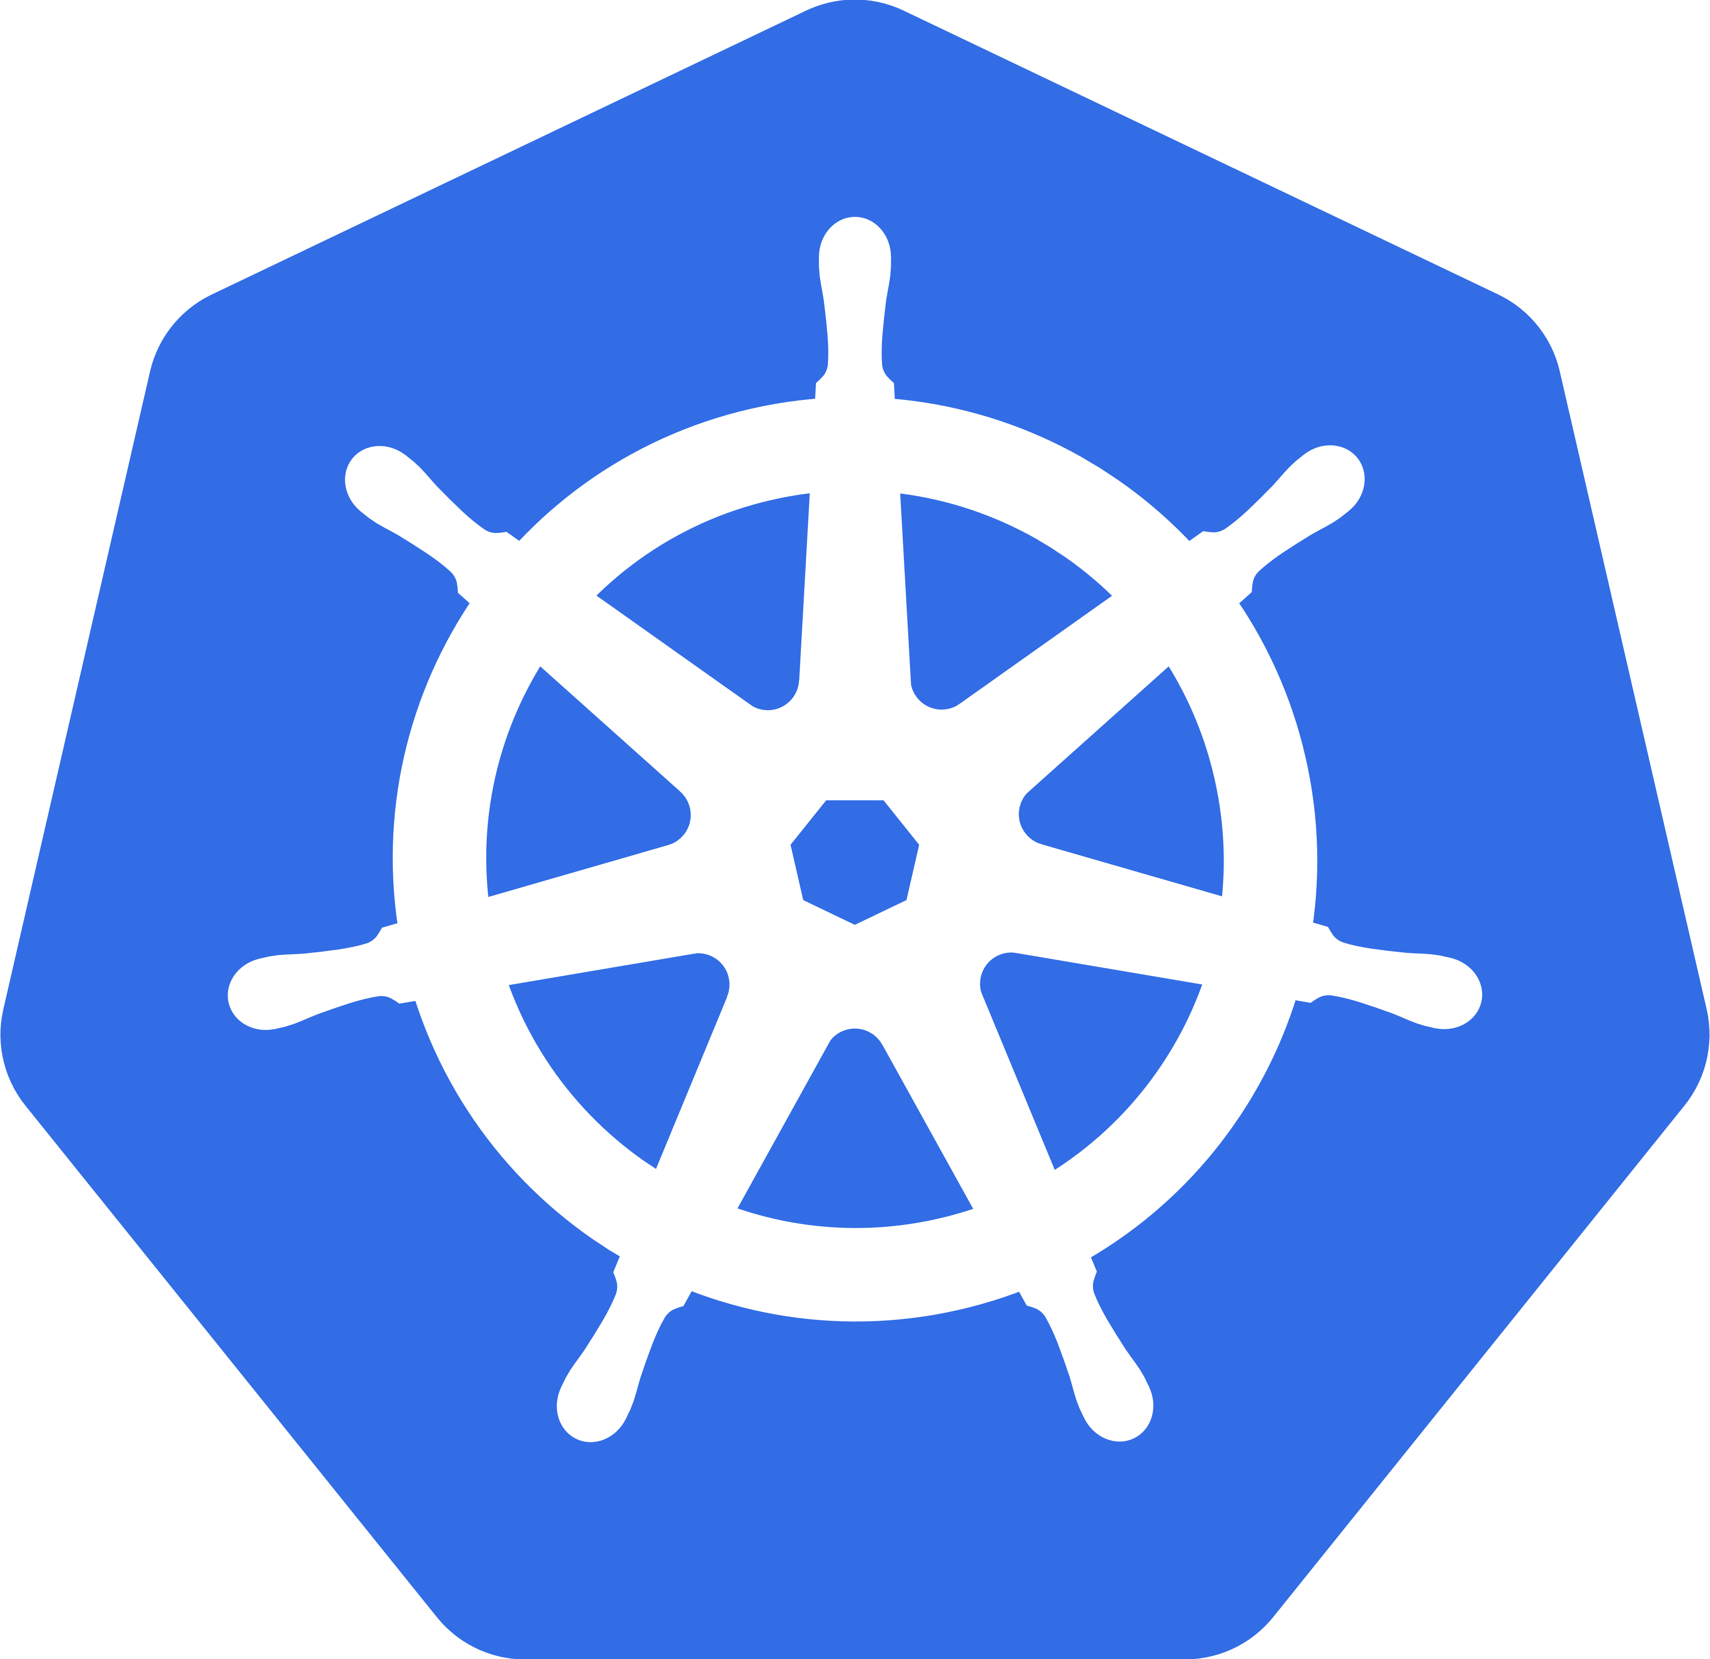
Lightweight Kubernetes
Kubernetes is an open-source container orchestration system for automating deployment, scaling, and management of containerized applications.
https://kubernetes.io
cri-o
Lightweight container runtime for Kubernetes
https://cri-o.io/
k3s
Lightweight Kubernetes. “ 5 less than k8s”.
https://k3s.io/

Slide 5
Container Runtimes
docker
dockerd
k8s
kubectl
CRI
crictl
containerd
crio
Because “ containers” are actually
an array of complicated,
sometimes arcane system features,
we have integrated them into
a unified low-level component
which we simply call runC
runc
conmon
podman
OCI
Cgroups
Namespaces
Linux
https://github.com/opencontainers/runc

Slide 6

Demo - Boot2podman

Slide 7
Questions?
Anders F Björklund
github.com/afbjorklund
For more info on boot2podman:
https://boot2podman.github.io/

