Slide 1
Podman Community Meeting
The boot2podman project
"rise and fall of", 2013-2020

Slide 2


Overview
Containers
Docker
Tiny Core Linux
Boot2podman
Varlink
Podman Machine

Slide 3
Containers?
1982: Chroot (Unix)
2000: Jails (FreeBSD)
2002: Zones (Solaris)
2005: OpenVZ (Linux)
2008: LXC (also Linux)
Virtual Private Servers
Virtual Environments
Now called: Containers
File Tree
/ (root)
Process Tree
1 (init)
User
0 (root)
Group
0 (root)

Slide 4

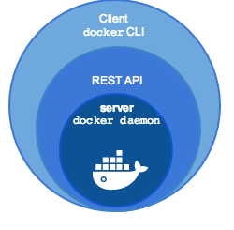
Docker
2013: Docker announced
https://www.docker.com/
Docker Engine
  Client (docker)
  Server (daemon)
Docker Desktop
  macOS (Linux VM)
  Windows (Linux VM)
2015: runC introduced
2016: containerd introduced
2017: Moby Project introduced
2016: Docker 1.12
Docker for Mac
Docker for Windows

Slide 5
Boot2docker
2013: boot2docker (v0.2)
“boot2docker is a lightweight Linux distribution based on
Tiny Core Linux made specifically to run Docker containers.
It runs completely from RAM, weights ~38mb and boots in ~5-6s (YMMV).
It was made during the Global Docker Hack Day on Dec. 3, 2013.”
Features
--------
* Kernel 3.12.1 with AUFS
* Docker 0.7
* LXC 1.0-alpha2
* Container persistance via disk automount
* SSH keys persistance via disk automount
How to use
----------
Simply boot from the ISO, and you're done.
It runs on VMs and bare-metal machines.
https://github.com/boot2docker/boot2docker

Slide 6
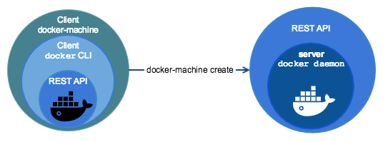

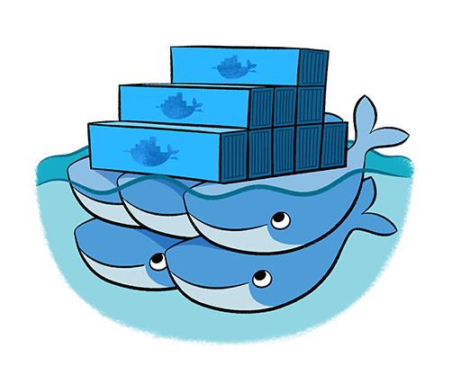

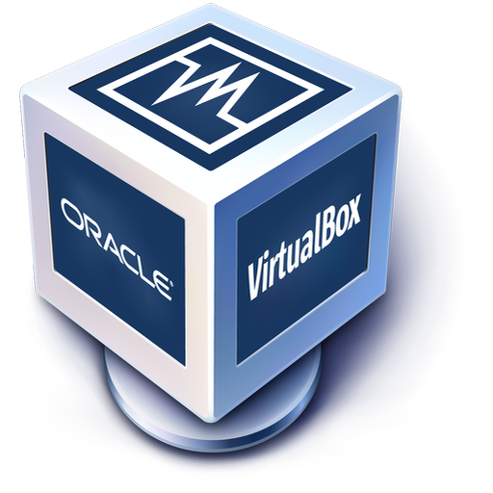


Docker Machine
2014: Docker Toolbox
(Boot2Docker ISO)
Docker Machine
(Oracle VirtualBox)
Docker Swarm
Docker Compose
(Kitematic – a GUI)
Replaced by:
https://blog.docker.com/2014/12/announcing-docker-machine-swarm-and-compose-for-orchestrating-distributed-apps/

Slide 7
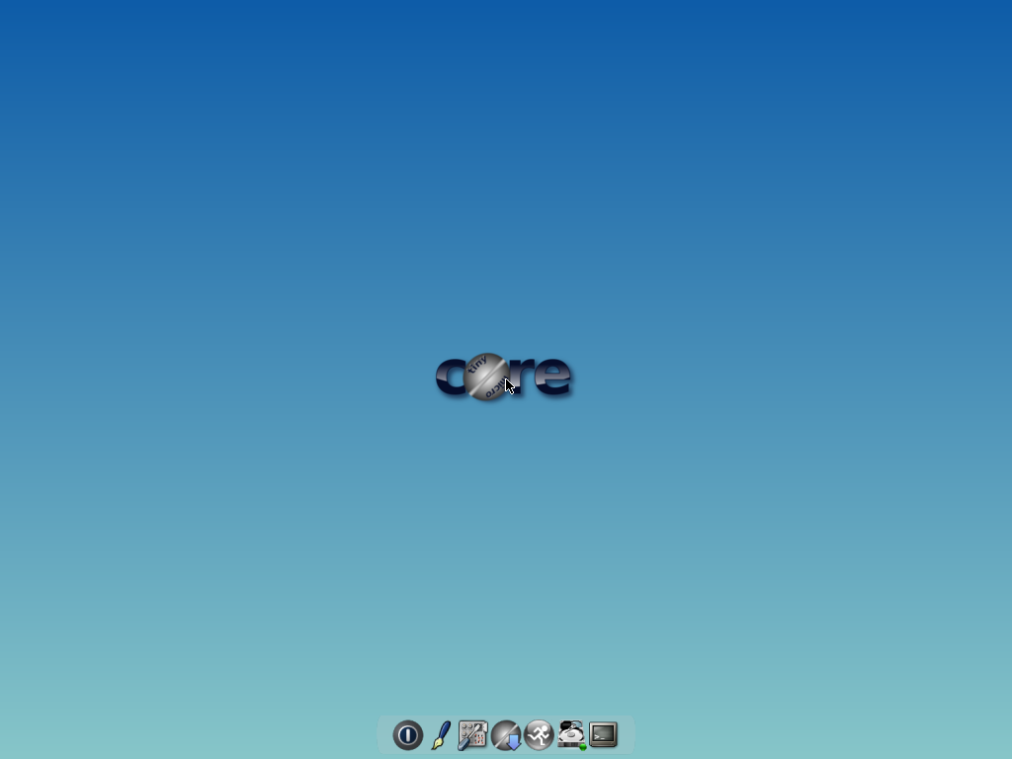
Base: Tiny Core Linux
Kernel (4.14)
Initrd (9.4M!)
Multiple Arch
  Pure64 = x86_64
Desktop (Tiny)
  X11 with FLWM
Packages (.tcz)
Containers (8.2M!)
15M CorePure64-9.0.iso
28M TinyCorePure64-9.0.iso
Bonus Feature: “Boot2Docker with X11 desktop” (55M)
https://github.com/boot2docker/boot2docker/pull/1289
https://github.com/tatsushid/docker-tinycore
docker.io/tatsushid/tinycore:9.0-x86_64

Slide 8

Add: boot2podman
Custom kernel
  vmlinuz64
Add-on initrd
  corepure64.gz
  boot2podman.gz
Build Tools
  Compile TC
  Go compiler

Slide 9
From scratch
Kernel
  cgroupfs
  overlayfs
Build
  compiletc
  git
Other
  cgroupfs-mount
  ssh
Packages
  Go
  Podman
    runc
    conmon
    cni-plugins
  Varlink
  Rootless
  Buildah
  Skopeo

Slide 10


Varlink (podman v1)
Varlink tool (varlink)
  https://github.com/varlink/libvarlink
Varlink resolver (/run/org.varlink.resolver)
  https://github.com/varlink/org.varlink.resolver
$ sudo varlink info unix://run/podman/io.podman
Vendor: Atomic
Product: podman
Version: 1.9.3
URL: https://github.com/containers/libpod
Interfaces:
org.varlink.service
io.podman
$ sudo varlink resolve io.podman
unix:/run/podman/io.podman;mode=0600
$ sudo varlink call io.podman.GetVersion
{
"built": "2020-09-18T23:49:21Z",
"git_commit": "5d44534fff6877b1cb15b760242279ae6293154c",
"go_version": "go1.11.13",
"os_arch": "linux/amd64",
"remote_api_version": 1,
"version": "1.9.3"
}
# --bridge="sudo varlink -A \
'podman varlink \$VARLINK_ADDRESS' bridge"

Slide 11
Podman-machine
Adopted from github.com/docker/machine:
“Machine lets you create Podman hosts on your computer. It creates servers with Podman on them, then configures the Podman client to talk to them.”
Docker to Podman conversion
Drop support for Swarm
Add the driver for QEMU (KVM)
Drop support for Cloud
$ podman-machine create box
$ podman-machine ssh box
tc@box:~$ sudo podman
$ eval $(podman-machine env box)
$ podman-remote version
https://podman.io/blogs/2019/01/14/podman-machine-and-boot2podman.html

Slide 12

Deprecated 2020
Docker Machine (boot2docker) deprecated
  “As has been obvious for some time now, we’ve slowly stopped implementing or accepting new features for the project.”
  “Boot2Docker is officially deprecated and unmaintained. It is recommended that users transition from Boot2Docker over to Docker Desktop instead (especially with the new WSL2 backend, which supports Windows 10 Home).” (also available for macOS)
Podman Machine (boot2podman) deprecated
  The Fedora image was popular than the custom ISO
  Podman v2 replaced the varlink API with a REST API

Slide 13

Demo – podman

Slide 14
Questions?
Anders F Björklund
github.com/afbjorklund
For more info on boot2podman:
https://boot2podman.github.io/

