Slide 1
Kubernetes Göteborg
minikube
Run Kubernetes locally

Slide 2


Minikube
Minikube is a tool that makes it easy to run Kubernetes locally.
“ Minikube runs a single-node Kubernetes cluster inside a Virtual Machine (VM)
on your laptop for users looking to try out Kubernetes or develop with it day-to-day”
$ minikube start
Linux
macOS
Windows
https://github.com/kubernetes/minikube
Part of Kubernetes Cluster Lifecycle SIG
https://kubernetes.io/blog/2019/03/28/running-kubernetes-locally-on-linux-with-minikube-now-with-kubernetes-1.14-support/

Slide 3
Building blocks
Linux (operating system)
VirtualBox (hypervisor)
Docker (container runtime)
Kubeadm (bootstrapper)
Optional client components:
Docker (i.e. docker client)
Kubectl (kubernetes client)

Slide 4
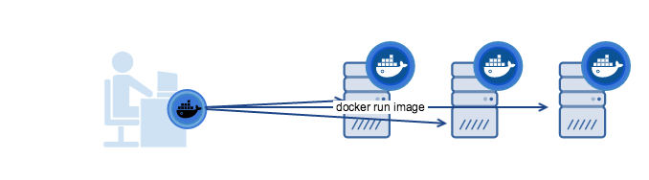
Machine
Docker Machine lets you easily create Docker hosts
“ Machine lets you create Docker hosts on your computer [...] It creates servers,
installs Docker on them, then configures the Docker client to talk to them.”
$ docker-machine create default
https://docs.docker.com/machine

Slide 5

Demo - Machine

Slide 6

Kubeadm
Easily bootstrap a secure Kubernetes cluster
“ performs the actions necessary to get a minimum viable cluster up and running.
By design, it cares only about bootstrapping, not about provisioning machines.”
kubeadm config images list
$ kubeadm init
k8s.gcr.io/kube-apiserver:v1.16.3
k8s.gcr.io/kube-controller-manager:v1.16.3
k8s.gcr.io/kube-scheduler:v1.16.3
k8s.gcr.io/kube-proxy:v1.16.3
k8s.gcr.io/pause:3.1
k8s.gcr.io/etcd:3.3.15-0
k8s.gcr.io/coredns:1.6.2
https://kubernetes.io/blog/2016/09/how-we-made-kubernetes-easy-to-install/

Slide 7
Linux Distributions
Boot2Docker
Buildroot
  2018.05
  2019.02
Ubuntu
  16.04 LTS
  18.04 LTS
CentOS
  7 (≈ fc18)
  8 (≈ fc28)

Slide 8
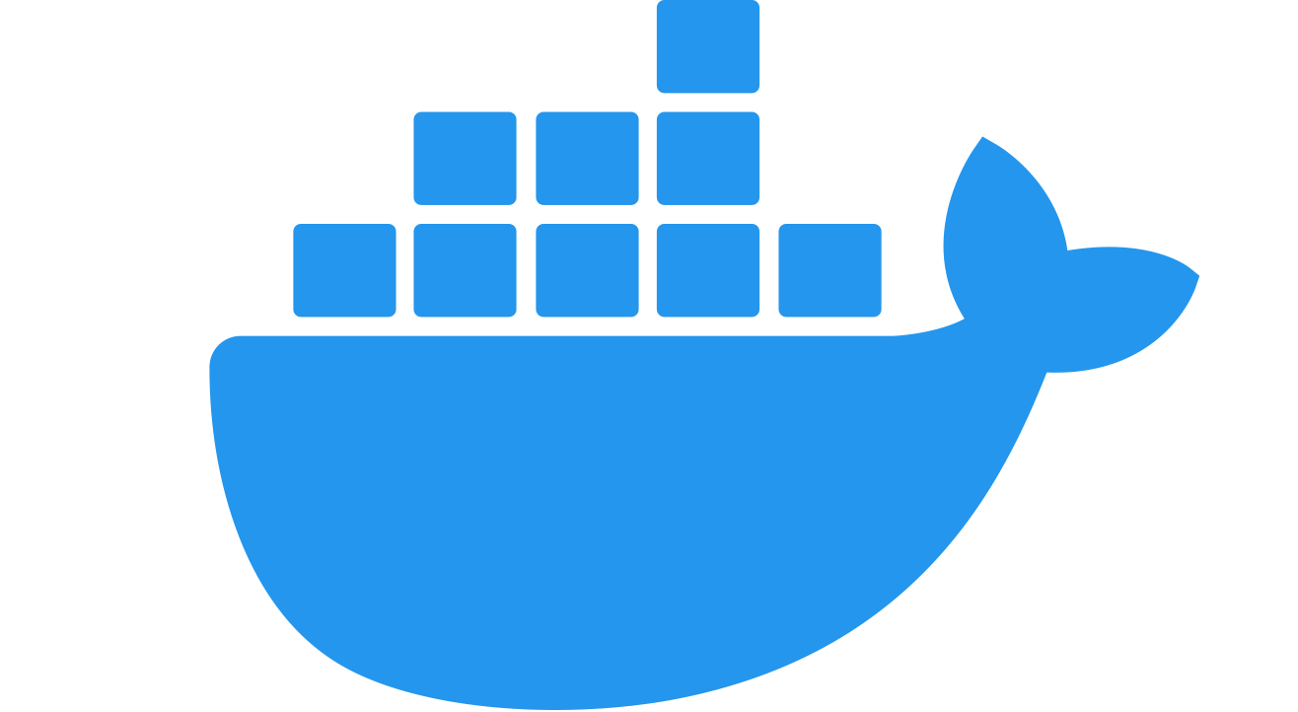
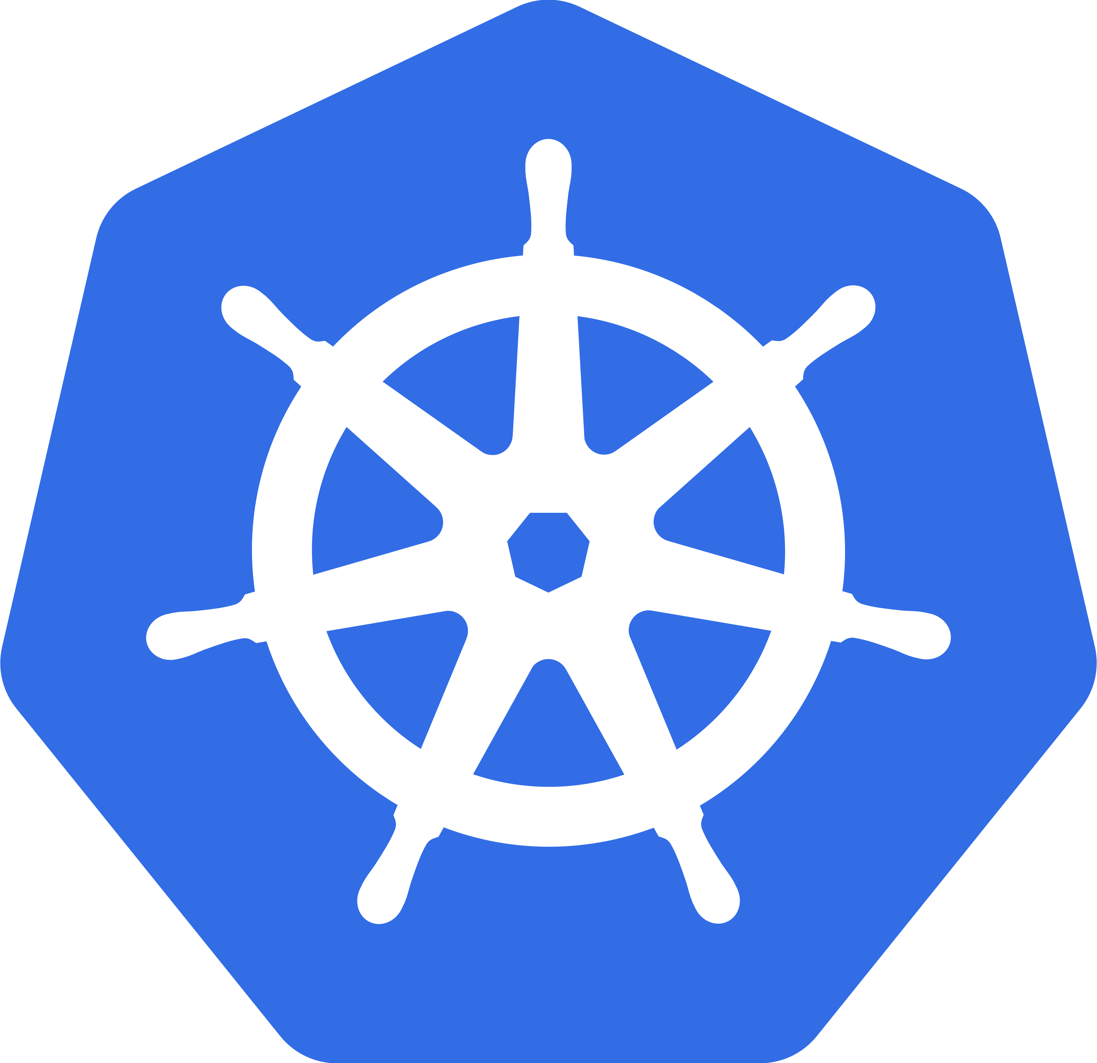
Packages
Docker (CE)
  docker-ce
  docker-ce-cli
  containerd.io
Kubernetes
  kubeadm
  kubelet
  kubectl

Slide 9
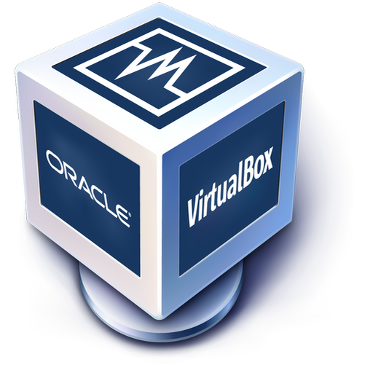
Alternatives
Alternative hypervisors
  Libvirt/KVM(Linux)
  HyperKit (macOS)
  Hyper-V (Windows)
Alternative runtimes
  containerd <https://containerd.io/>
  CRI-O <https://cri-o.io/>
  gVisor <https://gvisor.dev/>

Slide 10
Demo - Minikube

Slide 11
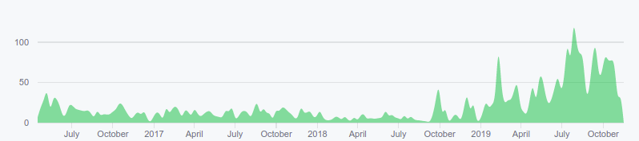
History
Since 2016
Boot2Docker
  Memory-based tiny core linux
  Replaced with custom .iso image
Localkube
  All-in-one kubernetes binary
  Replaced with standard installer
https://kubernetes.io/blog/2016/07/minikube-easily-run-kubernetes-locally/

Slide 12
Future
Cross-platform improvements
  Linux “ kubernetes in container”
  macOS
  Windows
Optional Multi-node (init / join)
  Master or “ control-plane node”
  Minion(s) or “ worker node” (#1111)
  Registry

Slide 13
Contributors
Become a Kubernetes contributor!
Inclusive and community-driven
Kubernetes Slack (#minikube)
SIG Cluster Lifecycle
Kubeadm
Minikube
https://github.com/kubernetes/community/tree/master/contributors/guide

Slide 14
Questions?
Anders F Björklund
github.com/afbjorklund
For more info on minikube:
https://minikube.sigs.k8s.io/

