Slide 1



Slide 2

JBehave
Training

Slide 3



Behaviour Driven Development
BDD is a process designed to aid the management and the delivery of software development projects by improving communication between engineers and business professionals. In so doing, BDD ensures all development projects remain focused on delivering what the business actually needs while meeting all requirements of the user.
Notes:
*

Slide 4
Behaviour Driven Development
Establishing the goals of different stakeholders required for a vision to be implemented.
Drawing out features which will achieve those goals using feature injection.
Involving stakeholders in the implementation process through outside–in software development.
Using examples to describe the behavior of the application, or of units of code Automating those examples to provide quick feedback and regression testing.
Using ‘should’ when describing the behavior of software to help clarify responsibility and allow the software’s functionality to be questioned.
Using ‘ensure’ when describing responsibilities of software to differentiate outcomes in the scope of the code in question from side-effects of other elements of code.
Notes:
*

Slide 5
Gherkin language
Gherkin is a Business Readable, Domain Specific Language created especially for behavior descriptions. It gives you the ability to remove logic details from behavior tests.
Feature: Some terse yet descriptive text of what is desired In order to realize a named business value As an explicit system actor I want to gain some beneficial outcome which furthers the goal Scenario: Some determinable business situation Given some precondition And some other precondition When some action by the actor And some other action And yet another action Then some testable outcome is achieved And something else we can check happens too Scenario: A different situation …
Notes:
*

Slide 6
JBehave
JBehave is a framework for Behaviour-Driven Development (BDD). It shifts the vocabulary from being test-based to behaviour-based, and positions itself as a design philosophy.
Users can specify and run text-based user stories, which allows "out-in" development.
User stories can be written in JBehave syntax or Gherkin syntax.
User stories can be specified as classpath resources or external URL-based resources.
User stories can be executed concurrently, specifying the number of concurrent threads.
User stories can be documented via generic user-defined meta information that allows easy story filtering and organisation into story maps.
Notes:
*

Slide 7
JBehave
Annotation-based configuration and Steps class specifications
Extensible story reporting: outputs stories executed in different human-readable file-based formats (HTML, TXT, XML). Fully style-able view.
Story cross reference report format in JSON and XML, consumable by external applications.
Auto-generation of pending steps so the build is not broken by a missing step, but has option to configure breaking build for pending steps.
IDE integration: stories can be run as JUnit tests or other annotation-based unit test frameworks, providing easy integration with your favourite IDE.
Maven integration: allows stories to be run via Maven plugin at given build phase
Notes:
*

Slide 8
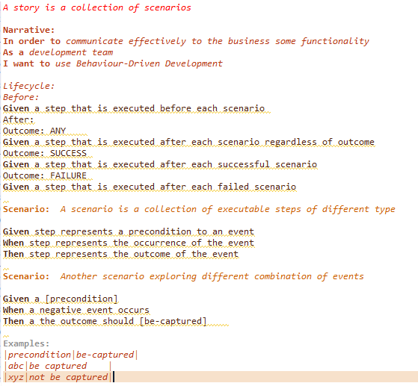
JBehave Syntax
Notes:
*

Slide 9
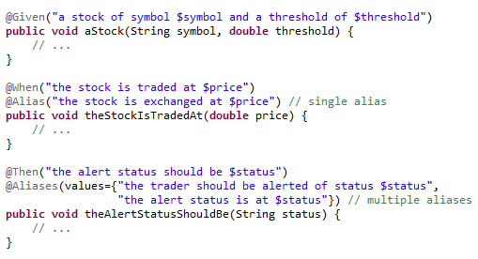
Annotations
@Given: Preconditions.
@When: Actions.
@Then: Expected results.
@Alias: Other expression to represent a step.
@Aliases: Multiple expressions to represent a step.
Notes:
*

Slide 10
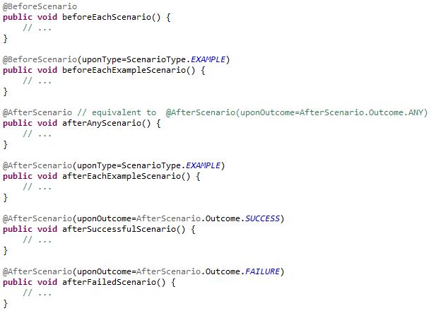
Annotations
The @BeforeScenario and @AfterScenario annotations allow the corresponding methods to be executed before and after each scenario
Notes:
*

Slide 11
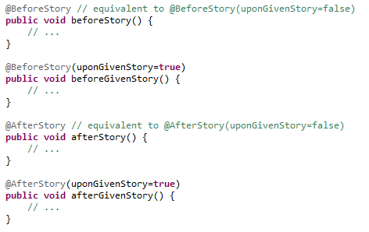
Annotations
The @BeforeStory and @AfterStory annotations allow the corresponding methods to be executed before and after each story, either a GivenStory or not:
Notes:
*

Slide 12


Parameter Injection
Given a step in the story:
Arguments "STK1" and "10.0" are matched to the first and second method parameters of the Java method:
Or we can express named parameters, one mechanism is to use annotations:
Notes:
*

Slide 13
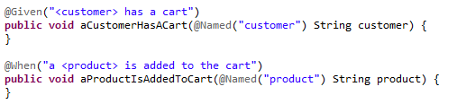
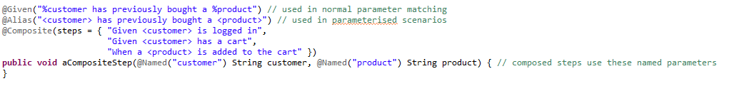
Composite Steps
Given the following steps:
Now we want to define a composite step that takes both parameters (customer and product) and executes the two "composed" steps:
We can generate a composite step:
Notes:
*

Slide 14

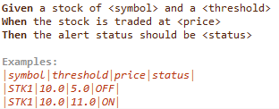
Parameterized Scenarios
Given the following story:
We can iterate the scenario with this:
Notes:
*

Slide 15

Thank you

