Slide 1

Database Schema Design
Organizing Data
Phase 1: Day 9

Slide 2
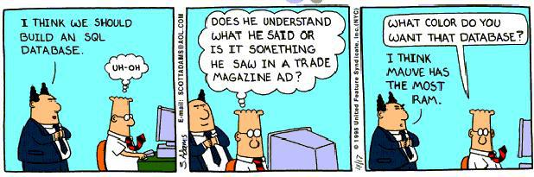
Databases
Database Schema Design: Organizing Data

Slide 3
Why you care
SQL is the gateway to the world of Databases
Reading & Writing Raw SQL is a skill that
will set you apart from other Devs
Super Important for implementing &
debugging advanced Database systems
Database Schema Design: Organizing Data

Slide 4
Database Schema Design
Good Database Design should:
Capture state, not behavior
Design relationships between tables
Database Schema Design: Organizing Data

Slide 5
State and Behavior
class OrangeTree
def initialize
@age = 5
@height = 5
@oranges = produce_oranges
end
def produce_oranges
Array.new(3) { Orange.new }
end
end
class Orange
def initialize
@diameter = rand(2..4)
end
end
Database Schema Design: Organizing Data

Slide 6
Temporary State
We create objects to hold data
Data is lost when our program has finished executing
☹
Database Schema Design: Organizing Data

Slide 7
Temporary State Problems
What if we want to use the current state later?
Database Schema Design: Organizing Data

Slide 8
Temporary State Problems
What if we want to use the current state later? Mega Man vs. Mega Man II
Phone number from a super hot crush
50 million client purchase records
Database Schema Design: Organizing Data

Slide 9
Persistant State
To convert temp state to persistent state we need to save the data. But where?
CSV
Pen && Paper
☺Database☺
Database Schema Design: Organizing Data

Slide 10
Databases && Ruby
Like object-oriented programming, databases model the data in real world systems
How do objects in databases relate to Ruby?
Database Schema Design: Organizing Data

Slide 11
Databases and Ruby
Modeling State
Ruby | Database
Classes
Instances of classes
Instance variables
Database Schema Design: Organizing Data

Slide 12
Databases and Ruby
Modeling State
Ruby | Database
Classes | Tables
Instances of classes
Instance variables
Database Schema Design: Organizing Data

Slide 13
Databases and Ruby
Modeling State
Ruby | Database
Classes | Tables
Instances of classes | Rows
Instance variables
Database Schema Design: Organizing Data

Slide 14
Databases and Ruby
Modeling State
Ruby | Database
Classes | Tables
Instances of classes | Rows
Instance variables | Fields
AKA: Schema
Database Schema Design: Organizing Data

Slide 15
Schema Design
orange_trees
id
created_at
updated_at
oranges
id
created_at
updated_at
Database Schema Design: Organizing Data

Slide 16
Schema Design
orange_trees
id
created_at
updated_at
oranges
id
created_at
updated_at
Database Schema Design: Organizing Data

Slide 17
Schema Design
orange_trees
id
age
height
created_at
updated_at
oranges
id
created_at
updated_at
Database Schema Design: Organizing Data

Slide 18
Schema Design
orange_trees
id
age
height
created_at
updated_at
oranges
id
created_at
updated_at
Database Schema Design: Organizing Data

Slide 19
Schema Design
orange_trees
id
age
height
created_at
updated_at
oranges
id
diameter
created_at
updated_at
Database Schema Design: Organizing Data

Slide 20
Schema Design
orange_trees
id
age
height
name
created_at
updated_at
oranges
id
diameter
created_at
updated_at
Database Schema Design: Organizing Data

Slide 21
Schema Design WorkFlow
Identify Tables
Identify Relationships
Add Foreign Keys
Identify Attributes & Data Types
Accomplish the above steps by modeling real world observations within your schema.
Database Schema Design: Organizing Data

Slide 22
Relationships
Schema is more than just static tables
SQL is a relational DB
Types of Relationships:
One to One
One to Many
Many to Many
Database Schema Design: Organizing Data

Slide 23
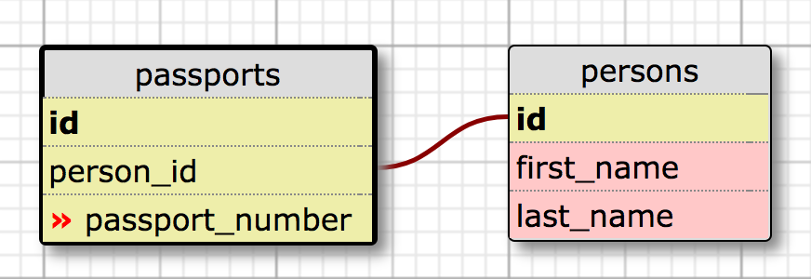
One to One
Least common type of relationship.
Must ensure that only one of each record will be associated with a corresponding record.
Database Schema Design: Organizing Data

Slide 24
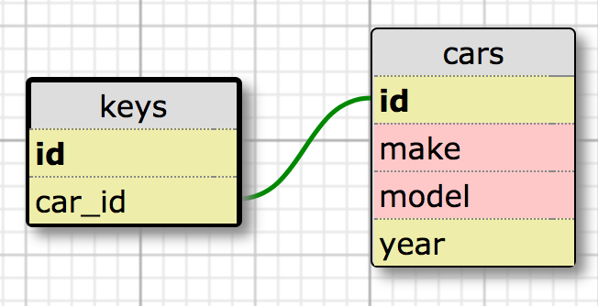
One to Many
Most common type of relationship
A Car has many Keys
A Key belongs to a Car
Database Schema Design: Organizing Data

Slide 25
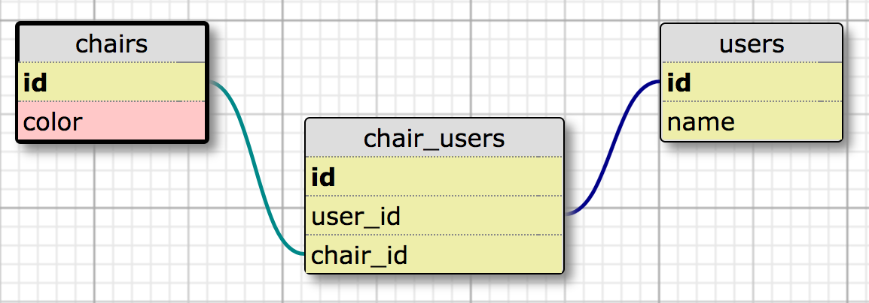
Many to Many
Uses a Join Table
A Chair has many Users through chair_users
A User has_many Chairs through chair_users
A chair_user belongs_to user && chair
Database Schema Design: Organizing Data

Slide 26
Schema Design
What is the relationship between orange trees and oranges?
Database Schema Design: Organizing Data

Slide 27
Schema Design
What is the relationship between orange trees and oranges? An orange tree has many oranges.
Database Schema Design: Organizing Data

Slide 28
Schema Design
What is the relationship between orange trees and oranges? An orange tree has many oranges. An orange belongs to an orange tree.
Database Schema Design: Organizing Data

Slide 29
DB Relationships: Talk it out.
Relationships are two way streets
Should sound like a natural sentence
An orange tree has many oranges. An orange belongs to an orange tree.
Database Schema Design: Organizing Data

Slide 30
Schema Design
How to link tables?
Database Schema Design: Organizing Data

Slide 31
Schema Design
How to link tables? Primary key: unique identifier table field Every table has autogenerated Primary Keys, unless specifically disabled
Foreign key: another table’s unique identifier
Only tables which belong to another table contain a Foreign Key
Database Schema Design: Organizing Data

Slide 32
Schema Design
orange_trees
id
age
height
created_at
updated_at
oranges
id
diameter
created_at
updated_at
On which table does the foreign key belong?
Database Schema Design: Organizing Data

Slide 33
Schema Design
orange_trees
id
age
height
created_at
updated_at
oranges
id
diameter
orange_tree_id
created_at
updated_at
The foreign key belongs on the table of the objects that are owned
Database Schema Design: Organizing Data

Slide 34
Schema Design
orange_trees
id
age
height
created_at
updated_at
oranges
id
diameter
orange_tree_id
created_at
updated_at
The foreign key belongs on the table of the objects that are owned
Database Schema Design: Organizing Data

Slide 35
Schema Design
orange_trees
id | age | height | created_at | updated_at
1 | 5 | 5 | 2014-03-22 | 2014-03-22
2 | 6 | 6 | 2014-03-22 | 2014-03-22
oranges
id | diameter | orange_tree_id | created_at | updated_at
1 | 2 | 1 | 2014-03-22 | 2014-03-22
2 | 4 | 2 | 2014-03-22 | 2014-03-22
3 | 3 | 1 | 2014-03-22 | 2014-03-22
4 | 4 | 1 | 2014-03-22 | 2014-03-22
Database Schema Design: Organizing Data

Slide 36
Schema Design
orange_trees
id | age | height | created_at | updated_at
1 | 5 | 5 | 2014-03-22 | 2014-03-22
2 | 6 | 6 | 2014-03-22 | 2014-03-22
oranges
id | diameter | orange_tree_id | created_at | updated_at
1 | 2 | 1 | 2014-03-22 | 2014-03-22
2 | 4 | 2 | 2014-03-22 | 2014-03-22
3 | 3 | 1 | 2014-03-22 | 2014-03-22
4 | 4 | 1 | 2014-03-22 | 2014-03-22
Database Schema Design: Organizing Data

Slide 37

SQL Joins
More Detail @ the Source
Database Schema Design: Organizing Data

Slide 38
SQL Statements
orange_trees
id
age
height
name
created_at
updated_at
Database Schema Design: Organizing Data

Slide 39
SQL Statements
oranges
id
diameter
created_at
updated_at
Database Schema Design: Organizing Data

Slide 40
SQL Statements
Database Schema Design: Organizing Data

Slide 41
SQL Statements
Database Schema Design: Organizing Data

Slide 42
SQL Links:
http://www.cheat-sheets.org/sites/sql.su/
https://dev.mysql.com/doc/refman/5.0/en/group-by-functions.html
http://lmgtfy.com/?q=SQL+group+by+aggregate+functions
Database Schema Design: Organizing Data

Slide 43
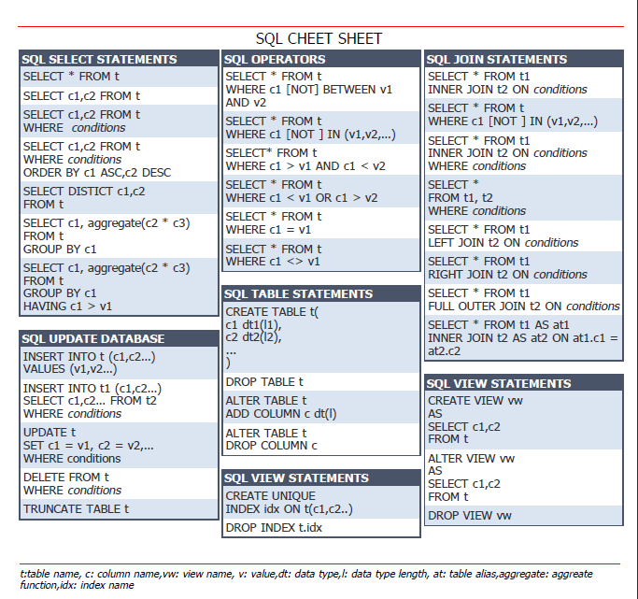
SQL CheatSheet:
Database Schema Design: Organizing Data

Slide 44
SQL && Schema
Questions
Database Schema Design: Organizing Data

