Slide 1
The workshops...

Slide 2
Workshops
1 – Simple functions, lists and tuples
2 – Using types and type classes
3 – Syntax in more interesting functions
4 – Higher order functions
5 – Writing our own types
6 – I/O
7 – Functors, applicative functors and Monoids
8 – …

Slide 3
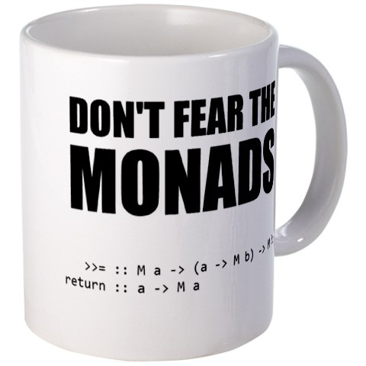
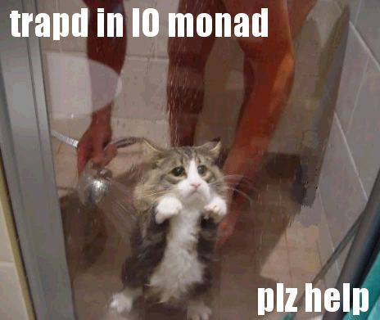



Slide 4
Why come to the workshops?
To get another language under your belt
To be prepared for when more functional concepts appear in Java
To understand other new languages quicker
So you can say you get Monads
Because I need someone to talk to about it

Slide 5
Haskell Workshop
Part 1 – Simple functions, lists and tuples

Slide 6
Topics
Calling functions
Writing functions
Lists
Tuples

Slide 7
Calling functions
succ 9
not True
min 12 9
2 + 5
Infix/prefix
  12 `min` 9
  (+) 2 5
min 12 9 + succ 2
  (+) min 12 9 succ 2
  (+) (min 12 9) (succ 2)

Slide 8
Writing functions
double x = x + x
square x = x * x
addDoubles x y = double x + double y
addSquares x y = square x + square y
Higher order function
  addAfterApply x y f = f x + f y

Slide 9
Lists
[2,3,4,1,12]
“Hello”
[ [1,2], [], [12,6] ]
[]

Slide 10
Creating lists
3 : [5,7,6]
12 : []
[1,2,3] : [ [4,5], [6,7,8] ]
'H' : “ello”
[3,67,4] ++ [2,5,11]
“Oh, ” ++ “hello”
[ [1,3], [6,4,2] ] ++ [ [3,6,44], [3,7,3] ]
[ 'h', 'e' ] ++ [ 'l', 'l', 'o' ]

Slide 11
List functions
“hello” !! 2
[45, 34, 1, 36] !! 1
head [1,2,3,4,5,6]
tail [1,2,3,4,5,6]
init [1,2,3,4,5,6]
last [1,2,3,4,5,6]
length, null, reverse, take, drop, maximum, minimum, sum, product, elem

Slide 12
Lists ranges
[1..10]
[2,4..10]
[1..]
take 20 [1..]
cycle, repeat

Slide 13
List comprehensions
[ x | x <- [1..20] ]
[ x | x <- [1..20], x*2 >= 10 ]
[ x | x <- [1..20], x /= 3, x /= 12, x /= 17 ]
[ x*2 | x <- [10..20] ]
[ square x | x <- [10..20] ]
[ x*y | x <- [1..3], y <- [10,20..100] ]
[ if x `mod` 3 == 0 then “FOO” else “bar” | x <- [1..100] ]

Slide 14
Tuples
(1, 2)
(10, 20, 30)
(“hello”, 12, 15.2)
fst (“hello”, 12)
snd (“hello”)
zip [1,2,3,4] [“hello”, “there”, “whats”, “up?”]

Slide 15
Next workshop
Types
Types inference
Polymorphism
Type classes

