Slide 1
Haskell workshop
Part 5 – Writing our own types

Slide 2
Where we are
1 – Simple functions, lists and tuples
2 – Using types and type classes
3 – Syntax in more interesting functions
4 – Higher order functions
5 – Writing our own types
6 – I/O
7 – Functors, applicative functors and Monoids
8 – …

Slide 3
Topics
Brief overview of types in Haskell again
Creating simple 'algebraic' data types
Creating types with record syntax
Creating polymorphic types
Creating type synonyms
Types in general
Exercises

Slide 4
Haskell's type system
Static
  Like Java, types are decided at compile time
Type inference
  Not like Java
    int three = 3 ;
  Compiler works out the type for you, type signatures are optional, but good documentation
    three :: Int
    three = 3
  Or just
    three = 3

Slide 5
Haskell's polymorphism
Ad hoc polymorphism
  In Java, extend classes, or implement interfaces
    If something implements java.lang.Comparable
    We know we can call compareTo() on it
  In Haskell, membership of type classes
    If something is a member of the Num type class
    We know we can call negate on it

Slide 6
Haskell's polymorphism
Parametric polymorphism
  In Java, we've got the generics libraries
    List<E> : is a list of anything that extends Object
    E is a type variable
  In Haskell, its part of the language, its easier to write and more powerful
    [a] : is a list of anything
    [a] -> (a -> b) -> Int -> b : is a function that takes:
      a list of a's
      a function that takes an a and returns a b
      an Int
      and returns something of type b
      a and b could be any type, and don't have to be the same type

Slide 7
Types we've already seen
Int : 1,2,3 ...
Char : 'a', '2' ...
Bool : True, False
Polymorphic
  (a,b) : (2, “Hello”), (2.1, 33.6) ...
  [a] : [1,2,3,4], [“lol”, “omg”, “lmao”, “wtf”]
Synonyms
  String is just another name for [Char]

Slide 8
Bool
How is Bool defined?
  data Bool = False | True
data means we're defining a new type
Bool is the name of the type
False and True are value constructors for that type (the values allowed for the type)
| can be read 'or'

Slide 9
Fruit
data Fruit = Apple | Grapefruit | Lychee | Banana
deriving Show
opinion :: Fruit -> String
opinion Lychee = "Ugh"
opinion Grapefruit = "Super yum"
opinion _ = "Yum"

Slide 10
Types with properties
Types usually have properties (classes have members in Java)
A person might have a first name, a second name and an age

Slide 11
Person
data Person = Person String String Int
deriving Show
The Person type has only one value constructor
It has the same name as the type itself
It takes a String, another String and an Int
Creates and returns something of type Person
The value constructor sounds a lot like a function
:t Person
Person :: String -> String -> Int -> Person

Slide 12
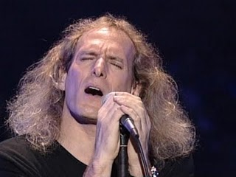
Creating a Person
ghci> let mick = Person “Michael” “Bolton” 58
ghci> mick
Person "Michael" "Bolton" 58
ghci> :t mick
mick :: Person

Slide 13
Getting properties
How do I get the first name of a person?
firstName :: Person -> String
firstName (Person f _ _) = f
So..
ghci> let mick = Person “Michael” “Bolton” 58
ghci> firstName mick
“Michael”

Slide 14
The Person type so far
data Person = Person String String Int
deriving Show
firstName :: Person -> String
firstName (Person f _ _) = f
secondName :: Person -> String
secondName (Person _ s _) = s
age :: Person -> Int
age (Person _ _ a) = a

Slide 15
Record syntax
That's a lot of work to create a type with some properties and their 'getters'
And it's not easy to see what fields we're populating when we create a Person
Haskell provides a better way
Called Record Syntax
  A shortcut to creating the getter functions automatically
  And makes things easier to read when constructing values of the type

Slide 16
Defining a type with Record Syntax
data Person = Person { firstName :: String
, secondName :: String
, age :: Int
} deriving Show

Slide 17
Creating a Person using Record Syntax
mick = Person { firstName = “Michael”
, secondName = “Bolton”
, age = 57
}
We can specify the properties in any order, as long as we specify them all

Slide 18
Record Syntax continued
ghci> age mick
58
ghci> mick
Person {firstName = "Michael", secondName = "Bolton", age = 58}
(Notice Show displays using record syntax)

Slide 19
“deriving Show”
So far we've used 'deriving Show' to:
  make our type a member of the 'Show' typeclass
  use the default implementation of the 'show' method of that typeclass
ghci> mick
Person {firstName = "Michael", secondName = "Bolton", age = 58}

Slide 20
Implementing 'show' ourselves
data Person = Person { firstName :: String
, secondName :: String
, age :: Int
}
instance Show Person where
show p = secondName p ++ ", " ++ firstName p
++ ": " ++ show (age p)
++ " years old."

Slide 21
Implementing 'show' ourselves
ghci> let mick = Person { firstName = "Michael", secondName = "Bolton", age = 58 }
ghci> mick
Bolton, Michael: 58 years old.

Slide 22
Type variables
How do we create polymorphic types like:
[a]
(a,b)
Maybe a

Slide 23
Maybe... again
The definition of Maybe
data Maybe a = Nothing | Just a
We've introduced a type variable in the definition of a type
  Maybe is a type constructor that takes one type as an argument
  We cannot have things of type Maybe
We can have things of type:
  Maybe Int, Maybe Char etc

Slide 24
Examples using Maybe
ghci> :t Just 2
Just 2 :: Maybe Int
ghci> :t Just “Hello”
Just "Hello" :: Maybe [Char]
ghci> :t Nothing
Nothing :: Maybe a
ghci> :t Nothing :: Maybe Int
Nothing :: Maybe Int :: Maybe Int

Slide 25
Examples using Maybe
returnMaybe 0 = Nothing
returnMaybe x = Just x
ghci> returnMaybe 1
Just 1
ghci> :t it
it :: Maybe Integer
ghci> returnMaybe 12.64
Just 12.64
ghci> :t it
it :: Maybe Double

Slide 26
Examples using Maybe
ghci> returnMaybe 0
Nothing
ghci> :t it
it :: Maybe Integer
ghci> returnMaybe 0.0
Nothing
ghci> :t it
it :: Maybe Double
ghci> :t returnMaybe
returnMaybe :: (Num a) => a -> Maybe a

Slide 27
Writing a polymorphic type
We want to implement lists ourselves
  without any of the built in list implementation
  to work on lists of anythings (of the same type)
How do we construct a list?
  Either it is empty
  Or it is an element of any type and the rest of the list (of elements of the same type)

Slide 28
Writing a polymorphic type
Either it is empty...
data List a = Empty
Or...
data List a = Empty |
It is an element of any type...
data List a = Empty | Element a
and the rest of the list (of elements of the same type)...
data List a = Empty | Element a (List a)

Slide 29
Our type is recursive
One of its value constructors, Element
  Includes as one of its properties (or fields)
  something of the type that we're currently defining!
List a = Empty | Element a (List a)

Slide 30
Using our new List type
The empty list (of anythings)
ghci> Empty
Empty
ghci> :t it
List a
An empty list of integers
ghci> Empty :: List Integer
Empty
ghci> t: it
it :: List Integer

Slide 31
List continued
ghci> Elem 12 Empty
Elem 12 Empty
ghci> :t it
it :: List Integer
ghci> Elem 'w' (Elem 'h' (Elem 'a' (Elem 't' Empty)))
Elem 'w' (Elem 'h' (Elem 'a' (Elem 't' Empty)))
ghci> :t it
it :: List Char

Slide 32
Implementing 'show' for List
instance (Show a) => Show (List a) where
show Empty = ""
show (Elem x Empty) = show x
show (Elem x xs) = show x ++ ", " ++ show xs

Slide 33
Type synonyms
Remember String is just another name for [Char]
We can create our own synonyms using 'type'
type Name = String
data Person = Person { firstName :: Name
, secondName :: Name
, age :: Int
}

Slide 34
Type synonyms
Used just for readability
They often make type signatures better documentation:
whoOldest :: [Person] -> String
whoOldest :: [Person] -> Name

Slide 35
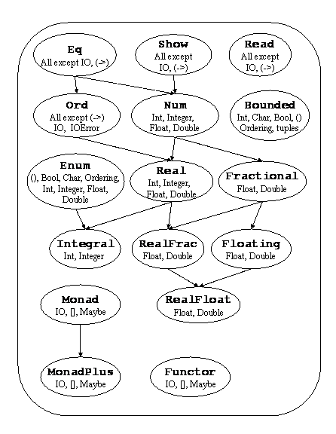
Some other type classes of interest
http://www.haskell.org/onlinereport/basic.html

Slide 36
Type systems in general
Impact the way you design, write, document and test code
  Writing generic code:
    Parametric polymorphism
  Restricting generic code:
    Ad hoc polymorphism
  Verbosity vs documentation:
    Type inference
  Safety:
    Static vs dynamic typing
    Strong vs weak typing

Slide 37
Haskell
Design often starts with typing
  Creating your own types
  Writing type signatures before implementing functions
The compiler helps
  People often use the compiler to tell them their type signatures when they're not sure
It's very safe, and it's pure
  “If it compiles it's likely to work”
This is not a fact

Slide 38
There is another way
Python and Ruby
  “If it walks, swims and quacks like a duck, it's a duck”
I don't care what the object's type is, I'm calling quack() on it.
If it doesn't have a quack() method, I'm crashing, and you need to write better code and more tests.
Super flexible, very quick to code, but open to many more kinds of runtime error

Slide 39
Next up
Modules, we haven't really looked at encapsulation
IO... we're getting closer to Monads

Slide 40
Exercises with List (using Maybe for error handling)
Write listHead
  listHead :: List a -> Maybe a
Write listTail
  listTail :: List a -> Maybe (List a)
Write listSize
  listSize :: List a -> Int
Write listGet
  listGet :: Int -> List a -> Maybe a
Write listMap
  listMap :: (a -> b) -> List a -> List b

