Slide 1
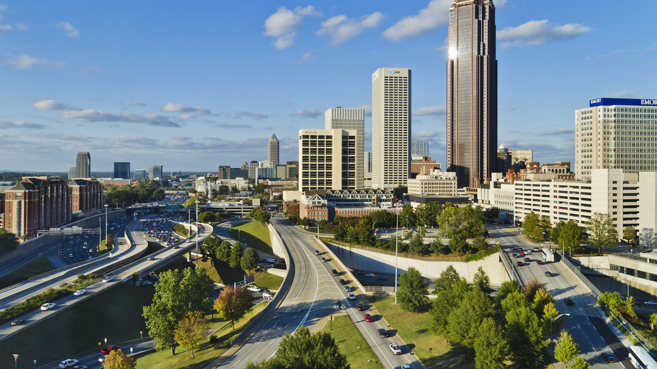
An Analysis of the Relationship between Presence of Green Space in 330 Cities in the United States and the Health Status of Their Citizens
Naomi Mauss, Department of Data Science

Slide 2
Defining Health Status:
Kidney disease
Asthma
Cancer
High Blood Pressure
Arthritis
Diabetes
Chronic Obstructive Pulmonary Disease (COPD)
Binge drinking
Poor mental health

Slide 3
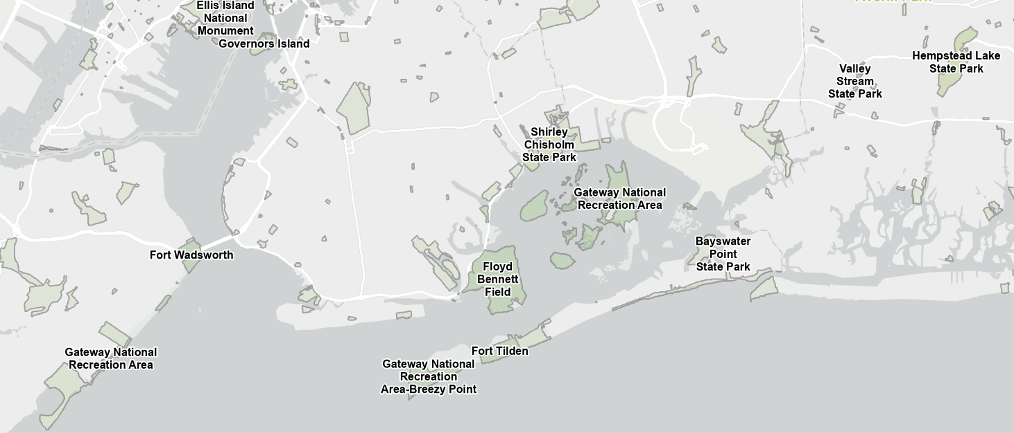


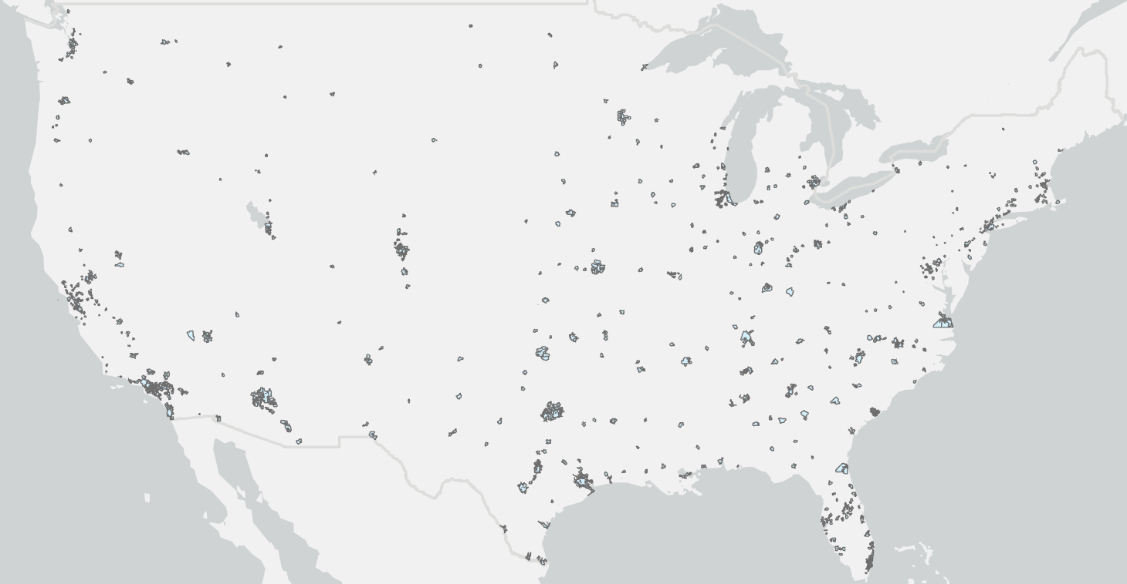

Datasets
Data cleaning:
Data merging:
Remove duplicates
Calculate geometry
Pairwise Clip
Explode
Comparative statistics
Select by Attributes
Spatial Join
Pairwise Intersect
US Parks
US Cities

Slide 4
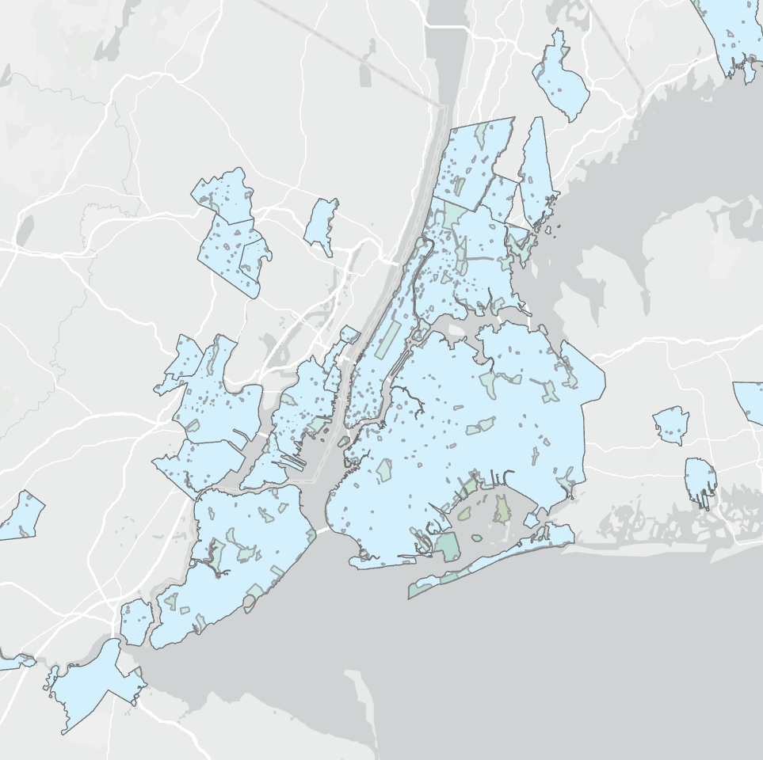
Output:
Parks have a calculated area inside each city
Health data is joined to each city by FIPS code

Slide 5
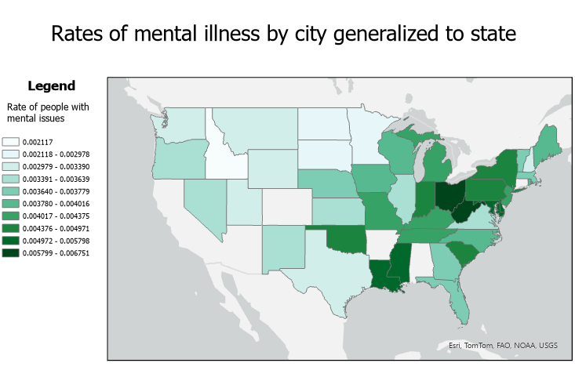

Slide 6
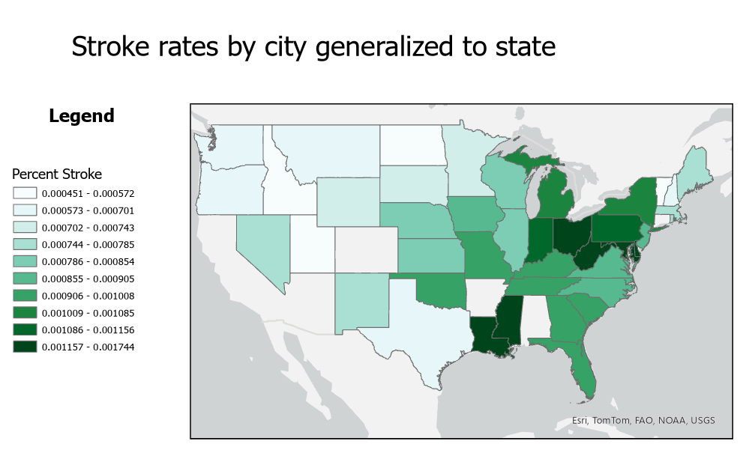

Slide 7
In Conclusion: No correlation
Health Condition | Correlation coefficient
Binge Drinking | 0.000
Asthma | 0.003
Arthritis | 0.008
Cancer | 0.004
Kidney Disease | 0.005
High Blood Pressure | 0.005
Diabetes | 0.003
Mental Issues | 0.001
COPD | 0.010

Slide 8
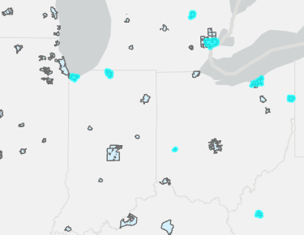
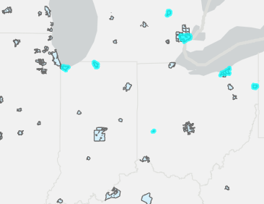
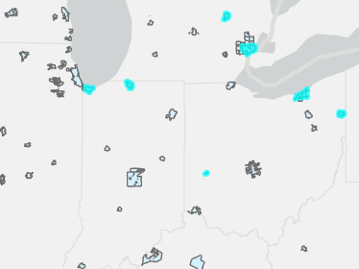
Is there a correlation between geographical attributes of an area and health level?

Slide 9
Is there a significant difference in the health levels of people living within 30 miles of a lake compared to the rest of the country?

Slide 10
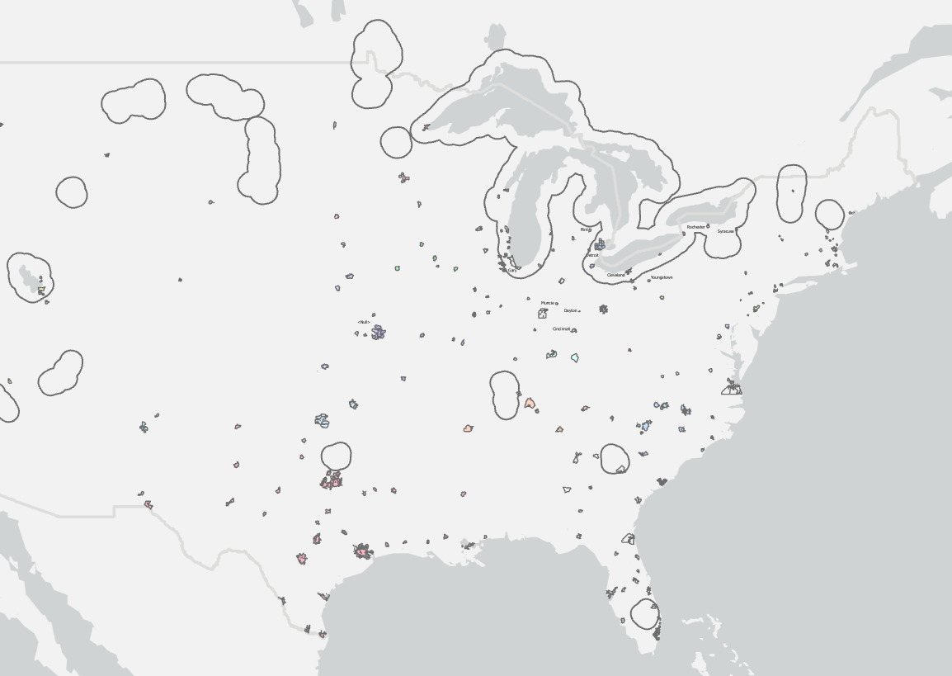
How to determine if a correlation exists?
Using the Buffer and Pairwise Intersect tools, separate the cities
Use the Explore Statistics tool to find the mean and standard deviation of the data for each group

Slide 11
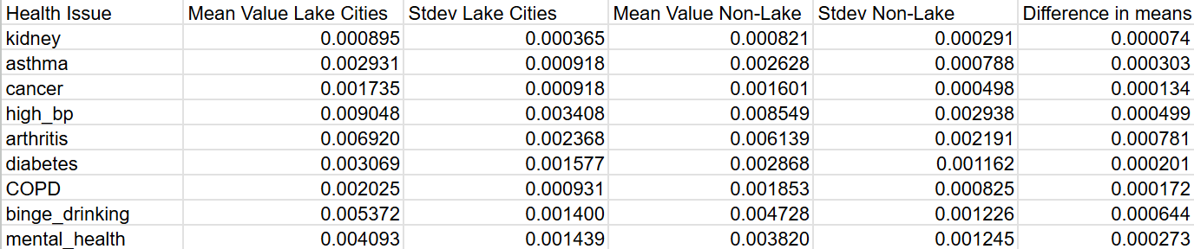

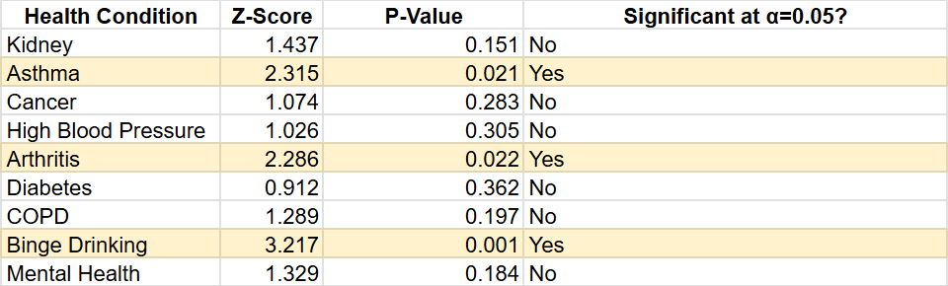
Two-value Hypothesis testing

Slide 12
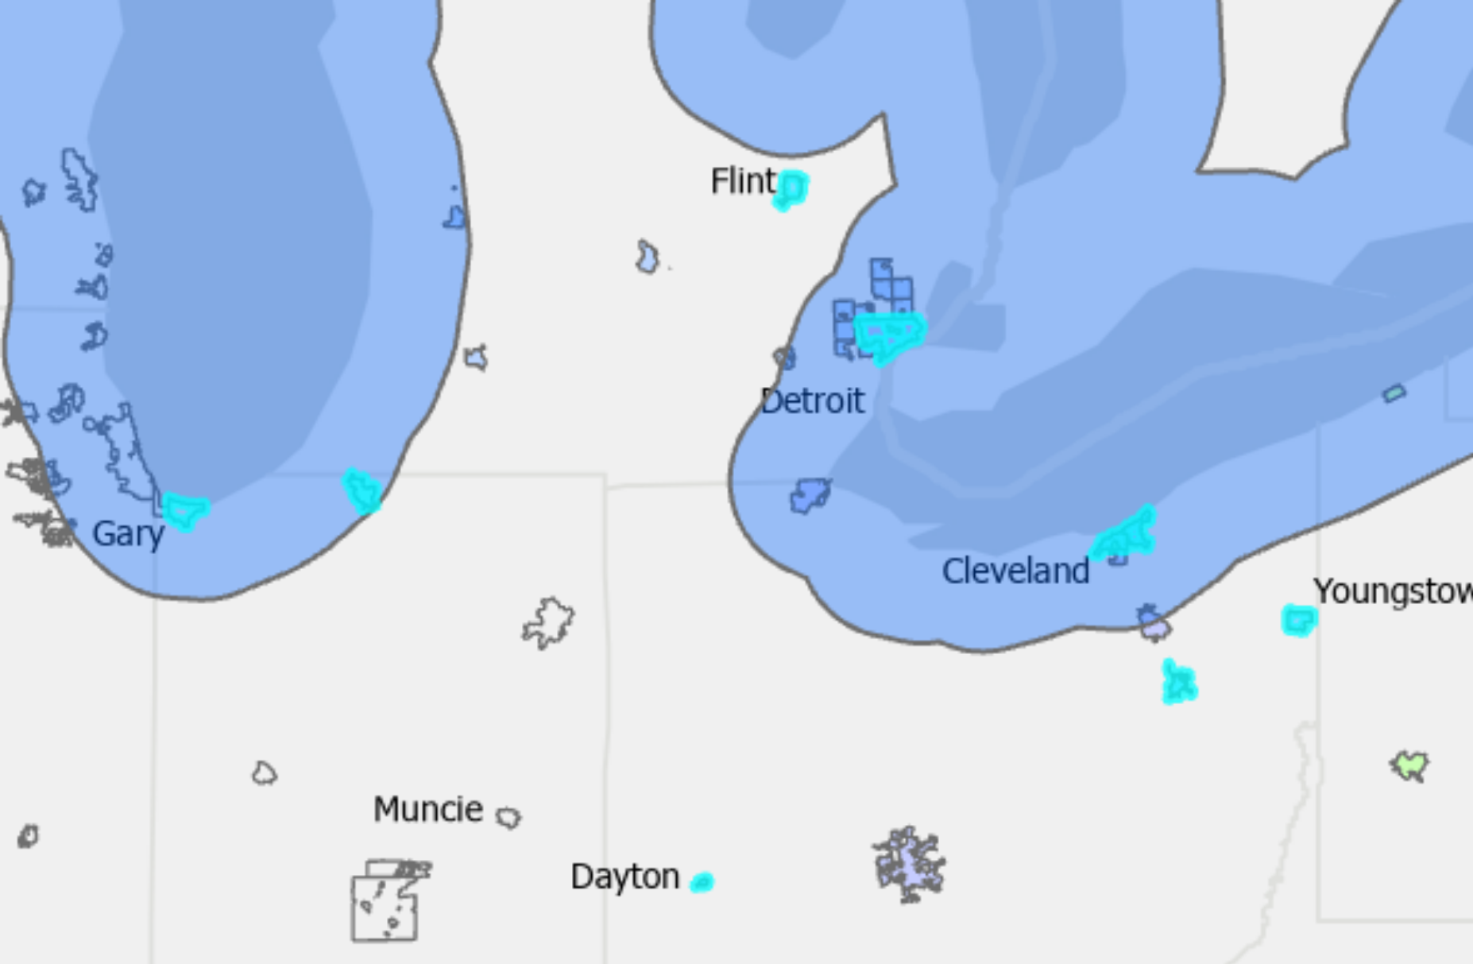
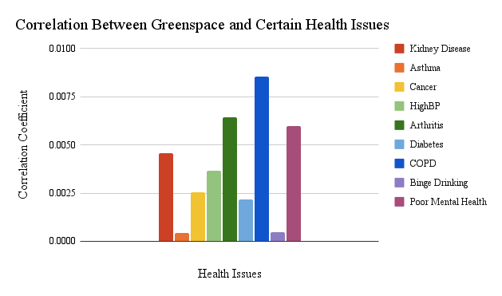
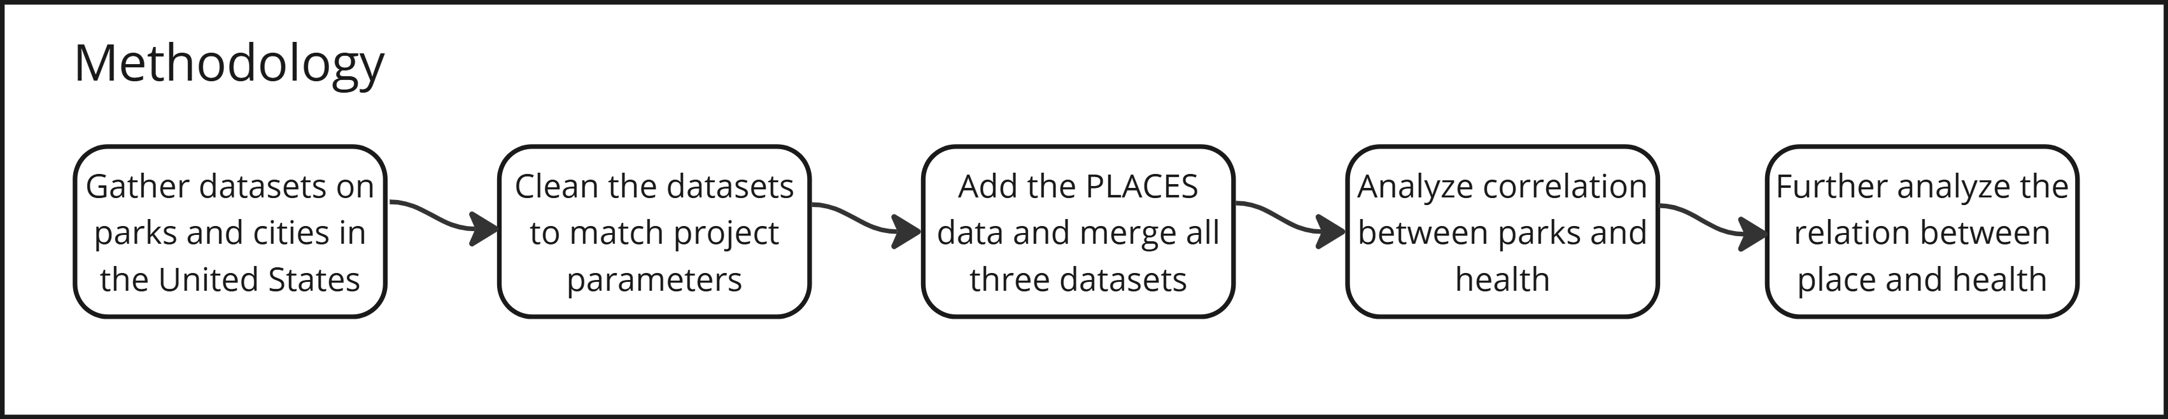
Department of Computer Science
CRP 551 – Semester Project Poster Presentation
12/11/2024
Principal investigators
An Analysis of the Relationship between Presence of Green Space in 330 Cities in the United States and the Health Status of their Citizens
Abstract
Increasingly, scientific literature suggests that there is a positive correlation between the amount of green space in an area–the amount of plant matter growing in an area–and the health of the population living in that area. A meta-analysis published in The Lancet Planetary Health in 2019 found that there is a link between a higher percentage of green space in an area and the mortality rate of people living in that area. A different meta-analysis published in Science of The Total Environment in 2019 found a positive correlation between an area’s Normalized Difference Vegetation Index (NDVI) and a decrease in the prevalence of hypertension in the population.
Conclusion
The results of this study indicate there is less than a 0.0085 coefficient of determination between the percent of a city dedicated to parks and any of the health metrics for that city. However, regional differences in health may be acting as a confounding variable, causing the apparent lack of correlation. Specifically, the cities within 30 miles of lakes have higher levels of asthma, arthritis, and binge drinking than cities outside of that lake buffer. Further studies would be needed in to determine whether a smaller geographic scope would result in a significant correlation between the amount of greenspace and the rate of health issues.
Goal
The goal of this research was to examine the correlation between different health conditions and the prevalence of green space for the 330 largest cities in the United States. The study considered kidney disease, asthma, cancer, high blood pressure, arthritis, diabetes, Chronic Obstructive Pulmonary Disease (COPD), binge drinking, and poor mental health by city, as obtained from the CDC’s PLACES survey. This study measured greenspace as the percentage of the city designated as parks. As used here, a park includes city, state, and national parks, as well as city and state forests.
Acknowledgements:
Green Spaces and Mortality: A Systematic Review and Meta-Analysis of Cohort Studies.
Association between Greenspace and Blood Pressure: A Systematic Review and Meta-Analysis
ESRI, USGS

