Slide 1

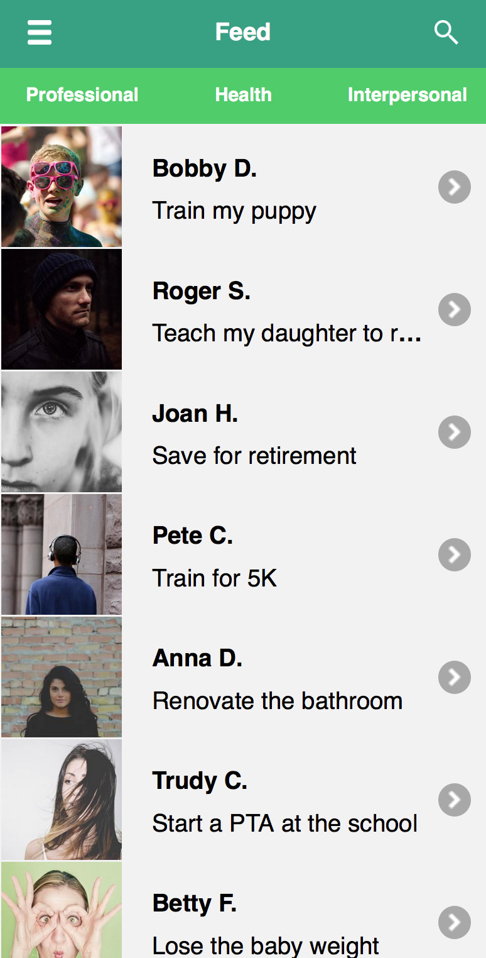
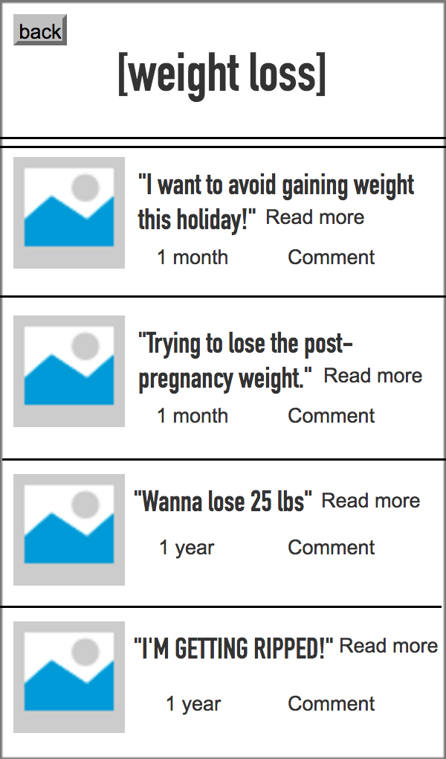
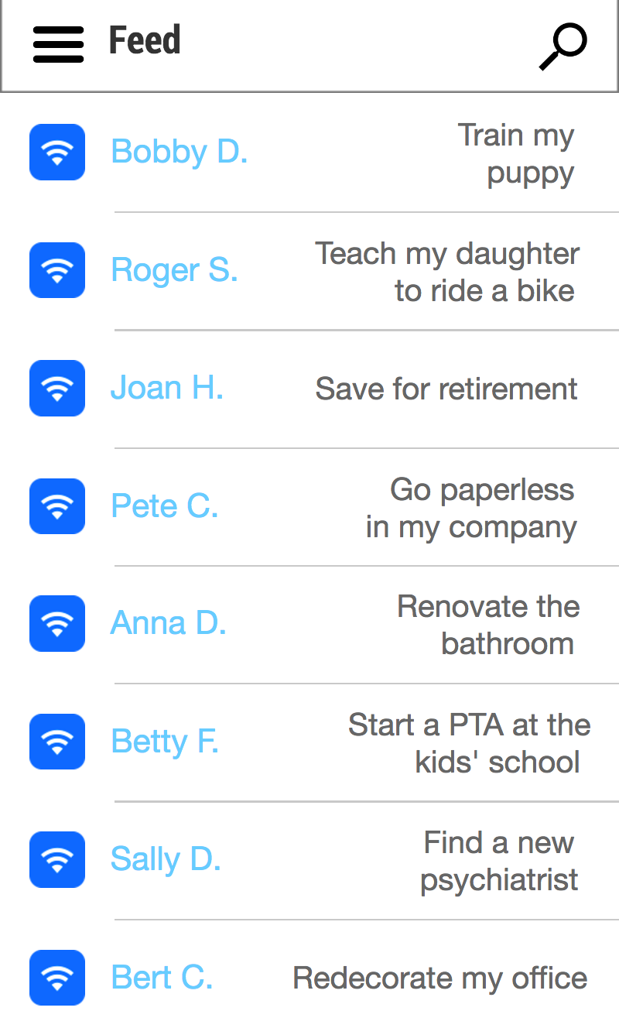
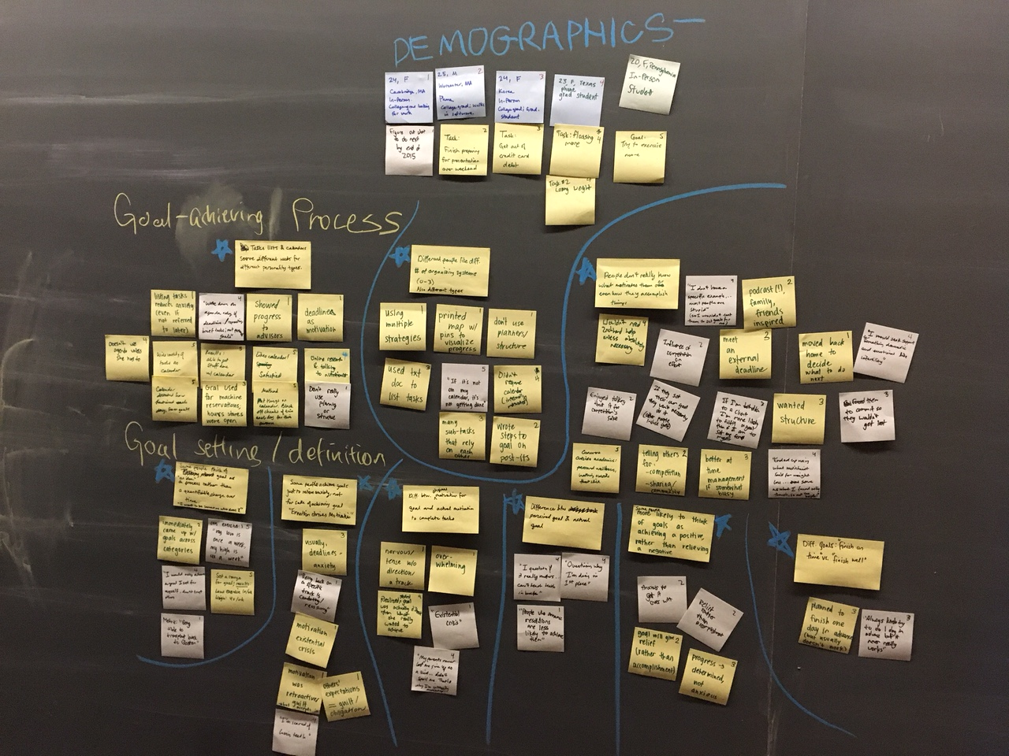
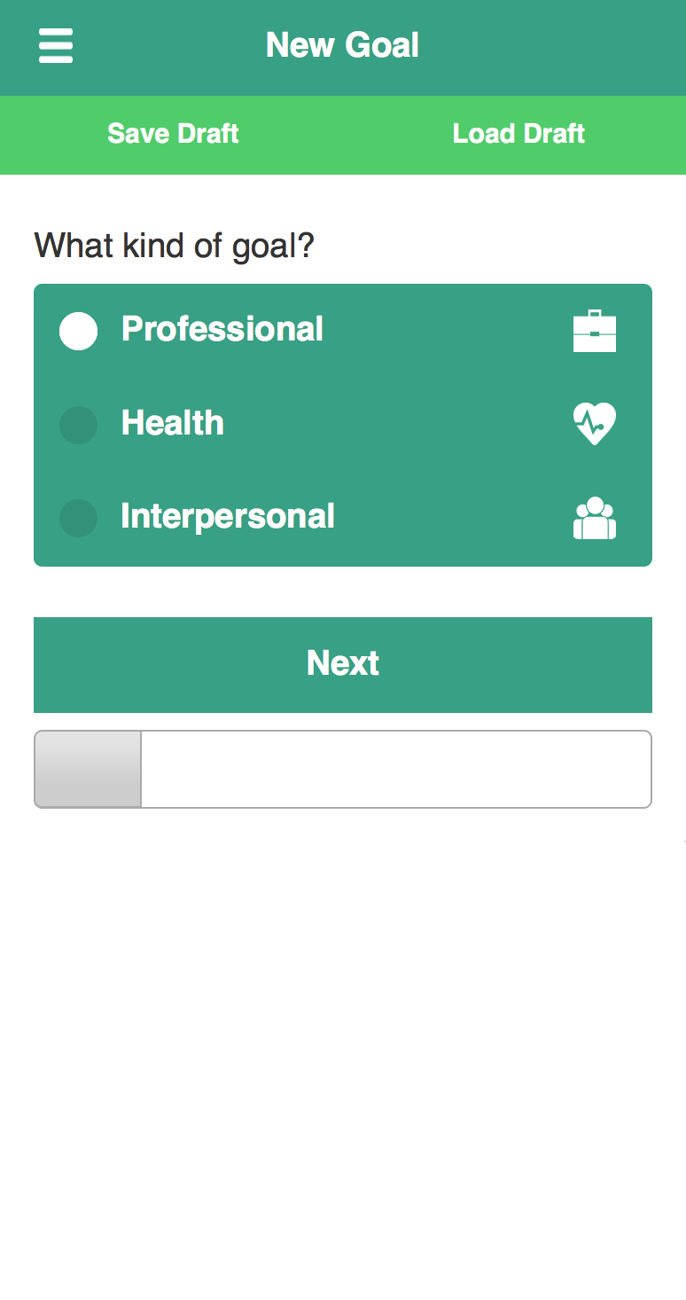
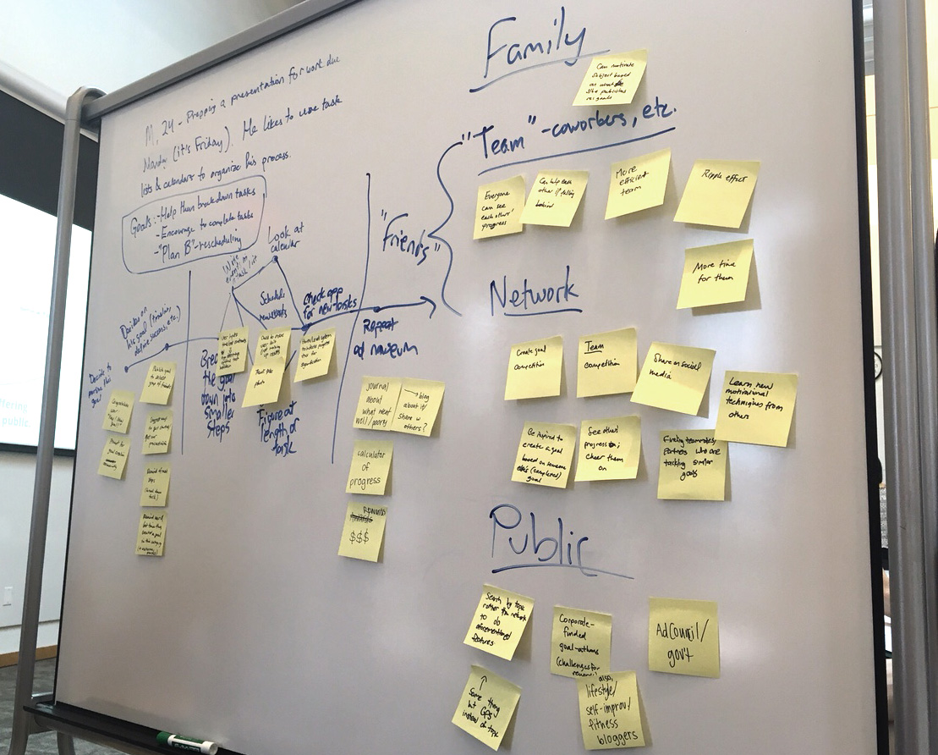
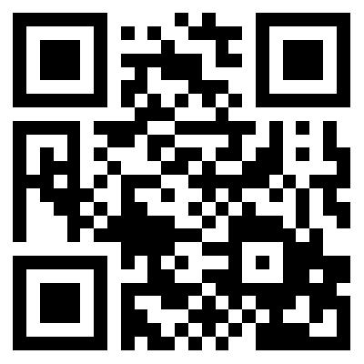
goallective
You’re smart. Your goals should be smart, too.
Where would you start if…
You moved to a new city and felt lonely?
You had a great startup idea but didn’t know how to find a business partner?
You were a new parent, and needed to navigate acquiring daycare for your child?
You were trying to overcome your seasonal depression?
Break your goals into smaller steps
Identify your obstacles
and how to overcome them
Find inspiration in friends’ achievements
Our design process
1. Interviewed our target users
to discover their needs
3. Refined our product based on feedback from potential users
2. Developed multiple prototypes
The Goallective team: Catherine Bousquet, Curren Iyer, and Alma Lafler
contact: catherinebousquet OR curreniyer OR alafler@college.harvard.edu

