Slide 1
Predictive Analytics
Girish Kemba,
girish.kemba26@gmail.com

Slide 2
Model building parameters:
Scatter plots were made for Salary vs Age, Salary vs Account Balance and Salary vs Transaction Amount.
Filtering the type of transaction in the transaction description column, The amount the person has spent on an average in POS, Interbank, Phone Bank.
Phone bank and bank transfer do not have adequate data for all customers. Data is not considered for predictive analysis
Created 2 new features for the data. The average payments made by customers and the average money spent by customers at point of sale.

Slide 3
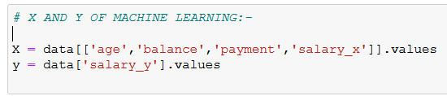
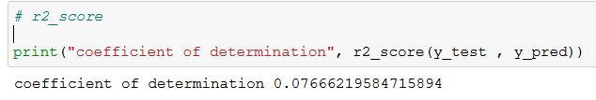
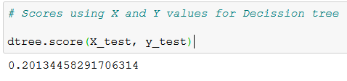
Supervised Model:
Linear Regression Model:
Took these columns as X and y. The r2 score was low, main reason being lack of data, hence less training examples.
Decision Tree Regressor:
This model also gave a very low score.
But the sample prediction it made was also in in realistic values.

Slide 4
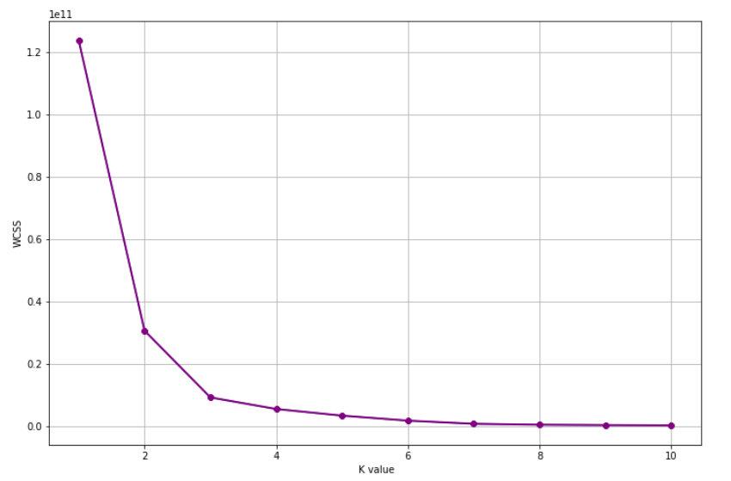
Unsupervised Model:
Customer Segmentation using K-Means:
The elbow curve of Kmeans shows that the elbow is formed at K=3. So we can make 3 clusters.
The customer segments have been made. The segments are based on customer age, account balance, average payment and POS transactions and salary.

