Slide 1
Completable futures
Composable Asynchronous Programming w/ java 8
Burak Yildirim

Slide 2
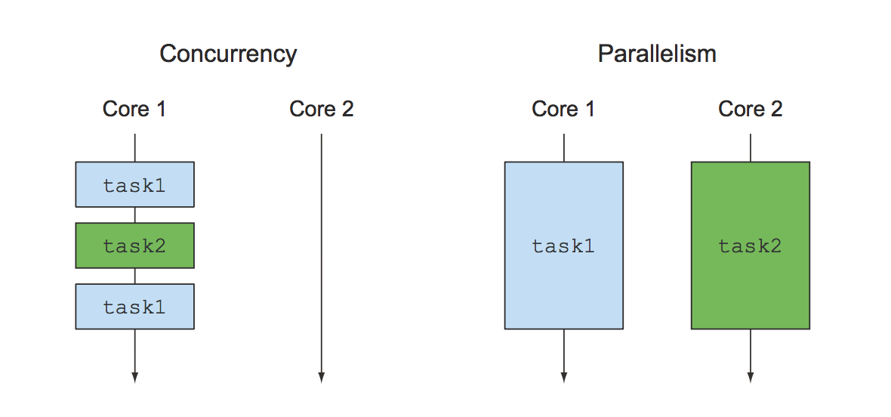
Concurrency vs Parallelism
Notes:
There are 2 computing trends in recent years: concurrency and parallelism. Parallelism is mostly a hardware issue that we want to utilise more than one CPUs and some operations can be done with java 8 streams on the JVM level.
Our interest is concurrency: when your main goal is to perform several loosely related tasks on the same CPUs, keeping their cores as busy as possible to maximize the throughput of your application, what you really want to achieve is to avoid blocking a thread and wasting its computational resources while waiting, potentially for quite a while, for a result from a remote ser- vice or from interrogating a database .

Slide 3
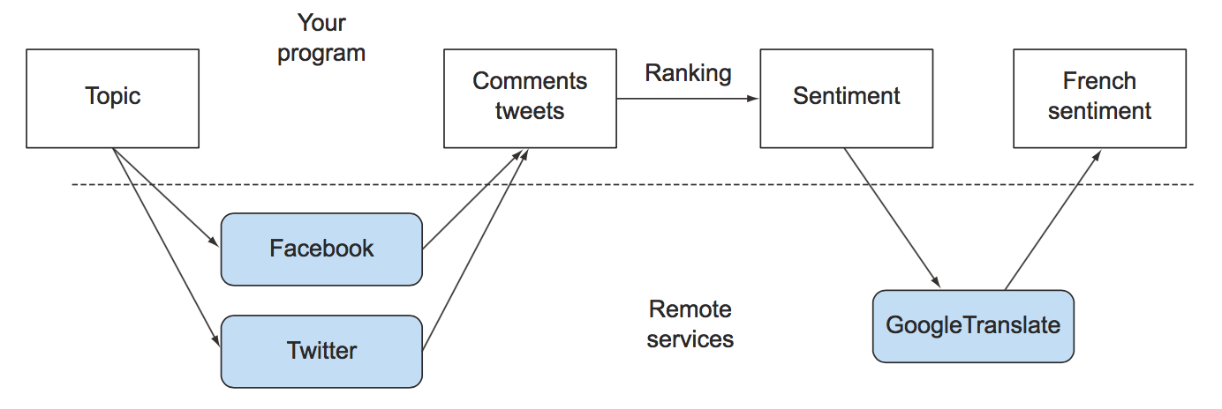
Asynchronous APIs and Mash-up applications
Notes:
For instance, you might like to provide the collective sentiment about a given topic to your French users; to do this you could ask the Facebook or Twitter API for the most trending comments about that topic in any language and maybe rank the most rele- vant ones with your internal algorithms. Then you might use Google Translate to translate them into French, or even Google Maps to geolocate where their authors live, and finally aggregate all this information and display it on your website.
Oh, and of course, if any of these external network services are slow to respond, then you’ll wish to provide partial results to your users, for example, showing your text results alongside a generic map with a question mark in it, instead of showing a totally blank screen until the map server responds or times out.
To implement a similar application, you’ll have to contact multiple web services across the internet. But what you don’t want to do is block your computations and waste billions of precious clock cycles of your CPU waiting for an answer from these services. For example, you shouldn’t have to wait for data from Facebook to start pro- cessing the data coming from Twitter.

Slide 4
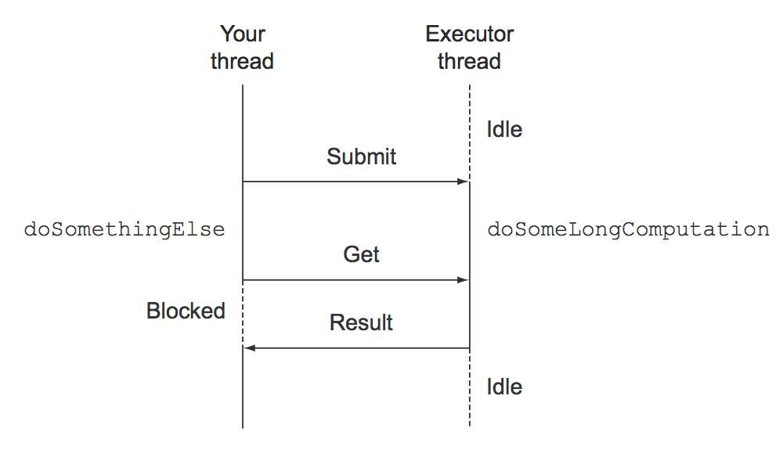
The good old Java Future (from java 5) until java 8’s CompletableFuture
Notes:
model a result made available at some point in the future. It models an asynchronous computation and provides a ref- erence to its result that will be available when the computation itself is completed. Triggering a potentially time-consuming action inside a Future allows the caller Thread to continue doing useful work instead of just waiting for the operation’s result.
this style of programming allows your thread to perform some other tasks while the long-lasting operation is executed concurrently in a sepa- rate thread provided by the ExecutorService.
What if the long operation never returns? To handle this possibility, even though there also exists a get method that doesn’t take a parameter, it’s almost always a good idea to use its overloaded version, accepting a timeout defining the maximum time your thread has to wait for the Future’s result, instead of waiting indefinitely.

Slide 5
Future Limitations
When the result of the long computation is available, please send its result to another long computation, and when that’s done, combine its result with the result from another query. – wtf ?
There’s no fancy way of doing this in the old Futures !

Slide 6
CompletableFuture implements Future
Combining two asynchronous computations in one
Waiting for the completion of all tasks performed by a set of Futures
Waiting for the completion of only the quickest task in a set of Futures (possibly because they’re trying to calculate the same value in different ways) and retrieving its result
Programmatically completing a Future (that is, by manually providing the result of the asynchronous operation)
Reacting to a Future completion (that is, being notified when the completion happens and then having the ability to perform a further action using the result of the Future, instead of being blocked waiting for its result)

Slide 7
CompletableFuture Features
implementing an async. Api
non blocking api consumption
Pipelining asynchronous tasks
Reacting to a CompletableFuture completion
Notes:
implementing an async. api: provide an asynchronous API for your customers
non blocking api consumption: you’ll learn how to make your code non-blocking when you’re a con- sumer of a synchronous API, how to pipeline two subsequent asynchronous operations, merging them into a single asynchronous computation.
Pipelining asynchronous tasks
Reacting to a CompletableFuture completion: how to reactively process events representing the completion of an asynchronous operation

Slide 8
Basics of Completable Future
CompletableFuture<T> future = ...
future.complete(val)
future.completeExceptionally(ex)
CompletableFuture.supplyAsync(() -> foo(bar))

Slide 9
Demo
Shop, SyncApiExample, AsyncApiExample, NonBlockingApiCalls - demo
Notes:
Shop, SyncApiExample, AsyncApiExample, NonBlockingApiCalls - demo

Slide 10
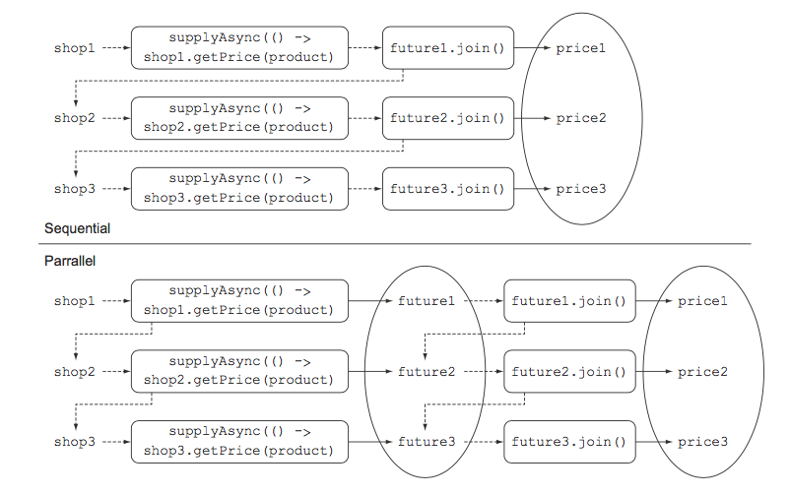
Lazy Streams

Slide 11
Pipelining Async. Tasks
thenCompose
thenComposeAsync
thanApply (for sync.)
Notes:
thenCompose allowing you to pipeline two asynchronous operations, passing the result of the first operation to the second operation when it becomes available.
thenComposeAsync. In general, a method without the Async suffix in its name executes its task in the same thread as the previous task, whereas a method terminating with Async always submits the succeeding task to the thread pool, so each of the tasks can be handled by a different thread.
Be careful – thread switch overhead!
thenApply is used if you have a synchronous mapping function

Slide 12
Combining two CompletableFutures—dependent and independent
thenCombine
thenCombineAsync
Notes:
where you need to combine the results of the operations performed by two completely indepen- dent CompletableFutures, and you don’t want to wait for the first to complete before starting on the second.

Slide 13
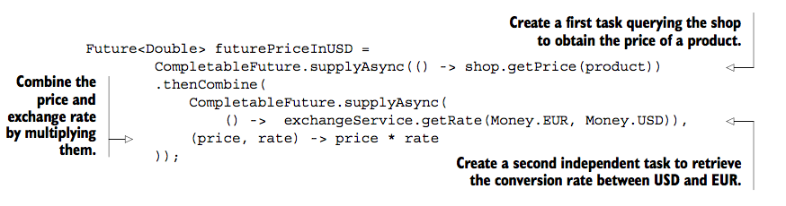
Combining two independent operations

Slide 14
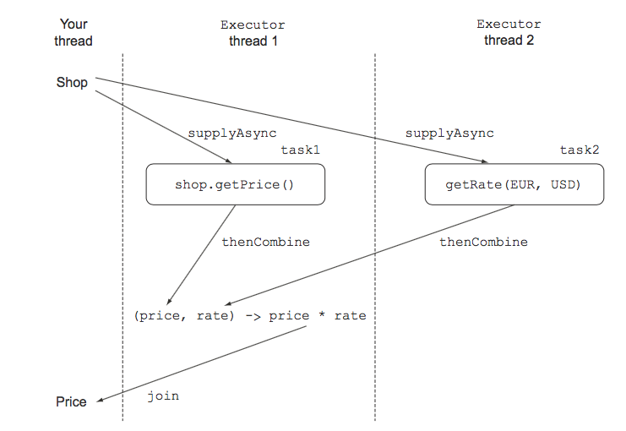
Combining two independent operations – how it works

Slide 15
Reacting to a CompletableFuture completion
We want to have the application display the price for a given shop as soon as it becomes available, without waiting for the slowest one! Sounds cool !
thenAccept: registers an action on each CompletableFuture; this action consumes the value of the CompletableFuture as soon as it completes.
findPricesStream("myPhone").map(f -> f.thenAccept(System.out::println));
CompletableFuture.allOf(futures).join();
Notes:
thenAccept: registers an action on each CompletableFuture; this action consumes the value of the CompletableFuture as soon as it completes.
allOf: The allOf factory method takes as input an array of CompletableFutures and returns a CompletableFuture<Void> that’s completed only when all the CompletableFutures passed have completed.

Slide 16
Demo
Reacting to a CompletableFuture completion
Notes:
Reacting.java visualVM demo
jvisualvm

Slide 17
Summary or More Confusion ?
supplyAsync
thenAccept
thenApply
thenCompose
thenCombine
applyToEither
allOf
thenRun
anyOf
Handle
exceptionally
completeExceptionally

