Slide 1
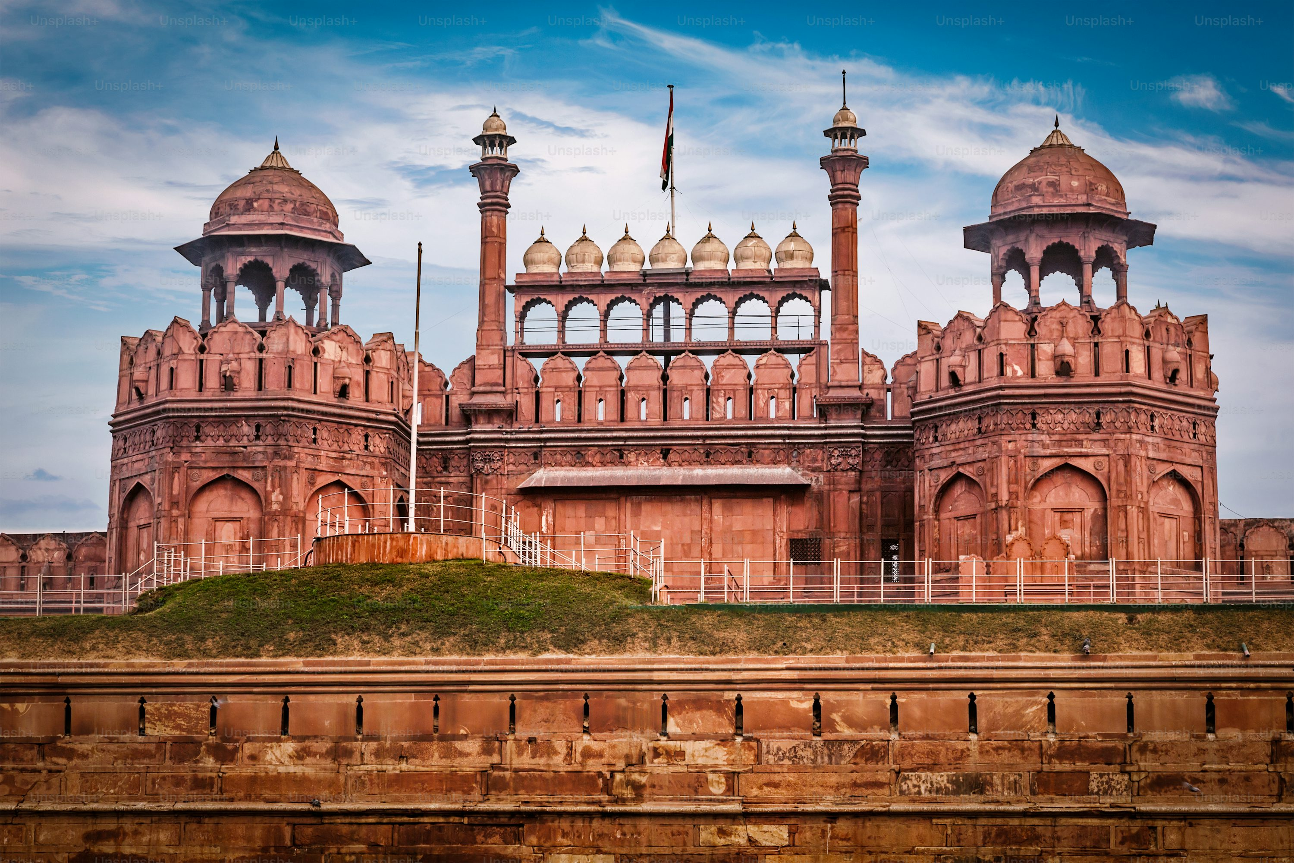




INDIAN SOCIETY FOR QUALITY
NCR Chapter
awarded to
Name
Organisation
in recognition of your valuable support as a volunteer during
TOPS CONVENTION 2024
(Contest of Team Oriented Problem Solving Case Studies) on 23, November 2024
at Tata Power DDL Learning Centre, Delhi
Kunal Pareek
Vice President, NCR Chapter
Virendra Atre
Program Chair

Slide 2
INDIAN SOCIETY FOR QUALITY
NCR Chapter
awarded to
Name
Organisation
in recognition of your valuable support as a volunteer during
TOPS CONVENTION 2024
(Contest of Team Oriented Problem Solving Case Studies) on 23, November 2024
at Tata Power DDL Learning Centre, Delhi
Kunal Pareek
Vice President, NCR Chapter
Virendra Atre
Program Chair

Slide 3
INDIAN SOCIETY FOR QUALITY
NCR Chapter
awarded to
Name
Organisation
in recognition of your valuable support as a volunteer during
TOPS CONVENTION 2024
(Contest of Team Oriented Problem Solving Case Studies) on 23, November 2024
at Tata Power DDL Learning Centre, Delhi
Kunal Pareek
Vice President, NCR Chapter
Virendra Atre
Program Chair

Slide 4
INDIAN SOCIETY FOR QUALITY
NCR Chapter
awarded to
Name
Organisation
in recognition of your valuable support as a volunteer during
TOPS CONVENTION 2024
(Contest of Team Oriented Problem Solving Case Studies) on 23, November 2024
at Tata Power DDL Learning Centre, Delhi
Kunal Pareek
Vice President, NCR Chapter
Virendra Atre
Program Chair

Slide 5
INDIAN SOCIETY FOR QUALITY
NCR Chapter
awarded to
Name
Organisation
in recognition of your valuable support as a volunteer during
TOPS CONVENTION 2024
(Contest of Team Oriented Problem Solving Case Studies) on 23, November 2024
at Tata Power DDL Learning Centre, Delhi
Kunal Pareek
Vice President, NCR Chapter
Virendra Atre
Program Chair

Slide 6
INDIAN SOCIETY FOR QUALITY
NCR Chapter
awarded to
Name
Organisation
in recognition of your valuable support as a volunteer during
TOPS CONVENTION 2024
(Contest of Team Oriented Problem Solving Case Studies) on 23, November 2024
at Tata Power DDL Learning Centre, Delhi
Kunal Pareek
Vice President, NCR Chapter
Virendra Atre
Program Chair

Slide 7
INDIAN SOCIETY FOR QUALITY
NCR Chapter
awarded to
Name
Organisation
in recognition of your valuable support as a volunteer during
TOPS CONVENTION 2024
(Contest of Team Oriented Problem Solving Case Studies) on 23, November 2024
at Tata Power DDL Learning Centre, Delhi
Kunal Pareek
Vice President, NCR Chapter
Virendra Atre
Program Chair

Slide 8
INDIAN SOCIETY FOR QUALITY
NCR Chapter
awarded to
Name
Organisation
in recognition of your valuable support as a volunteer during
TOPS CONVENTION 2024
(Contest of Team Oriented Problem Solving Case Studies) on 23, November 2024
at Tata Power DDL Learning Centre, Delhi
Kunal Pareek
Vice President, NCR Chapter
Virendra Atre
Program Chair

Slide 9
INDIAN SOCIETY FOR QUALITY
NCR Chapter
awarded to
Name
Organisation
in recognition of your valuable support as a volunteer during
TOPS CONVENTION 2024
(Contest of Team Oriented Problem Solving Case Studies) on 23, November 2024
at Tata Power DDL Learning Centre, Delhi
Kunal Pareek
Vice President, NCR Chapter
Virendra Atre
Program Chair

Slide 10
INDIAN SOCIETY FOR QUALITY
NCR Chapter
awarded to
Name
Organisation
in recognition of your valuable support as a volunteer during
TOPS CONVENTION 2024
(Contest of Team Oriented Problem Solving Case Studies) on 23, November 2024
at Tata Power DDL Learning Centre, Delhi
Kunal Pareek
Vice President, NCR Chapter
Virendra Atre
Program Chair

Slide 11
INDIAN SOCIETY FOR QUALITY
NCR Chapter
awarded to
Name
Organisation
in recognition of your valuable support as a volunteer during
TOPS CONVENTION 2024
(Contest of Team Oriented Problem Solving Case Studies) on 23, November 2024
at Tata Power DDL Learning Centre, Delhi
Kunal Pareek
Vice President, NCR Chapter
Virendra Atre
Program Chair

