Slide 1
DATALEUM POWER BI PROJECT
by
Opitien Brume Pascal
Oluwadamilola Odeyemi

Slide 2
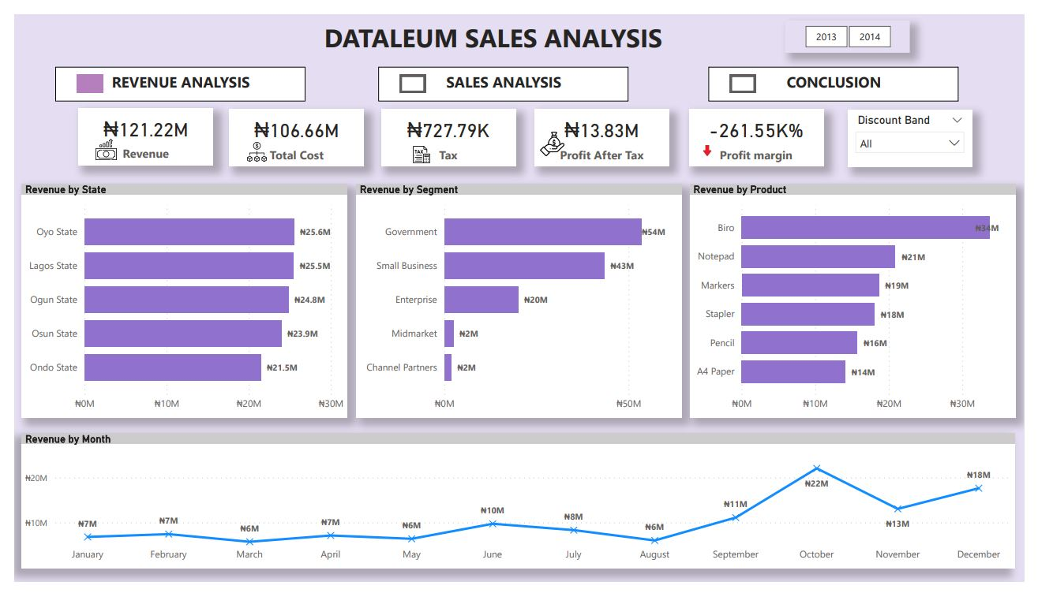
Executive Summary
REVENUE
Revenue Analysis
• Total Revenue of N94.28m and total Operating cost of N81.67m.
• Oyo State recorded the highest revenue of N20.3m, Government is the segment with the most revenue at N40m and Biro the top product by revenue at N28m.

Slide 3
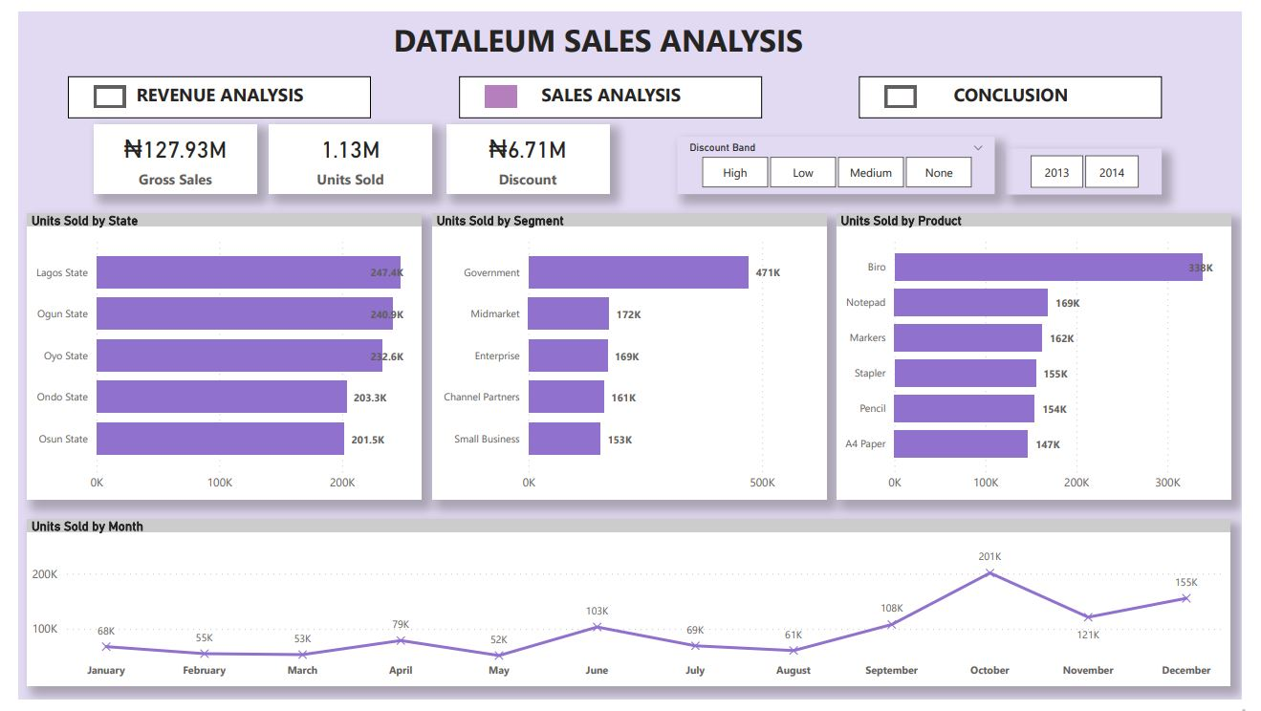
SALES
Sales Analysis
Total Gross Sales is N127.9m with N1.12m units sold. There were more unit sales in Biro (N338K), and more units sold in Government segment (N471K).
Sales Particularly Improved where we had a high discount compared to where discount band is low or where no discount was given.

Slide 4
PROFIT
• Total Profit of N13.8m was recorded. Small businesses are the most performing segment; this accounts for the highest profit (N25.9m) and better profit margin (5995%). It is also key to note that more taxes were paid on small businesses.
• A significant loss was incurred on Midmarket segment followed by Channel Partners with the losses recorded at -N11m and -N14.3m respectively. This is likely due to total cost or running cost greater than the revenue generated.
• Osun State accounts for the most profit (N3.5m) generated, and the least profit generated comes from Ogun State (N2.2m). Biro is the best performing product by profit after tax (N28m) and also has a better profit margin than other products.

Slide 5
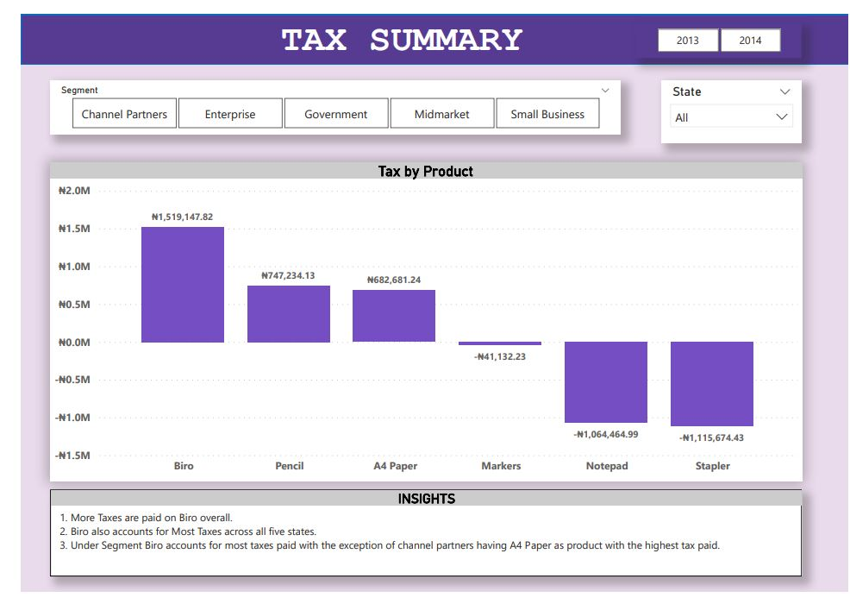
TAX
Tax Summary
More Taxes were paid on Biro overall.
Biro also accounts for the most tax across all five states.
Under Segment, Biro accounts for most taxes paid except for Channel Partners having A4 Paper as product with the highest tax paid.

Slide 6
Key Findings
Biro has been the most performing product by gross sales, revenue, profit and units sold.
There are also other observations to be noted.
Marker, Notepad and Stapler made no significant improvement in profit and profit margin, most likely because total cost is higher than Gross sales. Thus, a discontinuation may be recommended.
Biro accounted for most product units sold in 2014 by N338k units. The least was A4 Paper N145k units.
Biro, A4 Paper and Pencil are key performance drivers by profit and profit margin.
Small businesses are the most performing segment; this segment accounts for the most profit (N26m) and best profit margin (5995%).
Better Q4 Performance in 2014 across all States and products than in previous year

Slide 7
Conclusion / Recommendations
Biro, A4 Paper and Pencil are key performance drivers by profit and profit margins; therefore, should be the focus of Business
Marker, Notepad and Stapler made no significant improvements over time most likely due to total cost higher than Gross sales and poor units sold. We recommend a discontinuation of these products.
It is key to note that small businesses are the most performing segment by profit N26m and highest profit margin of 5995%. This segment should be a key focus as it drives performance and profitability.

