Slide 1
Benchmarking the state-of-the-art Task Execution Frameworks of Many-Task Computing
Thomas Dubucq – Tony Forlini – Virgile Landeiro Dos Reis – Isabelle Santos

Slide 2
Introduction
Systems:
Charm++
HPX
Legion
MATRIX
Sparrow
Swift/T
Testbeds:
From 1 to 128 nodes
C3.large instances
2 cores per node
Weak scaling
Metrics:
Throughput
Efficiency
Task latency

Slide 3
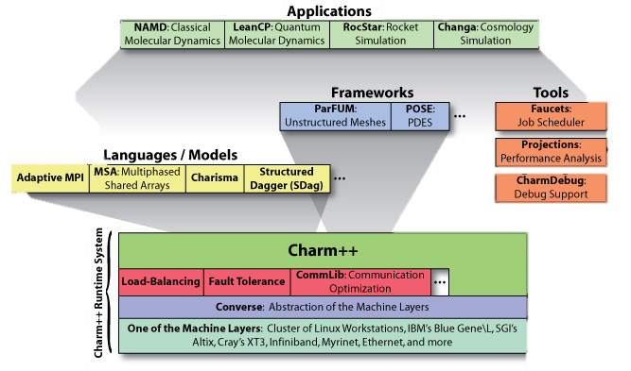
Charm++
Explicit parallelism
Applications:
NAMD molecular dynamics
LeanCP quantum molecular dynamics
Tools:
Faucets job scheduler
CharmDebug
Projections

Slide 4
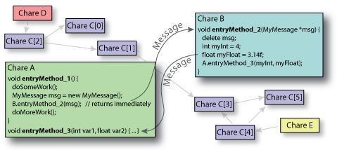
Charm++
Asynchronous message passing parallel programming paradigm
Tasks defined as chare objects
Chare objects communicate with each other by sending messages

Slide 5
Charm++ - Results

Slide 6
Charm++ - Efficiency

Slide 7
Charm++ - Results

Slide 8
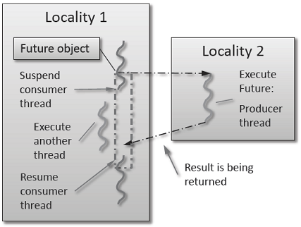
HPX (High Performance ParalleX)
Boost C++ runtime system for parallel and distributed applications
ParalleX execution model
hide latency by switching tasks
fine-grained tasks
reduce overhead
Futures
delayed computation
reader thread & producer thread

Slide 9
HPX: Challenges
Never previously deployed on EC2
Incomplete documentation
unmentioned dependencies
typos in command lines
Long compilation time
Memory requirements
Version compatibility among dependencies

Slide 10
Legion
Programming model for heterogeneous, distributed machines
Built on top of GASNet communication system
Heterogeneous
Mixed CPUs and GPUs
Distributed
Large spread and variability of communication latencies
Implicit parallelism

Slide 11
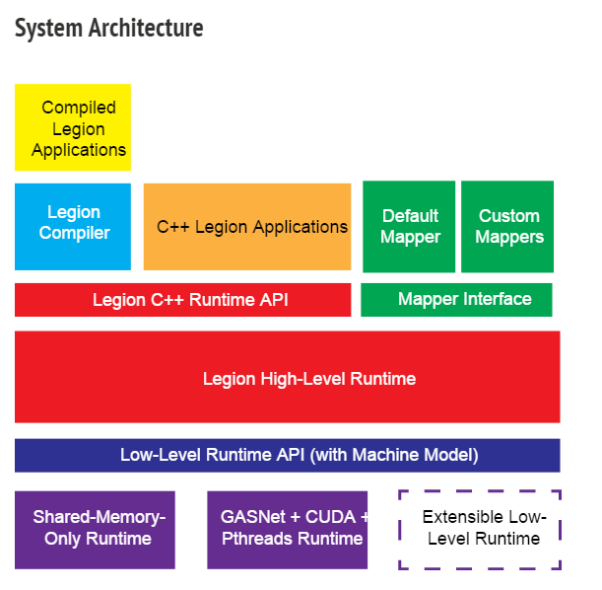
Legion

Slide 12
Legion - Results

Slide 13
Legion - Results

Slide 14
Legion - Results

Slide 15
MATRIX
Distributed data-aware execution fabric
Work stealing
Built on top of ZHT
Supports MTC and HPC workloads
Coded in C++

Slide 16
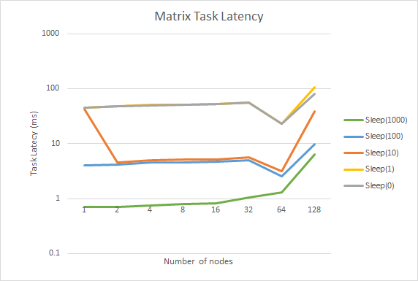
MATRIX - Results

Slide 17
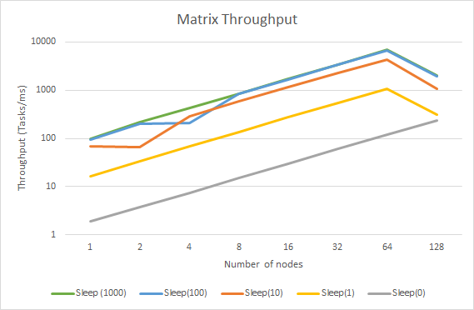
MATRIX - Results

Slide 18
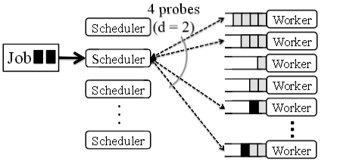
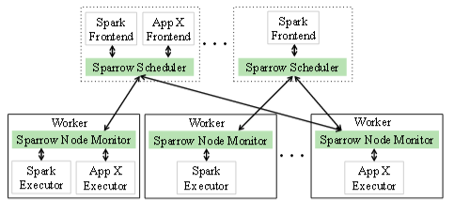
Sparrow
Stateless distributed scheduler
Late binding
Batch sampling
Coded in Java

Slide 19
Sparrow - Challenges
Backend and Frontend provided in the code source don't match the benchmark metrics
Necessity of task completion acknowledgement
Dense workload handling

Slide 20
Sparrow
Scheduler
Frontend
Task submitter
Message Server(s)
Message Processing
Backend
Worker(s)
Message batching
Synchronized write
Log
Log

Slide 21
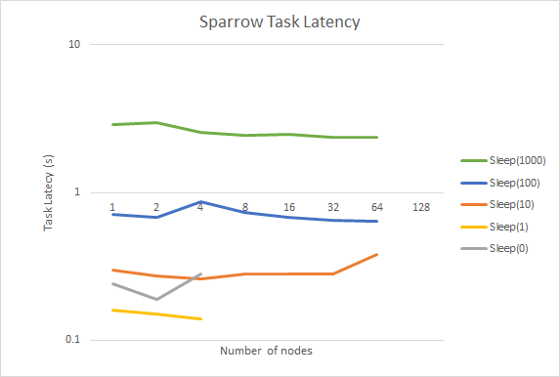
Sparrow - Results

Slide 22
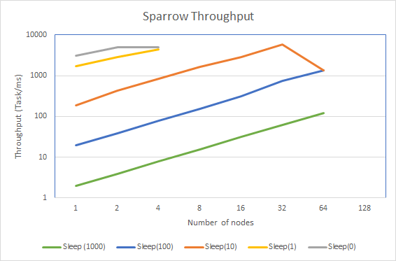
Sparrow - Results

Slide 23
Swift/T
Workflow system
Built on top of MPI
Highly programmable
Improve from Swift/K by introducing a parallel evaluation of complex scripts
Two main tools:
STC: Java-based compiler that produces Turbine code
Turbine: execution combining MPI and ADLB

Slide 24
Swift/T - Challenges
Very sparse documentation to deploy on EC2 but very reactive support by Justin M. Wozniak.
Sleep(0) tasks do not scale. Have not found why yet but suspect the following piece of code: @dispatch=WORKER (void v) sleep(float seconds) "turbine" "0.0.4" "sleep" [ "if { <<seconds>> > 0 } { after [ expr {round(<<seconds>> * 1000)} ] }“ ];

Slide 25
Swift/T - Results

Slide 26
Swift/T - Results

Slide 27
Swift/T - Results

Slide 28
Conclusion
Performance ranking:
Charm++ best
Legion
Sparrow
MATRIX
Swift/T worst
Non evaluated systems:
HPX

