Slide 1
CS4101 嵌入式系統概論 Timers and Clocks
金仲達教授
國立清華大學資訊工程學系
Materials from MSP430 Microcontroller Basics, John H. Davies, Newnes, 2008

Slide 2
Time-based Control
Many embedded systems are used to control things based on time or that have time constraints
Traffic light controller
Power meter
Pacemaker (心跳節律器)
Subway collision avoidance system
Airbag
...
How to track real (wall clock) time?

Slide 3
Recall First MSP430 Program
#include <msp430x2231.h> void main(void) { WDTCTL = WDTPW + WDTHOLD; // Stop watchdog timer P1DIR |= 0x41; // set P1.0 & 6 to outputs //(red & green LEDs) for(;;) { volatile unsigned int i; P1OUT ^= 0x41; // Toggle P1.0 & 6 using XOR i = 50000; // Delay do (i--); while (i != 0); } }
How much time?
Notes:
2

Slide 4
Problems Regarding Time
Using software delay loops
Waste of processor because it is not available for other operations
Difficult to translate into actual time
Given a time for the delay, difficult to translate into number of iterations
The delays are unpredictable, e.g., compiler optimization, interrupts
We need an independent reference of time!

Slide 5
Reference of Time
The simplest hardware to provide a reference of time is a counter that counts every fixed unit of time → timer
The actual time can be obtained by multiplying the counter with the clock interval time
→ The accuracy and stability of the clock is critical
Where to put the timers?
Counter
Clock

Slide 6
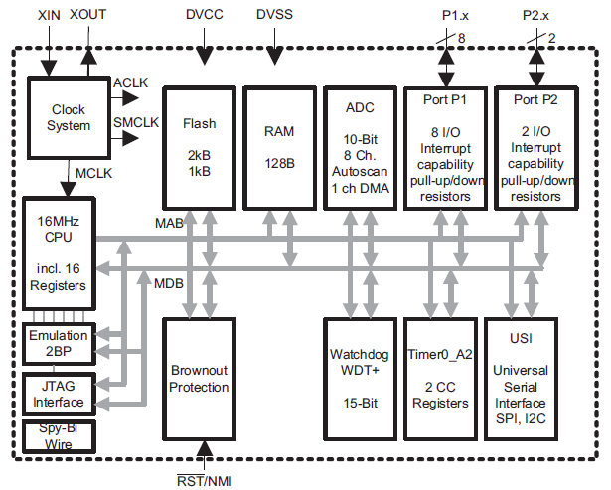
Make Timer an IO Device!

Slide 7
Timers Being IO Devices
Have internal registers with addresses in the memory space for the CPU to access

Slide 8
Typical Registers in a Timer
The counter itself
Target for counting
Control settings
Others: clock source selection, flags
Counter
Comparator
Control
Target Time

Slide 9
Outline
Basic concepts of timers
MSP430 timers
An example of using MSP430 Timer_A
Clocks in MSP430

Slide 10
MSP430 Timers
Usually contain several timers, including:
Timer_A
A 16-bit counter, TAR, with three capture/compare registers.
Watchdog timer
Count up and reset MSP430 when it reaches its limit
The code must keep clearing the counter before the limit is reached to prevent a reset
Protect system against failure of software, such as unintended, infinite loops
Notes:
9

Slide 11
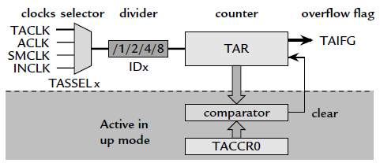
Registers in Timer_A
TAR (0x0170): the counter itself
TACCR0 (0x0172): target for counting
TACTL (0x0160): control settings
Others: clock source selection, flags

Slide 12
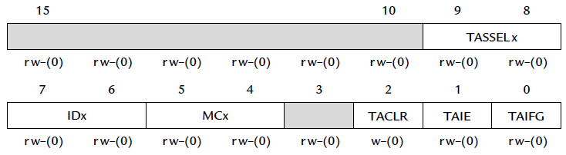
Timer_A Control Register (TACTL)
TASSELx: Timer_A clock source select
Idx: input divider
MCx: mode control
TACLR: Timer_A clear
TAIE: Timer_A interrupt enable
TAIFG: Timer_A interrupt flag

Slide 13
Sample Code 1 for Timer_A
Goal: simplest way to flash an LED at 1Hz
Need an event to trigger the flashing → counter (TAR) overflow
Need a way to detect the event → CPU polling
How to make TAR overflow at 1 Hz?
Use SMCLK clock (discussed later) at 800 KHz
When TAR (16 bits) overflows, it has counted 2¹⁶, equivalent to a period of 2¹⁶/800KHz ≈ 0.08 sec
Divide the frequency of the clock by 8 to give a period of about 0.66 sec → close enough!
Continuously count up; on overflow return to 0

Slide 14
Sample Code 1 for Timer_A
#define LED1 BIT0 void main (void) { WDTCTL = WDTPW|WDTHOLD; // Stop watchdog timer P1OUT = ˜~LED1; P1DIR = LED1; TACTL = MC_2|ID_3|TASSEL_2|TACLR; //Setup Timer_A for (;;) { // Loop forever while (TACTL_bit.TAIFG == 0) { // Wait overflow } // doing nothing TACTL_bit.TAIFG = 0; // Clear overflow flag P1OUT ˆ= LED1; // Toggle LEDs } // Back around infinite loop }
Notes:
13

Slide 15
Sample Code Settings Explained
The following symbols are defined in header file:
MC_2: set MC of TACTL to 10 (continuous mode)
ID_3: set ID of TACTL to 11 (divide freq. by 8)
TASSEL_2: set TASSEL to 10 (use SMCLK)
TACLR: clear the counter, the divider, and the direction of the count

Slide 16
Sample Code 2 for Timer_A
Can have more accurate time if we can control the amount to count
The maximum desired value of the count is programmed into TACCR0
TAR starts from 0 and counts up to the value in TACCR0, after which it returns to 0 and sets TAIFG
Thus the period is TACCR0+1 counts
With SMCLK (800KHz) divided down to 100 KHz, we need 50,000 counts for a delay of 0.5 sec → store 49,999 in TACCR0

Slide 17
Outline
Basic concepts of timers
MSP430 timers
An example of using MSP430 Timer_A
Clocks in MSP430

Slide 18
Theoretically, One Clock Is Enough
A clock source, e.g. crystal, to drive CPU directly and it is divided down by a factor of 2 or 4 for the main bus and rest of circuit board
But, systems have conflicting requirements
Low power, fast start/stop, accurate

Slide 19
Different Requirements for Clocks
Devices often in a low-power mode until some event occurs, then must wake up and handle event rapidly
Clock must get to be stabilized quickly
Devices also need to keep track of real time: (1) can wake up periodically, or (2) time-stamp external events
Therefore, two kinds of clocks often needed:
A fast clock to drive CPU, which can be started and stopped rapidly but need not be particularly accurate
A slow clock that runs continuously to monitor real time, which must use little power and be accurate

Slide 20
Different Requirements for Clocks
Different clock sources also have different characteristics
Crystal: accurate and stable (w.r.t. temperature or time); expensive, delicate, drawing large current, external component, longer time to start up/stabilize
Resistor and capacitor (RC): cheap, quick to start, integrated within MCU and sleep with CPU; poor accuracy and stability
Ceramic resonator and MEMS clocks in between
Need multiple clocks

Slide 21
Clocks in MSP430
MSP430 addresses the conflicting demands for high performance, low power, precise frequency by using 3 internal clocks, which can be derived from up to 4 sources
Master clock (MCLK): for CPU & some peripherals, normally driven by digitally controlled oscillator (DCO)
Subsystem master clock (SMCLK): distributed to peripherals, normally driven by DCO
Auxiliary clock (ACLK): distributed to peripherals, normally for real-time clocking, normally driven by a low-frequency crystal oscillator, typically at 32 KHz

Slide 22
Clock Sources
Very Low Power/Low Frequency Oscillator (VLO): 12kHz
Crystal oscillator (LFXT1): 32768 Hz (external)
Digitally Controlled Oscillator (DCO): slowest 1 MHz (default)
VLO and LFXT1 are mutual exclusive as source of MCLK and ACLK
Typical sources of clocks:
MCLK, SMCLK: DCO
ACLK: LFXT1
Basic Clock Module
VLO
ACLK
LFXT1
MCLK
DCO
SMCLK
Notes:
To support the lowest power consumption and performance on-demand, the enhanced basic clock system (BCS+) on the MSP430F2xx (like all other MSP430 clock systems) typically provides two clocks. A low frequency auxiliary clock (ACLK) is typically sourced directly from a common 32 kHz watch crystal and is used for always-on low power peripherals. A high-speed clock is generated on-chip from an instant-on digitally controlled oscillator (DCO) used by the CPU and other peripherals. To save power, an application’s interrupt events steer the usage of the DCO only when required. The majority of the application’s life is spent in standby mode with high-performance available on-demand and only when required.
Reduced standby power consumption also known as real-time clock (RTC) or LPM3 mode current has been reduced to less than 1 micro amp. This power consumption can be achieved using an external 32kHz crystal or the VLO.
The F20xx introduces a new very-low power oscillator (VLO) as an alternative to the typical 32kHz ACLK. The VLO provide a 12kHz on-chip oscillator with no external components that is perfect for ultra-low power applications that need a wake-up function, but the precision of a 32kHz crystal.
The F2xx crystal oscillator is improved providing programmable integrated crystal load capacitors allows the use of a wider range of crystals and elimination of external components used typically to stabilize oscillation. Failsafe crystal oscillator can trigger a non-maskable interrupt and start the on-chip oscillator for failsafe operation. This feature is always available with no additional power consumption in both high-frequency and low frequency modes. Crystal min-pulse input de-glitch filters reduce the possibility of externally introduced high frequency system noise and improves reliability.
Improved on-chip digitally controlled oscillator (DCO) offers a sub 1 micro second start with +2.5% accuracies and 16MHz operation over temperature and voltage.

Slide 23
Controlling Clocks
In MSP430, the Basic Clock Module is also an IO peripheral
Being an IO peripheral, it can be controlled by registers, DCOCTL and BCSCTL1–3
DCOCTL: configure DCO
Basic clock system control 1: configure ACLK
Basic clock system control 2: configure MCLK, SMCLK
Basic clock system control 3: control LFXT1/VLO

Slide 24
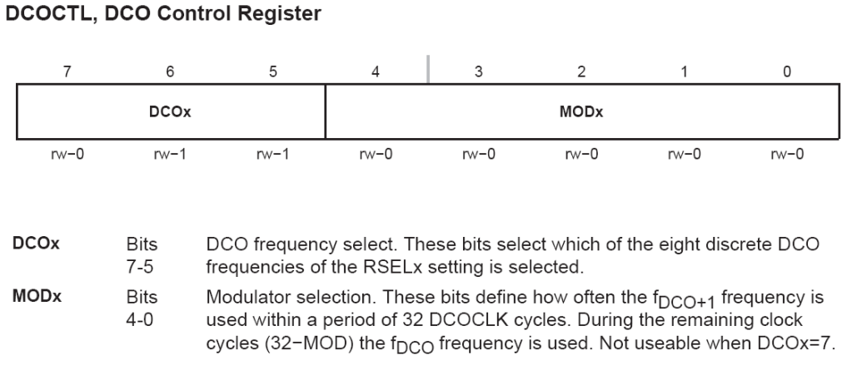
DCOCTL
Tag-Length-Value
DCOCTL = CALDCO_1MHZ; // Set DCO step + modulation
Notes:
The Tag-Length-Value (TLV) structure is used in selected MSP430x2xx devices to provide device-specific information in the device’s flash memory SegmentA, such as calibration data. For the device-dependent implementation, see the device-specific data sheet. (@ chapter 24, userguide, page 587)

Slide 25
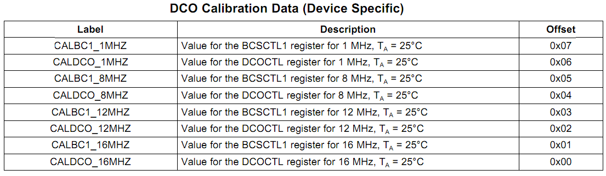
Tag-Length-Value
Tag-Length-Value (TLV) stores the device-specific information.
Notes:
The Tag-Length-Value (TLV) structure is used in selected MSP430x2xx devices to provide device-specific information in the device’s flash memory SegmentA, such as calibration data. For the device-dependent Implementation, see the device-specific data sheet. (@ chapter 24, userguide, page 587)
For DCO calibration, the BCS+ registers (BCSCTL1 and DCOCTL) are used. The values stored in the flash information memory SegmentA are written to the BCS+ registers

Slide 26
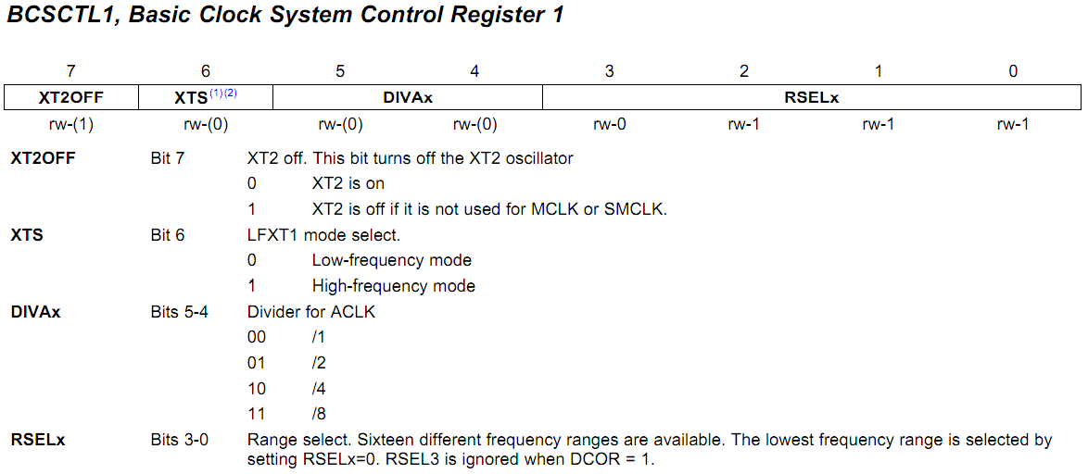
BCSCTL1
BCSCTL1 = CALBC1_1MHZ; // Set range
Notes:
(1) XTS = 1 is not supported in MSP430x20xx devices.
(2) This bit is reserved in the MSP430AFE2xx devices

Slide 27
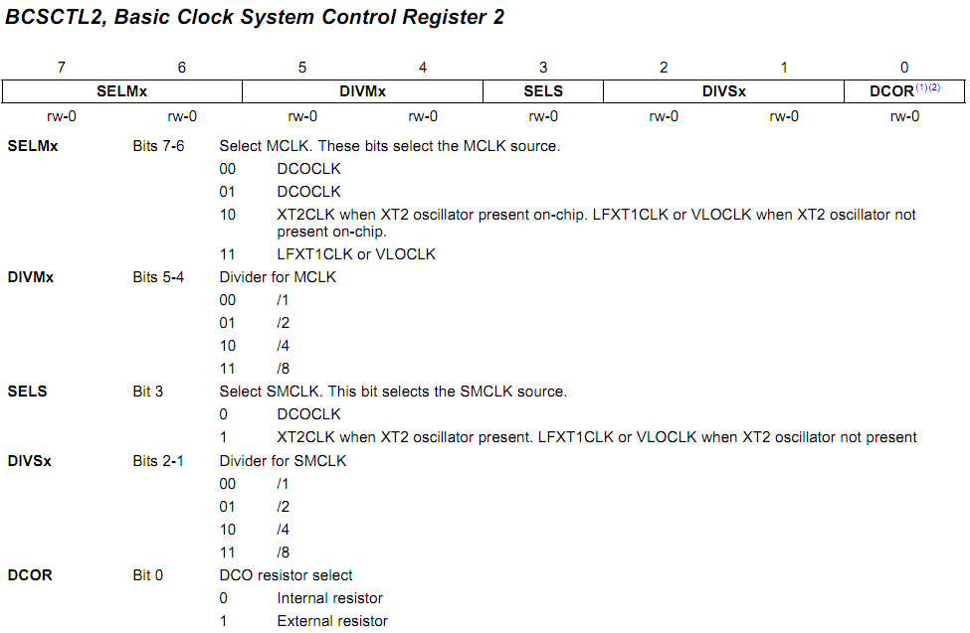
BCSCTL2
MCLK
SMCLK
BCSCTL2 |= SELM_3 + DIVM_3; // MCLK = VLO/8
Notes:
(1) Does not apply to MSP430x20xx or MSP430x21xx devices.
(2) This bit is reserved in the MSP430AFE2xx devices

Slide 28
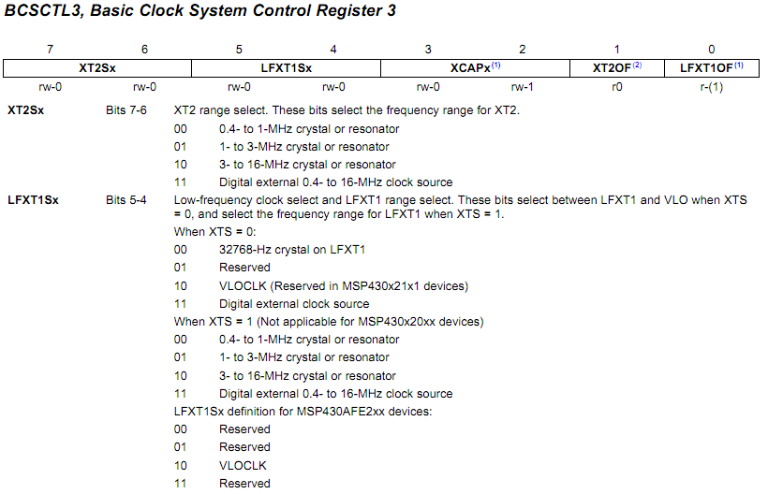
BCSCTL3
In MSP430G2231
BCSCTL3 |= LFXT1S_2; // Enable VLO as MCLK/ACLK src
Notes:
MSP430x22xx, MSP430x23x0: XT2 is not present
(1) This bit is reserved in the MSP430AFE2xx devices.
(2) Does not apply to MSP430x2xx, MSP430x21xx, or MSP430x22xx devices.

Slide 29
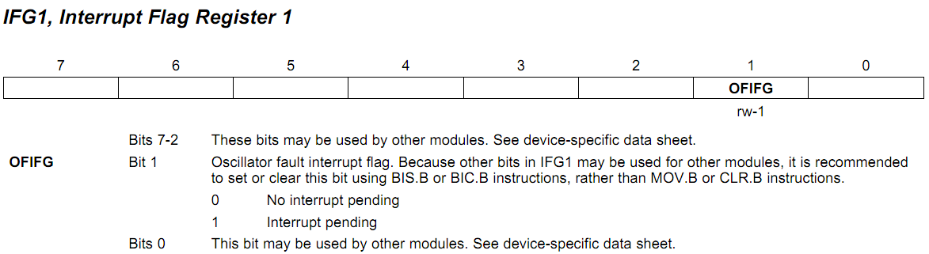
Interrupt Flag Register 1 (IFG1)
OFIFG oscillator-fault flag is set when an oscillator fault (LFXT1OF) is detected.
IFG1 &= ~OFIFG; // Clear OSCFault flag
Notes:
* The clock system will force the MCLK to use the DCO as its source in the presence of a clock fault (see the User’s Guide section 5.2.7).
5.2.7 @userguide. Page 280
The OFIFG oscillator-fault flag is set and latched at POR or when an oscillator fault (LFXT1OF, or XT2OF) is detected. When OFIFG is set, MCLK is sourced from the DCO, and if OFIE is set, the OFIFG requests an NMI interrupt. When the interrupt is granted, the OFIE is reset automatically. The OFIFG flag must be cleared by software. The source of the fault can be identified by checking the individual fault bits.

