Slide 1
CS4101 嵌入式系統概論 Task Synchronization
Prof. Chung-Ta King
Department of Computer Science
National Tsing Hua University, Taiwan
(Materials from Freescale and MQX User Guide)

Slide 2
Outline
Introduction to task synchronization
Events
Mutexs
Semaphores

Slide 3
Why Synchronization?
Synchronization may be used to solve:
Mutual exclusion
Control flow
Data flow
Synchronization mechanisms include:
Semaphores
Events
Mutexs
Message queues
Correct synchronization mechanism depends on the synchronization issue being addressed
EF
M

Slide 4
Mutual Exclusion
Problem: multiple tasks may “simultaneously” need to access the same resource
Resource may be code, data, peripheral, etc.
Need to allow the shared resource exclusively accessible to only one task at a time
How to do?
Allowing only one task to lock the resource and the rest have to wait for the resource to be unlocked
Common mechanisms: lock/unlock, mutex, semaphore

Slide 5
Control Flow Synchronization
Problem: a task or ISR may need to resume the execution of one or more other tasks, so that tasks execute in an application-controlled order
Mutual exclusion is used to prevent another task from running
Control flow is used to allow another, often specific, task to run;
How to do?
Common mechanisms: post/wait, signal, event

Slide 6
Data Flow Synchronization
Problem: a task or ISR may need to pass some data to one or more specific tasks, so that data may be processed in an application-specified order
How to do?
May be accomplished indirectly through control flow synchronization
Common mechanisms: messages

Slide 7
Outline
Introduction to task synchronization
Events
Mutex
Semaphores

Slide 8
Events
Can be used to synchronize a task with another task or ISR → control flow synchronization
The event component consists of event groups, which are groupings of event bits.
32 event bits per group (mqx_unit)
Event groups can be identified by name (named event group) or an index (fast event group)
Tasks can wait for a combination of event bits to become set. A task can set or clear a combination of event bits.

Slide 9
Event Bits
A task waits for a pattern of event bits (a mask) in an event group with _event_wait_all() or _event_wait_any()
Wait for all bits in mask to be set or any of the bits
A task can set a mask with _event_set()

Slide 10
Operations on Events
When a task waits for an event group
If the event bits are not set, the task blocks.
When event bits are set, MQX puts all waiting tasks, whose waiting condition is met, into the task’s ready queue.
If the event group has autoclearing event bits, MQX clears the event bits as soon as they are set.
Can use events across processors (not possible with lightweight events)

Slide 11
Example of Events

Slide 12
Example of Events (1/3)
#include <mqx.h> #include <bsp.h> #include <event.h> #define SERVICE_TASK 5 #define ISR_TASK 6 extern void simulated_ISR_task(uint_32); extern void service_task(uint_32); const TASK_TEMPLATE_STRUCT MQX_template_list[] = { /* Task Index, Function, Stack, Priority, Name, Attributes, Param, Time Slice */ {SERVICE_TASK, service_task, 2000, 8, "service", MQX_AUTO_START_TASK, 0, 0 }, {ISR_TASK, simulated_ISR_task, 2000, 8, "simulated_ISR", 0, 0, 0 }, { 0 } };
Notes:
11
11

Slide 13
Example of Events (2/3)
void simulated_ISR_task (uint_32 initial_data) { pointer event_ptr; /* open event connection */ if (_event_open("event.global",&event_ptr)!=MQX_OK){ printf("\nOpen Event failed"); _task_block(); } while (TRUE) { _time_delay_ticks(1000); if (_event_set(event_ptr,0x01) != MQX_OK) { printf("\nSet Event failed"); _task_block(); } } }
Notes:
12
12

Slide 14
Example of Events (3/3)
void service_task(uint_32 initial_data){ pointer event_ptr; _task_id second_task_id; /* Set up an event group */ if (_event_create("event.global") != MQX_OK) { printf("\nMake event failed"); _task_block(); } if(_event_open("event.global",&event_ptr)!=MQX_OK){ printf("\nOpen event failed"); _task_block(); } second_task_id = _task_create(0, ISR_TASK, 0); while (TRUE) { if(_event_wait_all(event_ptr,0x01,0)!=MQX_OK) { printf("\nEvent Wait failed"); _task_block(); } if (_event_clear(event_ptr,0x01) != MQX_OK) { printf("\nEvent Clear failed"); _task_block(); } printf(" Tick \n"); } }
Notes:
13
13

Slide 15
Common Calls for Events
_event_create | Creates a named event group.
_event_create_auto_clear | Creates a named event group with autoclearing event bits
_event_open | Opens a connection to a named event group.
_event_wait_all | Waits for all specified event bits in an event group for a specified number of milliseconds.
_event_wait_any | Waits for any of specified event bits in an event group for a specified number of ms.
_event_set | Sets the specified event bits in an event group on the local or a remote processor.
_event_clear | Clears specified event bits in an event group.
_event_close | Closes a connection to an event group.
_event_destroy | Destroys a named event group.

Slide 16
Outline
Introduction to task synchronization
Events
Mutex
Semaphores

Slide 17
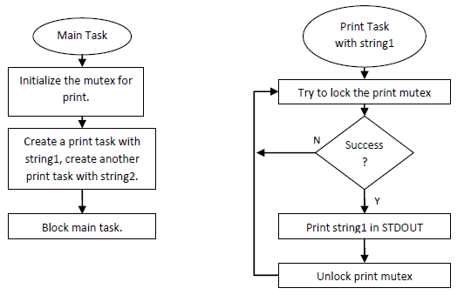
Example of Mutex
One main task and 2 printing tasks, which access STDOUT exclusively with mutex

Slide 18
Example of Mutex
#include <mqx.h> #include <bsp.h> #include <mutex.h> #define MAIN_TASK 5 #define PRINT_TASK 6 extern void main_task(uint_32 initial_data); extern void print_task(uint_32 initial_data); const TASK_TEMPLATE_STRUCT MQX_template_list[] = { /* Task Index, Function, Stack, Priority, Name, Attributes, Param, Time Slice */ { MAIN_TASK, main_task, 1000, 8, "main", MQX_AUTO_START_TASK, 0, 0 }, { PRINT_TASK, print_task, 1000, 9, "print", MQX_TIME_SLICE_TASK, 0, 3 }, { 0 } };
Notes:
17
17

Slide 19
Example of Mutex
MUTEX_STRUCT print_mutex; void main_task(uint_32 initial_data){ MUTEX_ATTR_STRUCT mutexattr; char* string1 = "Hello from Print task 1\n"; char* string2 = "Print task 2 is alive\n"; if (_mutatr_init(&mutexattr) != MQX_OK) { printf("Initialize mutex attributes failed.\n"); _task_block(); } if(_mutex_init(&print_mutex,&mutexattr)!= MQX_OK){ printf("Initialize print mutex failed.\n"); _task_block(); } _task_create(0, PRINT_TASK, (uint_32)string1); _task_create(0, PRINT_TASK, (uint_32)string2); _task_block(); }
Notes:
18
18

Slide 20
Example of Mutex
void print_task(uint_32 initial_data) { while(TRUE) { if (_mutex_lock(&print_mutex) != MQX_OK) { printf("Mutex lock failed.\n"); _task_block(); } _io_puts((char *)initial_data); _mutex_unlock(&print_mutex); } }
Notes:
19
19

Slide 21
Creating and Initializing a Mutex
Define a mutex variable of type MUTEX_STRUCT
Call _mutex_init() with a pointer to mutex variable and a NULL pointer to initialize mutex with default attributes
To initialize mutex with attributes other than default:
Define a mutex attributes structure of type MUTEX_ATTR_STRUCT.
Initialize the attributes structure with _mutatr_init().
Calls functions to set appropriate attributes of the mutex, e.g., _mutatr_set_sched_protocol(), _mutatr_set_wait_protocol()
Initializes mutex by calling _mutex_init() with pointers to the mutex and to the attributes structure.
Destroys the mutex attributes structure with _mutatr_destroy().

Slide 22
Common Calls for Mutex
_mutex_destroy | Destroys a mutex.
_mutex_get_wait_count | Gets the number of tasks that are waiting for a mutex.
_mutex_init | Initializes a mutex.
_mutex_lock | Locks a mutex.
_mutex_try_lock | Tries to lock a mutex.
_mutex_unlock | Unlocks a mutex.

Slide 23
Mutex Attributes
Waiting protocols
Queuing: (default) Blocks until another task unlocks the mutex. Then, the first task (regardless of priority) that requested the lock, locks the mutex.
Priority queuing: Blocks until another task unlocks the mutex. Then, highest-priority task that requested the lock, locks mutex.
Spin only: Spins (is timesliced) indefinitely until another task unlocks the mutex.
MQX saves the requesting task’s context, and dispatches the next task in the same-priority ready queue. When all the tasks in this ready queue have run, the requesting task becomes active again. If mutex is still locked, spin repeats.
Limited spin: Spins for a specified number of times, or fewer if another task unlocks the mutex first.

Slide 24
Mutex Attributes
Scheduling protocol
Priority inheritance: If priority of the task that has locked the mutex (task_A) is not as high as the highest-priority task that is waiting to lock the mutex (task_B), MQX raises priority of task_A to be same as the priority of task_B, while task_A has the mutex.
Priority protection: A mutex can have a priority. If the priority of a task that requests to lock the mutex (task_A) is not at least as high as the mutex priority, MQX raises the priority of task_A to the mutex priority for as long as task_A has the mutex locked.

Slide 25
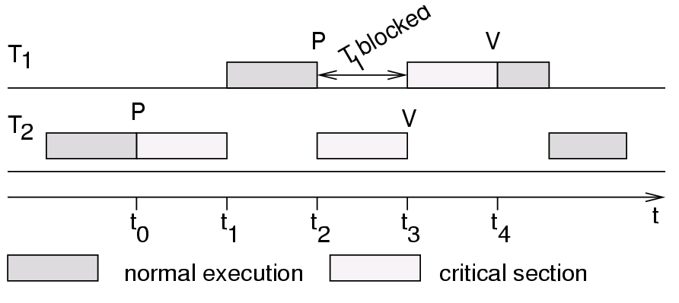
Priority Inversion
Assume priority of T₁ > priority of T₂
If T₂ requests exclusive access first (at t₀), T₁ has to wait until T₂ releases resource (time t₃), thus inverting priority

Slide 26
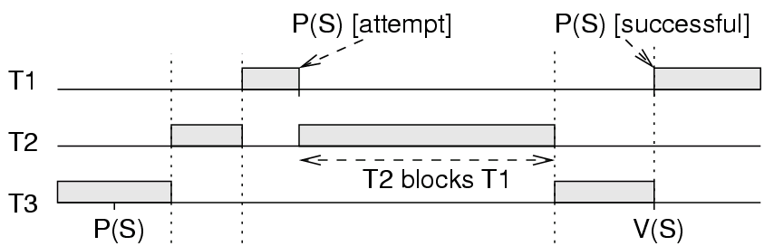
Priority Inversion
Duration of priority inversion with >2 tasks can exceed the length of any critical section
Priority of T₁ > T₂ > T₃ and T₂ preempts T₃
T₂ can prevent T₃ from releasing the resource
normal execution
critical section

Slide 27
Solution: Priority Inheritance
Tasks inherit highest priority of tasks blocked by it
T₃ inherits priority of T₁ and T₃ resumes.
V(S)

Slide 28
Outline
Introduction to task synchronization
Events
Mutex
Semaphores

Slide 29

Semaphores
Semaphores are used to:
Control access to a shared resource (mutual exclusion)
Signal the occurrence of an event
Allow two tasks to synchronize their activities
Basic idea
A semaphore is a token that your code acquires in order to continue execution
If the semaphore is already in use, the requesting task is suspended until the semaphore is released by its current owner → signal/post and wait

Slide 30
How Semaphores Work?
A semaphore has:
Counter: maximum number of concurrent accesses
Queue: for tasks that wait for access
If a task waits for a semaphore
if counter > 0
counter is decremented by 1
task gets the semaphore and proceed to do work
else
task is put in the queue
If a task releases (post) a semaphore
if there are tasks in the semaphore queue
appropriate task is readied, according to queuing policy
else
counter is incremented by 1
Notes:
29
This should be a quick review from the basic RTOS section earlier
Mutex is special case where the count =1 so only one task can hold it at a time

Slide 31
Example of Semaphores
The example manages a FIFO that multiple tasks can write to and read from.
Mutual exclusion is required for access to the FIFO
Task synchronization is required to block the writing tasks when the FIFO is full, and to block the reading tasks when the FIFO is empty.
Three semaphores are used:
Index semaphore for mutual exclusion on the FIFO.
Read semaphore to synchronize the readers.
Write semaphore to synchronize the writers.
Three tasks: Main, Read, Write

Slide 32
Example of Semaphores
#define MAIN_TASK 5 #define WRITE_TASK 6 #define READ_TASK 7 #define ARRAY_SIZE 5 #define NUM_WRITERS 2 // 2 writers, 1 reader typedef struct _task_id DATA[ARRAY_SIZE]; uint_32 READ_INDEX; uint_32 WRITE_INDEX; } SW_FIFO, _PTR_ SW_FIFO_PTR; /* Function prototypes */ extern void main_task(uint_32 initial_data); extern void write_task(uint_32 initial_data); extern void read_task(uint_32 initial_data);
Notes:
31
31

Slide 33
Example of Semaphores
const TASK_TEMPLATE_STRUCT MQX_template_list[] = { /* Task Index, Function, Stack, Priority, Name, Attributes, Param, Time Slice */ { MAIN_TASK, main_task, 2000, 8, "main", MQX_AUTO_START_TASK, 0, 0 }, { WRITE_TASK, write_task, 2000, 8, "write", 0, 0, 0 }, { READ_TASK, read_task, 2000, 8, "read", 0, 0, 0 }, { 0 } };
Notes:
32
32

Slide 34
Example of Semaphores: Main
SW_FIFO fifo; void main_task(uint_32 initial_data) { _task_id task_id; _mqx_uint i; fifo.READ_INDEX = 0; fifo.WRITE_INDEX = 0; /* Create the semaphores */ if (_sem_create_component(3,1,6) != MQX_OK) { printf("\nCreate semaphore component failed"); _task_block(); } if (_sem_create("sem.write",ARRAY_SIZE,0)!=MQX_OK){ printf("\nCreating write semaphore failed"); _task_block(); }
Notes:
33
33

Slide 35
Example of Semaphores: Main
if (_sem_create("sem.read", 0, 0) != MQX_OK) { printf("\nCreating read semaphore failed"); _task_block(); } if (_sem_create("sem.index", 1, 0) != MQX_OK) { printf("\nCreating index semaphore failed"); _task_block(); } for (i = 0; i < NUM_WRITERS; i++) { task_id = _task_create(0, WRITE_TASK, (uint_32)i); printf("\nwrite_task created, id 0x%lx", task_id); } task_id = _task_create(0,READ_TASK, 0); printf("\nread_task created, id 0x%lX", task_id); _task_block(); }
Notes:
34
34

Slide 36
Attributes of Semaphores
When a task creates a semaphore, it specifies:
Initial count: # of locks the semaphore has
Flag: specifying followings
Priority queuing: if specified, the queue of tasks waiting for the semaphore is in priority order, and MQX puts the semaphore to the highest-priority waiting task. Otherwise, use FIFO queue.
Priority inheritance: if specified and a higher-priority task is waiting, MQX raises priority of the tasks that have the semaphore to that of the waiting task.
Strictness: if specified, a task must wait for the semaphore, before it can post the semaphore.

Slide 37
Example of Semaphores: Read
void read_task(uint_32 initial_data) { pointer write_sem, read_sem, index_sem; if (_sem_open("sem.write", &write_sem) != MQX_OK) { printf("\nOpening write semaphore failed."); _task_block(); } if (_sem_open("sem.index", &index_sem) != MQX_OK) { printf("\nOpening index semaphore failed."); _task_block(); } if (_sem_open("sem.read", &read_sem) != MQX_OK) { printf("\nOpening read semaphore failed."); _task_block(); }
Notes:
36
36

Slide 38
Example of Semaphores: Read
while (TRUE) { /* wait for the semaphores */ if (_sem_wait(read_sem, 0) != MQX_OK) { printf("\nWaiting for read semaphore failed."); _task_block(); } if (_sem_wait(index_sem,0) != MQX_OK) { printf("\nWaiting for index semaphore failed."); _task_block(); } printf("\n 0x%lx", fifo.DATA[fifo.READ_INDEX++]); if (fifo.READ_INDEX >= ARRAY_SIZE) { fifo.READ_INDEX = 0; } _sem_post(index_sem); _sem_post(write_sem); } }
Notes:
37
37

Slide 39
Example of Semaphores: Write
void write_task(uint_32 initial_data) { pointer write_sem, read_sem, index_sem; if (_sem_open("sem.write", &write_sem) != MQX_OK) { printf("\nOpening write semaphore failed."); _task_block(); } if (_sem_open("sem.index", &index_sem) != MQX_OK) { printf("\nOpening index semaphore failed."); _task_block(); } if (_sem_open("sem.read", &read_sem) != MQX_OK) { printf("\nOpening read semaphore failed."); _task_block(); }
Notes:
38
38

Slide 40
Example of Semaphores: Write
while (TRUE) { if (_sem_wait(write_sem, 0) != MQX_OK) { printf("\nWwaiting for Write semaphore failed"); _task_block(); } if (_sem_wait(index_sem, 0) != MQX_OK) { printf("\nWaiting for index semaphore failed"); _task_block(); } fifo.DATA[fifo.WRITE_INDEX++] = _task_get_id(); if (fifo.WRITE_INDEX >= ARRAY_SIZE) { fifo.WRITE_INDEX = 0; } _sem_post(index_sem); _sem_post(read_sem); } }
Notes:
39
39

Slide 41
Common Calls to Semaphores
_sem_close | Closes a connection to a semaphore.
_sem_create | Creates a semaphore.
_sem_create_component | Creates the semaphore component.
_sem_destroy | Destroys a named semaphore.
_sem_open | Opens a connection to a named semaphore
_sem_post | Posts (frees) a semaphore.
_sem_wait | Waits for a semaphore for a number of ms
_sem_wait_for | Waits for a semaphore for a tick-time period.
_sem_wait_ticks | Waits for a semaphore for a number of ticks.
_sem_wait_until | Waits for a semaphore until a time (in tick).

