Slide 1
Alternative Green Systems: Turbine Management Prototype
Blue Cohort - Team 29
Rachael Sicking, Ontick Khan, Jonathon Timbrook, Guanzhou Simon Wang

Slide 2
Agenda
Issue Overview
Product Viability
Final Prototype
Lessons Learned

Slide 3
Issue Overview
The Problem
Desired Outcomes
Having a reactive approach to outages is expensive. Engineers need to be dispatched, replacement parts need to be transported, and logistics must be handled. All of these issues can extend the customer’s downtime.
The SMs need a self-service solution to proactively monitor the health of the turbines and be able to predict when an outage will occur so they can minimize the time it takes to perform maintenance.
Overview
Product Viability
Final Prototype
Lessons Learned

Slide 4
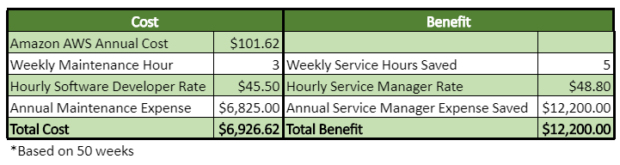
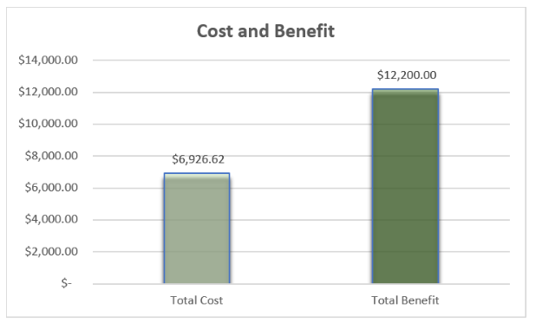
Product Viability
Overview
Product Viability
Final Prototype
Lessons Learned
Notes:
How viable is the product? Through cost analysis
Costs: people to develop/maintain it
Benefits:
-reduce outtage time
-reduce costs associated with on-site checkins
-

Slide 5



Our Approach
One Page KPI Dashboard
Responsive, API Driven
Cloud-Based Infrastructure
Highcharts Javascript Library
Displays visualizations for each KPI for both turbines
Uses time-series data to be able to identify trends over time
Additional pages:
Page with client data form where SMs can submit comments on each client
Page with all site data and turbine data
Overview
Product Viability
Final Prototype
Lessons Learned
Notes:
Describe your approach to solving the problem-
We developed a responsive, cloud-based, API driven dashboard to monitor each turbine's key performance indicators all on one page using Highcharts Javascript library for the visuals. We wanted to display each turbine's KPI's separately so that owners of the SLA's could clearly see how their turbine is operating.

Slide 6
DEMO
Overview
Product Viability
Final Prototype
Lessons Learned

Slide 7
Technology Stack Business Justification
Technology | Benefits
MySQL | 1) Relational databases provide availability and consistency. 2) It is very simple and easy to maintain - doesn’t require a $150,000 per year certified DBA, or team, to maintain.
PHP | 1) Reduced development costs - open source. 2) Rapid building and maintaining of Agile web apps - facilitates scalability and application maintenance, allowing your app to easily evolve over time. 3) Cross-platform compatibility - compatible with major operating systems and supports all leading servers
Vue Js | 1) Simple syntax - easier for newer developers to pick up and reduced bugs 2) Very flexible - can be used in a lot of different environments, and even inside other JavaScript and PHP frameworks. Aids in decreasing time to market.
Highcharts | 1) Lots of options - works for most use-cases out of the box, with extensive customization options when needed. 2) Mobile ready - adapts to any device and supports multi-touch gestures. 3) High speed - fastest development, implementation and rendering option.
Overview
Product Viability
Final Prototype
Lessons Learned
Notes:
MySQL – Relational database provides availability and consistency. It is very simple and easy to maintain. It doesn't need a $150,000 per year certified DBA, or team, to maintain.
PHP - 1. Reduced development costs. PHP is open source (distributed under GPL license). It allows building prototypes and ready websites pretty fast.
2. Rapid building of Agile web apps. Utilizing PHP frameworks allows building web apps faster. They also facilitate scalability and application maintenance, allowing your app to evolve over time. 3. Cross-platform compatibility. PHP is compatible with major operating systems, such as Windows, Linux, Solaris, Mac OSX, etc. and supports all leading servers (Apache, IIS, iPlanet, etc.)
Vue JS – Simplicity and ease of use - Developers with a basic understanding of HTML and JS, designers and juniors in a team can get started with Vue, and understand it. Simple code leads to better maintainability of code which reduces bugs and eventually less developer hours in fixing bugs.
Vue.js is very flexible - Vue has been built in a way that it can be used in a lot of different environments, and even inside other JavaScript, PHP and other frameworks. You can add it to an existing project in a lot of technologies, and create components with it, or you can start a website or even a native app with the tools Vue provides the developers with. Ultimately it aides businesses Decrease your time to market.
Highcharts - Options Optional - Works for most use-cases out of the box, with extensive customization options when needed. Responsive & mobile ready - Intelligently adapts to any device and supports multi-touch gestures. Speed! - Fastest development, implementation and rendering on the market.

Slide 8


Team Organization and Process
Team Organization
Team Process
Open discussions about strategy, more knowledgeable coders trusted to provide insight and lead efforts
Constant communication throughout project to stay on same page, especially when making commits to master
Different team members focused on different sections: Rachael – CSS/HTML, Simon and Ontick – Charts, Jon – SQL, PHP, Vue JS controllers
As we learned how to implement certain functionality in class, applied that knowledge to built out that functionality in application
Incremental changes to the code each week
Used Atom for version control
Each developer used separate branch to build and test, then after whole team approved of edits would commit to master
Overview
Product Viability
Final Prototype
Lessons Learned
Notes:
How did we self-organize? (team dynamics, structure, communication, & effectiveness; who built which parts of the app?)
What was our process for designing and building the system?
We self-organized by making incremental changes to the code semi-weekly by incorporating topics discussed in class with our project
Rachael did the CSS and HTML styling, Simon and Ontick built out the charts, Jon handled building out the SQL, PHP and Vue JS controller

Slide 9
What We Learned
Jon
Rachael
Guanzhou
Ontick
The intricacies and frustrations of error checking. Also how to use PHP and Vue JS to connect a database to a web page
I learned how to connect what a user sees and the information they enter to the backend where it can be stored. How to add functionality to a well-designed interface.
Putting everything together and how to connect the SQL, PHP and Vue JS. How to use charts effectively to present data.
I learned some of the best practices for coding, how to organize and structure it so that it becomes cleaner and more efficient. How to connect the front end to the backend.
Overview
Product Viability
Final Prototype
Lessons Learned

Slide 10
Questions?
Reinforce existing BC/DR plans and identify backup shipping company
Diversify suppliers and identify backup distribution methods

Slide 11
Appendix

Slide 12
Appendix – User Stories
The Service Manager is able to view client company information and create and read notes about how to provide service to a client. It is complete when the page is able to display client information, accept user comments, display those comments, and update a table in the database with the comments.
The Client should be about to see each site that has turbines monitored under the SLA. It is complete when the page displays the site information and turbines at that site.
The Service Manager should be able to see specific KPI information for a given turbine at a particular site. It is complete when the page loads the KPI information, segmented by turbine and site

Slide 13

Appendix – Key Risks
Risk | Likelihood(X), Severity(Y) | Solution
Costs of building and maintaining dashboard outweigh realized benefits |  | Cut down cost to maintain dashboard or add functionality that increases benefits
KPIs don’t effectively predict when outages are going to occur |  | Alter KPIs or add new KPIs that are better predictors of outages
Dashboard doesn't reduce amount of on-site checkups required for turbines |  | Integrate tool for notes to be taken to add value for managers doing on-site checkups

Slide 14
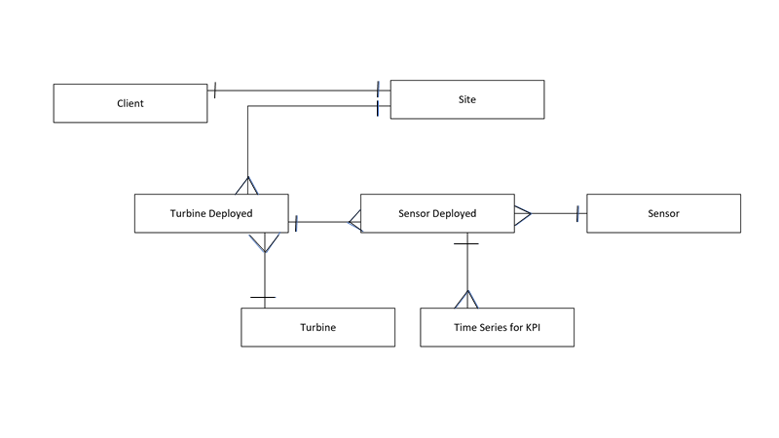
Appendix – Data Model

