Slide 1

Real-Time Heart Simulation
Author: Yuecheng Rong & Yinsheng Dong
Supervisor: Raymond.J.Spiteri
(yur013@mail.usask.ca, 11177862)
(yid164@mail.usask.ca, 11148648)
Department of Computer Science

Slide 2
Outline
Review the Real-Time Heart Simulations
Project Structures and Tools
What we are doing and Our Attempts
Conclusion
Challenges & Future
‹#›

Slide 3
Review
Again, what we are going to do about the heart simulation:
create a simulation of a piece of heart tissue on the computer and make the tissue active as ‘real-time’ as possible
manipulation: the tissue consists of vast copies of cell models represented by mathematical models solved by numerical methods

Slide 4
Work Divide
Code Automation (Done)
Mathematical Studies (IP)
Database Established (IP)
GPU programming (CS)
Rendering the data (CS)

Slide 5
Structure, Techniques & Tools
Project Structure
Backend
Python (Code Automation)
myokit tool to extract OEDs and variables from .cellml files or URLs
TensorFlow.js (GPU Programming)
Parallel Calculation of ODEs (Cell Model) and implementing PDEs (Monodomain Model)
front-end
HTML <canvas> to render graph
Database
MySQL

Slide 6
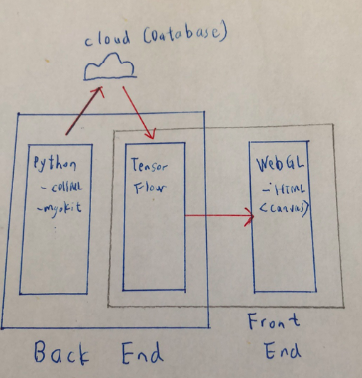
Structure, Techniques & Tools

Slide 7
Our Attempts
To guarantee the data accuracy, we are supposed to get cell model from cellml.org
Official SDK has some limitations (in old version, API documents are not well written, OS issues)
myokit (Python) is a better idea
Notes:
To guarantee the data accuracy, we need to get cell models from their official website, they used .cellml files to store the cell models, and these files are not programmable. One of our goals is automate these files, So we initially used their official SDK to extract the datas, however, the SDK they provided has a lots of issue. They only runs in native JVM which has very slow performance, their API documents are not well written, also, by our testing, the SDK only runs in Linux machines. For dealing these issues, we found another tool which called myokit which is a python toolbox which can modelize the .cellml files to programmable languages such as python, opencl, matlab etc. We spent 40 hours on these case, but fortunately, we have addressed this problem

Slide 8
Our Attempts
GPU programming on browser
Pure WebGL (in low level programming)
GPU.js (not complete library)
OpenCL (executed on backend)
TensorFlow.js (current learn)
Notes:
Another attempt is GPU programming on browser. In this work, we’ve tried different ways to achieve the goal. We used pure WebGL initially, which we showed in the idea presentation. However, since the GLSL is encapsulated by OpenCL, we have to do the low level programming, it’s hard and it might need much of time to learn. So we tried multiple ways to avoid this. We tried GPU.js, but it is not a complete library, and it doesn’t support using multi-GPUs, then we tried to use OpenCL, it has all functions we need but since it is not WebGL-based, so we make it as our backup plan, then we are trying to use TensorFlow.js, it made by Google, and it uses WebGL accelerate , hopefully, it can fit our requirements.

Slide 9
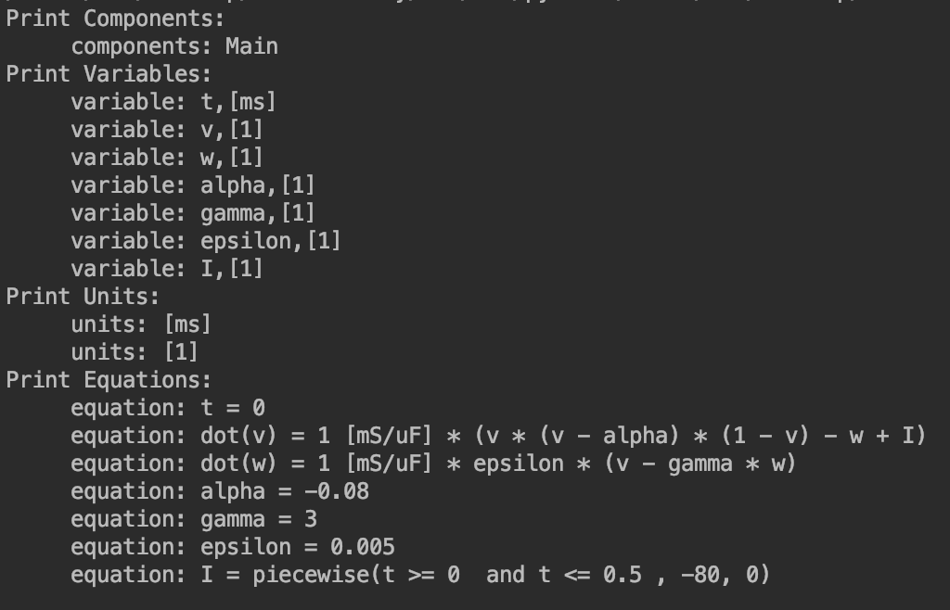
Initial Results
Data Result:
Notes:
This is one of our initial data results which is invoked by python myokit. The cell model name is Fitzhugh-Nagumo we got the components, variables, units, equations. Right now, we have the correct datas, so we are able to build the database.

Slide 10
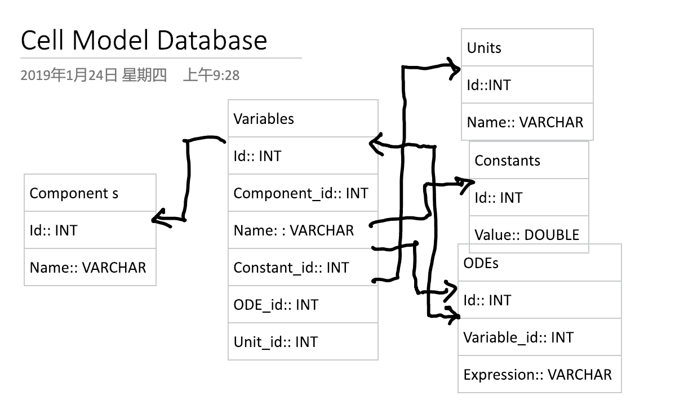
Database Idea
Notes:
The variables use components as their foreign key, all of the variables have their own units, and if the variable is a constant, we store their RHS expression to be a value, otherwise, their RHS expressions must contain the other variables, so we double linked these two tables. We are doing this in MySQL locally, after we finished, we will put them to Google App Engine or other cloud services.

Slide 11
Conclusions
Goal:
-- macro: to simulate a heart tissue as close to real-time as possible
-- micro: to calculate many copies of cell models on GPU as fast as possible
What we are going to do next?
-- Mathematics
-- Programming
-- backup plan

