Slide 1
SparkSpatial: Distributed Spatial Data Processing System
JDBC
Console
User Programs
(Java, Scala, Python)
Distributed Spatial Data Processing System based on Spark
Supporting compound queries on multi-dimensions (spatial, textual, temporal)
Supporting fast spatial joins on large spatial data
Adopting a user-friendly SQL-like query language as main interface
DataFrame API
Providing several kinds of multi-dimensional index and partitioning strategies
More complex optimizers based on cost evaluation.
SparkSpatial SQL Context
DataFrame API
Catalyst Optimizer
Optimized Logical Plan
Physical Execution Engine
Spatial Operations
Multi-dimensional Index
Partitioning
Selected Physical Plan
Spark
Resilient Distributed Datasets (RDD)

Slide 2
Programming Interface
SQL-Like Query Language
SELECT r.foodtype, count(*) AS c
FROM queries AS q DISTANCE JOIN rests AS r
ON POINT(r.x, r.y) IN CIRCLERANGE(POINT(q.x, q.y), 10.0)
GROUP BY r.foodtype
ORDER BY c
DataFrame API
rest.knn(Point(rest(“x”), rest(“y”)), Point(3.0, 5.0), 10)
rest.distancejoin(query, Point(query(“x”), query(“y”)),
Point(rest(“x”), rest(“y”)), 10.0)
.groupBy(rest(“foodtype”))
.select(rest(“foodtype”), count())
Index Management:
CREATE INDEX pointIndex ON point1(x, y) USE rtree

Slide 3
Comparison
Spark SQL:
SELECT id, x, y
FROM points
ORDER BY (x - 3) * (x - 3) + (y - 4) * (y - 4)
LIMIT 10
SparkSpatial:
SELECT id, x, y
FROM points
WHERE POINT(x, y) in KNN(POINT(3, 4), 10)
Expressing Ability: KNN Join
SELECT *
FROM point1 KNN JOIN point2
ON POINT(point2.x, point2.y) IN KNN(POINT(point1.x, point1.y), 10)

Slide 4
Indexing Strategy
Motivation:
Prune useless scanning, save time & resources.
Challenge:
RDD → Distributed Set → Poor in Random Access
Solution:
Storage Format Changing & Local + Global Indexing
Three phases:
Data Partitioning
Local Indexing
Global Indexing

Slide 5
Indexing Strategy (Cont.d)
Data Partitioning
Three Main Concerns:
Partition Size Fitness: Memory Overflow
Data Locality: Query Acceleration.
Load Balancing
Abstract Class: ‘Partitioner’
number of partitions + mapping from key to partition
Solution:
One Dimensional: Equal Depth Range Partitioner
Multi-Dimensional: STRPartitioner

Slide 6
Indexing Strategy (Cont.d)
Local Indexing
Partition Packing:
Pack all elements of a partition into an array.
→ explicit index & faster random access within partition.
Local Index Building:
Build requested index structure for each packed partition
Co-locate packed partition with its local index.
As a result:
Storage format for tables changed
RDD[Row] => RDD[PackedPartitionWithIndex]
A Partition => an element with original data & local index

Slide 7
Indexing Strategy (Cont.d)
Global Indexing
Index for pruning partitions in query processing.
Required Info:
Partition Boundaries (Data Partitioning)
Partition Statistics (Local Indexing)
Index Structure choosing:
One-dimensional data: sorted range bounds.
Multi-dimensional data: R-Tree over partition MBRs.

Slide 8
Spatial Operations
Developer API: PartitionPruningRDD
Skip tasks on specified partition.
Range Query & Circle Range Query
Step 1: Query for all partitions that intersect query area.
Step 2: Invoke range query on remaining partitions.

Slide 9
Spatial Operations (Cont.d)
KNN Query
Safe pruning bound: Top k maximum distance.
Maximum distance as Distance Function.
Step 1: KNN Query on all partition boundaries.
Step 2: KNN Query on remaining partition.
Take k-th distance as pruning bound.
Only step 1 is safe, but loose.
Step 2: Much stronger pruning power:
27 partitions remaining → 4 partitions remaining.

Slide 10
Spatial Operations (Cont.d)
Distance Join:
R join S on distance between point in R and S less than r.
Theta-Join => Cartesian Product + Filter (SLOW!!)
Native Implementation:
Nested-Loop Distance Join (with/without R-Tree)
SJMR Distance Join
R-Tree Distance Join

Slide 11
Spatial Operations (Cont.d)
KNN Join
R join S on point in S is k-nearest neighbor of point in R over data set S.
In Spark SQL: unavailable.
Implemented Solutions:
Cartesian KNN Join
NestedLoop KNN Join (with/without R-Tree)
Voronoi KNN Join
R-Tree KNN Join

Slide 12
Optimization
Automatic optimization according to built indexes.
Formating Query Predicates
CNF (Conjunctive Normal Form)
DNF (Disconjuctive Normal Form)
Predicate Combination:
e.g. x > 4 && x < 6 && y > 3 && y < 7
→ InRange(Point(4, 3), Point(6, 7))
Alternative Execution Path for Indexed Relation:
IndexedRelationScan

Slide 13
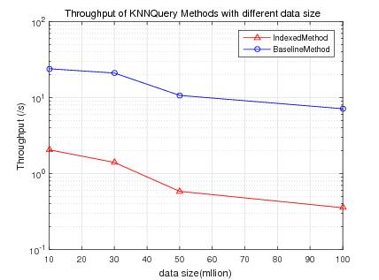

Slide 14
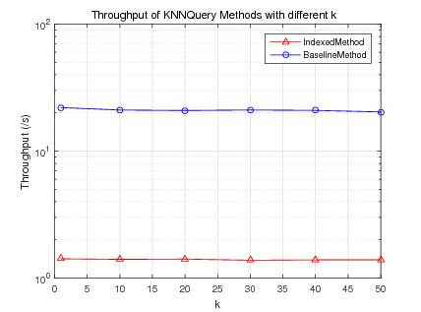

Slide 15
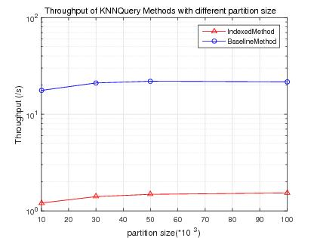

Slide 16
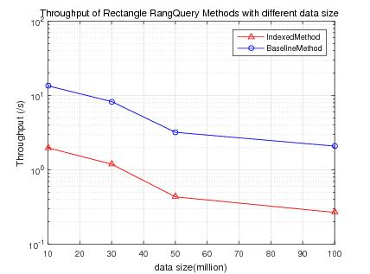

Slide 17
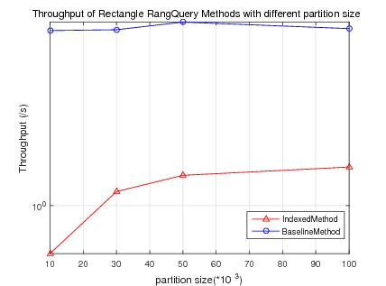

Slide 18
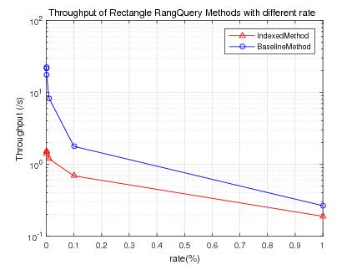

Slide 19
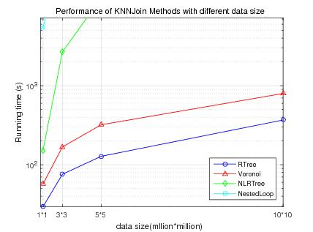

Slide 20
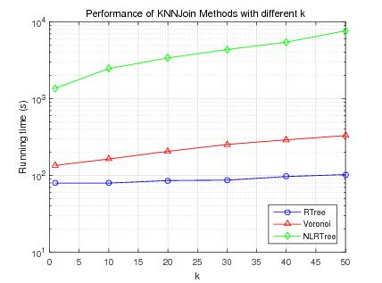

Slide 21
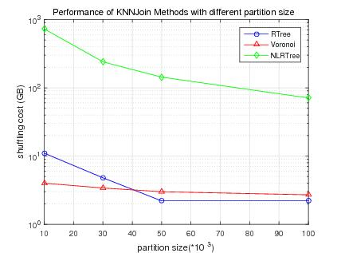

Slide 22
