Slide 2
















Partition
Local Index
Global Index
$$R_{0}$$
Row
$$IR_{0}$$
$$i_{0}$$
$$R_{1}$$
$$IR_{1}$$
$$i_{1}$$
On Master Node
Packing
&
Indexing
$$R_{2}$$
$$IR_{2}$$
$$i_{2}$$
$$R$$
Global Index
$$R_{3}$$
$$IR_{3}$$
$$i_{3}$$
$$R_{4}$$
Array[Row]
Local Index
$$IR_{4}$$
$$i_{4}$$
IPartition[Row]
Partition Info
IndexedRDD[Row]

Slide 4



























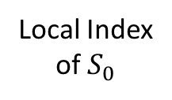
Global Join
Local Join
$$B_{2}$$
$$S_{0}$$
$$B_{1}$$
Local Index
of $S_{0}$
$$R$$
$$R_{0}$$
$$R_{0}$$
$$B_{3}$$
$$B_{4}$$
$$B_{6}$$
$$S_{1}$$
$$B_{5}$$
$$B_{7}$$
$$R_{0}$$
$$B_{4}$$
$$S_{0}$$
$$S_{2}$$
…
$$S_{0}$$
$$B_{3}$$
$$p$$
$$S$$
$$S_{1}$$
$$S_{6}$$
$$τ$$
$$S_{3}$$
$$S_{4}$$
$$S_{5}$$
$$R_{0}$$
$$S_{6}$$
$$R_{0}$$

Slide 5




$$q$$
$$q$$
$$γ$$
$$γ$$

Slide 6


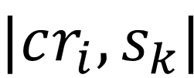



$$u_{i}+|cr_{i}, s_{k}|$$
$$cr_{i}$$
$$r$$
$$|cr_{i}, s_{k}|$$
$$u_{i}$$
$$s_{k}$$

Slide 7


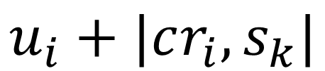
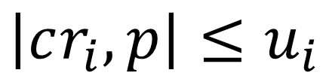

$$e$$
$$cr_{i}$$
$$r$$
$$\left|cr_{i},p\right|≤u_{i}$$
$$u_{i}+|cr_{i},s_{k}|$$

Slide 8
Logical
Optimization
Physical
Planning
Cost-Based
Optimization
Analysis
SQL Query
Unresolved
Logical Plan
Optimized
Logical Plan
Physical
Plans
Selected
Physical Plan
Logical Plan
RDDs
DataFrame
API
Statistics
Catalog
Index Manager
Cache Manager

Slide 9
RDBMS
Distributed
Indexing
IndexedRDD
Hive
RDD[Row]
HDFS
In-Memory
Columnar Storage
ColumnarRDD
Native RDD

Slide 10
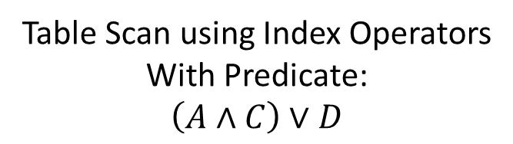
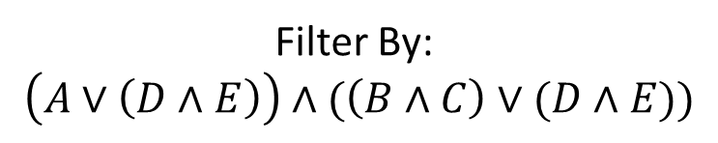
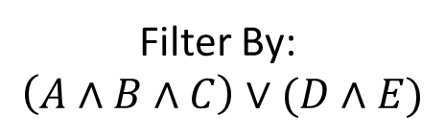


Result
Result
Filter By:
$$\left(A∧B∧C\right)∨(D∧E)$$
Optimize
Filter By:
$$\left(A∨\left(D∧E\right)\right)∧(\left(B∧C\right)∨(D∧E))$$
Table Scan using Index Operators
With Predicate:
$$\left(A∧C\right)∨D$$
$$\left(\underline{A}∧B∧\underline{C}\right)∨(\underline{D}∧E)$$
Transform to DNF
Full Table Scan
$$\left(A∨\left(D∧E\right)\right)∧(\left(B∧C\right)∨(D∧E))$$

