Slide 1

Smart Bin (GHC HACKATHON PROJECT 3)
Team: EMC-TRIDAX
Members: Shwetha Ravoor, Priya Chandramohan, Savitha Bijoy, Soumya Narayanan, Shruthi M N

Slide 2
Contents
Product Vision
Design
Technologies used
Smart Bin Client (Mobile App)
Smart Bin Server and Database
Sensor Circuit for the Smart Bin
Source code layout in GIT
Profile of the team

Slide 3
Product vision
Scalability
Reliability
Usability
User Friendly
Robust
Futuristic!!

Slide 4
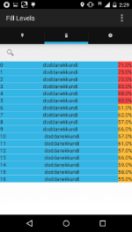
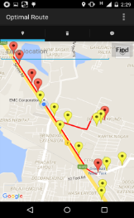
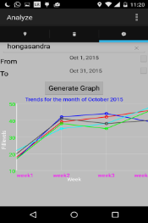
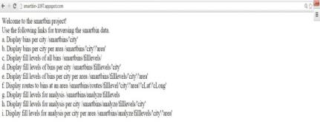
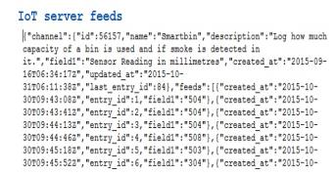
Complete Design
…………
Bin 1
Bin 2
Server (hosted on cloud)
IoT server
.
.
.
Bin N

Slide 5
Design Benefits
Availability of data
This design ensures that multiple clients can access the server at any point in time
Ability to augment additional parameters
This design helps in adding more parameters apart from fill level such as smoke, humidity, temperature etc
This design also ensures that the parameters of multiple bins can be updated in server database by polling the IoT server (or MQTT server) periodically
Scalability
The design helps to scale – in terms of number of clients and in terms of number of bins

Slide 6
Technologies used for software development
Smart Bin Client - Android app built using Android Developer Tools for Eclipse
Smart Bin Server – Server hosted on Google App Engine (cloud) exposing REST interface via python flask web development interface
Smart Bin Database – MySQL database
IoT server – Data from the fill level sensor circuit is available at https://thingspeak.com/channels/56157
Sensor circuit built using ESP8266 wi-fi module.

Slide 7
Use cases addressed
View the fill levels of the smart bins based on the current location
View fill levels of the smart bins based on an area provided by user
View the smart bins on a map with different colours for high, medium and low fill levels
View the optimal route for collecting the trash based on the current location
Graphical view of the average fill levels on a weekly basis
Provision to register a user
Provision to login to the app based on a registered username and password
After logging in the user need not login every time App is opened.

Slide 8
Smart Bin Client (Mobile App)

Slide 9
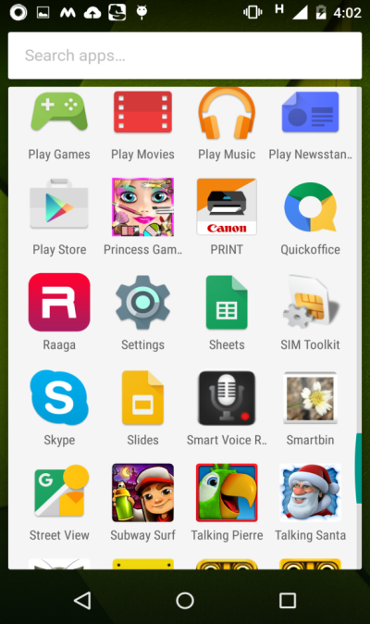
Smart Bin Mobile App
The mobile app is a simple and easy to use application for supporting BBMP workers in clearing the trash from smart bins effectively.
The app has been integrated with GPS which helps in retrieving the current location (latitude and longitude)
Presently, the app considers ‘fill level’ as the ‘property’ retrieved from smart bin sensor. This can be later enhanced for other parameters like temperature, humidity, smoke detection and so on.

Slide 10
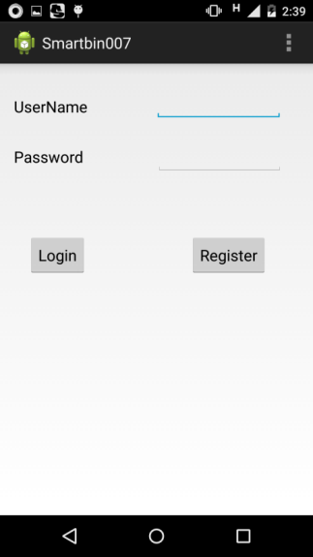
Login Screen
If the user enters a valid username and password, the tab to view and analyze the fill levels open up
If user enters incorrect information, “username or password is invalid” is displayed
‘Register’ button opens a new frame where a new user can be registered.

Slide 11
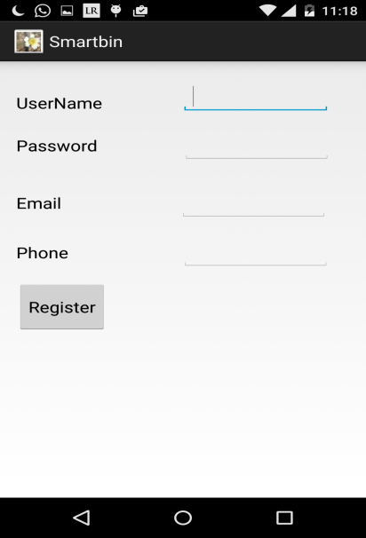
Register Screen
Accepts username, password, email and contact number of the user
This information is saved in the ‘shared preferences’ of the app so that future logins with the same login id can be validated
If validation with the data available in shared preferences is not possible, the request for validation is sent to server

Slide 12
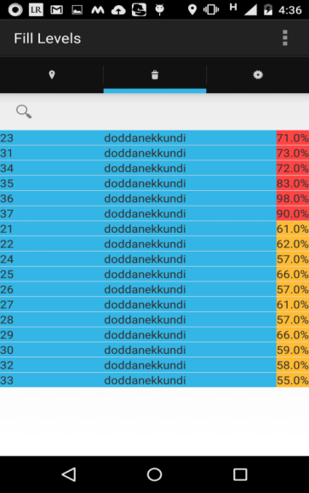
View Fill Levels
Fill levels can be viewed based on
current location (retrieved with GPS)
location provided by user
The app has been integrated with GPS which helps in retrieving the current location of the user. This information is used if user does not enter an ‘area’ in the ‘edit box’
The request is sent to the server which responds with the data in json format

Slide 13
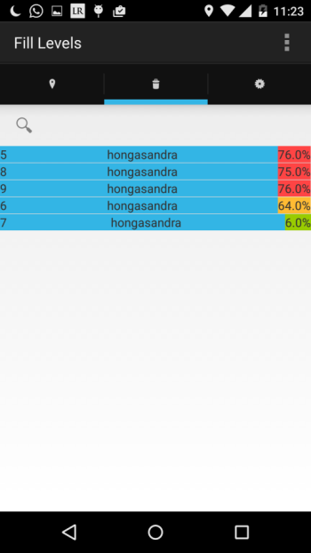
View Fill Levels (contd.)
The content displayed in mobile app frame are:
Bin id
Area
Fill levels
Color coding
Fill levels greater than (or equal to) 70% is considered ‘High’; This is displayed in ‘red’
Fill levels greater than (or equal to) 40% and less than 70% is considered ‘Medium’; This is displayed in ‘orange’
Fill levels less than 40% is considered ‘Low’ ; This is displayed in ‘green’

Slide 14
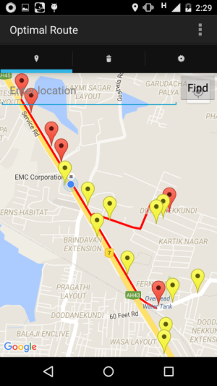
View fill levels and optimal routes on gmap
The optimal route is displayed on gmap based on
current location retrieved using GPS
the location entered by user in ‘edit box’
Color coding for the markers
Fill levels greater than (or equal to) 70% is considered ‘High’; This is displayed in ‘red’
Fill levels greater than (or equal to) 40% and less than 70% is considered ‘Medium’; This is displayed in ‘orange’
Fill levels less than 40% is considered ‘Low’ ; This is displayed in ‘green’

Slide 15
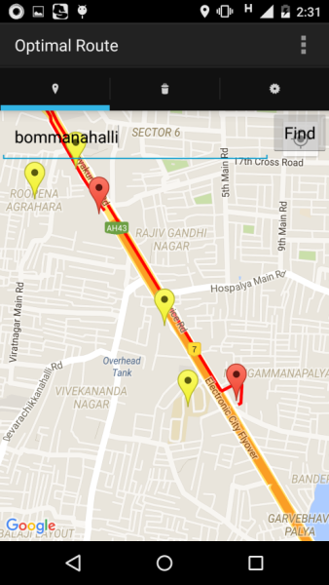
View fill levels and optimal routes on gmap
If user provides a different location, the details of all bins in that location is displayed.
The color coding for the markers on the map remains the same.

Slide 16
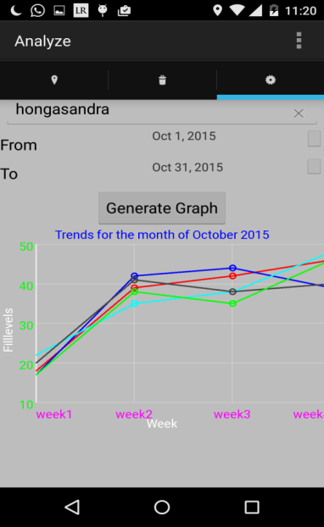
Analyze fill levels
Graphical representation of the fill levels can be viewed in ‘Analyze’ tab
User needs to provide the ‘area’ for which the graph needs to be generated.
The average fill levels on a weekly basis for the month of October is displayed using line graph

Slide 17
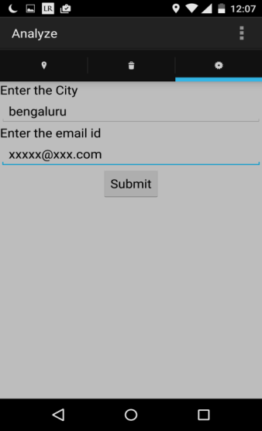
Settings menu
Provides option to modify the email registered by user
Also provides option to change the name of the city

Slide 18
Smart Bin Server and Database

Slide 19
Smart Bin Server
The server has been implemented using the python flask framework
REST interface is exposed to clients for accessing smart bin information
The server has been hosted on Google App Engine to enable concurrent access from multiple clients
Internally, the smart bin application is hosted on Google App Engine WSGI application server

Slide 20
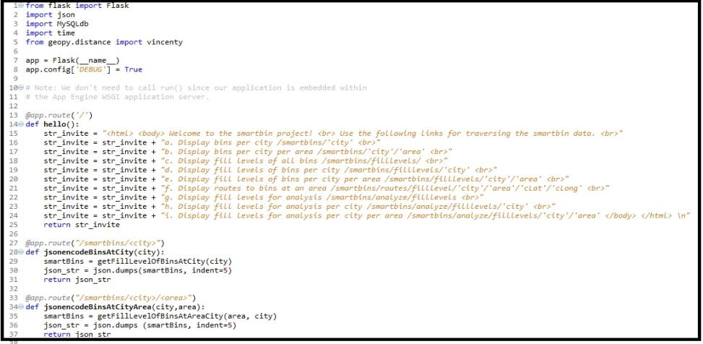
REST interface
REST interface is the architecture used for faster and simplified component interactions
This helps in improving the scalability of the server to support large number of client interactions

Slide 21
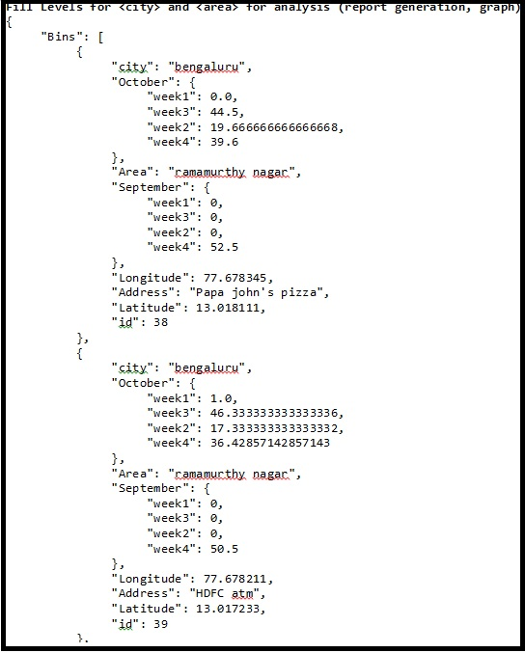
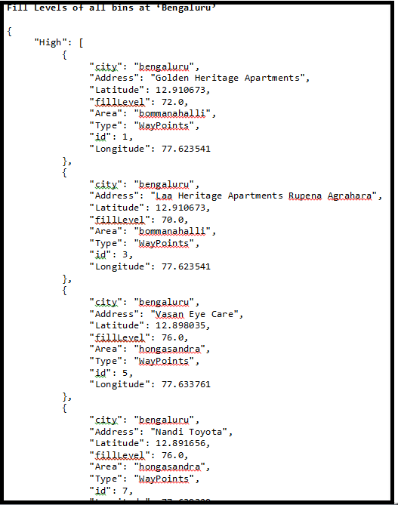
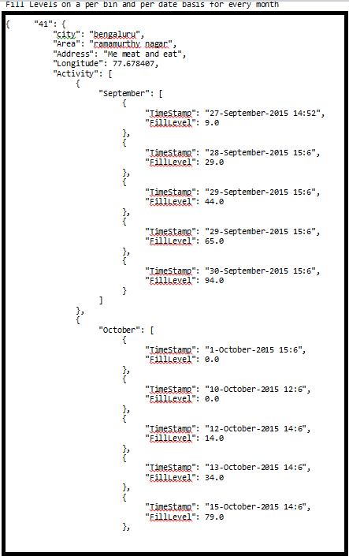
Sample Data exposed through REST interface

Slide 22
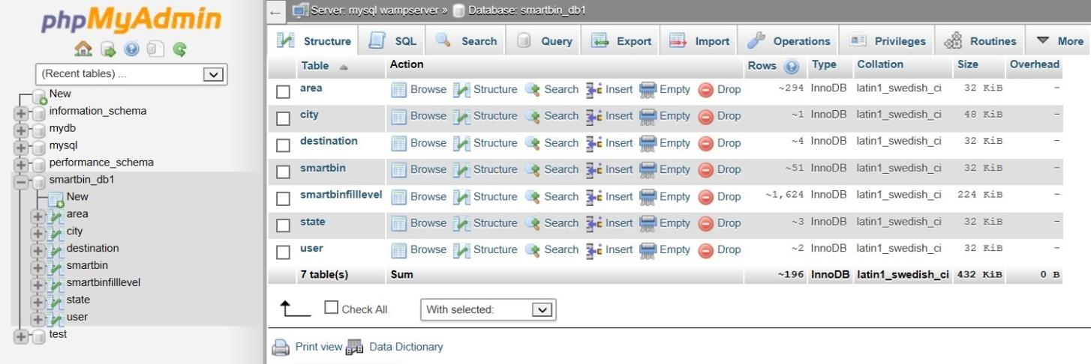
Smart Bin Database
MySQL database is used as the backend database
The smart bin database smartbin_db1 which is exported on Google App Engine

Slide 23
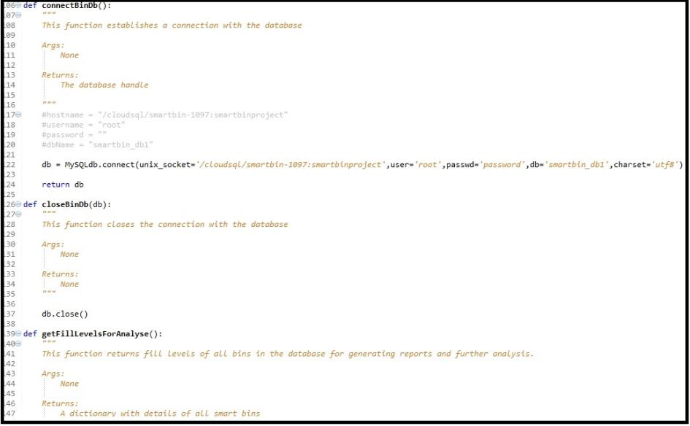
Smart Bin Database
The smart bin database access in code (available in GIT) connects the database using the socket exposed by Google App Engine

Slide 24
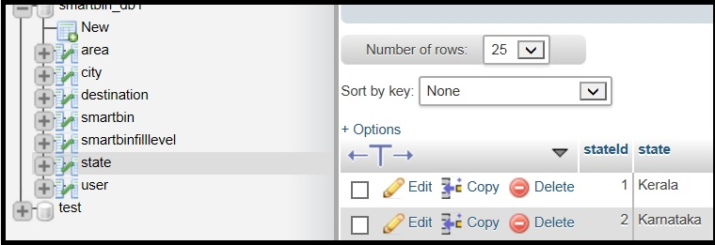
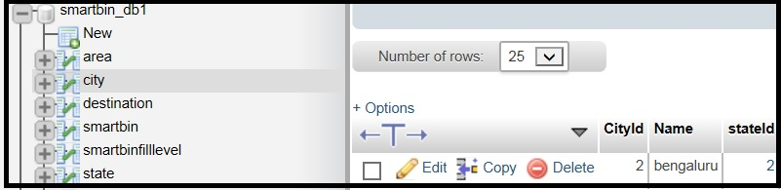
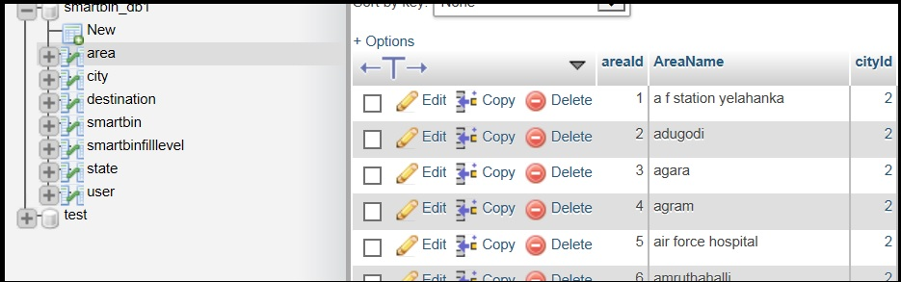
Smart Bin Database (contd.)
Tables in the database
State
City
Area

Slide 25
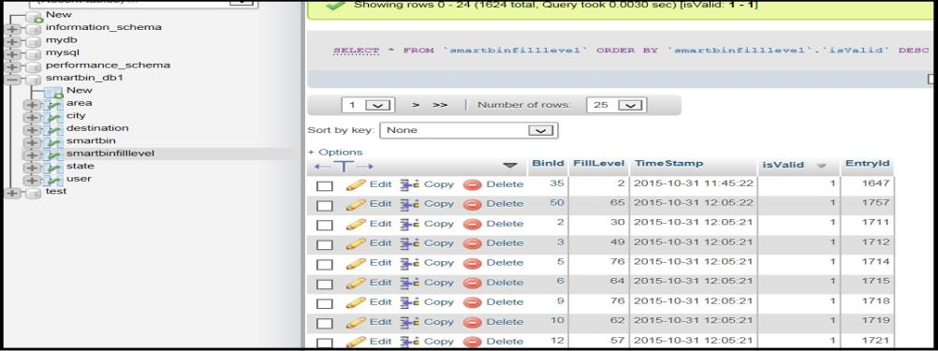
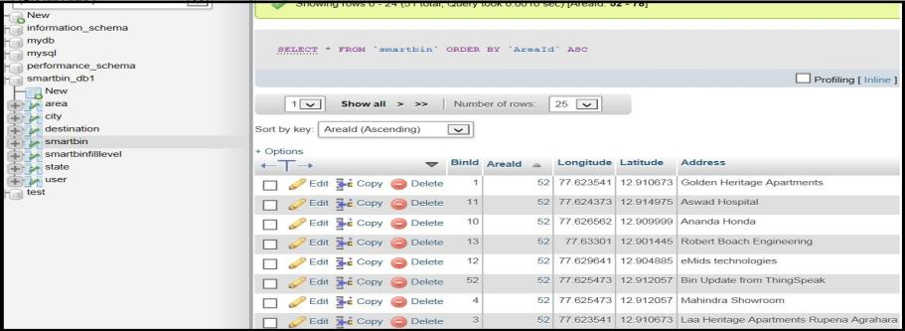
Smart Bin Database (contd.)
Tables
SmartBinFilllevel
SmartBin
Destination

Slide 26
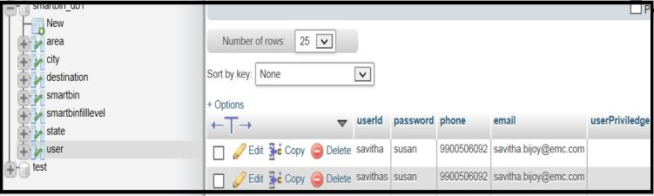
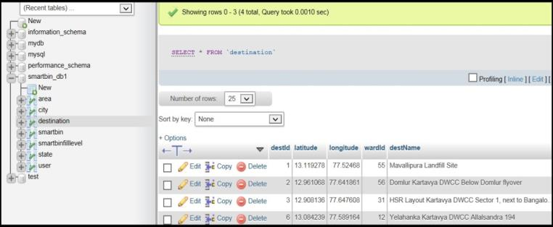
Smart Bin Database (contd.)
Tables to persist user information is also available in the database. This feature requires enhancement in terms of securing user information by employing encryption or other encoding techniques
Additional table for ‘destination’ i.e. landfill/dump sites have been added. This is not being used now but is intended for enhancing the ‘optimal route use case.

Slide 27
Smart Bin Database (contd.)
Other considerations
Table ‘Area’ has been populated based on the pin code list of Bangalore which is available for public use
Around 52 smart bins have been registered along the areas of Bommanahalli, Hongasandra, Marathahalli, Doddanekkundi and Ramamurthy Nagar
There are around 1700+ entries in SmartBinFillLevel table to simulate the fill levels for these 52 bins

Slide 28
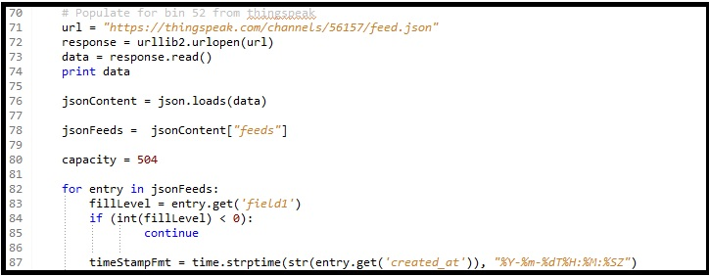
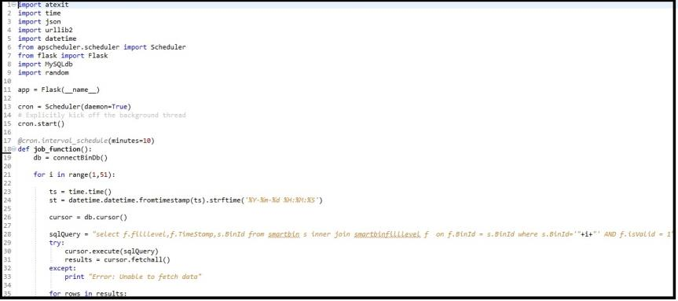
Updating the Fill Level in Database
Python provides the Scheduler library which can be used to schedule a cron job at defined intervals (say, every 5 min)
We have used this library to update the database with fill levels at frequent intervals
One of bin has been populated based on real time data available in thingspeak IoT server

Slide 29
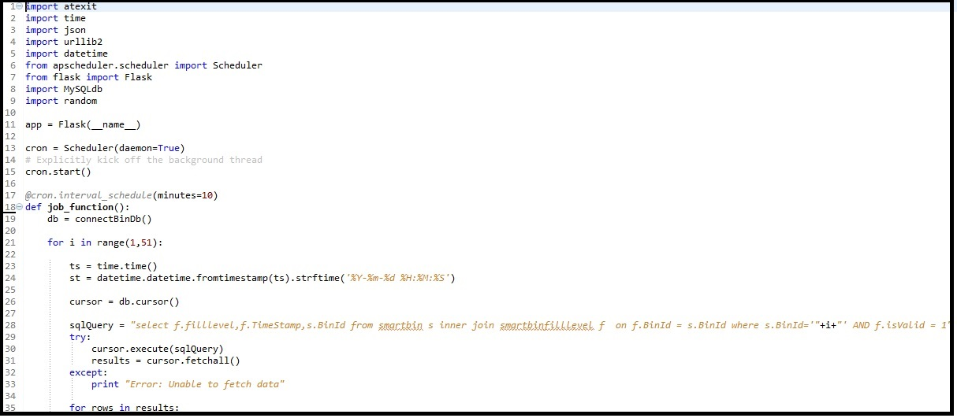
Updating the Fill Level in Database
Python provides the Scheduler library which can be used to schedule a cron job at defined intervals (say, every 5 min)
We have used this library to update the database with fill levels at frequent intervals
One of bin has been populated based on real time data available in thingspeak IoT server

Slide 30
Sensor Circuit for the Smart Bin

Slide 31
Sensor Circuit
Sensor circuit built using ESP8266 wi-fi module.
Significance of the circuit:
It has a ultrasonic sensor (should be mounted on top of the bin) which provides the unused capacity/depth of the bin (i.e. the distance from the top of the bin till the used level)
The circuit is powered by a solar panel
It also has a chargeable battery for backup power
The module has been configured to poll the distance every 5 seconds. The polled distance is available in thingspeak IoT server at real time.
Note: The circuit details has been added since the updates made in IoT server is of significance to the project.

Slide 32
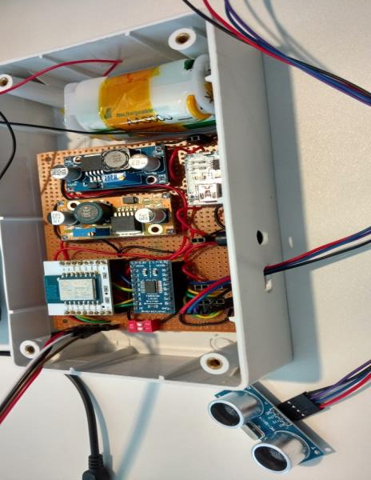
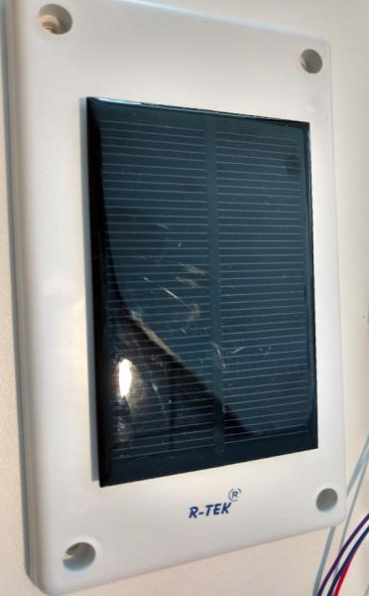
Important parts of Sensor Circuit
1.2V Nmh rechargeable battery charged via solar panel or DC power supply
Solar panel for powering up the circuit
ESP8266 Wi-Fi module (3.3V)
Connectors to the sensors
HC-SR04 Ultrasonic sensor (5V) for
detecting fill level
of the bin

Slide 33
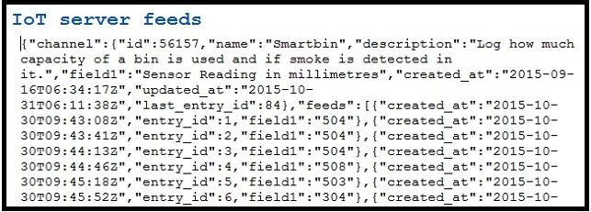
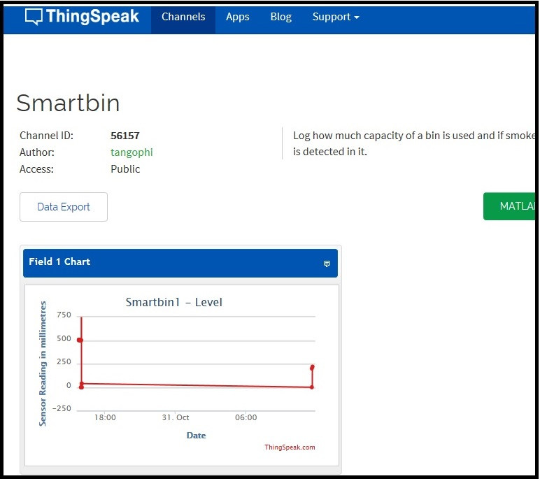
Json feeds from thingspeak
The module has been configured to poll the distance every 5 seconds. The polled distance is available in thingspeak IoT server at real time.
The ‘field1’ entry is inversely proportional to the fill level of the bin

Slide 34
Source code Layout in GIT
https://github.com/emc-tridax/SmartBinProject3/ has been created and acehacker-ghci-2015 has been added as collaborator.
Below is the source code information
MobileAppClient – Android code for mobile app
Appengine-python-flask-master – Server code for the smart bin
Smartbin_db1.sql – imported sql database
SmartBin.pptx – The presentation for SmartBin database
Videos – Videos explaining the complete implementation

Slide 35
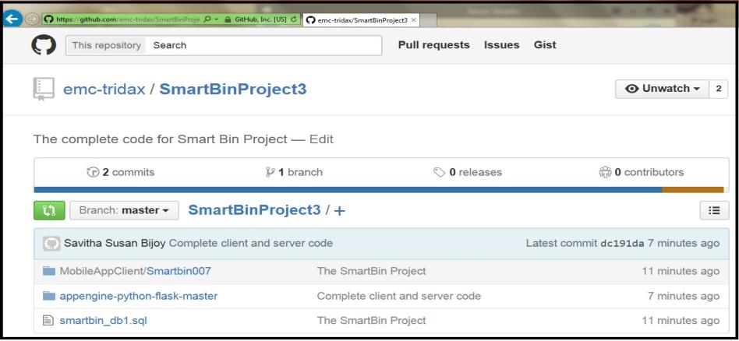
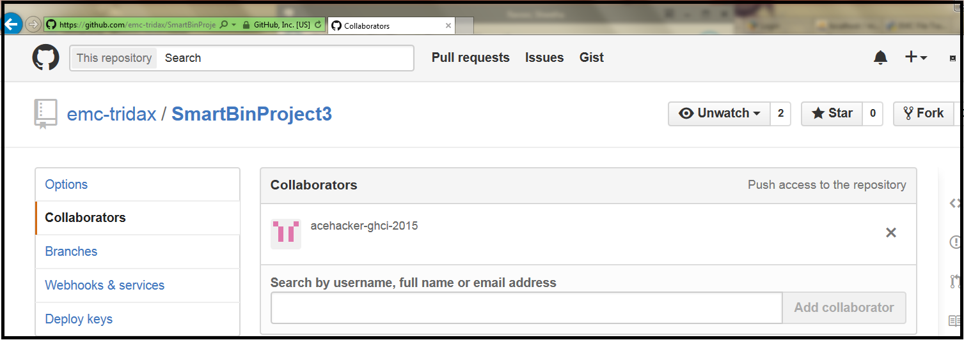
Source code Layout in GIT

Slide 36
Profile of team
Shwetha Ravoor is a Senior Software engineer with Emerging Technology Division (ETD) in EMC. She has 10+ years of experience in software development, HPUX kernel development and systems engineering. She was the winner of the EMC innovation conference which is an annual event held globally. She has also contributed to numerous published white papers in HP.
Priya Chandramohan is principal engineer working in EMC. She has 15 years of experience in windows kernel programming, storage technologies and Archival concepts. She is good in handling customer escalations and have received several awards. She has also filed patent on load balancing algorithms.
Savitha Bijoy is a principal engineer with ETD in EMC. She has 9+ years of experience in systems engineering, storage technologies, virtualization and operating system kernels. She holds a master’s degree in Information Technology. She also filed a patent in the area of storage systems with USPTO.

Slide 37
Profile of team (contd.)
Soumya Narayanan is Senior Software engineer with HP with 9+ years of experience in embedded systems, Linux device drivers, object oriented design and implementation.
Shruthi M N is associate software engineer with ETD in EMC with 2+ years of experience in object oriented design and implementation.

