Slide 1
My beverage antenna

Slide 2
Why choose beverage
Antenna gains are fixed for both Rx and Tx
We can use separate antennas for Rx and Tx
I’m more into listening at this point, so beverage is ideal
It’s easy to setup (and teardown/move) – can hang between 2 trees
It’s inexpensive
It’s possible to use shorter ¼ lambda wires and still get good reception

Slide 3
Beverage ingredients
Cu stranded insulated wire approximately 60’ long.
2 copper ground rods w/clamps.
Feedline attached to one end – 50 ohms coax.
Feedline transformer
The other end terminated through a 450 ohm resistor (2-watt, non-inductive, flame-proof) to ground.

Slide 4
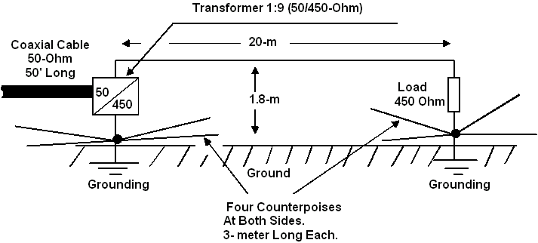
Overview layout of the beverage

Slide 5
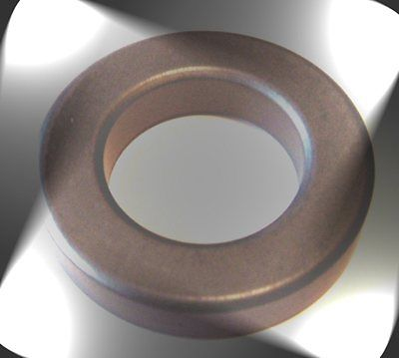
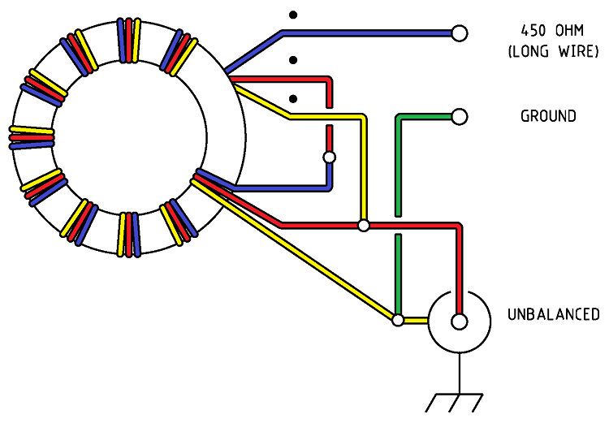
Transformer
http://www.amidoncorp.com/ft-114-43/
AWG #26 mag wire

Slide 6
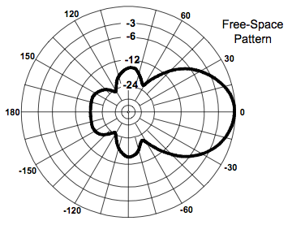
Radiation pattern – very directional

Slide 7
Some theory
Because of the directionality of the beverage (I just like saying it) antenna, it rejects off axis signals and noise.
The dB gain is due to increased SNR, but its still pretty low around -20 to -10 dBi.
The incoming wave acts like an electron bulldozer, aka a travelling wave antenna – it does not resonate.
The E field is tilted due to resistance in the earth causing a drag effect and acting like a bulldozer’s shovel, pushing the electrons down the pike.

Slide 8
A glimpse into the future

