Slide 1
My beverage antenna

Slide 2
Why choose beverage
Antenna gains are fixed for both Rx and Tx
We can get higher Rx gain using a separate antenna
I’m more into listening at this point, so beverage is ideal
It’s easy to setup (and teardown/move)
It’s inexpensive
It’s possible to use shorter wires and still get good reception
Drawback: It requires a very long wire (0.5 to 1.0 lambda)

Slide 3
20 meter beverage ingredients
A horizontal 26 AWG mag wire approximately 60’ long.
Above ground about 4 feet.
Any suspension hardware, needs to be insulated from the mag wire.
2 copper ground rods w/clamps.
Feedline attached to one end – 50 ohms coax.
Feedline transformer (8-turn trifilar winding) – design by ON4UN available https://www.arrl.org/shop/ON4UN-s-Low-Band-DXing
The other end terminated through a 450 ohm resistor (2-watt, non-inductive, flame-proof) to ground.

Slide 4
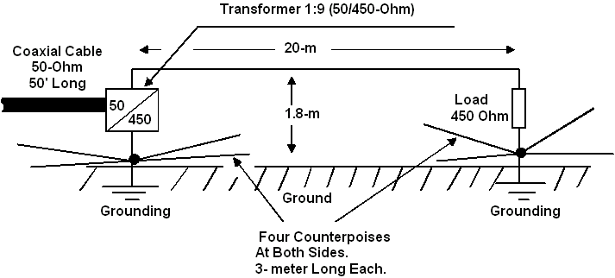
Overview layout of the beverage

Slide 5
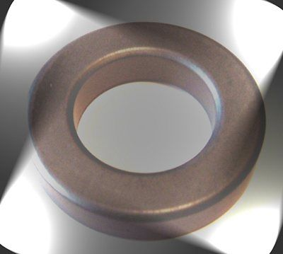
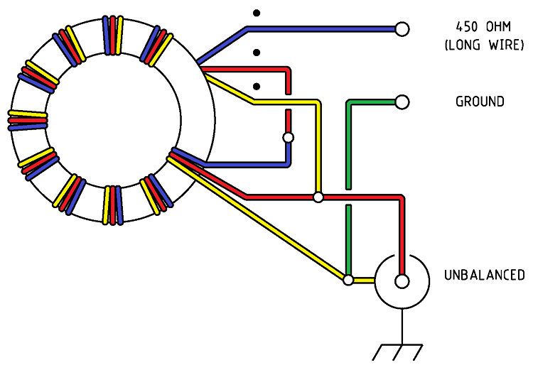
Transformer
http://www.amidoncorp.com/ft-114-43/
AWG #26 mag wire

Slide 6
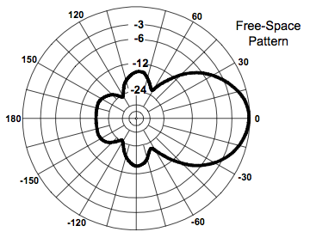
Radiation pattern – very directional

Slide 7
Some theory
Because of the directionality of the beverage (I just like saying it) antenna, it rejects off axis signals and noise.
So the dB gain is due to increased SNR.

Slide 8
A glimpse into the future

