Slide 1
Benchmarking the state-of-the-art Task Execution Framework of Many-Task Computing: MATRIX Bench
Team Mentor- Ke Wang
Under Prof. – Ioan Raicu

Slide 2
Systems Given to work on
1. MATRIX
2. Yarn
3. Swift
4. Spark
5. Charm ++
6. Legion

Slide 3
Proposed Solution / Goal
In the given project we had proposed to run and install all the given systems.
During this phase, we would be understanding the execution of each of these system.
And find the execution graphs along with the throughput of each of these systems.

Slide 4
1. MATRIX
MATRIX is a fully distributed task exectuion.
It works as a framework for Many Task computing data intensive computing applications
It utilizes a distributed key value store that is ZHT, for distributed task metadata management.
MATRIX aims to deliver high throughput, efficiency and low latency for all applications in both scientific computing and cloud domains
Increased the number of clients as we increased the nodes.
Instance type used is m3.xlarge location used is US-West(Oregon)

Slide 5
Matrix execution at Sleep(0)
time taken(in secs)
Number of Nodes

Slide 6
MATRIX throughput graph for sleep(0)
task/time taken
Number of Nodes

Slide 7
Matrix execution at Sleep(1)
time taken(in secs)
Number of Nodes

Slide 8
MATRIX throughput graph for sleep(1)
task/time taken
Number of Nodes

Slide 9
Matrix Speed up graph
Time taken (secs)
Number of nodes

Slide 10
2. Yarn
Fundamental idea of Yarn is to split the major functionalities of job tracker i.e. resource management and job scheduling into seperate daemons.
Main idea is to have a global resource manager and per application ApplicationMaster.
Resource manager has two main components; scheduler and applications manager.
ApplicationMaster has the responsibility of tracking their status and monitoring for progress.
Instance type used is m3x.large location used is US-West

Slide 11
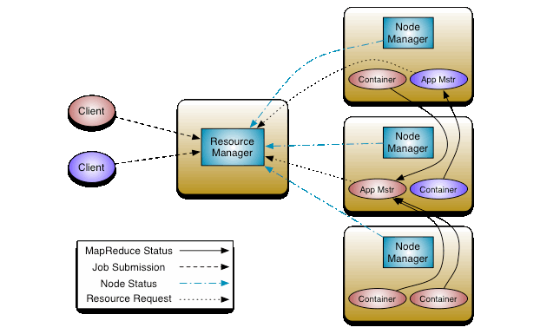
Yarn Architecture

Slide 12
Yarn execution data for a 10GB file
time taken(in mins)
Number of Nodes

Slide 13
YARN throughput Analysis
1/Latency
Number of Nodes

Slide 14
3. Swift
Swift is a implicitly parallel programming language, that allows the writing of script that distribute the progam execution across distributed computing resources including clusters, clouds, grids and supercomputers.
It runs multiple programs concurrently as soon as their inputs are available, reducing the needs of complex parallel programming.
Instance type used is t2.micro location used is US-West

Slide 15
Swift execution data
time taken(in secs)
Number of Nodes

Slide 16
Swift throughput data
1/latency
Number of Nodes

Slide 17
4. Spark Sparrow
It is a high throughput, fault tolerance and low latency distributed cluster schedule.
It is designed for application that require resource allocation frequently for short jobs viz analytics frameworks.
Sparrow schedules from a distributed set of schedulers that maintain no shared state and the scheduler obtains instantaneous load information by sending probes to a subset of worker machines.
Instance type used is t2.micro location used is US-East(N. Virginia)

Slide 18
Spark execution data for 3100 tasks
time taken(in mins)
Number of Nodes

Slide 19
Spark throughput graph using 3100 tasks
3100/ time taken
Number of Nodes

Slide 20
5. Charm++
Charm++ is a C++ based parallel programming, founded on the migratable objects programming model.
It automates dynamic load balancing for task-parallel as well as data parallel applications via seperate suites of load balancing strategies.
It can be used for task parallelism as well as data parallelism in a single application.
via its message driven execution model, it supports automatic latency, tolerance, modularity and parallel composition.
Instance type used is t2.small location used is US-West

Slide 21
Charm++ execution
We had 14200 solutions for the execution of 12 queens.
The system was benchmarked on the following data.
We executed the system with the cmd line code ./charmrun ./pgm 12 6 +px, where x denotes number of nodes and 12 is the execution for 12 queens.

Slide 22
Charm++ data
time taken(in secs)
Number of Nodes

Slide 23
Throughput graph for Charm++
1/latency
Number of Nodes

Slide 24
6. Legion
Legion is a data centric parallel programming system for writing high performance for portable programs targetted at distributed heterogenous architectures.
Legion presents abstractions which allow programmers to describe properties of program data, like independence and locality.

Slide 25
Legion Execution
During this execution we installed the necessary system along with the frameworks required such as GASNet and CUDA.
During this phase of working we executed and invoked the sleep state for the system on one node.
The execution graph for the sleep function on one node by incrementing the sleep value can be given as :-

Slide 26
Legion execution graph for one node
time taken (in secs)
Sleep function value

Slide 27
Legion Execution issues
During the build phase of the system legion; we came across some issues, which inhibitted us from the execution of the system in multiple nodes.
The system required the installation of GASNet along with the necessary CONDUITS viz udp, aries, gemini, ibv. And enable them to allow the communication of it through the main legion framework.
But the CONDUITS were error struck and never got enabled, leaving us to be deprived of the execution on multiple nodes.

Slide 28
The error encountered for each CONDUIT build was as shown in the picture above
This is a screen grab of the build attempt of gemini CONDUIT

Slide 29
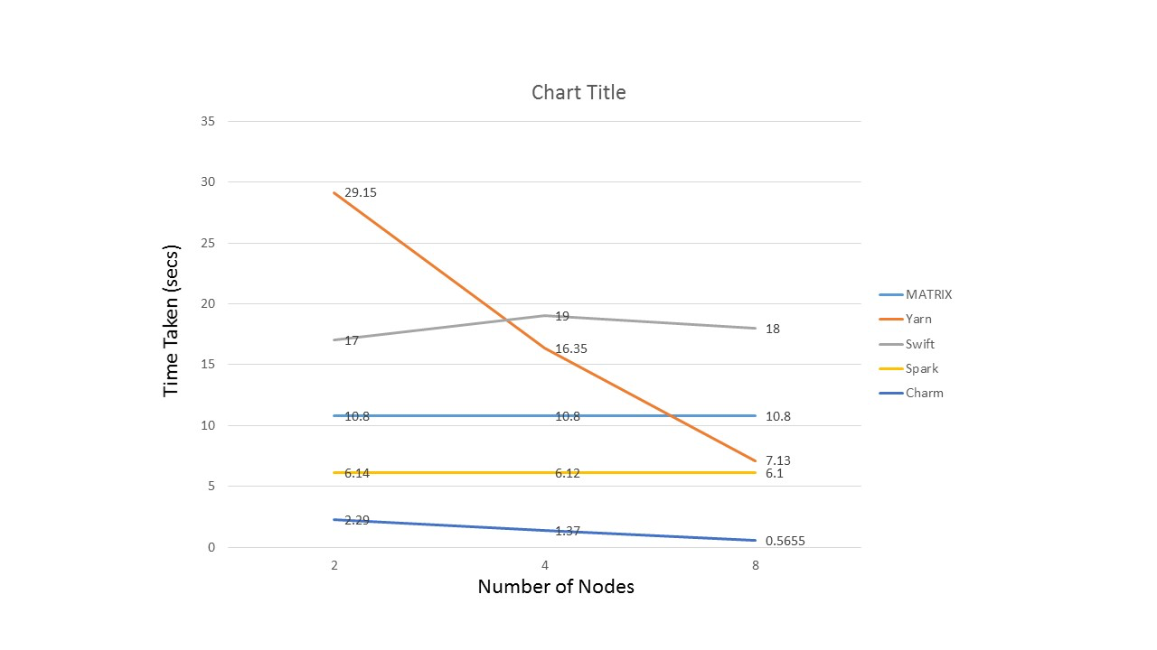
Conclusion

Slide 30
Work Done by Team Mates on each system
1. MATRIX - Dhirendra Singh
2. Yarn - Varun Bhatia
3. Swift - Gopal Bhatia
4. Charm++ - Akshay Kamra
5. Spark - Dhirendra Singh, Gopal Bhatia
6. Legion - Akshay Kamra, Varun Bhatia

Slide 31


THANK YOU

