Slide 1
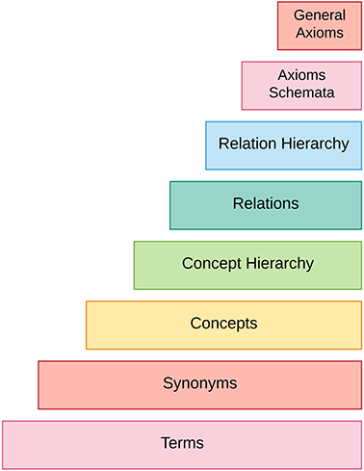

Figure 2 Ontology learning layer cake.
Notes:
Figure 2 Ontology learning layer cake.
Unless provided in the caption above, the following copyright applies to the content of this slide: © The Author(s) 2018. Published by Oxford University Press.This is an Open Access article distributed under the terms of the Creative Commons Attribution License (http://creativecommons.org/licenses/by/4.0/), which permits unrestricted reuse, distribution, and reproduction in any medium, provided the original work is properly cited.

