Slide 1
CuGene as a tool to view and explore genomic data
authors: Michał Haponiuk, Magdalena Pawełkowicz, Zbigniew Przybecki, Robert M. Nowak

Slide 2
Software functionality
display of sequence and annotation tracks
interactive zooming
editing of individual features, supporting manual annotation
intuitive aligned sequences, elegant to view
many searching algorithms
import FASTA, GFF (general feature format), XLS (Excel) files
the possibility to integrate third party applications with CuGene via HTTP API

Slide 3
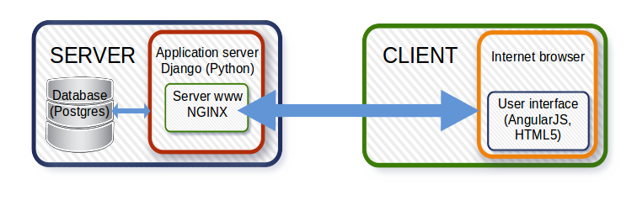
Architecture

Slide 4
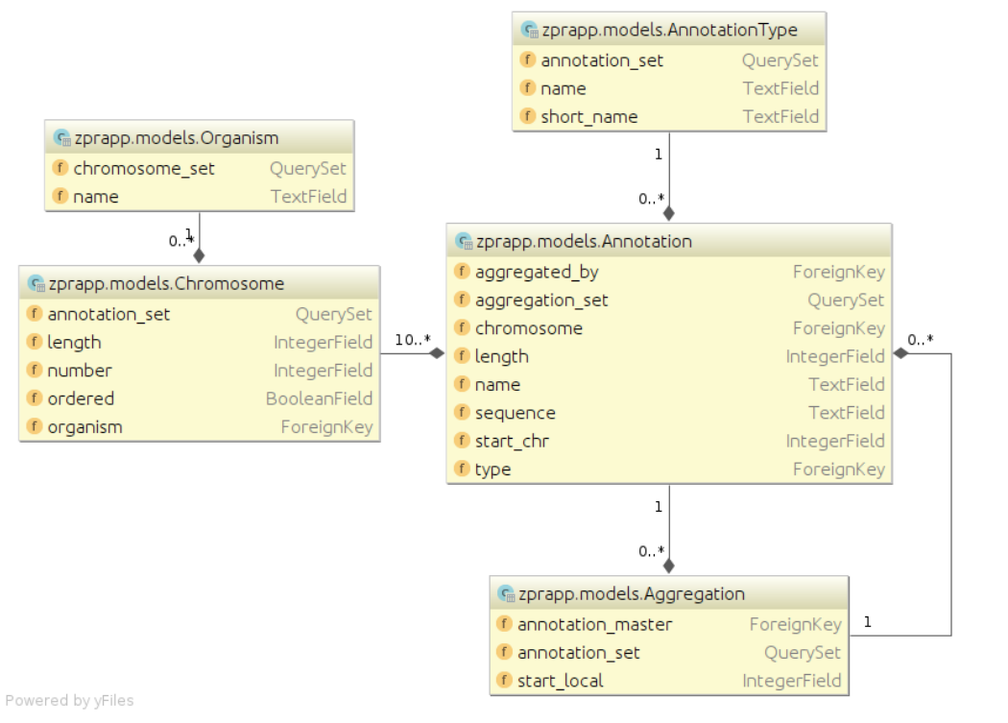
Database

Slide 5
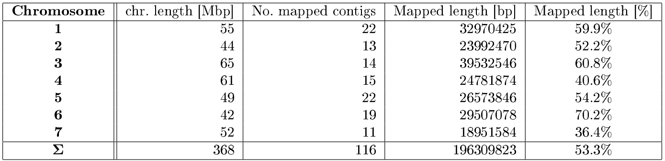
Mapped cucumber’s genome
All contigs amount: 8035
Mapped contigs amount: 116
Sum of known contig sequence lengths: 342 288 160 bp
Sum of mapped contig sequence lengths: 196 309 823 bp (57%)
Chen, J.-f., Staub, J. E., and Jiang, J., A reevaluation of karyotype in cucumber (cucumis sativus l.), Genetic Resources and Crop Evolution 45 (4), 301305 (1998).

Slide 6
Pattern searching algorithms
accurate match:
Knuth-Morris-Prath
Boyer Moore
approximate match:
Smith-Waterman (dynamic programming)
BLAST (heuristic method)

Slide 7
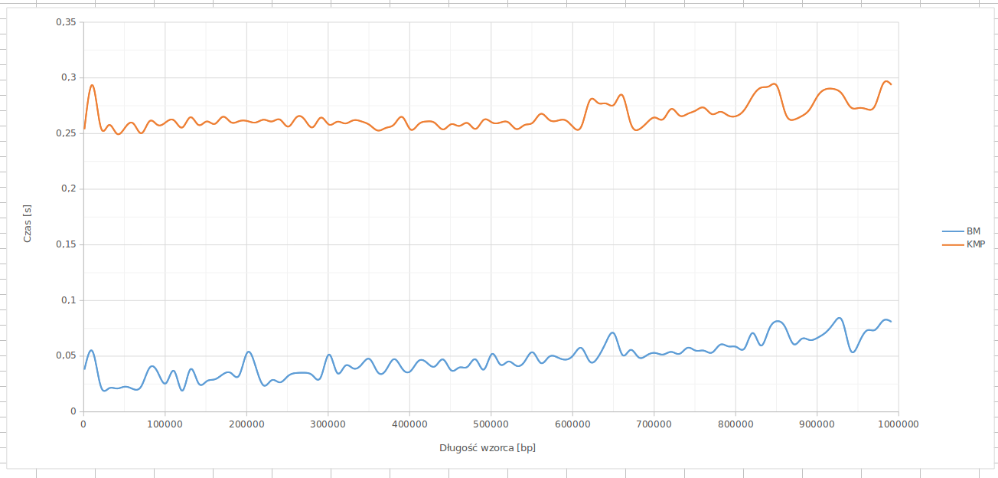
Searching time, KMP, BM
sequence length: 10 000 000 bp
time [s]
pattern length [bp]

Slide 8
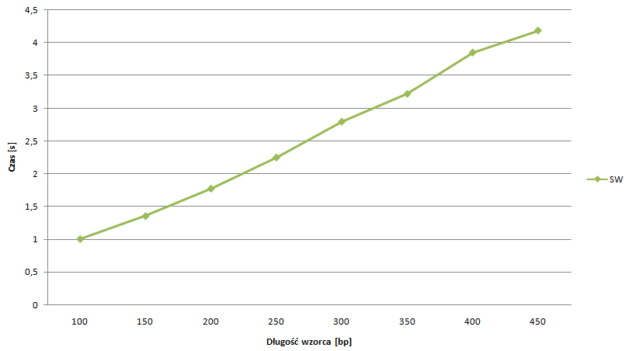
Searching time, SW algorithm
sequence length: 5 000 bp
time [s]
pattern length [bp]

Slide 9
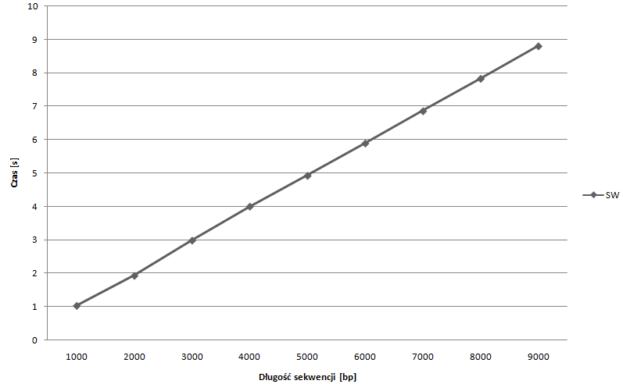
Searching time, SW algorithm
pattern length: 500 bp
time [s]
sequence length [bp]

Slide 10
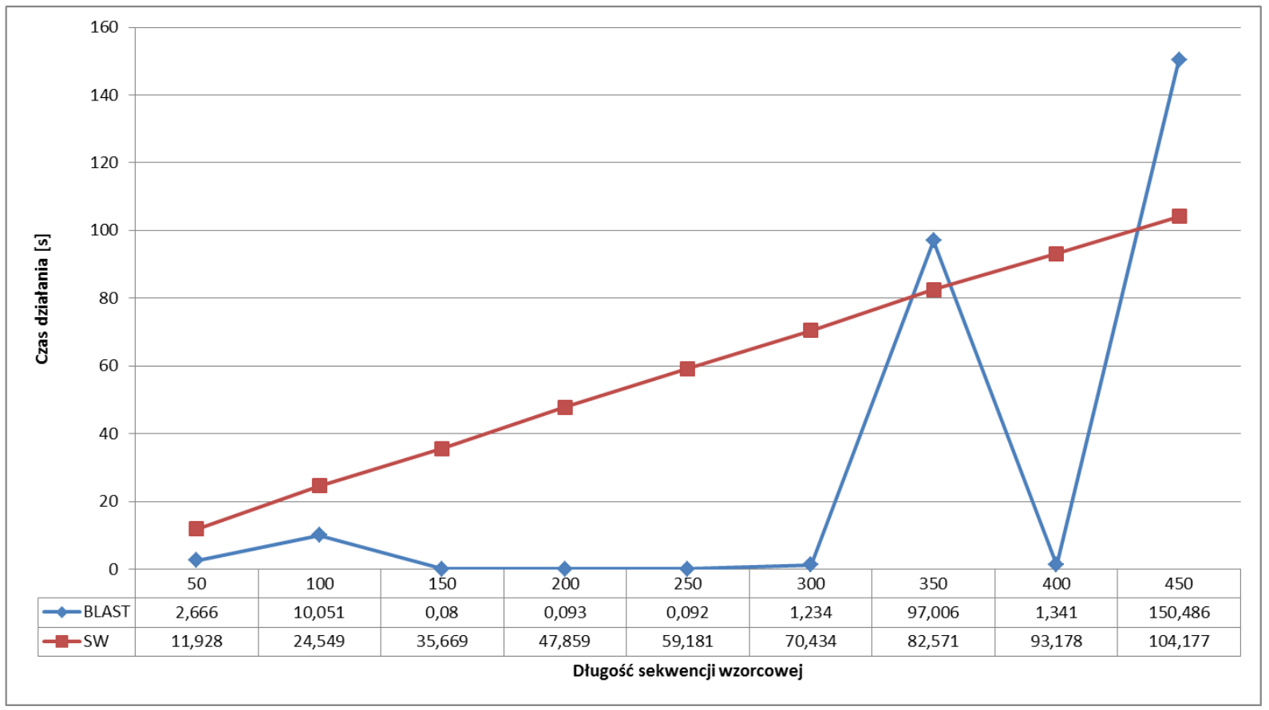
Searching time, SW and BLAST
sequence length: 5 000 bp
time [s]
pattern length [bp]

Slide 11
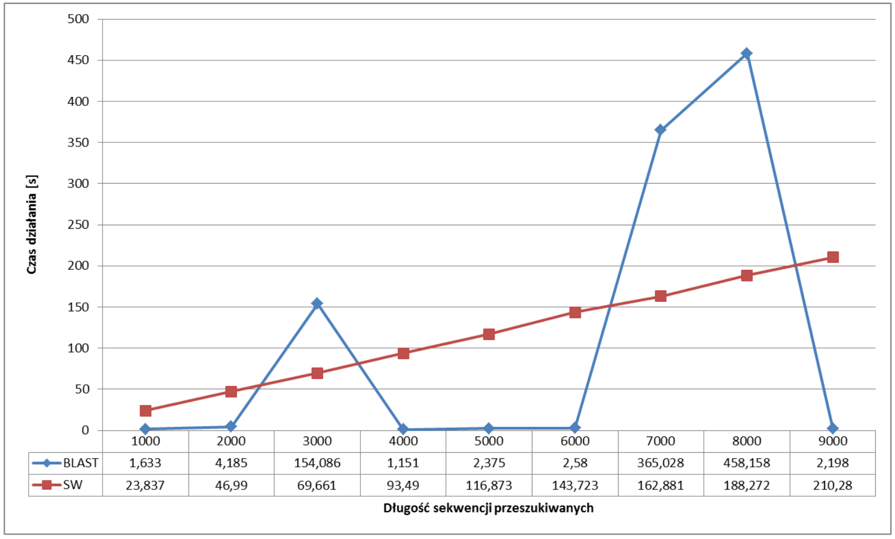
Searching time, SW and BLAST
pattern length: 500 bp
time [s]
sequence length [bp]

Slide 12
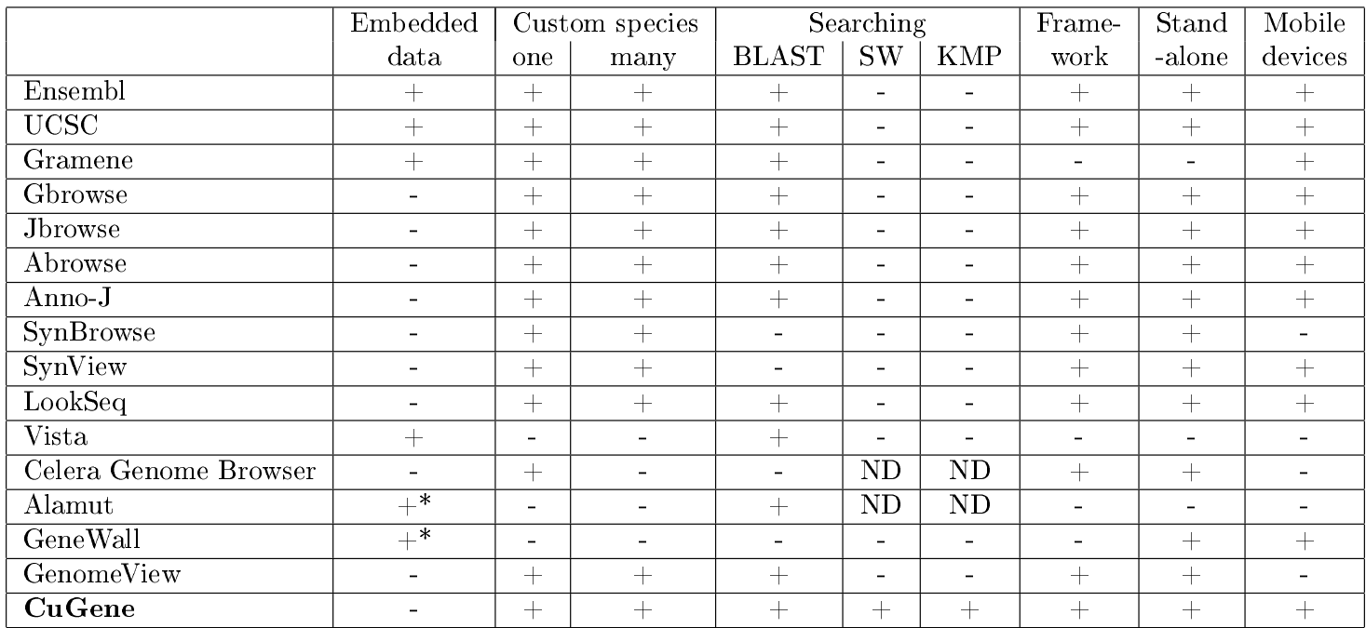
Genome browsers functionality comparison

Slide 13
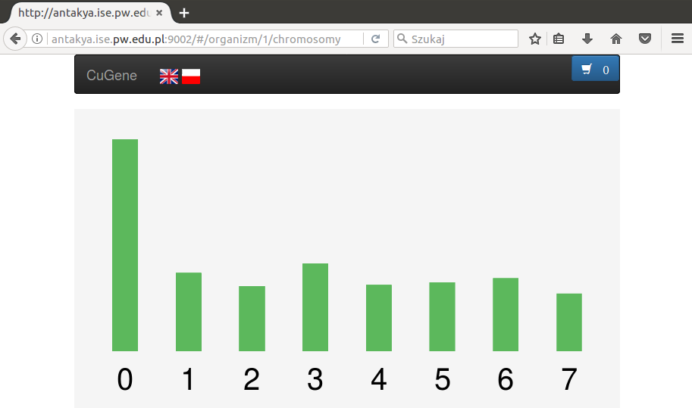

Slide 14
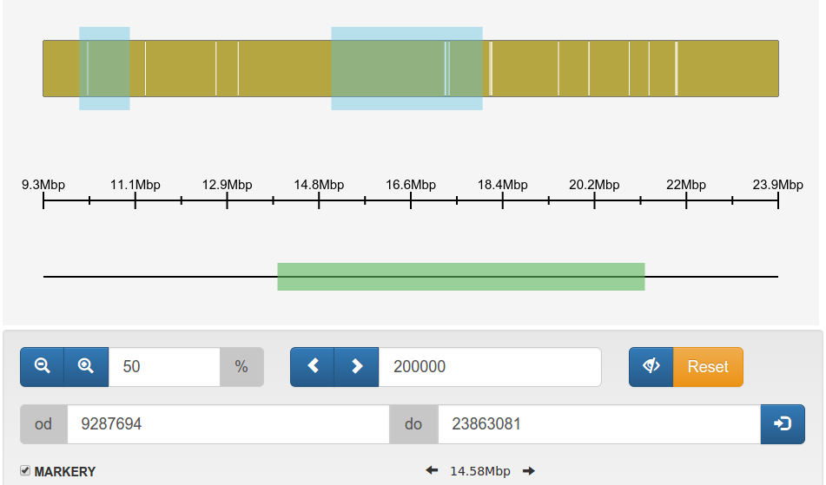

Slide 15
Conclusions
client-server web application, easy to use
developed to store many ogranisms, many genomes
used for cucumber genome
freealy available at http://cugene.sourceforge.net
demo server http://antakya.ise.pw.edu.pl:9002

Slide 16
Thank you

