Slide 1
Geodesic Flow Kernel for Unsupervised Domain Adaptation
Boqing Gong
University of Southern California
Joint work with Yuan Shi, Fei Sha, and Kristen Grauman

Slide 2
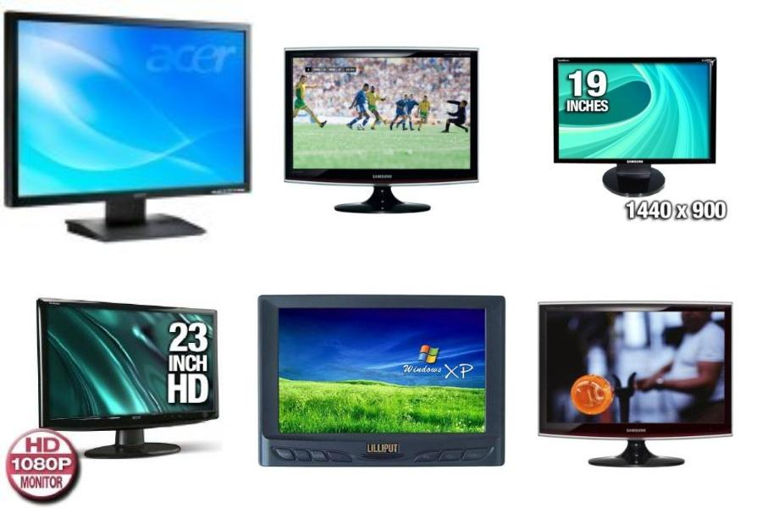
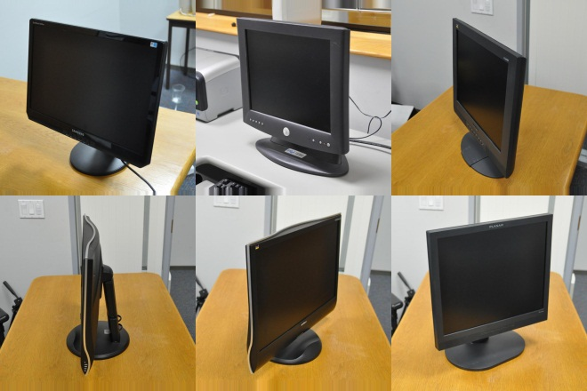
Motivation
Mismatch between different domains/datasets
Object recognition
Ex. [Torralba & Efros’11, Perronnin et al.’10]
Video analysis
Ex. [Duan et al.’09, 10]
Pedestrian detection
Ex. [Dollár et al.’09]
Other vision tasks
TRAIN
Performance degrades significantly!
TEST
Images from [Saenko et al.’10].

Slide 3
Unsupervised domain adaptation
Source domain (labeled)
Target domain (unlabeled)
Objective
Train classification model to work well on the target
?
The two distributions are not the same!

Slide 4
Challenges
How to optimally, w.r.t. target domain,
define discriminative loss function
select model, tune parameters
How to solve this ill-posed problem?
impose additional structure

Slide 5
Examples of existing approaches
Correcting sample bias
Ex. [Shimodaira’00, Huang et al.’06, Bickel et al.’07]
Assumption: marginal distributions are the only difference.
Learning transductively
Ex. [Bergamo & Torresani’10, Bruzzone & Marconcini’10]
Assumption: classifiers have high-confidence predictions across domains.
Learning a shared representation
Ex. [Daumé III’07, Pan et al.’09, Gopalan et al.’11]
Assumption: a latent feature space exists in which classification hypotheses fit both domains.

Slide 6



Our approach: learning a shared representation
Key insight: bridging the gap
Fantasize infinite number of domains
Integrate out analytically idiosyncrasies in domains
Learn invariant features by constructing kernel
Target
Source

Slide 7
Main idea: geodesic flow kernel
1
Target
4
Source
2
3
Model data with linear subspaces
Model domain shift with geodesic flow
Derive domain-invariant features with kernel
Classify target data with the new features

Slide 8
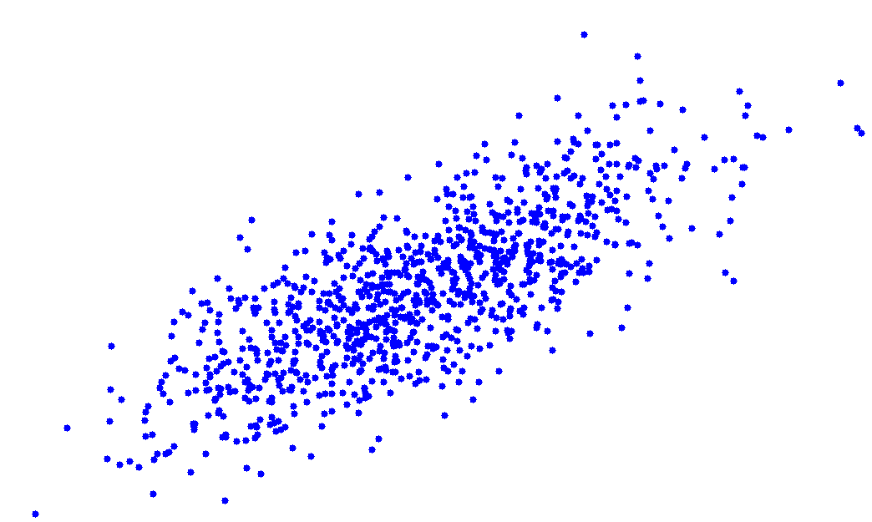
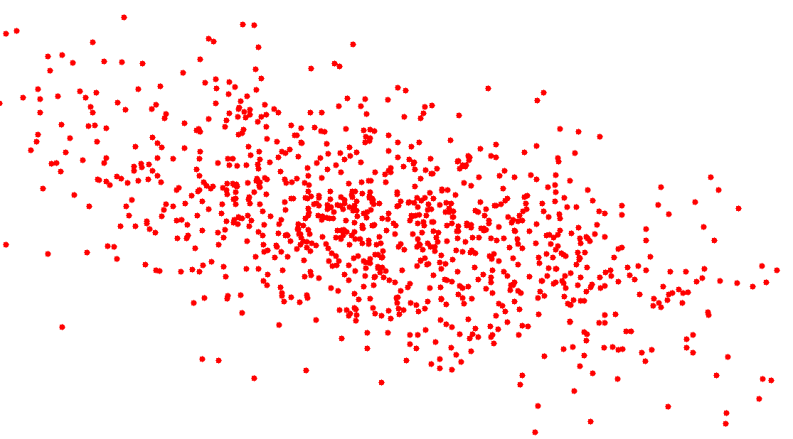
Modeling data with linear subspaces
Assume low-dimensional structure
Ex. PCA, Partial Least Squares (source only)
Target
Source

Slide 9
Characterizing domains geometrically
Grassmann manifold
Collection of d-dimensional subspaces of a vector space
Each point corresponds to a subspace
Target
subspace
Source
subspace

Slide 10
Modeling domain shift with geodesic flow
Target
Source
Geodesic flow on the manifold
starting at source & arriving at target in unit time
flow parameterized with one parameter
closed-form, easy to compute with SVD

Slide 11
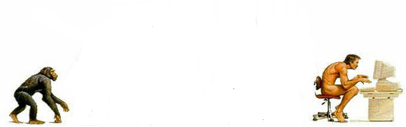
Modeling domain shift with geodesic flow
Subspaces:
Target
Source
Domains:
Source
Target

Slide 12
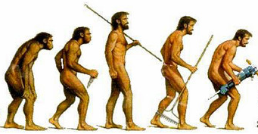
Modeling domain shift with geodesic flow
Subspaces:
Target
Source
Along this flow,
points (subspaces) represent intermediate domains.
Domains:

Slide 13
Domain-invariant features
Source
Target
More similar to source.

Slide 14
Domain-invariant features
Source
Target
More similar to target.

Slide 15
Domain-invariant features
Source
Target
Blend the two.

Slide 16
Measuring feature similarities with inner products
More similar to source.
More similar to target.
Invariant to either source or target.

Slide 17
Learning domain-invariant features with kernels
We define the geodesic flow kernel (GFK):
Advantages
Analytically computable
Robust to variants towards either source or target
Broadly applicable: can kernelize many classifiers

Slide 18
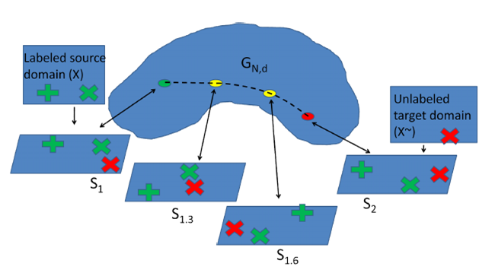
Contrast to discretely sampling
GFK (ours)
[Gopalan et al. ICCV 2011]
Dimensionality reduction
Number of subspaces, dimensionality of subspace, dimensionality after reduction
No free parameters
GFK is conceptually cleaner and computationally more tractable.

Slide 19

Recap of key steps
1
Target
subspace
$z^{∞}=\left({\begin{aligned}{Φ(0)}^{T} \\ ⋮ \\ {Φ(t)}^{T}\end{aligned} \atop \begin{aligned}⋮ \\ {Φ(1)}^{T}\end{aligned}}\right)$x
Source
subspace
2
3
$$H^{∞}$$
$$=x_{i}Gx_{j}$$
4

Slide 20
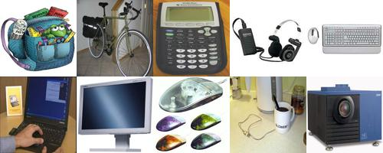
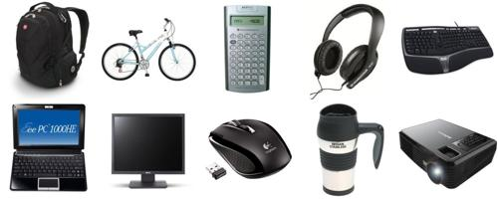
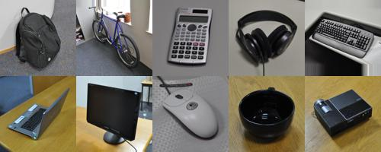
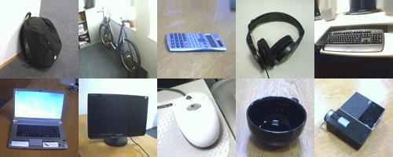
Experimental setup
Four domains
Features
Bag-of-SURF
Classifier: 1NN
Average over 20 random trials
Caltech-256
Amazon
DSLR
Webcam

Slide 21
Classification accuracy on target
Accuracy (%)
Source→Target

Slide 22
Classification accuracy on target
Accuracy (%)
Source→Target

Slide 23
Classification accuracy on target
Accuracy (%)
Source→Target

Slide 24
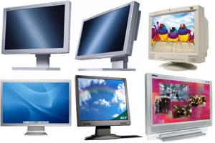
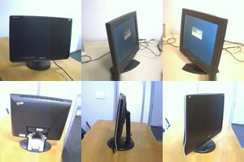
Which domain should be used as the source?
DSLR
?
?
Caltech-256
?
Amazon
Webcam

Slide 25
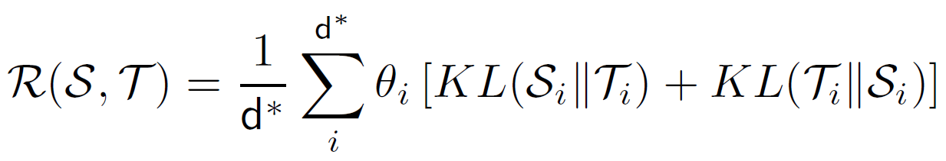
Automatically selecting the best
We introduce the Rank of Domains measure:
Intuition
Geometrically, how subspaces disagree
Statistically, how distributions disagree

Slide 26
Automatically selecting the best
Possible sources | Our ROD measure
Caltech-256 | 0.003
Amazon | 0
DSLR | 0.26
Webcam | 0.05
Accuracy (%)
Source→Target
Caltech-256 adapts the best to Amazon.

Slide 27
Semi-supervised domain adaptation
Label three instances per category in the target
Accuracy (%)
Source→Target

Slide 28
Analyzing datasets in light of domain adaptation
Cross-dataset generalization [Torralba & Efros’11]
Accuracy (%)

Slide 29
Analyzing datasets in light of domain adaptation
Cross-dataset generalization [Torralba & Efros’11]
Performance drop!
Accuracy (%)
Caltech-101 generalizes the worst.
Performance drop of ImageNet is big.

Slide 30
Analyzing datasets in light of domain adaptation
Cross-dataset generalization [Torralba & Efros’11]
Accuracy (%)
Performance drop becomes smaller!
Caltech-101 generalizes the worst (w/ or w/o adaptation).
There is nearly no performance drop of ImageNet.

Slide 31
Summary
Unsupervised domain adaptation
Important in visual recognition
Challenge: no labeled data from the target
Geodesic flow kernel (GFK)
Conceptually clean formulation: no free parameter
Computationally tractable: closed-form solution
Empirically successful: state-of-the-art results
New insight on vision datasets
Cross-dataset generalization with domain adaptation
Leveraging existing datasets despite their idiosyncrasies

Slide 32
Future work
Beyond subspaces
Other techniques to model domain shift
From GFK to statistical flow kernel
Add more statistical properties to the flow
Applications of GFK
Ex., face recognition, video analysis

Slide 33
Summary
Thank you!
Unsupervised domain adaptation
Important in visual recognition
Challenge: no labeled data from the target
Geodesic flow kernel (GFK)
Conceptually clean formulation
Computationally tractable
Empirically successful
New insight on vision datasets
Cross-dataset generalization with domain adaptation
Leveraging existing datasets despite their idiosyncrasies

